Slide 1

CHE 1020: Introduction to Chemistry
Module 1: Essential ideas and skills
  1.1: Chemistry in context and the scientific method
  1.2: Math skills review for chemistry [week 1 lab]
  1.3: Measurements: units, derived units and unit prefixes
  1.4: Uncertainty in measurement and accuracy vs precision
  1.5: Unit conversions and problem solving for chemistry
Resources on Canvas:
Periodic table
Chemistry conversion factors
Guide to prefixes, sig figs, conversions
Guide to railroad track unit conversion
Quick summary of Module 1
OpenStax Chemistry Atoms First 2/e p.10 – 14; 29 - 51

Slide 2
Module 1: Essential ideas and skills
  1.1: Chemistry in context and the scientific method
      Outline historical development of chemistry
      Provide examples of chemistry in everyday life
      Describe the scientific method
      Differentiate between hypotheses, theories and laws
OpenStax Chemistry 2/e p.10 - 14

Slide 3
1. Essential ideas and skills
Big ideas?
Chemistry is the systematic study of the changes matter undergoes.
Dimensional analysis allows us to quantitate chemical change.

Slide 4
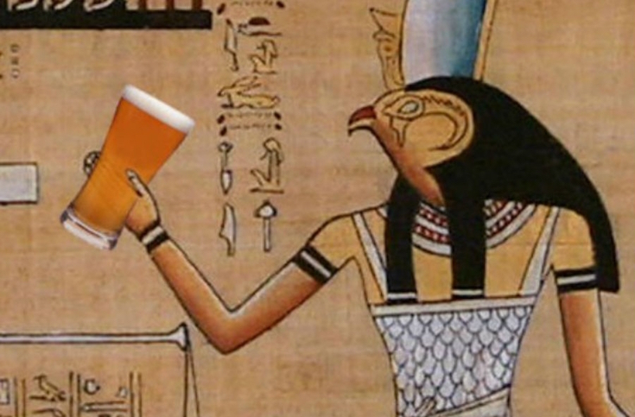
Earliest chemists?
The ancients harnessed food chemistry to make cheese, bread, beer and other delights. They were early chemists.
Tanning of hides to make leather;
Smelting of copper ore;
Isolation of myrrh and opium from plants;
Creation of dyes like indigo and Tyrian purple;
Creating soap by reacting fats and lye;
Creating alloys like bronze from tin and copper
http://www.cairoscene.com/ArtsAndCulture/The-History-of-Beer-In-Ancient-Egypt

Slide 5
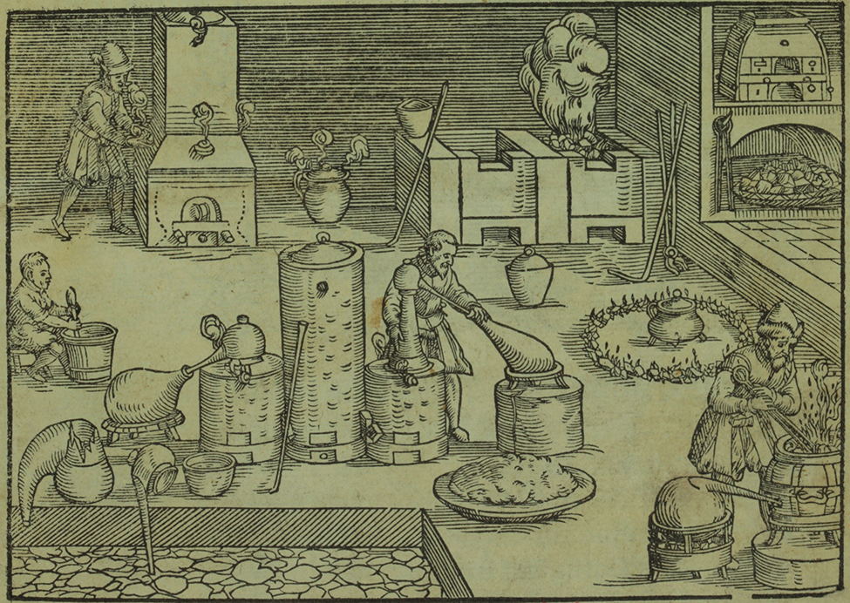
Elements and alchemy
600 B.C. the Greeks, trying to understand the fundamental nature of the world, hypothesized that all matter was a combination of four elements:
Earth, wind, fire and water
Alchemists combined early chemical knowledge with philosophy in an attempt to transform ‘base metals’ into gold and to cure disease and extend life.
While alchemy was a bit of a stretch, the work of alchemists advanced our knowledge of the world and became the basis of scientific experimentation.
Alchemist’s laboratory
(Chemical Heritage Foundation)

Slide 6
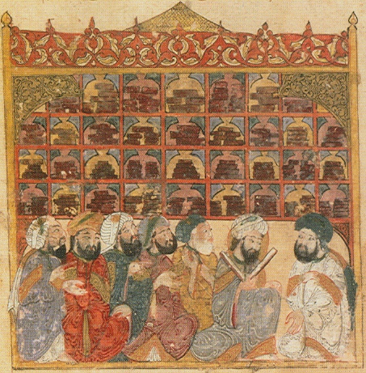
Dark ages shifted centers of learning
During the Dark Ages (5th – 10th centuries) knowledge developed by the Greeks and Romans was lost in Europe but preserved by Arab and Asian societies.
An 8th-century Arab alchemist, Jābir ibn Hayyān, added lab experimentation to alchemy and may be the father of modern chemistry.
The House of Wisdom library in Bagdad, Maqamat of al-Hariri Illustration by Yahyá al-Wasiti, 1237 (Wikipedia)

Slide 7
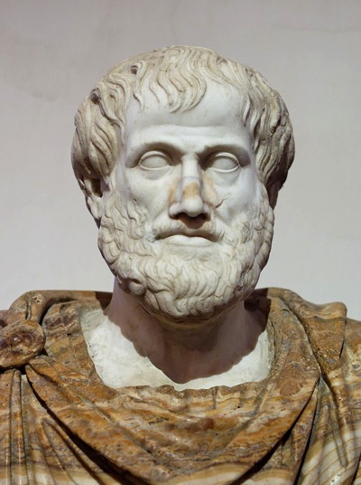
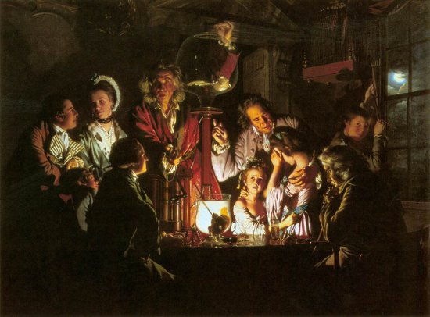
The Enlightenment
During the Enlightenment (1600s to 1800) the Western world rediscovered the works of philosophers of the ancient world (Greek, Arabic, Asian) who had developed logic and
experimentation.
Aristotle
Scientists like Bacon, Newton, Hooke, Boyle, Faraday, Wright, Lavoisier and others married logic with experimentation to ask and answer questions about the ‘invisible’ forces of the natural world.
Wright’s gas pump experiments

Slide 8
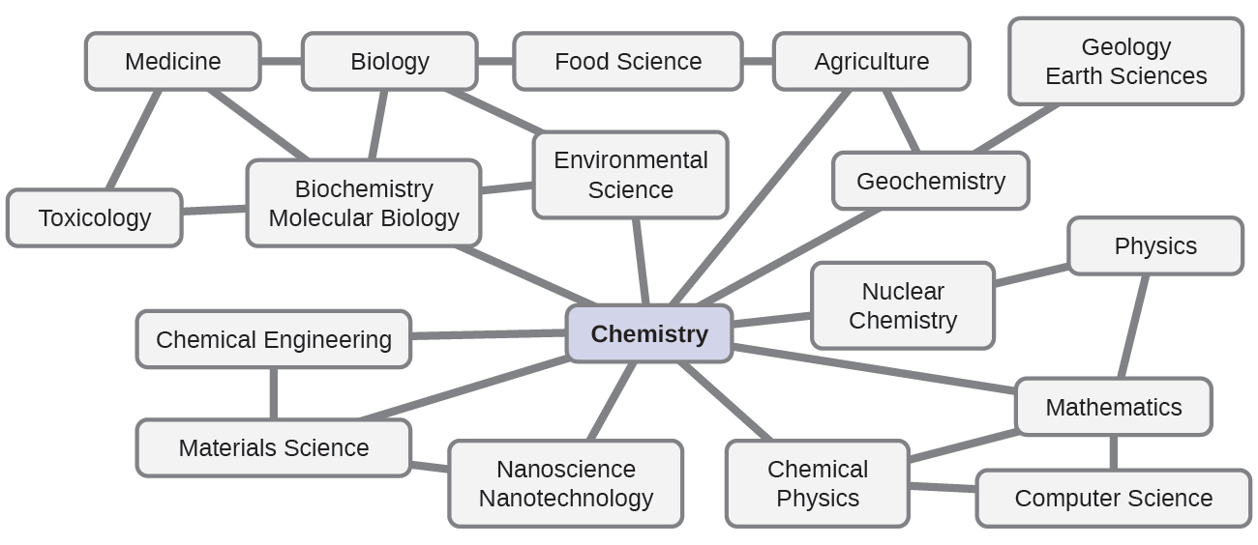
The central science?
Some refer to chemistry as the central science because it is interconnected with many other fields of scientific and STEM study.
STEM: science, technology, engineering & medicine
Chemistry OpenStax

Slide 9
Science?
sci·ence (n)
The study of the physical world and its manifestations, especially by using systematic observation and experimentation
A branch of science of a particular area of study
The knowledge gained by study of the physical world
Any systematically organized body of knowledge about a specific subject
Any activity that is the object of careful study or that is carried out according to an accepted method
Chemistry OpenStax

Slide 10
Chemistry
Chemistry (n): the study of matter and the changes it undergoes
Most often (but not always) studied at the atomic and molecular level
Inorganic chemistry
Organic chemistry
Physical chemistry
Materials chemistry
Nuclear chemistry
Chemical engineering
Biochemistry
Chemistry OpenStax

Slide 11
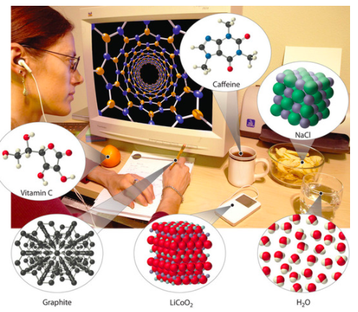
Can you picture the changes about to happen here?
metabolism: use by the body
metabolism: use by the body
metabolism: use by the body
metabolism: use by the body
redox: release of chemical energy
LibreText: Introduction to chemistry

Slide 12
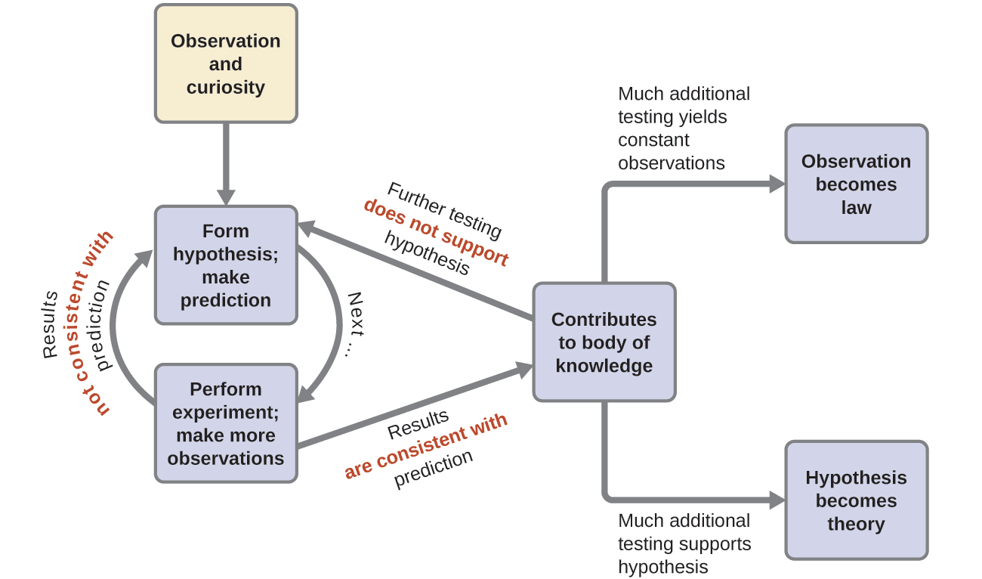
The scientific method
Developed to ask and answer questions in order to explain observations.
1
2
4
3
Chemistry OpenStax

Slide 13
The scientific method
Developed to ask and answer questions in order to explain observations.
1
Hypothesis: a tentative explanation of an observation;
an educated guess
2
Hypotheses can be supported but not proven. Why?
4
We can never know all potential causes of an observation or all the factors that contribute to the phenomenon we are observing.
3
Example?
Black swans: Until the 1600s Europeans believed that all swans were white. They were certain because they’d only ever seen white swans. Then Europeans found Australia and its black swans. Whoops.
Chemistry OpenStax

Slide 14
The scientific method
Developed to ask and answer questions in order to explain observations.
1
Experiment: a test done by collecting data;
Data and results may support or disprove a hypothesis.
Remember: Hypotheses cannot be proven.
2
4
3
Chemistry OpenStax

Slide 15
The scientific method
Developed to ask and answer questions in order to explain observations.
1
Scientific law: summarizes vast amounts of data; and predicts some behavior of the world.
A law simply says what happens; it does not address the question of why.
2
Theory: a hypothesis supported by much data through extensive experimentation.
A theory attempts to explain why nature behaves as it does.
Unlike laws, theories are incomplete and imperfect, evolving with time and evidence.
4
3
Chemistry OpenStax; LibreText Chemistry

Slide 16
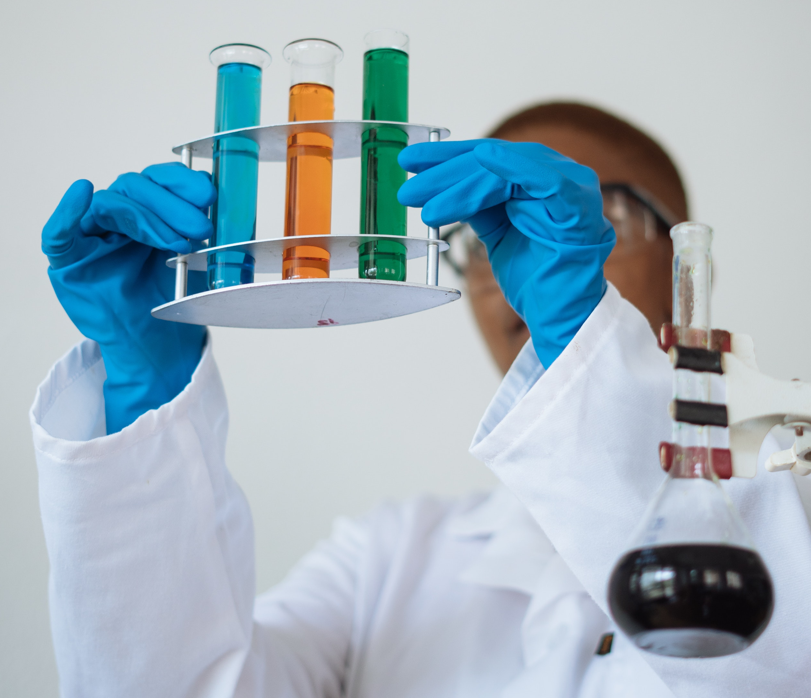
Experiments: Is once enough?
Nope! While we can’t prove hypotheses, scientists seek as much certainty as we can get using repetition.
Multiple trials allow us to collect enough data to allow us to use statistics to look for precision and accuracy.
At least three trials are needed to calculate means and SDs.
Independent repetition: others repeat the experiment using multiple trials.
Ask the same question with different methods:
When we ask the same or similar questions with different methods, we ensure that important results reflect the phenomenon and are not ‘artifacts’ of a particular method.
Chemistry OpenStax

Slide 17
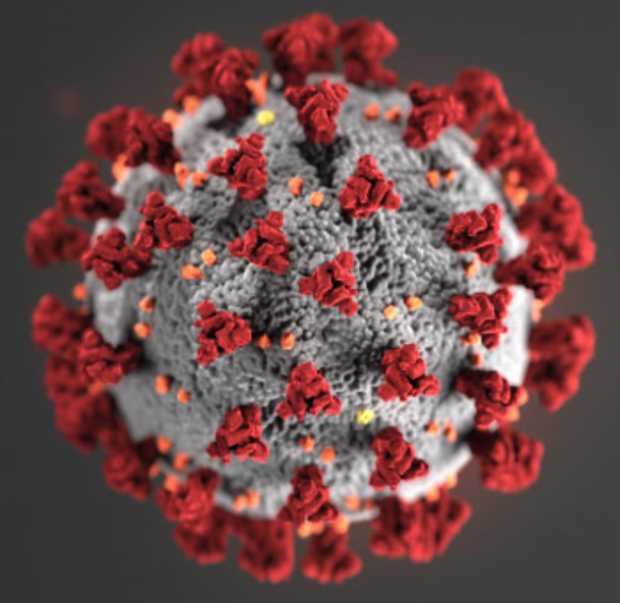
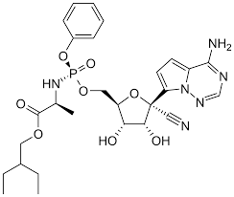
What makes a good experiment?
While natural experiments do happen, scientists use carefully designed controlled experiments in which a few factors are changed while others remain constant
C
E
Control vs. experimental (aka treatment) groups:
Subjects are divided into two groups
(1) given no treatment
(2) given experimental treatment
Independent and dependent variables:
Independent variable is changed or manipulated by the scientist (the treatment)
Dependent variable is measured to determine the effect of the independent variable
(the outcome)
remdesivir
recovery time
recovery time
Chemistry OpenStax

Slide 18
Fact vs. hypothesis vs. theory vs. law vs. belief?
These terms are often confused!
Fact: A fact is a basic statement establish by experiment or observation.
All facts are true under the specific conditions of the observation.
Hypothesis: a tentative explanation of an observation;
an educated guess
Theory: a hypothesis supported by much data through extensive experimentation
Scientific law: summarizes vast amounts of data;
predicts some behavior of the world.
These three terms have really different and specific meanings to a scientist.
Belief?
A statement that is not scientifically provable. (Though beliefs intrigue many scientists.)
Beliefs may or may not be correct; they are outside the realm of science to explore.
Chemistry OpenStax

Slide 19
1.1: Can you?
(1) Describe a few ancient, but everyday, applications of chemistry?
(2) Explain why chemistry flourished during the Enlightenment?
(3) Describe and define science and chemistry?
(4) List the steps in the scientific method and describe how it’s applied?
(5) Differentiate between a hypothesis and theory, and between a theory and a
scientific law?

Slide 20
1.1: Assignments
Canvas: Quick review questions quiz 1.1
Canvas Discussion: ‘Putting the scientific method to work’
Canvas: HW set 1, problems 1 - 2
Optional extras – great videos on this topic:
‘How I apply the scientific method to life’ (Jiwon Park, TEDxSGH)
https://www.ted.com/talks/jiwon_park_how_i_apply_the_scientific_method_to_life
‘What’s the difference between a scientific law and theory?’ (Matt Anticole, TEDEd)
https://www.youtube.com/watch?v=GyN2RhbhiEU
‘How to study chemistry’ (Ryan Holcomb)
https://www.youtube.com/watch?v=v1uF3XB-9uc

Slide 21
1. Essential ideas and skills
  1.2: Math skills review for chemistry [week 1 lab]
  Order of operations (PEMDAS)
  Percentages
  Ratios
  Powers and power operations
  Scientific notation
  Logarithms
  An algebraic approach to isolating variables and solving problems
  Rearranging equations
Mathematics for Chemistry, James Cook University, Australia
OpenStax Chemistry, Atoms First, Appendix B: Essential Mathematics

Slide 22
1. Essential ideas and skills
Big ideas?
Chemistry is the systematic study of the changes matter undergoes.
Dimensional analysis allows us to quantitate chemical change.

Slide 23
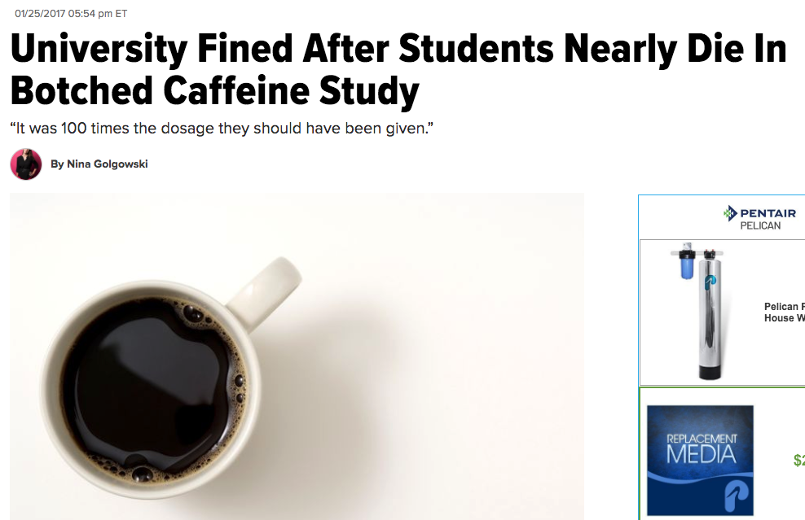
Math and measurement can be a matter of life or death!
“Instead of being served 0.3 grams of caffeine, the Northumbria University students were mistakenly given doses of 30 grams ― equivalent to 300 cups of coffee, the BBC reported.”
Both participants in the 2015 study, identified as Alex Rossetto and Luke Parkin, immediately had “violent” side effects after taking the powdered caffeine and had to undergo kidney dialysis, ITV reported. They eventually recovered, though Rossetto has reported short-term memory loss.
“If they had not been admitted to intensive care immediately for treatment, they could have died from caffeine overdose,” Farrer said, according to ITV.
https://www.huffpost.com/entry/university-fined-caffeine-study_n_588915b3e4b0737fd5cb5688

Slide 24
Order of operations
If an equation includes a bunch of different mathematical operations, what order should you do them in?
PEMDAS:
  parentheses
  exponents
  multiplication
  division
  addition
  subtraction
Rules:
Follow the PEMDAS order
Several of the same level operation? (+ and – ; x and /)
  Work left to right.
Nested parentheses?
  Start with the innermost and work outwards.
Example: 7 + (6 × 5² + 3)
Mathematics for Chemistry, James Cook University, Australia

Slide 25
Percentages
The word ‘percentage’ is derived from ‘per one hundred’.
1% = 1/100
25% = 25/100
50% = 50/100
100% = 100/100
% = part (100)
whole
Examples:
(a) JCU has 2154 female and 1978 male students enrolled. What percentage of the students is female?
(b) When John is exercising his heart rate rises to 180 bpm. His resting heart rate is 70 % of this. What is his resting heart rate?
Mathematics for Chemistry, James Cook University, Australia

Slide 26

Ratios
A ratio represents for every determined amount of one thing, how much there is of another thing.
Ratios are useful because they are unit-less. That is, the relationship between two numbers remains the same regardless of the units in which they are measured.
What is the ratio of red squares to blue squares?
1:3
Note 1:3 is not 1/3 !!
What is 1:3 as a fraction? = 1 part red = 1
      4 total parts 4
Example:
A pancake recipe requires flour and milk to be mixed to a ratio of 1:3. This means 1 part flour to 3 parts milk. No matter the unit of measure, the ratio must stay the same.
So if I add 200 mL of flour, I add 200 mL x 3 = 600 mL of milk
If I add 1 cup of flour, I add 3 cups of milk
If I add 50 grams of flour, I add 150 grams of milk
Mathematics for Chemistry, James Cook University, Australia

Slide 27
Ratios can be scaled up and down
And this makes them very useful in everyday life.
Can you think of examples where you scale ratios?
Mathematics for Chemistry, James Cook University, Australia

Slide 28
Powers simplify repeated ’self-multiplication’
Imagine we wanted to multiply 7 by itself 9 times: 7 x 7 x 7 x 7 x 7 x 7 x 7 x 7 x 7 = 40,353,607
Whewww. I had to count that!
Instead we can simply write 7⁹ = 40,353,607 to say the same thing.
power or exponent
7⁹ = 40,353,607
‘seven raised to the power of nine’
base
A negative exponent is a reciprocal.
7⁻ ⁹ = 1 = 1 = 2.5 E-8
7⁹ 40,353,607
Mathematics for Chemistry, James Cook University, Australia

Slide 29
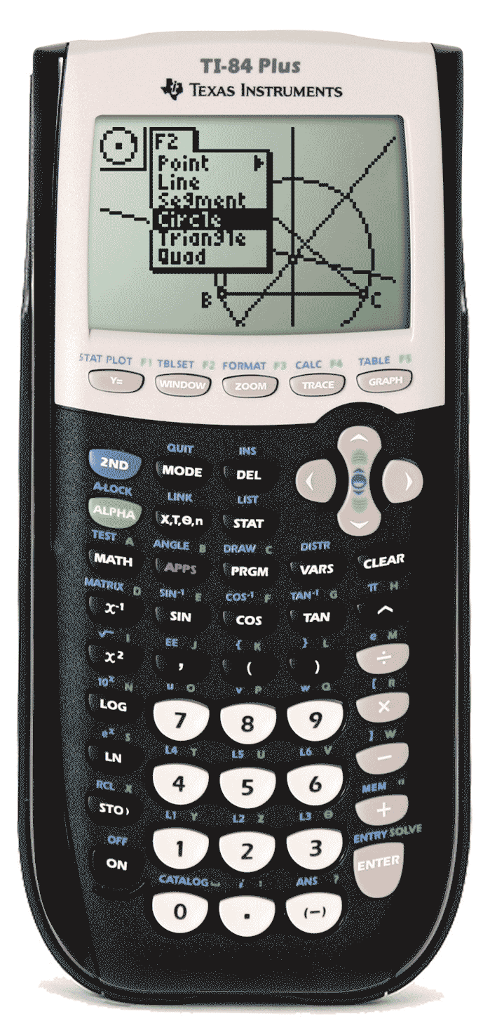
Scientific notation
Scientific notation allows us to express very large or small values while focusing on significant digits.
The maximum takeoff weigh of a jet is:
298,000 kg
The average weight of a mosquito is:
0.0000025 kg
What’s the best way to use a calculator for scientific notation?
Chemistry OpenStax

Slide 30
Rules for scientific notation
Scientific notation rules:
The decimal place follows the first non-zero digit.
If you move the decimal to the right to reach that non-zero, the exponent is negative.
If you move the decimal to the left to reach that non-zero, the exponent is positive.
65400000000 6.54 x 10¹⁰ = 6.54 E10
0.00000086 8.6 x 10⁻⁷ = 8.6 E-7
+
-
Since scientific notation uses exponents, use power operations when doing calculations.
Mathematics for Chemistry, James Cook University, Australia

Slide 31
Logarithm base 10 (log₁₀)
Log10 expresses 10-fold differences and is used in the pH scale.
log 1000 = 3
log 100 = 2
log 10 = 1
Acidity, pH, is determined by the concentration of H+ ions (measured in moles/L) and written as [H+] in a solution. In pure water [H+] = 0.0000001 mole/L of 1 E-7.
Mathematics for Chemistry, James Cook University, Australia

Slide 32
Algebraic approaches to problem solving
Four principles to apply when solving an equation:
1. Work towards solving the variable: (𝒙 )
2. Use the opposite mathematical operation: Remove a constant or coefficient by doing the opposite operation on both sides:
  Opposite of × is ÷
  Opposite of + is –
  Opposite of 𝑥² is √𝑥
  Opposite of √𝑥 𝑖s 𝑥²
3. Maintain balance: “What we do to one side, we must do to the other.”
4. Check: Substitute the value back into the equation to see if the solution is correct.
Mathematics for Chemistry, James Cook University, Australia

Slide 33
Examples
Mathematics for Chemistry, James Cook University, Australia

Slide 34
1.2: Can you?
(1) Decode PEMDAS and use it as order of operations?
(2) Calculate percentages?
(3) Calculate ratios and understand how they differ from fractions?
(4) Understand what exponents are and how to deal with them?
(5) Use scientific notation and use the EE button of your calculator to make use of scientific notation easier?
(6) Understand that log₁₀ represents 10-fold change and how logs are used to calculate pH?
(7) Use algebraic skills to rearrange equations to solve for each variable?

Slide 35
1.2: Assignments
Canvas: Quick review questions quiz 1.2
Canvas: Math skills review worksheet, week 1 lab
Optional extras – great videos on this topic:
‘Math review for general chemistry’ (ChemTutor BYU)
https://www.youtube.com/watch?v=qaVtqsk8wnQ
'Scientific notation: introduction' (Tyler DeWitt)
https://www.youtube.com/watch?v=Dme-G4rc6NI&index=3&list=PLwMsXymZ2TfS1Ow44o3CvmZXU3GeTjR4N
…this first video leads to a series of videos on scientific notation

Slide 36
1. Essential ideas and skills
  1.3: Measurements: units, derived units and unit prefixes
  Explain the process of measurement
  Identify the three basic parts of a quantity
  Describe properties and units of length, mass, volume, density, temperature, and time
  Uncertainty and significant digits
  Perform basic unit calculations and conversions in English and metric systems
Resources on Canvas:
Chemistry conversion factors chart
Quick guide to metric prefixes, scientific notation and significant figures
OpenStax Chemistry 2/e p.29 - 36

Slide 37
1. Essential ideas and skills
Big ideas?
Chemistry is the systematic study of the changes matter undergoes.
Dimensional analysis allows us to quantitate chemical change.

Slide 38
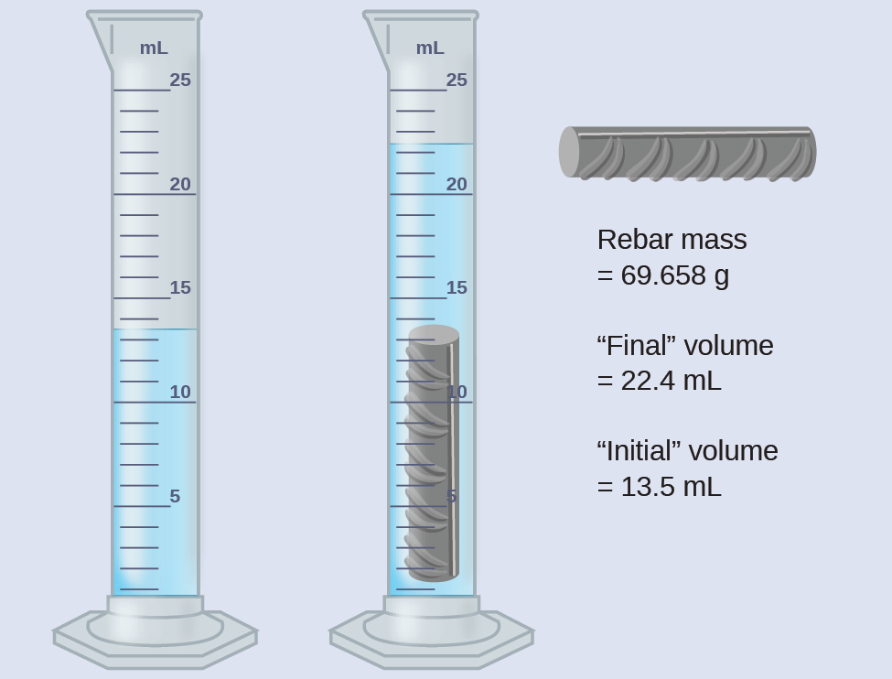
Measurement is used to collect data
Data (that’s plural BTW) are observations we make with our senses or using tools.
No math is used in collecting data! Numbers are ‘raw’ and unprocessed.
visual observations
Data:
The liquid is blue.
Initial volume is 13.5 mL.
The rebar is gray and ridged.
Final volume (with rebar) is 22.4 mL.
inexact numbers: numbers measured with an instrument; always have uncertainty
inexact numbers
Chemistry OpenStax

Slide 39
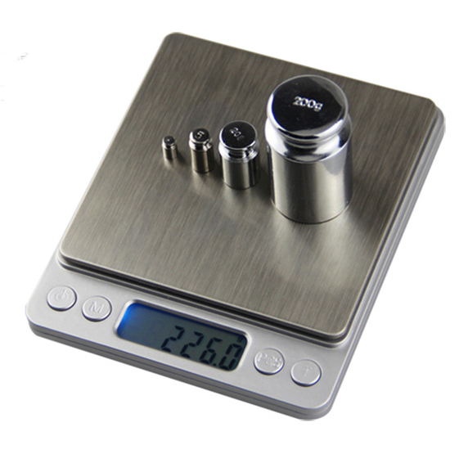
Every measurement has three parts
In science, every measurement has three essential elements:
Number or value
Unit
Uncertainty
Uncertainty: tells us about the calibration of the instrument being used.
Analog = ½ of the least count of the instrument.
Digital = least count.
226.0
g (grams)
226.0 ± 0.1 g
Least count: the smallest calibration (or subdivision) of the instrument
Here least count = 0.1 g
Chemistry OpenStax

Slide 40
Units
Science uses the metric system, or SI units.
quantity | unit | symbol
length | meter | m
mass | gram | g
time | second | s
temperature | Celsius / Kelvin | C / K
amount | mole | mol
The Kelvin scale is used to measure the temperature of gases.
Kevin = Celsius + 273.15
Chemistry OpenStax

Slide 41
Unit prefixes
Unit prefixes can be used in place of scientific notation.
Express these with unit prefixes instead of scientific notation:
8 E9 years
3,000,000 Hz
2 E-3 moles
1 E-6 L
prefix | symbol | factor
tera | T | 10¹²
giga | G | 10⁹
mega | M | 10⁶
kilo | k | 10³
centi | c | 10⁻²
milli | m | 10⁻³
micro | μ | 10⁻⁶
nano | n | 10⁻⁹
pico | p | 10⁻¹²
femto | f | 10⁻¹⁵
Notice the pattern?
Exponents change by 3.
Chemistry OpenStax

Slide 42
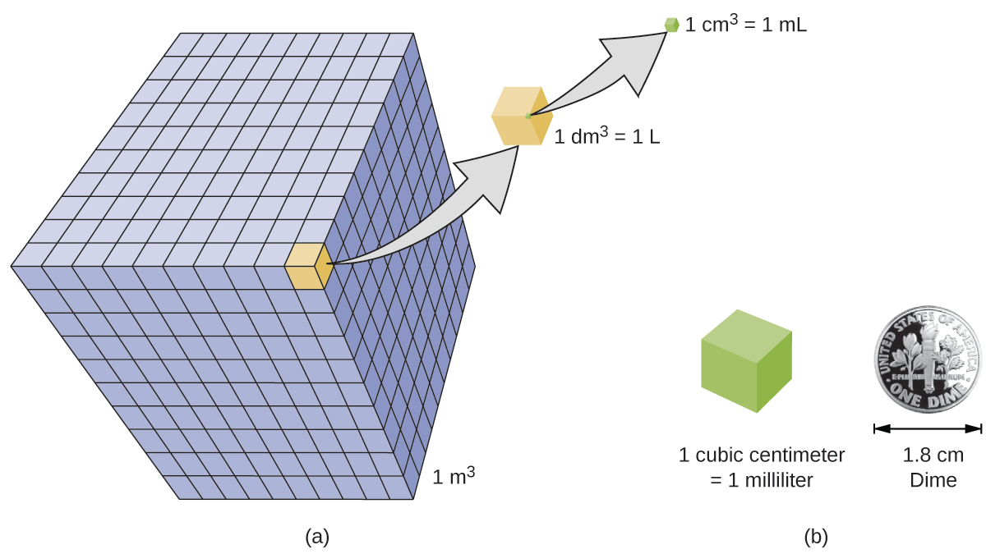
Volumes can be described by cubed lengths
Derived unit are created by combining SI units.
Volume can be expressed as a cubic length.
Chemistry OpenStax

Slide 43
Density: a derived unit
Density: the ratio of mass to volume (g/mL)
density (ρ) = mass .
volume
Density is intensive because it is a ratio of two extensive properties.
Think about what you know from the ‘real world’.
A material’s density is independent of the amount of the material you are looking at.
A one-ton block of steel has the same density as a tiny steel ball-bearing.
Is density an intensive or extensive property? Why?
solids (g/mL)
liquids (g/mL)
gases (g/L)
ice | 0.92 | water | 1.0 | dry air | 1.20
oak | 0.60- 0.90 | ethanol | 0.79 | oxygen | 1.31
iron | 7.9 | acetone | 0.79 | nitrogen | 1.14
copper | 9.0 | glycerin | 1.26 | CO2 | 1.80
lead | 11.3 | olive oil | 0.92 | helium | 0.16
silver | 10.5 | gasoline | 0.70-0.77 | neon | 0.83
gold | 19.3 | mercury | 13.6 | radon | 9.1
Notice that the density of gases is measured in g/L as it’s significantly lower.
Chemistry OpenStax

Slide 44
Calculating density
What is the density of a cube of lead each side of the cube measures 2.00 cm and the cube’s mass is 90.7 g?
What is the volume of a cube with edge lengths of 0.843 cm?
If the mass of that cube is 5.34 g, what is the density of the cube?
Chemistry OpenStax

Slide 45
1.3: Can you?
(1) Describe the three parts of any measurement?
(2) Convert numbers in and out of scientific notation?
(3) Replace scientific notation with metric prefixes?
(4) Relate density to mass and volume and solve for any of the three given the other two?

Slide 46
1.3: Assignments
  Canvas: Quick review questions quiz 1.3
  Canvas: HW set 1, problems 3 - 7
Optional extras – great videos on this topic:
‘Density: a story of Archimedes and the gold crown’ (Tyler DeWitt)
https://www.youtube.com/watch?v=KMNwXUCXLdk&list=PLkeXJJOwLWH4huqEg7ubDe6_Na1-BH-jg&index=10&t=0s
‘Density’ (Bozeman Science)
https://www.youtube.com/watch?v=GzdRGOuNIFg

Slide 47
1. Essential ideas and skills
1.4: Uncertainty in measurement and accuracy vs precision
  Define accuracy vs. precision
  Distinguish exact vs. inexact numbers
  Correctly represent uncertainty in quantities using significant figures
  Apply proper rounding rules to computed quantities
Resources on Canvas:
Chemistry conversion factors chart
Quick guide to metric prefixes, scientific notation and significant figures
OpenStax Chemistry 2/e p.36 - 44

Slide 48
1. Essential ideas and skills
Big ideas?
Chemistry is the systematic study of the changes matter undergoes.
Dimensional analysis allows us to quantitate chemical change.

Slide 49
Exact vs. inexact numbers
Exact numbers don’t have uncertainty.
Counted values: 5 books on the table
2. Conversion factors: 12 inches / foot
Because they are exact, conversion factors don’t affect significant figures.
What about enormous numbers?
Grains of sand on a beach?
Stars in the sky?
These numbers are so enormous that they are considered exact.
Inexact numbers: measured by instruments
Inexact numbers have uncertainty.
Imagine that I gave each student in class the same Stanley measuring tape and asked each to measure the dimensions of the room.
Would all the measurements be the same?
Not all measurements would be the same; they would all be considered inexact.
Chemistry OpenStax

Slide 50
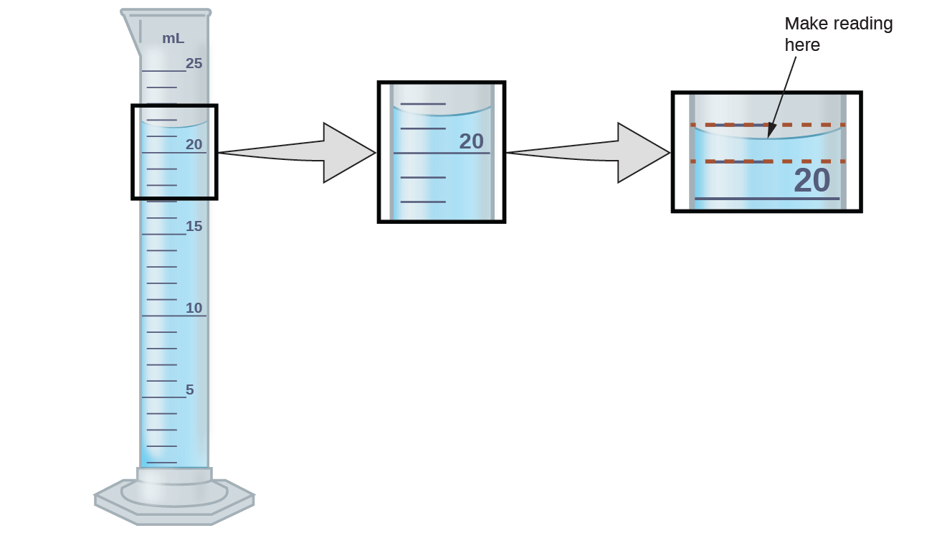
Uncertainty in measurement
Significant digits communicate the degree of uncertainty of instruments used to make measurements.
This graduated cylinder has a least count of 1 mL.
Liquid volumes are measured at the bottom of the curving meniscus.
Here, greater than 21 but less than 22, so what do you record?
Estimate the fraction of the least count, here the fraction of 1 mL.
I’d call it 21.7 mL, but others might disagree.
So we add the uncertainty ± ½ of the least count.
Thus, 21.7 ± 0.5 mL = 3 significant figures
Chemistry OpenStax

Slide 51
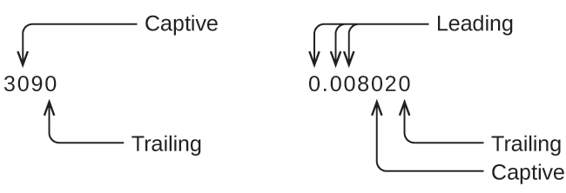
Significant digits
Rules for significant digits:
1. All non-zero digits are significant.
2. Zeros are sometimes significant:
  Leading: never
  Captive (trapped): always
  Trailing: only when following a decimal
3 sf
4 sf
As sci not: 3.09 E3
8.020 E-3
Chemistry OpenStax

Slide 52
Calculating with significant digits
1. Multiplication & division: least sf rules!
The answer has only as many sf as the value with the lowest sf.
(6.221 cm)(5.2 cm) =
2. Addition & subtraction: limit number of sf after the decimal
So the number of digits following the decimal is limited by the value in the problem
with fewest sf after the decimal.
20.4 + 1.322 + 83 =
There are 1609.344 m in 1 mile. How many meters in 1.35 miles?
(64.2 + 7.9)
220.3
Chemistry OpenStax

Slide 53
Try this
Using the data provided here, calculate the density of the rebar with the proper number of significant digits.
Chemistry OpenStax

Slide 54
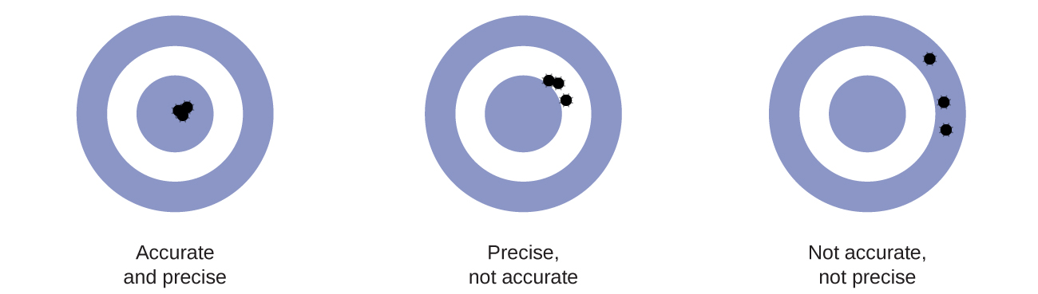
Accuracy vs. precision
Accurate: close to the true or accepted value
Precision: repeated values that are very close to one another
Chemistry OpenStax

Slide 55
Accuracy vs. precision
A pharmaceutical QA/QC tech checks the accuracy & precision of three machines that dispense 296 mL of cough syrup per bottle. She makes measurements in triplicate.
machine 1 (mL) | machine 2 (mL) | machine 3 (mL)
283.3 | 298.2 | 296.1
284.1 | 294.2 | 295.9
283.9 | 296.0 | 296.1
284.0 | 297.8 | 296.0
284.1 | 293.9 | 296.1
How do the machines compare in terms of accuracy & precision?
Chemistry OpenStax

Slide 56
1.4: Can you?
(1) Explain the difference between exact and inexact numbers and give examples of each?
(2) Explain how to measure the volume of a liquid using the meniscus, the instrument’s least count & the digit of uncertainty?
(3) Describe when zeros are significant and when they are not.
(4) Describe the rules for multiplying and dividing vs. adding & subtracting with significant figures.
(5) Define differentiate between accuracy and precision.

Slide 57
1.4: Assignments
  Canvas: Quick review questions quiz 1.4
  Canvas: HW set 1, problems 8 - 10
Optional extras – great videos on this topic:
  ‘Why are significant figures important?’ (Tyler DeWitt)
  https://www.youtube.com/watch?v=VAuslY-Uuf4
  ‘Significant figures made easy’ (Tyler DeWitt)
  https://www.youtube.com/watch?v=5UjwJ9PIUvE
  ‘Significant digits’ (Bozeman Science)
  https://www.youtube.com/watch?v=6oj4y0d44nQ
  ‘Accuracy and precision’ (Tyler DeWitt)
  https://www.youtube.com/watch?v=5APhVxCEPFs

Slide 58
1. Essential ideas and skills
  1.5: Unit conversions and problem solving for chemistry
  Explain the dimensional analysis approach
  Use dimensional analysis for unit conversions
Resources on Canvas:
Chemistry conversion factors chart
Quick guide to metric prefixes, scientific notation and significant figures
Guide to railroad track conversions
OpenStax Chemistry 2/e p.44 - 51

Slide 59
1. Essential ideas and skills
Big ideas?
Chemistry is the systematic study of the changes matter undergoes.
Dimensional analysis allows us to quantitate chemical change.

Slide 60
Conversion factors
Conversion factors: ratios of the same quantity expressed in two different units
  Conversion factors are equal to one
  ‘Flippable’
  No sig figs
2.54 cm
1 inch
=
1 inch
2.54 cm
$1.00
100 cents
=
100 cents
$1.00
12 donuts
1 dozen
=
1 dozen
12 donuts
Chemistry OpenStax

Slide 61
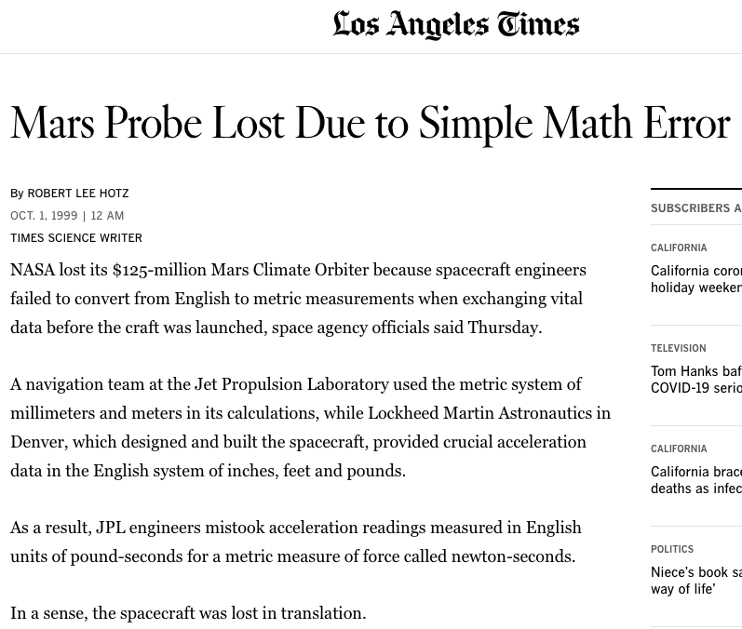
Calculations have consequences

Slide 62
A downloadable
version of this is available on Canvas.
Conversion factors

Slide 63
Railroad track method
The “railroad track” method lines up conversion factors so old units cancel diagonally leaving only the desired new unit.
Start at the left with the value with one unit.
Write the desired final unit at the right as the goal.
Look for a conversion factor with both units.
‘Flip’ the conversion factors so that units match diagonally.
Check to see that the unit matches the goal
old unit new unit = new unit
old unit
Multiply by non ‘1’s above the line, divide by non ‘1’s below the line.
The mass of a frisbee is 125 grams. Convert that mass to ounces.
Chemistry OpenStax

Slide 64
Apply the steps:
Convert a volume of 9.345 quarts to liters.
Start at the left with the value with one unit.
Write the desired final unit at the right as the goal.
Look for a conversion factor with both units.
‘Flip’ the conversion factors so that units match diagonally.
Check to see that the unit matches the goal
Chemistry OpenStax

Slide 65
Use more than one factor:
A 4.00-quart sample of antifreeze weighs 9.26 pounds.
What is the density of the antifreeze in units of g/mL?
Start at the left with the value with one unit.
Write the desired final unit at the right as the goal.
Look for a conversion factor with both units.
‘Flip’ the conversion factors so that units match diagonally.
Check to see that the unit matches the goal
Chemistry OpenStax

Slide 66
Now with more complexity
When driven the 1250 km from Philadelphia to Atlanta, a Lamborghini Aventador Roadster uses 213 L of gas.
What is the average mileage of the roadster (mpg)?
What is the cost of the trip when gas costs $2.50 per gallon?
Chemistry OpenStax

Slide 67
Changing both units: numerator and denominator
The average speed of a nitrogen molecule in air at 25°C is 515 m/s.
Convert this speed to miles/hour.
Chemistry OpenStax

Slide 68
Cubing conversion factors
What is the mass (g) of a piece of gold that’s 2 inches on each side?
The density of gold is 19.3 g/cm³.
Chemistry OpenStax

Slide 69
Try cubing
The Earth’s oceans contain 1.36x10⁹ km³ of water. Convert that to liters!
Chemistry OpenStax

Slide 70
1.5: Can you?
Create conversion factors from word problems and balanced chemical equations?
(2) Create a problem-solving strategy by identifying conversion factors and ordering
them to convert units from given to requested.
(3) Set up railroad tracks, using units to create a conversion process?
(4) Remember to cube both units and numbers when cubing lengths to create volumes?

Slide 71
1.5: Assignments
  Canvas: Quick review questions quiz 1.5
  Canvas: HW set 1, problems 11 - 16
Optional extras – great videos on this topic:
‘Understanding conversion factors’ (Tyler DeWitt)
https://www.youtube.com/watch?v=HZ9weUkSdoY
‘Converting units with conversion factors' (Tyler DeWitt)
https://www.youtube.com/watch?v=7N0lRJLwpPI
‘Converting units with multiple conversion factors’ (Tyler Dewitt)
https://www.youtube.com/watch?v=LdZ00OFAfaQ
‘The factor-label method’ (Bozeman Science)
https://www.youtube.com/watch?v=UBzVf8XeMYA

Slide 72
Module 1, Essential ideas and skills: key terms
accuracy
atom
Celsius
chemical change
chemical property
chemistry
compound
density
dimensional analysis
element
exact number
extensive property
gas
heterogeneous
homogeneous
hypothesis
intensive property
Kelvin
law
law of conservation of mass
liquid
mass
matter
mixture
molecule
physical change
physical property
plasma
precision
pure substance
scientific method
significant figure
solid
theory
uncertainty
volume
weight

Slide 74
Adding and subtracting fractions
If the denominators are the same, just add the numerators:
1 .3
numerator
1 + 1 = 2
3 3 3
denominator
If the denominators are different, find the smallest common denominator and convert to it first.
1 + 1 = 1 x 4 + 1 x 3 = 7
3 4 3 x 4 4 x 3 12
To use a common denominator of 12, multiply the first be 4 and the second by 3
Try this
1 + 2 =
3 5
1 x 5 + 2 x 3 = 11
3 x 5 5 x 3 15
Least common denominator = 15
Chemistry Openstax

Slide 75
Multiplying and dividing fractions
To multiply: just multiply numerators and denominators and then simplify the answer.
1 x 1 = 1
2 2 4
2 + 7 = 2 x 7 = 14 = 7
3 16 3 x 16 48 24
To divide: invert the second fraction and multiply (as above).
2 ➗ 1 = 2 x 2 = 4 = 1 1/3
3 2 3 1 3
Chemistry OpenStax

Slide 76
Try these
(a) Find the reciprocal of 2 2/5.
2 2/5 = 10 + 2 = 12
5 5 5
(b) 2 x 3 =
3 17
6
51
(d) -7 ➗ - 4 =
2 9
- 7 x 9 = - 63
2 - 4 - 14
(c) 1 1 x 2 =
6 9
7 x 2 = 14 = 7
6 9 54 27
(e) (-25) ➗ (- 5) =
4 – 2 x 7
+5 = - 1
-10 2
(d) 3 ➗ 2 =
7 5
3 x 5 = 15
7 2 14
Chemistry OpenStax

Slide 77
Converting decimals and fractions
The method used to convert decimals into fractions is based on the notion of place value. The place value of the last digit in the decimal determines the denominator: tenths, hundredths, thousandths, and so on.
Example problems:
0.5 has 5 in the tenths column.
Therefore, 0.5 is 5/10=1/2.
0.375 has the 5 in the thousandth column.
Therefore, 0.375 is 375/1000=3/8
(3) 1.25 has 5 in the hundredths column and you have 1 25/100 =1 1/4
Chemistry OpenStax

Slide 78
Try these
Convert these decimals into fractions
(a) 0.65
(b) 0.54
(c) 2.666
(d) 3.14
= 65
100
= 54 = 27
100 50
= 2666 = 2 666 = 2 2/3
1000 1000
= 3140 = 3 140 = 3 7/20
1000 1000
Chemistry OpenStax

Slide 79
Converting fractions into decimals
This is much easier! Simply divide the numerator by the denominator.
2 = 0.4
5
Try these:
2/3
3/8
17/3
(d) 3 5/9
2/3 = 0.667
3/8 = 0.375
17/3 = 5.667
(d) 3 5/9 = 3.556
Chemistry OpenStax

Slide 80
Power operations
When numbers with exponents (or powers) are multiplied, the exponents are added.
Mathematics for Chemistry, James Cook University, Australia

Slide 81
Power (exponent) laws
1. When the same base (a) with exponents or powers (m, n) are multiplied, the exponents are added.
a^{m} × a^{n} = a^{m+n}
5³ × 5⁷ = 5¹⁰
2. When the same base (a) with exponents or powers (m, n) are divided, the exponents are subtracted.
a^{m} ➗ a^{n} = a^{m - n}
5³ ➗ 5⁷ = 5⁻ ⁴
3. When a power is raised to a power, multiply the exponents.
(a^{m}) ^{n} = a^{m x n}
(5³)⁷ = 5²¹
4. A power of a product is the product of the powers.
(ab) ^{m} = (a^{m})(b^{n})
(5 x 4)⁷ = 5⁷ x 4⁷ = 9.45 E4
5. A power of a fraction is the fraction of the powers.
(a/b) ^{m} = (a^{m})/(b^{n})
(5/4)⁷ = 5⁷ ➗ 4⁷ = 4.77
Mathematics for Chemistry, James Cook University, Australia

Slide 83
Try these
(a) Miko bought a television that was advertised for $467.80. She received a discount of $32.75. What percentage discount did she receive?
(b) 50 kg of olives yields 23 kg of olive oil. What percentage of the olives’ mass was lost during the extraction process?
(c) The recommended daily energy intake for women is 8700 KJ. What percentage over the recommended intake is a woman consuming if her energy intake is 9500 KJ?
(d) An advertisement in the fruit and vegetable shop states that there is 25 % off everything. Bananas are normally $22/kg, what is the new per kilo price?
X% = $32.75 (100) = 7.00%
$467.80
X% = 23 (100) = 46% → 100 – 46 = 54% lost
50
X% = 9500 (100) = 109.96% – 100 = 9.96% over
8700
Discount = (0.25)($22) = $5.50 → $22.00 – 5.50 = $16.50/kg
Mathematics for Chemistry, James Cook University, Australia

Slide 84
Try these
10 – 10 + 1 = 1
(a) 10−2×5+1=
(b) 10×5÷2−3=
(c) 12×2−2×7=
(d) 48÷6×2−4=
(e) What operation is needed to fill in the blank? 18 _ 3×2+2=14
1st
left to right
25 – 3 = 22
1st
24 – 14 = 10
16 – 4 = 12
1st, left to right
18/3 = 6
6x2 = 12
12 + 2 = 14
➗
Mathematics for Chemistry, James Cook University, Australia

Slide 85
Try this
For example, a first-year chemistry subject has 36 males and 48 females, whereas the mathematics subject has 64 males and 80 females. You are asked to work out which cohort has the largest male to female ratio.
The male: female ratios can be expressed as:
Chemistry 36:48
Mathematics 64:80
¾ = 75%
Divide by 12 to simplify to 3:4
Divide by 16 to simplify to 4:5
4/5 = 80%
Mathematics for Chemistry, James Cook University, Australia

Slide 86
Try these
(a) Callie reads 25 pages in 30 minutes. How long does it take her to read 200 pages?
(b) Tullulah uses 7 eggs to make 4 muffins. How many eggs does he need to make 12 muffins?
(c) Emma is swimming laps at the local swimming pool. She swims 4 laps in 3 minutes. How long does it take her to swim 20 laps?
25 pages = 200 pages → (200)(30)/25 = 240 minutes
30 minutes X min
7 eggs = X eggs → (7)(12)/4 = 21 minutes
4 muffins 12 muffins
4 laps = 20 laps → (3)(20)/4 = 15 minutes
3 minutes X min.
Mathematics for Chemistry, James Cook University, Australia

Slide 87
Try these
5⁶ + 5² = 15625 + 25 = 15650
(b) x⁷
(c) t³
(d) 5¹²
(a) Simplify 5² × 5⁴ + 5² =
(b) Simplify 𝑥² × 𝑥⁵ =
(c) Simplify 4²× t³÷ 4²=
(d) Simplify (5⁴)³ =
Mathematics for Chemistry, James Cook University, Australia

Slide 88
Try these
Express these in scientific notation.
(a) 450
(b) 90000000
(c) 3.5
(d) 0.0975
(a) 4.50 E2
(b) 9.0000000 E7
(c) 3.5 E1
(d) 9.75 E-2
Express these without scientific notation.
(e) 3.75 × 10²
(f) 3.97 × 10¹
(g) 1.875× 10⁻¹
(h) −8.75× 10⁻³
(e) 375
(f) 3.97
(g) 0.1875
(h) – 0.00875
Mathematics for Chemistry, James Cook University, Australia

Slide 89
Try these
Remember to use power operations!
(a) (3 E2) × (2 E4)
(b) (8 E6) ÷ (4 E2)
(c) (7 E2) × (8 E2)
(d) (6 E4) × (0.5 E2)
(e) (3 E−4) ÷ (3 E−5)
(f) (8.8 E−1) × (8.8 E−1)
(a) 6 E6
(b) 2 E4
(c) 5.6 E5
(d) 3 E6
(e) 1 E1
(f) 1 E-2
Mathematics for Chemistry, James Cook University, Australia

Slide 90
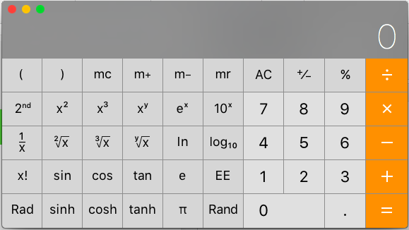
Try these
(a) 2³ =
(b) 9² =
(c) (1/2)³ =
(d) (−4)² =
(e) (−3)³ =
(f) (−14)² =
(a) 8
(b) 81
(c) (0.5)³ = 0.125
(d) 16
(e) - 27
(f) 196
Mathematics for Chemistry, James Cook University, Australia

Slide 91
Try this
pH is calculated using this equation: pH = - log [H⁺¹]
Calculate the pH values for these concentrations of hydrogen ion.
(a) [H+] = 0.001 moles/L
(b) [H+] = 0.00000001 moles/L
(c) [H+] = 0.0000001 moles/L
(d) [H+] = 0.000000000001 moles/L
(a) [H+] = 1 E-3 M pH = - log (1 E-3) = 3
(b) [H+] = 1 E-8 M pH = - log (1 E-8) = 8
(c) [H+] = 1 E-7 M pH = - log (1 E-7) = 7
(d) [H+] = 1 E-12 M pH = - log (1 E-12) = 12
[H⁺¹] can be calculated from pH by taking the antilog of the pH or by, 10^{-pH}
Calculate the [H⁺¹] for these pH readings.
(e) pH 4.8
(f) pH 7.2
(g) pH 1.2
(h) pH 11.1
(e) [H+] = 10^{- 4.8} = 1.58 E-5
(f) [H+] = 10^{- 7.2} = 6.31 E-8
(g) [H+] = 10^{- 1.2} = 6.31 E-2
(h) [H+] = 10^{-11.2} = 6.31 E-12
Mathematics for Chemistry, James Cook University, Australia

Slide 92
Try this
Solve for 𝑥:
(a) 𝑥 + 6 − 3 = 18
(b) 7 = 𝑥 + (−9)
(c) 𝑥 − 12 = (−3)
(d) 18 − 𝑥 = 10 + (−6)
(a) 𝑥 = 18 – 6 + 3 = 15
(b) 7 – (- 9) = 𝑥 = 16
(c) 𝑥 = (−3) + 12 = 9
(d) 18 − 𝑥 = 10 + (−6) → - x = 10 + (- 6) - 18 = - 14; x = 14
Mathematics for Chemistry, James Cook University, Australia

Slide 93
Rearranging formulas to solve for variables
A formula uses symbols and rules to describe a relationship between quantities. In mathematics, formulas follow the standard rules for algebra and can be rearranged to solve for each variable.
Calculate the density (𝝆) of lithium given a mass (m) of 268 g and volume (v) = 0.5 mL.
ρ = m = 268 g = 536 g/mL
v 0.5 mL
Now, calculate the mass (m) given a density (ρ) of 536 g/mL and volume (v) = 0.5 mL.
ρ = m → (ρ)(v) = (m)(v) → (ρ)(v) = m = (536 g/mL)(0.5 mL) = 268 g
v v
Finally, calculate the volume (v) given a density (ρ) of 536 g/mL and mass (m) of 268 g. ρ = m → (ρ)(v) = (m)(v) → (ρ)(v) = m → v = m = 268 g = 0.5 mL
v v ρ ρ ρ 536 g/mL
Mathematics for Chemistry, James Cook University, Australia

Slide 94
Try this
The speed of sound (v) is equal to the product of its frequency (f) and wavelength (λ). Use and rearrange the formula v = (f)(λ) for these problems.
(a) Calculate v (m/s) when f = 3 1/s and λ = 9 m.
(b) Calculate f (1/s) when v = 40 m/s and λ = 5 m.
(c) Calculate λ when v = 60 (m/s) and 𝑓 = 3 (1/s).
v = (f)(λ) = 3 1/s * 9 m = 27 m/s
v = (f)(λ) → v = (f)(λ) → f = v = 40 m/s = 8 1/s
λ λ λ 5 m
v = (f)(λ) → v = (f)(λ) → λ = v = 60 m/s = 20 m
f f f 3 1/s
Mathematics for Chemistry, James Cook University, Australia

