Slide 1
CHE 1020: Introduction to Chemistry
Module 2: Matter and energy basics
2.1: Matter: states, laws and types
2.2: Properties and changes of matter: physical vs. chemical
2.3: Conservation of mass
2.4: Energy basics
2.5: Heat vs. temperature
2.6: Heat capacity, specific heat and calculations of heat flow
Resources on Canvas:
Periodic table
Quick summary of Module 2
OpenStax Chemistry Atoms First 2/e p.14 – 29; 461 - 472

Slide 2
Module 2: Matter and energy basics
2.1: Matter: states, laws and types
Describe the basic properties of each physical state of matter: solid, liquid, and gas
Distinguish between mass and weight
Apply the law of conservation of matter
Classify matter as an element, compound, homogeneous mixture, or heterogeneous mixture with regard to its physical state and composition
Define and give examples of atoms and molecules
OpenStax Chemistry 2/e p.14 - 25

Slide 3
Module 2. Matter and energy basics
Big ideas?
Matter has mass and volume and is conserved during chemical reactions.
Energy is contained in chemical bonds and is conserved in chemical reactions.

Slide 4
What is matter
Matter: anything that has mass or occupies volume (or space)
Take a look around the room or space you are in now and answer these two questions.
Can you give three examples of matter?
Can you give three examples of ‘not matter’?
Chemistry OpenStax

Slide 5
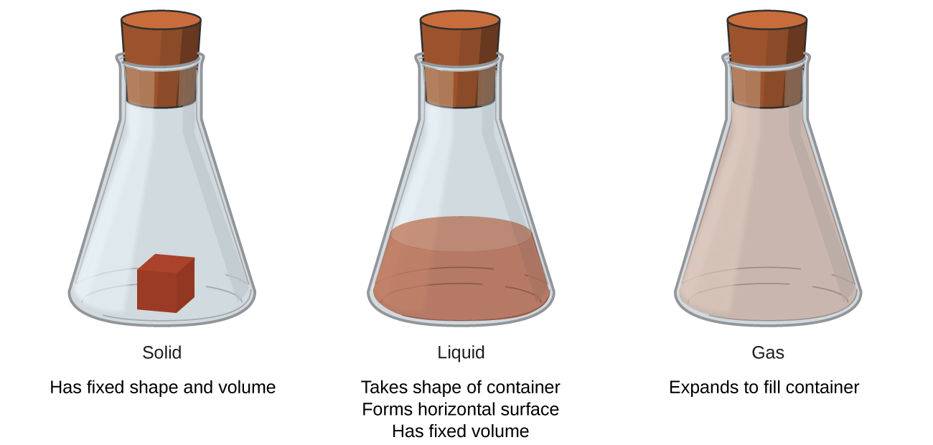
Physical states of matter
Solid:
Least energy
Highest density
Not compressible
Liquid:
Middling energy
Lower density
Not compressible
Gas:
Highest energy
Lowest density
Is compressible
Chemistry OpenStax

Slide 6
Mass vs. weight: what’s the difference?
Mass: a measure of the amount of matter in an object
How could you measure the mass of objects without a balance or scale?
Weight: the force that gravity exerts on an object; directly proportional to the mass of an object
In chemistry we tend to measure weights but record them as masses. Is that valid?
Chemistry OpenStax

Slide 7
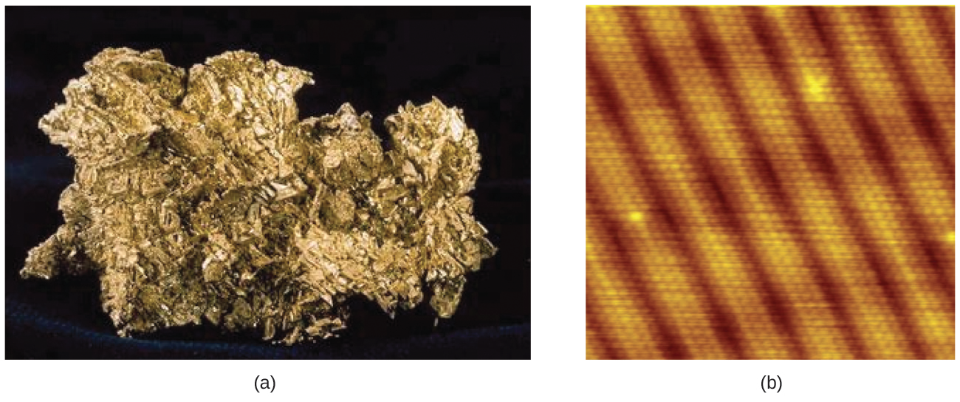
Atoms vs. elements?
Atoms: the smallest unit of matter that has the properties of that matter and can undergo chemical reaction
From the Greek atomos: indivisible or ‘uncuttable’
Atoms vs. elements?
The periodic table has more than 100 elements.
Each element has distinct physical and chemical properties.
Each element can exist in varying amounts, and atom is the smallest amount of any element.
nugget of pure gold (Au)
Atoms of gold in a gold crystal (SEM)
Chemistry OpenStax

Slide 8
Atomic scale
molecular close-up showing atoms
1.5 E-8 cm each
single strand of cotton (SEM, higher mag)
cotton boll
single strand of cotton (X40)
0.0001 cm
molecular model of cotton fiber
macro- to microscopic
Chemistry OpenStax

Slide 9
Molecules
Molecules: two or more atoms combined at a constant ratio
That’s the law of constant composition (or definite proportions)
Note that some define molecules and compounds differently. I’m going to use these terms as synonyms.
Chemical bonds: strong forces joining the atoms in molecules
Molecular formulas: the types and numbers of atoms in a molecule
molecules
compounds
diatomic
Chemistry OpenStax

Slide 10
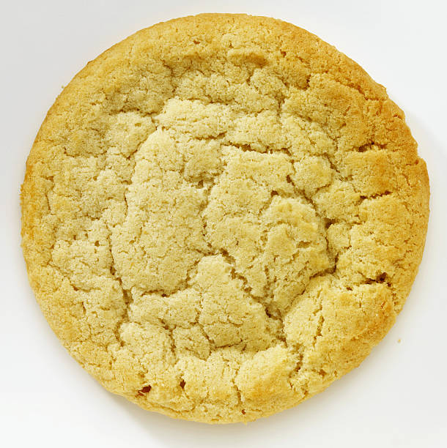
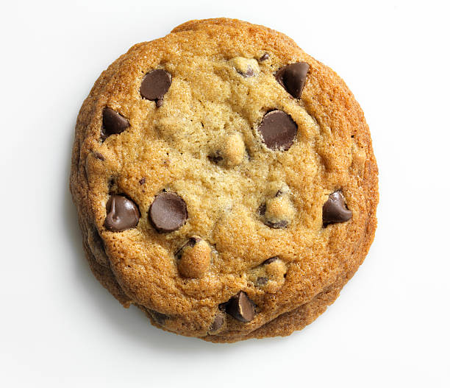
Classifying matter: pure vs. mixture
Pure substance: has constant composition
Mixture: has varying composition of elements or molecules
Element: can’t be chemically broken down or simplified
O
Homogenous: uniform throughout (smooth)
Solution = liquid homogenous mixture
Compound (molecule): can be chemically broken down into elements
O
O
Heterogeneous: not uniform throughout (chunky)
Chemistry OpenStax

Slide 11
Compounds: simplified by chemical change
Here’s an example of how compounds or molecules can be broken down (decomposed) into simpler compounds or elements by a chemical reaction:
2HgO (s) + heat → 2Hg (l) + O2 (g)
HgO (mercury II oxide)
→
adding heat to cause decomposition
Hg(l)+ O2(g)
Chemistry OpenStax

Slide 12
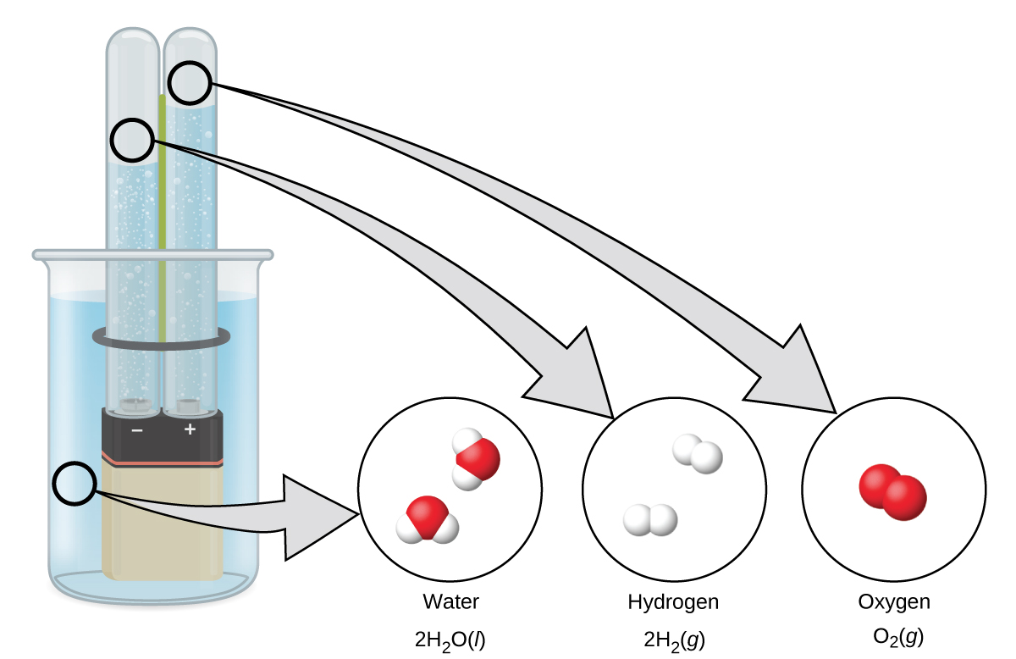
Another (redox) example
XXX
Electricity can decompose water into hydrogen and oxygen gases:
H2O (l) + e- → H2 (g) + O2 (g)
What’s the ratio of H2 to O2?
Could you have predicted this?
Chemistry OpenStax

Slide 13
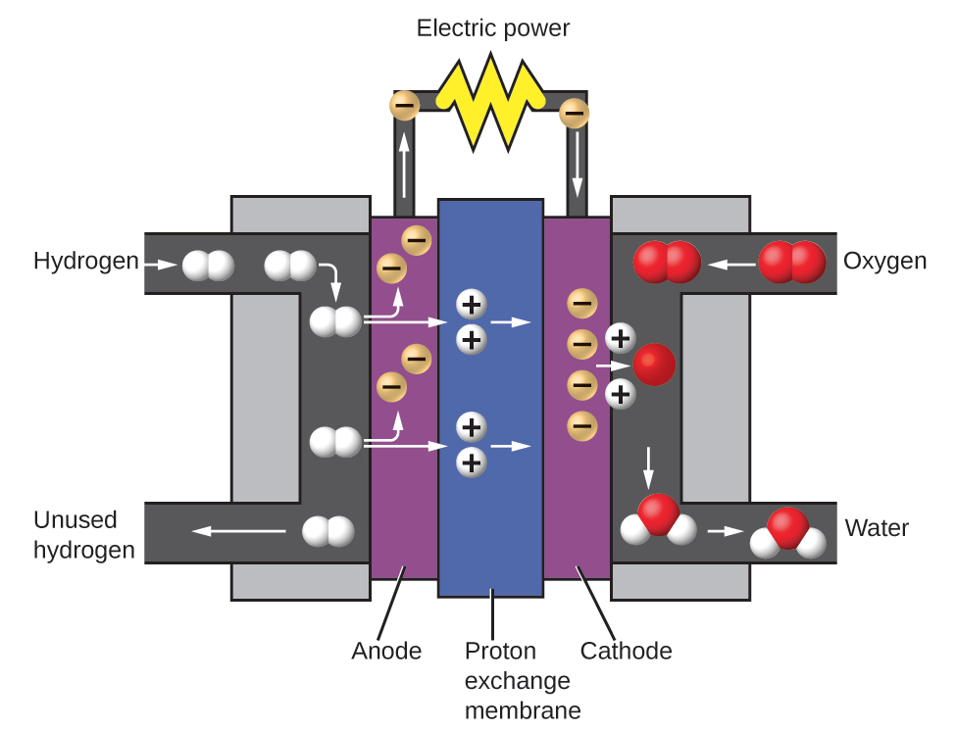
Practical application: fuel cells
Electrolysis of water can be used to store electricity as hydrogen gas.
Hydrogen gas can then be used to produce electricity using fuel cell technology
Chemistry OpenStax

Slide 14
Homo- vs. heterogeneous mixtures
heterogeneous mixture
homogenous mixture
A salad dressing of oil and vinegar has distinct, visible parts.
Droplets of oil are visible in the vinegar.
Sports drink solutions are uniform throughout.
Give examples of both types of mixture in each physical state.
Chemistry OpenStax

Slide 15
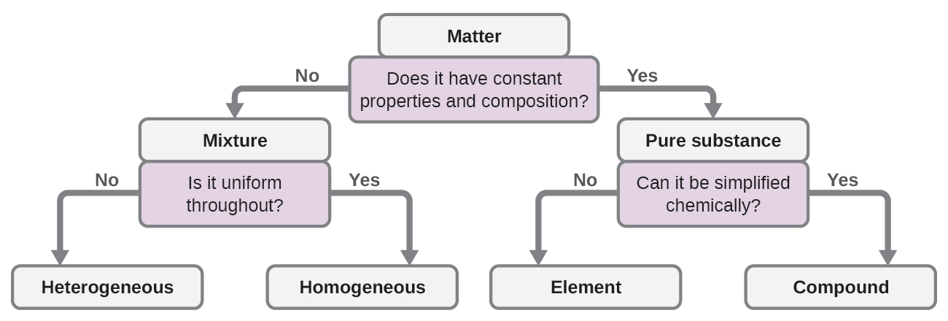
Ask yourself these questions
During this course you may find it useful to organizing information into flowcharts, lists of steps, or using diagrams like this one.
Can it be simplified physically?
Do these questions work for you? Try a few of the examples we’ve discussed in this lecture.
Chemistry OpenStax

Slide 16
2.1: Can you?
(1) Differentiate between the physical states of matter?
(2) Explain the difference between mass and weight?
(3) Explain why the law of conservation of mass is particularly important to chemistry?
(4) Define and differentiate between atoms, elements and molecules?
(5) Differentiate between pure substances and mixtures?
(6) Differentiate between homogeneous and heterogeneous mixtures?

Slide 17
2.1: Assignments
Canvas: Quick review questions quiz 2.1
Canvas: HW set 2, problems 1 - 2
Optional extras – great videos on this topic:
Warning: This may damage microwaves if you try it at home!
‘Make plasma with grapes in the microwave!’(Veritasium) https://www.youtube.com/watch?v=RwTjsRt0Fzo
‘What’s the difference between an atom and a molecule?’ (Tyler DeWitt) https://www.youtube.com/watch?v=RbbOBPfH_uk&list=PLAD1E2E66D9D6A8A6&index=6&t=0s
‘Evaluate: pure substances and mixtures?’ (ScienceBits) https://www.youtube.com/watch?v=RbbOBPfH_uk&list=PLAD1E2E66D9D6A8A6&index=6&t=0s

Slide 18
Module 2. Matter and energy basis
2.2: Properties and changes of matter: physical vs. chemical
Identify properties and changes in matter as physical or chemical
Identify properties of matter as extensive or intensive
OpenStax Chemistry 2/e p.25 - 29

Slide 19
Module 2. Matter and energy basics
Big ideas?
Matter has mass and volume and is conserved during chemical reactions.
Energy is contained in chemical bonds and is conserved in chemical reactions.

Slide 20
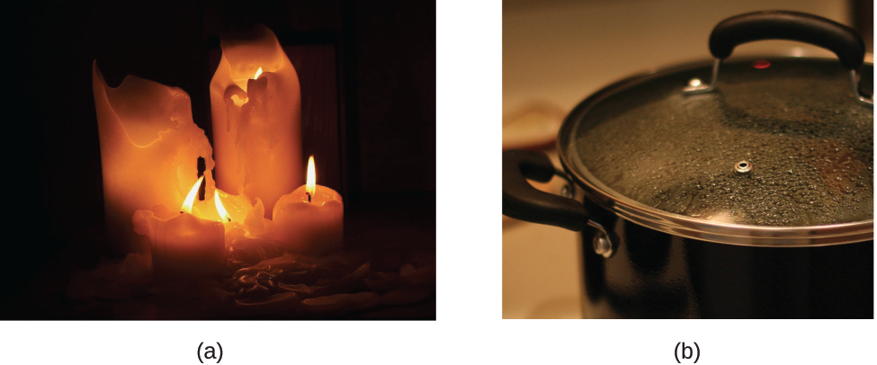
Physical properties and changes
Physical properties: a property or characteristic not associated with change of identity of chemical composition
Density, color, hardness, melting and boiling points, magnetism
Physical changes: changes in state or physical property without changes in identity or chemical composition
There’s also a chemical change shown in one of these images.
Do you know what it is?
melting wax
water boiling to steam
Chemistry OpenStax

Slide 21
Physical separation is used in the lab
A number of classical chemistry techniques separate compounds based on their physical properties. Here are two examples.
Distillation
A solution of two liquids is heated until one component boils ‘off’. The vapor of that component is collected and condensed back into a liquid.
Filtration
A mixture of liquid and solid are passed through a filter, holding the solid back and removing it from the liquid.
Chemistry OpenStax; Chemisry LibreText

Slide 22
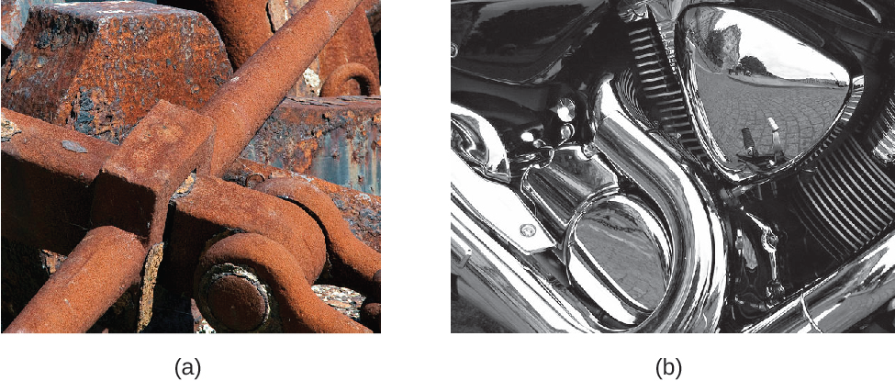
Chemical properties and changes
Chemical properties: a property that governs the ability of a substance to change (or not) its identity of chemical composition
Combustion, reduction-oxidation, precipitation, neutralization
Chemical changes: changes of chemical identity by reaction with another substance
Iron rusts when exposed to oxygen & water
Chromium doesn’t change when exposed to oxygen & water
Chemistry OpenStax

Slide 23
Chemical reactions – some examples
Oxidation:
Cu + 4HNO3 → Cu(NO3)2 + 2NO2 + 2H2O
heterogeneous mixture
Combustion:
cellulose + O2→ CO2 + H2O
Cooking meat: oxidation of myoglobin
Over-ripening of bananas
Chemistry OpenStax

Slide 24
Intensive vs. extensive properties
Extensive properties: properties dependent on mass and volume
Consider 10 drops vs. 10 liters of gasoline.
Both can be combusted in the presence of oxygen.
The amount of energy released is depends on volume combusted.
Intensive property: properties that don’t depend on mass & volume
Consider a steel ball bearing and a one-ton block of steel. What properties do they share?
Density, hardness, conductivity, melting point
What are some extensive and intensive properties of people?
Chemistry OpenStax

Slide 25
2.2: Can you?
(1) Define physical and chemical properties?
(2) Describe the difference between physical and chemical changes?
(3) Differentiate between intensive and extensive physical properties?

Slide 26
2.2: Assignments
Canvas: Quick review questions quiz 2.2
Canvas: HW set 2, problems 3 - 5
Optional extras – great videos on this topic:
‘Physical and chemical changes’ (Bozeman Science) https://www.youtube.com/watch?v=X328AWaJXvI
'Chemical change' (Bozeman Science) https://www.youtube.com/watch?v=oBFVPd9N5SY

Slide 27
Module 2. Matter and energy basics
2.3: Conservation of mass
Law of conservation of mass
Balanced chemical equations obey the law of conservation of mass
OpenStax Chemistry 2/e p.16- 17

Slide 28
Module 2. Matter and energy basics
Big ideas?
Matter has mass and volume and is conserved during chemical reactions.
Energy is contained in chemical bonds and is conserved in chemical reactions.

Slide 29
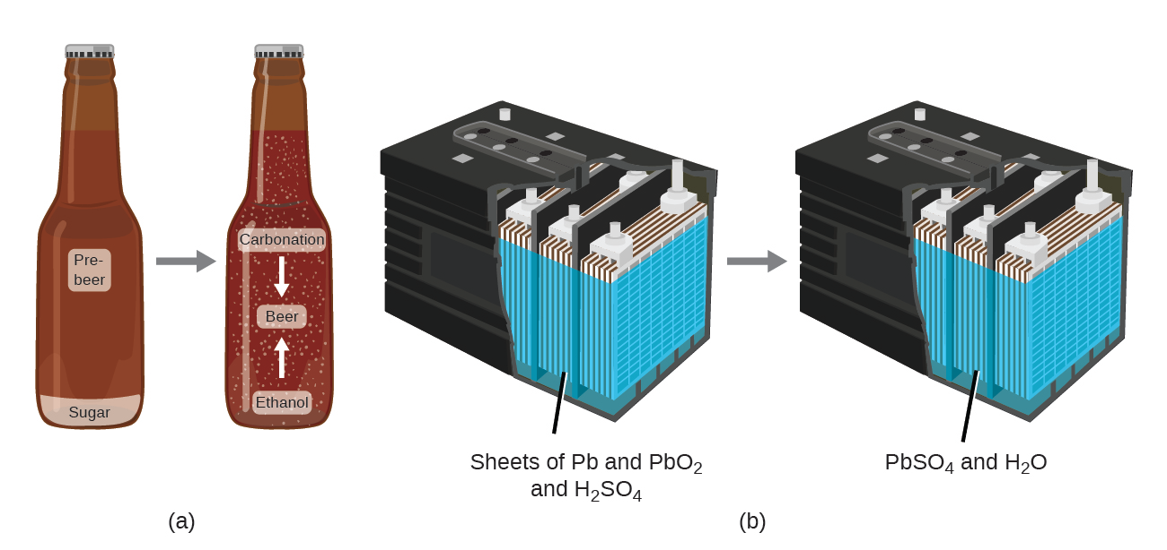
Law of conservation of mass
Much of what we do this semester will seek to obey the law of conservation of mass:
Mass is conserved, neither created nor destroyed by either physical and chemical change.
Redox reactions cause the battery to produce electric current & change the chemical nature of its components.
But the battery’s mass doesn’t change.
Fermentation changes sugar to alcohol or CO2, but mass doesn’t change.
Chemistry OpenStax

Slide 30
Chemical reactions obey the law of conservation of mass
Chemical equations are balanced to reflect chemistry’s obedience of the law of conservation of mass.
Every atom in the reactants must be present in the products.
3MgCl2 + 2AlBr3 → 3MgBr2 + 2AlCl3
element | # atoms in reactants | # atoms in products
Mg | 3 x 1 = 3 | 3 x 1 = 3
Cl | 3 x 2 = 6 | 2 x 3 = 6
Al | 2 x 1 = 2 | 2 x 1 = 2
Br | 2 x 3 = 6 | 3 x 2 = 6
So what does change?
The connectivity: which atom is connected to which.
This changes the formulas and identities of the chemical compounds.
Chemistry OpenStax

Slide 31
Try these
Count the number of each element on each side of this equation to be sure it’s balanced and obeying the law.
2Na3N + 3CaS → 3Na2S + Ca3N2
element | # atoms in reactants | # atoms in products
Na
N
Ca
S
Given this information about the reactants, what is the combined mass of the products?
Chemistry OpenStax

Slide 32
2.3: Can you?
(1) State the law of conservation of mass?
(2) Describe how balanced chemical equations obey the law?
(3) Explain what does change in chemical reactions?

Slide 33
2.3: Assignments
Canvas: Quick review questions quiz 2.3
Canvas: HW set 2, problems 6 - 7
Optional extras – great videos on this topic:
‘Law of conservation of mass example’ (MooMooMathandScience) https://www.youtube.com/watch?v=HmzFG_xOeaQ

Slide 34
Module 2. Matter and energy basics
2.4: Energy basics
Define energy, distinguish between types of energy, and describe the nature of energy changes that accompany physical and chemical changes.
Units of energy
First law of thermodynamics: conservation of energy
OpenStax Chemistry 2/e p.462 - 465

Slide 35
Module 2. Matter and energy basics
Big ideas?
Matter has mass and volume and is conserved during chemical reactions.
Energy is contained in chemical bonds and is conserved in chemical reactions.

Slide 36
Chemical changes often involve energy changes
Many, if not most, of the chemical changes we observe and use daily involve changes in energy:
Cooking food to make nutrients more bioavailable;
Burning fuels to provide heat, motive power and electricity; and
Chemical processing of raw materials to create materials for use to use.
More than 90% of our energy comes from the sun, though it may flow to us through physical changes (wind) and chemical changes (photosynthesis).
Chemistry OpenStax

Slide 37
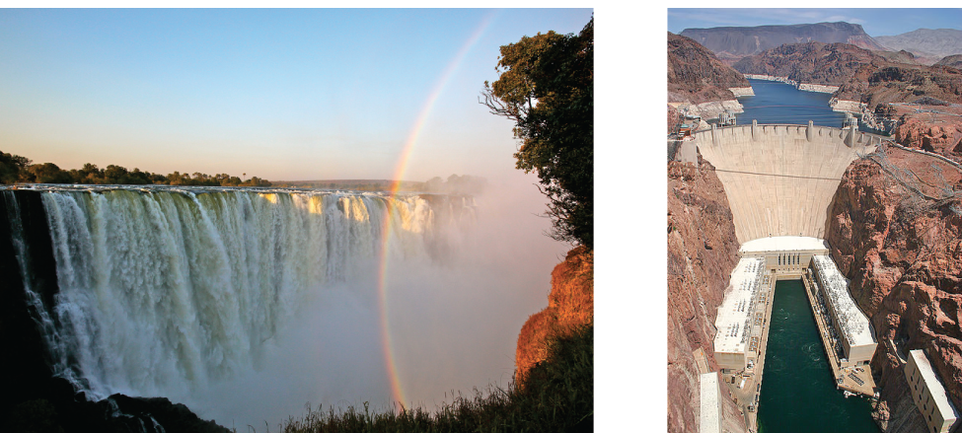
Energy: potential vs. kinetic
Energy: the capacity to supply heat (q) or do work (w)
Moving objects in opposition to forces like friction and gravity
Potential energy: the energy an object possesses by virtue of its position; stored energy
Chemical energy is potential energy (batteries, fuels)
Kinetic energy: the energy of objects in motion
kinetic energy
potential energy
Chemistry OpenStax

Slide 38
Units of energy
The SI unit of energy is the Joule (J).
J is a derived unit = kg-m²/s²
kilojoule (kJ) = 1000 J
The ‘English’ unit of energy is the calorie (cal): the amount of energy required to raise the temperature of 1 gram of water by 1ºC
1 cal = 4.184 J
The food calorie we’re all familiar with is actually a kilocalorie (kcal).
So how many J are released if we totally digest a 400 ‘calorie’ hamburger? 400 kcal 1000 cal 4.184 J = 1.673 E6 J = 1.673 E3 kJ
1 kcal 1 cal
Chemistry OpenStax

Slide 39
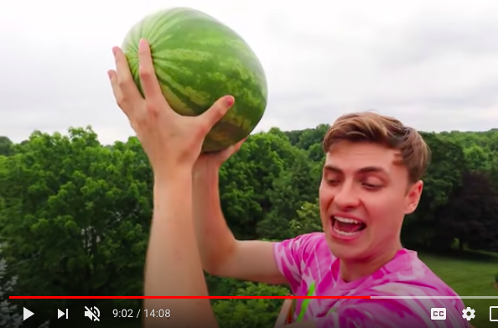
First law of thermodynamics: conservation of energy
First law of thermodynamics: energy is conserved, neither created nor destroyed, but only transferred or transformed
Transfer? From one object to another
Heat always flows from hot objects to cooler objects
Transformed? From one form to another
Kinetic energy can become potential energy (or vv).
Potential or kinetic energy can become heat.
You push a watermelon off out of a third-floor window. How is energy transferred or transformed?
Chemistry OpenStax

Slide 40
Chemical energy: a form of potential energy
Chemical energy is the energy stored in the chemical bonds that link atoms in a molecule or compound.
So chemical bond energy is a form of potential energy.
The combustion of gasoline, a chemical reaction, releases energy:
2C8H18 + 25O2 → 16CO2 + 18H2O + heat ΔH = - 5500 kJ/mol
This reaction is exothermic, it releases heat as a product.
ΔH (enthalpy or heat flow) is negative meaning heat is released.
Chemistry OpenStax

Slide 41
2.4: Can you?
Define the term ‘energy’ and differentiate between potential, kinetic and chemical energy?
(2) State the first law of thermodynamics?

Slide 42
2.4: Assignments
Canvas: Quick review questions quiz 2.4
Canvas HW set 2, problem 8
Optional extras – great videos on this topic:
‘Kinetic and potential energy’ (Bozeman Science) https://www.youtube.com/watch?v=VgyXWXI-wec
‘Conservation of energy’ (Bozeman Science) https://www.youtube.com/watch?v=LIh9ueO9FBM

Slide 43
Module 2. Matter and energy basics
2.5: Heat vs. temperature
Exothermic vs. endothermic reactions; system and surroundings
Thermal energy and temperature
Temperature scales
OpenStax Chemistry 2/e p.464 - 465

Slide 44
Module 2. Matter and energy basics
Big ideas?
Matter has mass and volume and is conserved during chemical reactions.
Energy is contained in chemical bonds and is conserved in chemical reactions.

Slide 45
Systems and surroundings
In order to understand how heat is involved in chemical reactions you must understand the concept of a system and its surroundings.
In chemistry the system is the chemical reaction.
Closed system: a system that exchanges energy, but not mass, with its surroundings
Open system: a system that exchanges both mass and energy with its surroundings
System: the chemical reaction or object being investigated
Surroundings: everything in the universe except the system
surroundings
system
(reaction)
surroundings
exothermic
endothermic
Chemistry OpenStax

Slide 46
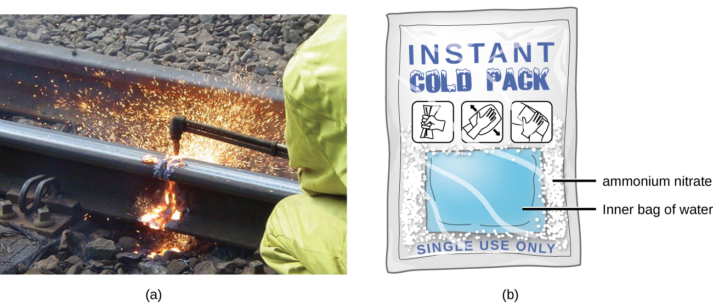
Exo- vs. endothermic reactions
Exothermic: processes that release energy or heat
ΔH = (-) negative
ΔH<0
exothermic
Endothermic: processes that require an input of energy or heat
ΔH = (+) positive
ΔH>0
endothermic
exothermic
endothermic
Chemistry OpenStax

Slide 47
Try this
Label each of the following processes as endothermic or exothermic.
(a) water boiling
(b) gasoline burning
(c) ice forming on a pond
LibreText Chemixtry

Slide 48
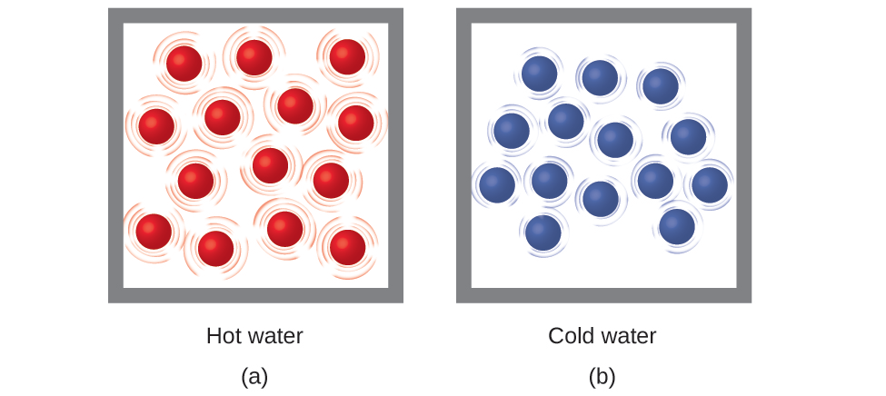
Thermal energy
Thermal energy: kinetic energy of the random motion of atoms and molecules
Temperature: quantitative measure of ‘hot’ and ‘cold’
Faster kinetic motion (sometimes called vibration) results in more thermal energy and a higher temperature.
slower motion
cooler temp
contraction
faster motion
warmer temp
expansion
Chemistry OpenStax

Slide 49
Temperature scales
Fahrenheit (ºF): English system
Arbitrary references
Celsius (ºC): metric
Uses water’s freezing and boiling points as references
Places 100 degrees between them
Kelvin (K): metric gases
‘Absolute zero’ references the temperature at which molecular motion stops
K = ºC + 273.15
LibreText Chemistry

Slide 50
Try this
Convert each temperature to °C.
(a) the temperature of the surface of the sun (5800 K)
(b) the boiling point of gold (3080 K)
(c) the boiling point of liquid nitrogen (77.36 K)
LibreText Chemistry

Slide 51
2.5: Can you?
Explain the relationship between thermal energy and heat?
Explain what thermometers measure?

Slide 52
2.5: Assignments
Canvas: Quick review questions quiz 2.5
Canvas HW set 2, problems 9 - 11
Optional extras – great videos on this topic:
‘Heat’ (Bozeman Science) https://www.youtube.com/watch?v=ldMcDvm29eA&t=71s
‘Temperature’ (Bozeman Science) https://www.youtube.com/watch?v=B6hAwZH2mmA
‘Heat flow animation (endothermic and exothermic)’ (Brandon Cruickshank) https://www.youtube.com/watch?v=If2h6zXRpGA

Slide 53
Module 2. Matter and energy basics
2.6: Heat capacity, specific heat, and calculations of heat flow
Heat flow
Heat capacity
Specific heat
Calculating energy changes during heat flow
OpenStax Chemistry 2/e p.465 - 472

Slide 54
Module 2. Matter and energy basics
Big ideas?
Matter has mass and volume and is conserved during chemical reactions.
Energy is contained in chemical bonds and is conserved in chemical reactions.

Slide 55
Heat flow
Heat (q) (heat flow): the transfer of thermal energy between two bodies at different temperatures: from hot to cold.
(1) initial difference
(2) heat flow!
(3) same temps
Heat flow continues until both bodies are the same temperature.
Direction always hot → cold
Chemistry OpenStax

Slide 56
Heat capacity
Substances have very different abilities to store heat.
If you’re barefoot on a bright and hot sunny day, do you want to walk on the asphalt sidewalk or a grass lawn?
Heat capacity: amount of energy needed to raise an object’s temperature by 1 degree C
c = q .= J .
ΔT °C
Heat capacity is used when dealing with objects that are a mixture of pure substances.
Calculate the heat capacity of two cast-iron frying pans, one large and one small. The temperature of each pan is increased by 50 degrees. That requires an input of 18,150 J of energy for the small pan, and 90,700 J for the large pan.
Chemistry OpenStax

Slide 57
Specific heat
Specific heat: amount of energy used to raise the temperature of 1 g of substance by 1 °C
Unit: J/g-°C
Water = 4.184 J/g-°C
c = q .= J .
(m)(ΔT) g- °C
Specific heat is used when dealing with pure substances.
Calculate the specific heat of two cast-iron frying pans, one large and one small. The temperature of each pan is increased by 50 degrees. That requires an input of 18,150 J of energy for the small pan, and 90,700 J for the large pan. The mass of the small pan is 808 g and the large pan is 4040 g.
Chemistry OpenStax

Slide 58
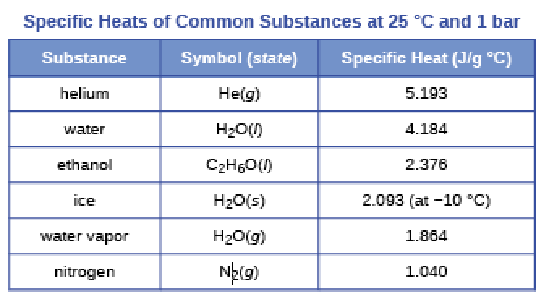
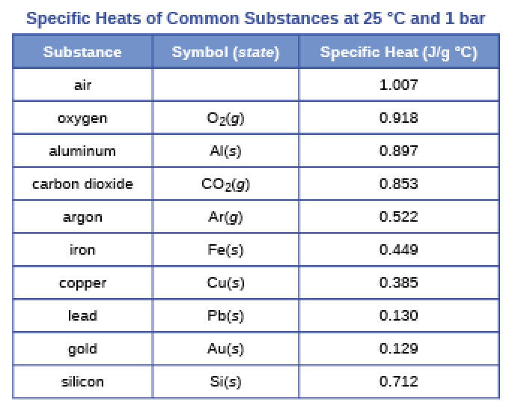
Common specific heat values
So, water holds on to heat much better than metals.
In fact, water’s high specific heat explains ‘lake effect’ weather: cooler in summer and warmer in winter.
Chemistry OpenStax

Slide 59
Calculating change of heat
If we know the mass of a substance, its specific heat and the change in temperature, we can calculate the heat flow using:
q = (c)(m)(ΔT)
units: J = (J/g-°C)(g)(°C)
q = ΔH
+ΔH = endothermic
- ΔH = exothermic
A flask containing 8.0 E2 g of water is heated and the temperature of the water increases from 21 to 85°C. How much heat was used?
Chemistry OpenStax

Slide 60
Try these (rearrange the equation!)
A piece of metal has a mass of 348 g and absorbs 6.64 kJ of heat as its temperature increases from 22.4 to 43.6°C.
Calculate the specific heat of the metal, and try to identify it.
A piece of metal weighs 217 g and absorbs 1.43 kJ of heat. Its temperature increases from 24.5 to 39.1°C. Calculate the metal‘s specific heat.
Chemistry OpenStax

Slide 61
How much energy can be stored using molten salt?
A solar power plant stores energy overnight by melting salt: a mixture of sodium nitrate and potassium nitrate.
If one ton of this salt, with a heat capacity of 1.53 J/g-°C, is heated from 260 to 550°C, how much energy can be stored?
Chemistry OpenStax

Slide 62
2.6: Can you?
( 1) Define, and differentiate between, processes that are endothermic and exothermic?
(2) Define heat capacity and its units?
(3) Define specific heat and its units?
(4) Use specific heat, mass and change in temperature to calculate heat changes?

Slide 63
2.6: Assignments
Canvas: Quick review questions quiz 2.6
Canvas HW set 2, problems 12 - 14
Optional extras – great videos on this topic:
‘Heat exchange’ (Bozeman Science) https://www.youtube.com/watch?v=OBVbV5dpCCA

