Slide 1
CHE 1020: Introduction to Chemistry
Module 3: Atoms, ions, isotopes and atomic models
3.1: The nuclear model of the atom
3.2: Properties of protons, neutrons and electrons
3.3: Patterns in the periodic table
3.4: Ions are atoms that have gained or lost electrons
3.5: Isotopes determine average atomic mass
3.6: Development of the Bohr model of the atom
3.7: The quantum mechanical model of the atom
3.8: Electron configuration - key to reactivity
Resources on Canvas:
Periodic table
Aufbau Christmas tree
Quick summary of Module 3
OpenStax Chemistry Atoms First 2/e p.68 - 79; 79 – 81; 165– 169; 80 – 81; 158 - 169; 83 – 87; 116 – 135; 135 – 148; 148 - 158

Slide 2
Module 3: Atoms, ions, isotopes and atomic models
3.1: The nuclear model of the atom
The atom from Democritus to Dalton
Dalton’s laws of definite and multiple proportions
Thomson’s discovery of the electron and his plum pudding model
Rutherford’s nuclear model
OpenStax Chemistry 2/e p.68 - 79

Slide 3
Module 3. Atoms, ions, isotopes and atomic models
Big ideas?
Ions and isotopes are variants of atoms with different numbers of electrons or neutrons, respectively.
Quantum mechanics is a strange form of physics that explains that structure and behavior of atoms.

Slide 4
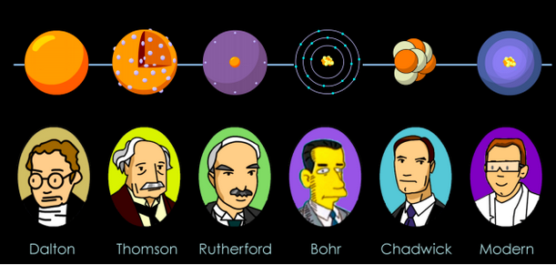
Atomic structure: what we know and when we knew it
The ancient Greeks: Democritus
Hypothesis: Atoms are indivisible and the smallest unit of matter that still has that matter’s properties. Divide a piece of iron in half: it’s still iron. Divide it again: still iron.
Rinse, repeat.
Until… you divide a very tiny piece of iron in half and it no longer behaves like iron.
Problem? The ancient Greeks didn’t have the technology needed to do the experiment!
1999 (IBM)
400 BC
1808
1897
1911
1913
1932
2013 (EPS)
Chemistry OpenStax

Slide 5
Atomic structure: what we know and when we knew it
John Dalton:
Access to very accurate scales allowed him to collect data supporting Democritus’ hypothesis.
Weighed pieces of pure metals.
Placed them under glass and ‘burned’ them.
Weighed again and found that mass increased! Oxygen atoms added to form metal oxides.
Ratios of oxygen to metal allowed him to confirm the existence of atoms.
1999 (IBM)
400 BC
1808
1897
1911
1913
1932
2013 (EPS)
Chemistry OpenStax

Slide 6
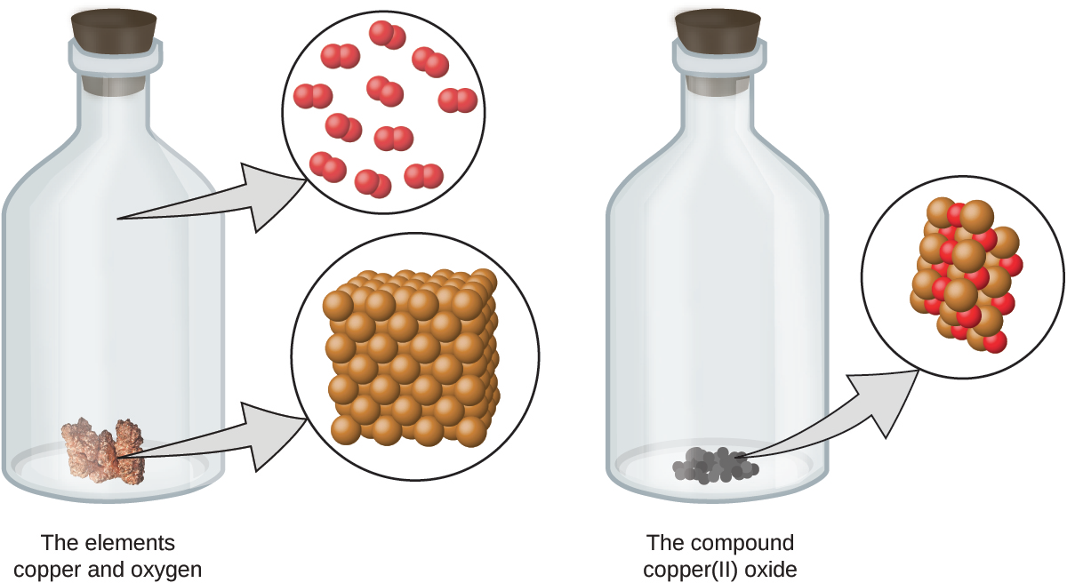
Here’s a look at Dalton’s experiment
chemical reaction
Now let’s look at the rules (or laws) that govern chemistry.
Chemistry OpenStax

Slide 7
Law of conservation of mass
Law of conservation of mass: mass is conserved, neither created nor destroyed.
Do the chemical reactions shown here obey the law of conservation of mass?
Each sphere represents an atom.
Chemistry OpenStax

Slide 8
Law of definite proportions (aka constant composition)
Law of definite proportions: all samples of one compound have the same elements in the same proportion by mass, or the same atomic ratio
Atoms combine at constant, small, whole-number ratios to form compounds.
For example, let’s look at the masses of carbon and hydrogen contained in three samples of of isooctane, C8H18.
sample* | carbon (g) | hydrogen (g) | mass ratio (C : H)
A | 14.82 | 2.78 | 5.33 : 1.00
B | 22.33 | 4.19 | 5.33 : 1.00
C | 19.40 | 3.64 | 5.33 : 1.00
Because all are isooctane:
all have 8 atoms of carbon for every 18 atoms of hydrogen; and
thus the mass ratios of these elements is also constant.
Chemistry OpenStax

Slide 9
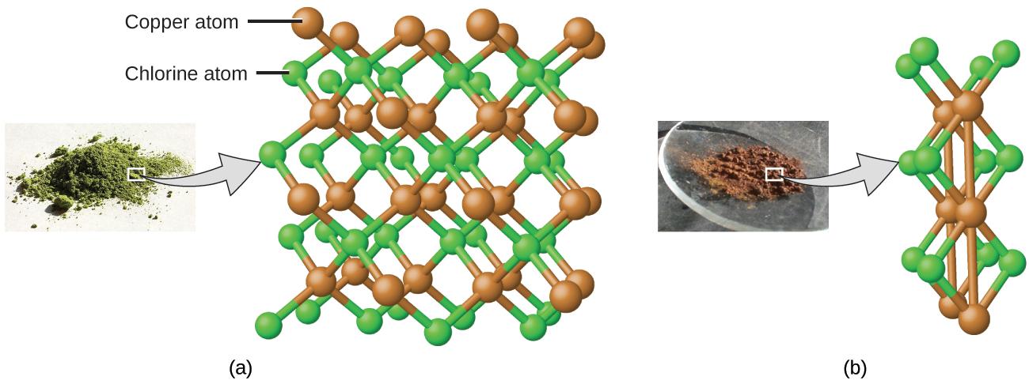
Law of multiple proportions
Law of multiple proportions: two elements can be combined in different proportions or at different ratios to create multiple (different) compounds
Multiple proportions (different ratios) produce multiple compounds
Cu : Cl
1.0 g : 0.558 g
= CuCl
Cu : Cl
1.0 g : 1.116 g
= CuCl2
Chemistry OpenStax

Slide 10
Try this
Compounds A and B are both clear, odorless gases.
A sample of compound A is found to contain 4.27 g of C and 5.69 g of O.
A sample of compound B is found to have 5.19 g of C and 13.84 g of O.
Are A and B examples of:
the law of definite proportions
the law of multiple proportions
both
neither
Chemistry OpenStax

Slide 11
Atomic structure: what we know and when we knew it
J.J. Thomson: ‘The electron, I found the electron!’
‘…. But what does that mean?’
1999 (IBM)
400 BC
1808
1897
1911
1913
1932
2013 (EPS)
Chemistry OpenStax

Slide 12
Thomson discovered electrons
1897, JJ Thomson used a cathode ray tube to discover the first subatomic particle, the electron.
Partially evacuated glass tube containing a cathode and anode.
When electricity was applied, a cathode ray flowed from the cathode to the anode.
Magnets deflected the beam, showing it was negatively charged.
Calculations showed the particle was much lighter than an atom.
Chemistry OpenStax

Slide 13
Where are the electrons in the atom?
Once Thomson had found electrons, everyone wanted to know where the were located in the atom. What was the atom’s structure?
Plum pudding model (Thomson)
The atom is a positively charged mass, studded with randomly placed and negatively charged electrons.
Saturn model (Nagaoka)
The atom is a positively charged mass, orbited by negatively charged electrons.
Chemistry OpenStax

Slide 14
Atomic structure: what we know and when we knew it
J.J. Thomson: ‘The atom is a tiny plum pudding!’
Ernest Rutherford: ‘This is my chance at the big time!’
1999 (IBM)
400 BC
1808
1897
1911
1913
1932
2013 (EPS)
Chemistry OpenStax

Slide 15
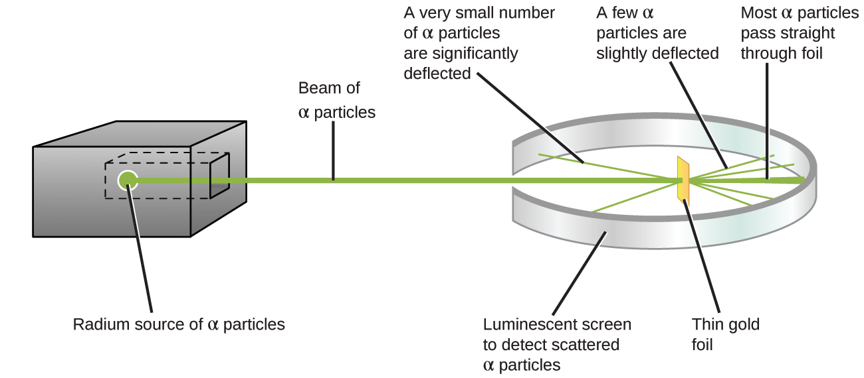
Rutherford’s elegant experiment gave the answer
1911, Ernest Rutherford’s gold foil experiment supported Nagaoka’s hypothesis and refined it into the ‘nuclear’ model of the atom.
Heavy alpha particles were aimed at gold foil 1 to 2 atoms thick.
Most particles passed through without deflection, showing that most of the atom held light electrons.
All pf the atom’s dense material is in a tiny central nucleus.
Chemistry OpenStax

Slide 16
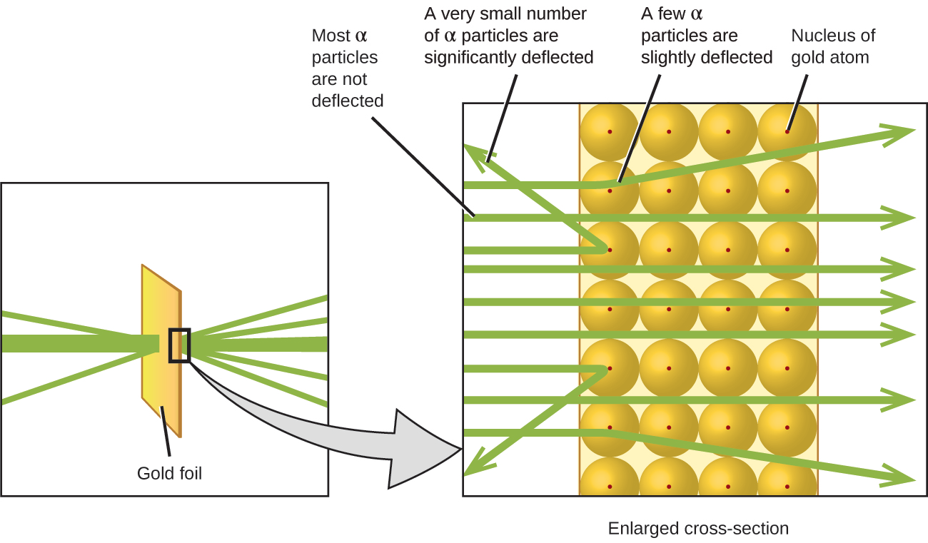
The nuclear model
The few deflected particles have hit the tiny but incredibly dense nucleus.
Chemistry OpenStax

Slide 17
Picturing the nuclear model of the atom
Most of the volume of the atom is occupied by electrons and is called the electron cloud.
The tiny and dense nucleus is located in the center of the atom and holds all of the heavy particles: protons & neutrons.
If an atom is the size of a superdome stadium, the nucleus is the size of a blueberry.
The angstrom (Å; 1 E-10 m) is used to measure atoms.
Chemistry OpenStax

Slide 18
Atomic structure: what we know and when we knew it
Ernest Rutherford: ‘My nuclear model is the bomb!’
1999 (IBM)
400 BC
1808
1897
1911
1913
1932
2013 (EPS)
Chemistry OpenStax

Slide 19
3.1: Can you?
(1) Visualize the rearrangement of atoms during a chemical reaction?
(2) Understand how chemical reactions obey the law of conservation of mass?
(3) State the law of definite proportions describe how it relates to molecular formulas?
(4) Explain the law of multiple proportions and give an example?
(5) Explain how Thomson used a cathode ray tube to discover the electron?
(6) Describe the essential difference between Thomson’s plum pudding model and Nagaoka’s Saturn model?
(7) Explain how the nuclear model was developed from the data Rutherford collected in his gold foil experiment?
(8) Understand just how small atoms really are?

Slide 20
3.1: Assignments
Canvas: Quick review questions quiz 3.1
Canvas: HW set 3, problems 1 - 2
Optional extras – great videos on this topic:
‘A boy and his atom: the world’s smallest movie’ (IBM) https://www.youtube.com/watch?v=oSCX78-8-q0&feature=emb_logo
‘Thomson’s cathode ray tube experiments’ (Wendell Thomas) https://www.youtube.com/watch?v=_nLESblUAHY
‘Rutherford’s experiment: nuclear atom’ (HerrPingui) https://www.youtube.com/watch?v=5pZj0u_XMbc

Slide 21
Module 3: Atoms, ions, isotopes and atomic models
3.2: Properties of protons, neutrons and electrons
Protons, neutrons and electrons are subatomic particles
Atomic mass (number of protons) identifies elements
Atom mass is equal to the sum or protons and neutrons
Rutherford’s nuclear model
OpenStax Chemistry 2/e p.79 - 81

Slide 22
Module 3. Atoms, ions, isotopes and atomic models
Big ideas?
Ions and isotopes are variants of atoms with different numbers of electrons or neutrons, respectively.
Quantum mechanics is a strange form of physics that explains that structure and behavior of atoms.

Slide 23
Protons, neutrons and electrons are subatomic particles
In time, scientists discovered the three major subatomic particles. The are compared here:
particle | location | charge (C) | charge | mass (amu) | mass (g)
electron | cloud | - 1.602 E-19 | -1 | 0.00056 | 0.00091 E-24
proton | nucleus | + 1.602 E-19 | +1 | 1.00727 | 1.67363 E-24
neutron | nucleus | none | 0 | 1.00866 | 1.67493 E-24
0.0005
1
1
C is Coulomb, a unit of electric charge.
Amu is atomic mass unit, an arbitrary and comparative unit of mass.
1 amu = 1/12th the mass of a carbon atom
1 carbon atom = 6 protons + 6 neutrons = 12 heavy particles
Chemistry OpenStax

Slide 24
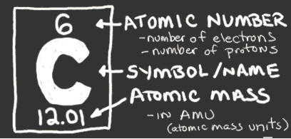
Atomic number and mass
Atomic number: the unique identifier for each atom
the number of protons in each element
also number of electrons in an atom
So atoms are neutral and uncharged…
…and their number of neutrons is predictable.
Atomic mass: the mass of each atom (amu or g/mole)
roughly = #p + # n
Number of neutrons: = atomic mass – atomic number
carbon:
#n = mass - #p
= 12 – 6 = 6
Why doesn’t the number of electrons factor into estimates of atomic mass?
The mass of electrons is 2000X smaller than an amu.
OpenStax Chemistry
http://www.chem4kids.com/files/elements/006_shells.html

Slide 25
Try this
Fill in the missing information in this table of the first six elements.
element | # protons | # neutrons | # electrons | atomic number (Z) | atomic mass (A)
H |  |  |  | 1 | 1
He |  |  |  | 2 | 4
Li |  |  |  | 3 | 7
Be |  |  |  | 4 | 9
B |  |  |  | 5 | 11
C |  |  |  | 6 | 12
Hydrogen is a bit odd and is missing one subatomic particle.
Hint: it is neutral.
OpenStax Chemistry

Slide 26
3.2: Assignments
Canvas: Quick review questions quiz 3.2
Canvas: HW set 3, problems 3 - 5
Optional extras – great videos on this topic:
'Basic Atomic Structure: A Look Inside the Atom’ (Tyler DeWitt) https://www.youtube.com/watch?v=h6LPAwAmnCQ&list=PL3hPm0ZdYhywb0pyaNIsXFzIOB3FESr0y
'Atomic Number, Mass Number, and Net Charge' (Tyler DeWitt) https://www.youtube.com/watch?v=dRfrvpVdKGM&list=PL3hPm0ZdYhywb0pyaNIsXFzIOB3FESr0y&index=2&pbjreload=10
'What are isotopes' (Tyler DeWitt) https://www.youtube.com/watch?v=EboWeWmh5Pg&list=PL3hPm0ZdYhywb0pyaNIsXFzIOB3FESr0y&index=4
Chemistry Openstax

Slide 27
Module 3: Atoms, ions, isotopes and atomic models
3.3: Patterns in the periodic table
:
Periodic law
Rows or periods
Columns or groups
Metals, transition metals, metalloids, nonmetals
OpenStax Chemistry 2/e p.165 - 169

Slide 28
Module 3. Atoms, ions, isotopes and atomic models
Big ideas?
Ions and isotopes are variants of atoms with different numbers of electrons or neutrons, respectively.
Quantum mechanics is a strange form of physics that explains that structure and behavior of atoms.

Slide 29
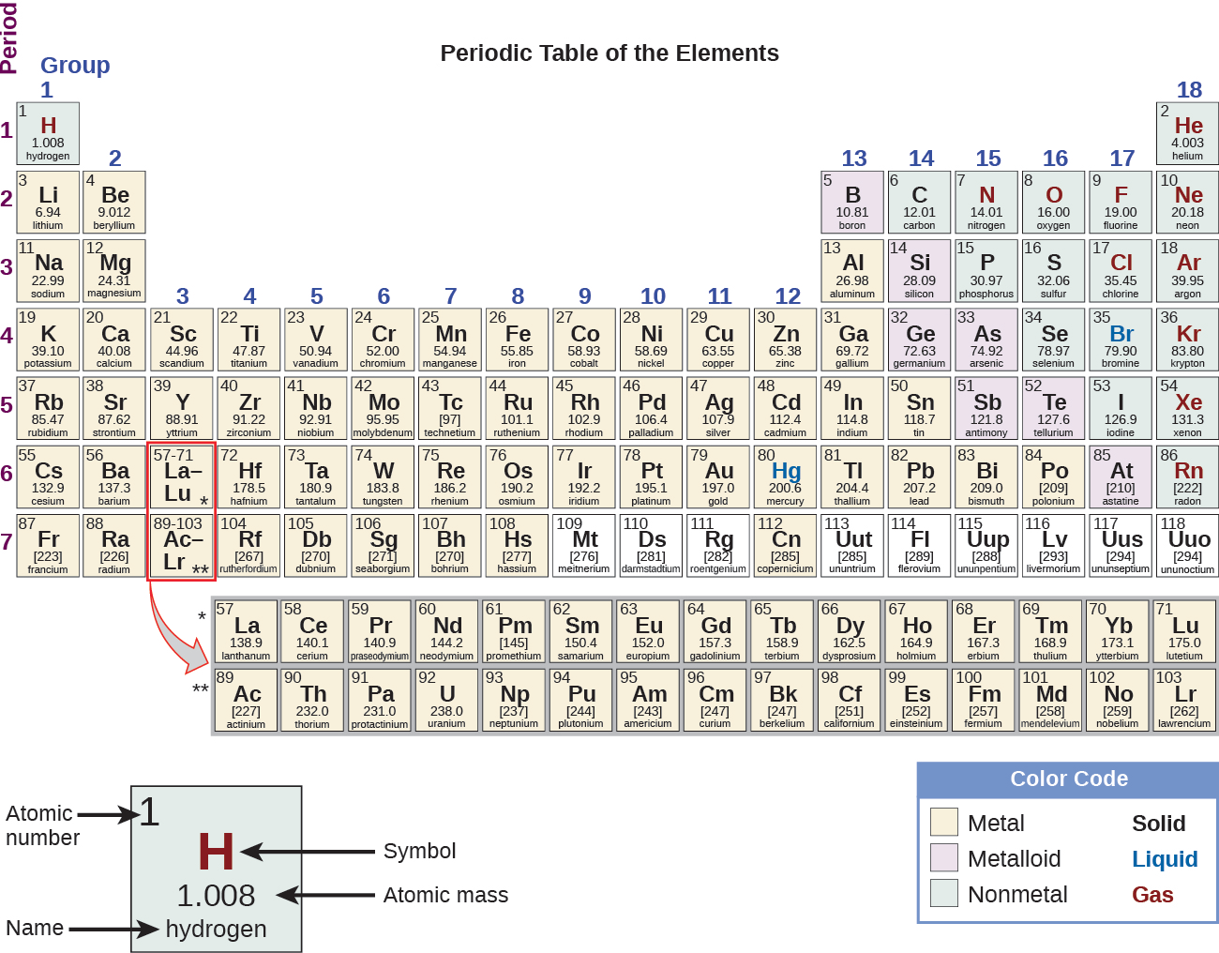
Periodic law
Periodic law: properties of elements are periodic functions of their atomic numbers
Period (row) = valence shell #
Group (column) = same e- configuration
Chemistry OpenStax

Slide 30
Rows or periods
All elements in the same row have the same valence (or outermost) shell of electrons.
7 rows, so seven shells
Within a row, from left to right, each element has one more proton.
Chemistry OpenStax

Slide 31
Columns or groups
All elements in the same column have the same valence electron configuration.
Therefore elements in the same column have similar physical and chemical properties.
Chemistry OpenStax

Slide 32
Metals, nonmetals and metalloids
Metals: shiny, malleable, ductile, conduct electricity and heat
Nonmetals: dull, poor conductors of electricity and heat
noble gases
Metalloids: intermediate between metals and non; (semiconductors)
alkali metals
halogens
transition metals
alkali earth
metals
Chemistry OpenStax

Slide 33
Names of groups of elements
Chemistry OpenStax

Slide 34
3.3: Can you?
State the periodic law?
Describe what is common to elements in the same column vs. those in the same row?
(3) Describe the location of metals, non-metals, transition metals and metalloids in the periodic table and the differences between these types of elements?
(4) Locate these types of elements in the periodic table?
Alkali metals
Alkali earth metals
Halogens
Noble gases

Slide 35
3.3: Assignments
Canvas: Quick review questions quiz 3.3
Canvas: HW set 3, problems 6 - 7
Optional extras – great videos on this topic:
'A tour of the Periodic Table’ (Bozeman Science) https://www.youtube.com/watch?v=fLSfgNxoVGk

Slide 36
Module 3: Atoms, ions, isotopes and atomic models
3.4: Ions: atoms that have lost or gained electrons
Ion formation: cations and anions
‘Predicting’ ionic charge
Calculating the number subatomic particles in ions
Ionic radius and ionization energy
OpenStax Chemistry 2/e p.80 – 81; 158 - 165

Slide 37
Module 3. Atoms, ions, isotopes and atomic models
Big ideas?
Ions and isotopes are variants of atoms with different numbers of electrons or neutrons, respectively.
Quantum mechanics is a strange form of physics that explains that structure and behavior of atoms.

Slide 38
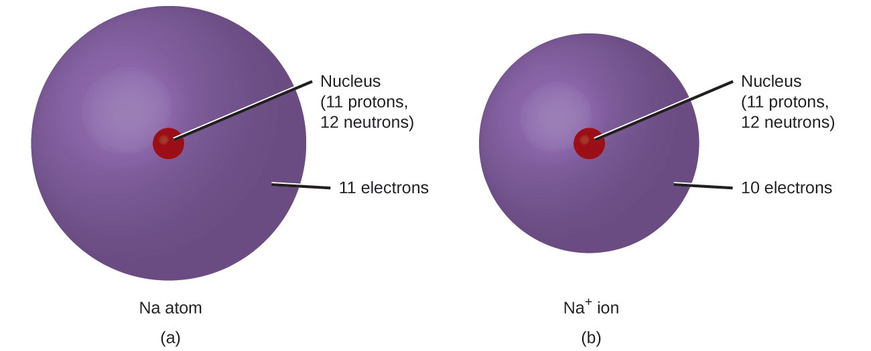
Ions: atoms that have lost or gained electrons
Ions are atomic variants of what we see in the periodic table.
Ions: atoms of the same element that have lost or gained electrons and are therefore electrically charged
Why do ions form? They have lower energy levels than atoms and are therefore more stable. More about this later!
e-
Where does the e- go?
Chemistry OpenStax, Wikimedia commons

Slide 39
Cations vs. anions
Cations (+): have lost electrons
Metals
Oxidation = process of losing e-
The process of forming cations and anions is linked.
They must form simultaneously to obey the law of conservation of mass.
Notice the loss of the metal’s outermost shell
Anions (-) have gained electrons
Nonmetals
Reduction = gaining e-
Chemistry OpenStax, LibreText Chemistry

Slide 40
Predicting ionic charge using the periodic table
The position of atoms in the periodic table allows us to predict their charge as ions.
Notice the pattern?
+1
-1
-2
+2
+3
-3
Chemistry OpenStax, LibreText Chemistry

Slide 41
Periodic table of ions
Chemistry OpenStax, LibreText Chemistry

Slide 42
Try these
What charges do these elements take when they become ions?
Try it without looking at the ‘marked up’ periodic tables!
(a) chlorine
(b) phosphorus
(c) scandium
(d) magnesium
How many subatomic particles are there in each of these ions?
(a) an oxygen ion with a −2 charge
(b) a beryllium ion with a +2 charge
(c) a silver ion with a +1 charge
(d) a selenium ion with a +4 charge
Chemistry OpenStax, LibreText Chemistry

Slide 43
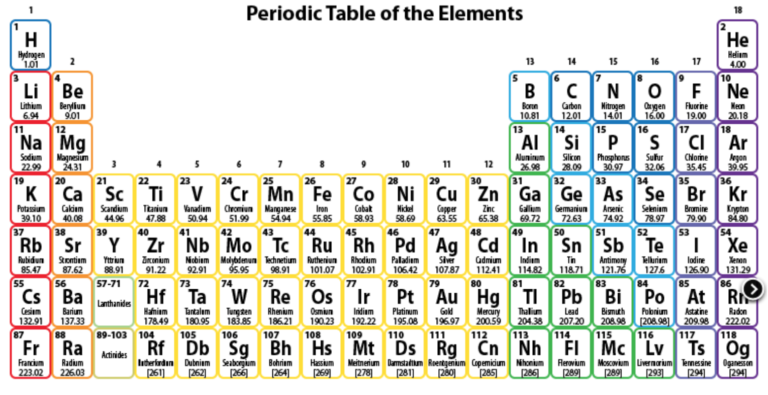
Quick look at periodic trends
Many atomic properties are governed by these basic changes that occur across and down the periodic table.
Increasing number of protons in the nucleus
increasing number of shells
Chemistry OpenStax

Slide 44
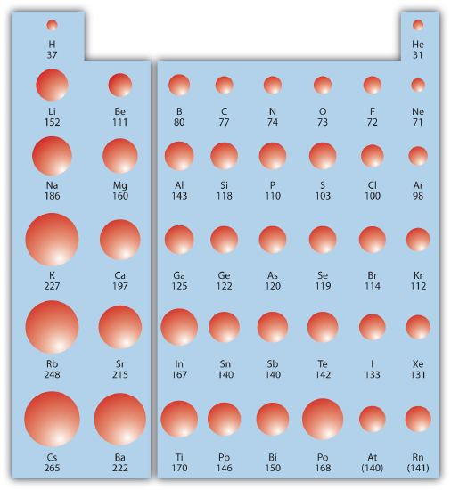
Atomic radius: trends down and across
It makes sense that radius increases down columns.
But can you make sense of the decrease across rows from left to right?
Why?
The number of protons in the nucleus increases across rows, creating more electrostatic pull (+) on electrons ( - ) and sucking them closer to the nucleus.
(pm)
Chemistry OpenStax; LibreText Chemistry

Slide 45
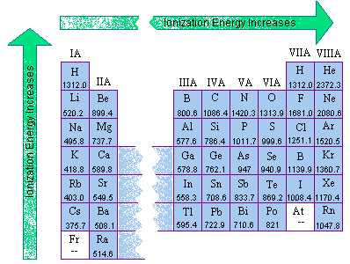
Ionization energy
Ionization energy (IE): the amount of energy required to remove an electron from an atom in the gas phase
A (g)→A⁺¹(g) + e− ΔH ≡ IE
What are the general trends do you see with ionization energies?
Up: smaller atoms have higher IE
Across: more protons cause higher IE
(kJ/mol)
Chemistry OpenStax; LibreText Chemistry

Slide 46
Successive ionization energies
Ionization energy increases each time another electron is removed.
Mg (g) → Mg⁺¹ (g) + e− ΔH ≡ IE = 738 kJ/mol
Up X2 as the nucleus has fewer e- to pull in
Mg⁺¹ (g) → Mg⁺² (g) + e− ΔH ≡ IE = 1,450 kJ/mol
Up X 5.3 because the 3rd electron is in the next shell
Mg⁺² (g) → Mg⁺³ (g) + e− ΔH ≡ IE = 7,734 kJ/mol
Chemistry OpenStax; LibreText Chemistry

Slide 47
Try this
In each pair, which has the larger first ionization energy?
(a) Ca or Sr
(b) K or K⁺¹
(kJ/mol)
Chemistry OpenStax; LibreText Chemistry

Slide 48
Electron affinity
Electron affinity (EA): which is the energy change when a gas-phase atom accepts an electron
A⁺¹(g) + e− → A (g) ΔH ≡ EA
EA is the opposite of IE.
(-) values mean that energy is released as the electron bonds and resolves charge.
Trends aren’t as clear
Often EA increase across rows as protons increase
(kJ/mol)
Chemistry OpenStax; LibreText Chemistry; Pearson Prentice-Hall

Slide 49
Try this
In each pair, predict which atom in each pair has the most negative electron affinity.
(a) C or F
(b) Na or S
(kJ/mol)
Chemistry OpenStax; LibreText Chemistry

Slide 50
3.4: Can you?
(1) Define the terms ions, cations and anions?
(2) Describe how and why ions form?
(3) Calculate numbers of protons, neutrons and electrons in ions?
(4) Describe how and why atomic radii vary down and across the periodic table?
(5) Define the term ionization energy and its periodic trends?
(6) Define the term electron affinity and its periodic trends?

Slide 51
3.4: Assignments
Canvas: Quick review questions quiz 3.4
Canvas: HW set 3, problem 8
Optional extras – great videos on this topic:
‘What’s an ion?’ (Tyler DeWitt) https://www.youtube.com/watch?v=WWc3k2723IM
‘Introduction to ionization energy and atomic radius’ (Tyler DeWitt) https://www.youtube.com/watch?v=ow3YUOYnqYU
’Periodicity’ (Bozeman Science) https://www.youtube.com/watch?v=0tP6bV89log

Slide 52
Module 3: Atoms, ions, isotopes and atomic models
3.5: Isotopes determine average atomic mass
Isotopes definition
Nuclear symbol for isotopes
Natural abundance
Calculating numbers of subatomic particles in ions and isotopes
Calculating average atomic mass with isotopic information
OpenStax Chemistry 2/e p.83 - 87

Slide 53
Module 3. Atoms, ions, isotopes and atomic models
Big ideas?
Ions and isotopes are variants of atoms with different numbers of electrons or neutrons, respectively.
Quantum mechanics is a strange form of physics that explains that structure and behavior of atoms.

Slide 54
Isotopes and ions: atomic variants
Like ions, isotopes are atomic variants of what we see in the periodic table.
Isotopes: atoms of the same element that differ in mass…
…because of a variant numbers of neutrons
So isotopes are lighter or heavier than the atom shown in the periodic table.
Isotopes are uncharged since neutrons are neutral.
Note the H is an odd duck: it’s the only element without a neutron!
Chemistry OpenStax, Wikimedia commons

Slide 55
Using symbols to representation
While atoms are represented by letters, the symbol for an isotope must also include isotopic mass, since the mass of an isotope can be lighter or heavier than that of other atoms of the same element. This is a called a nuclear symbol:
Isotopes only have charges if the lose or gain electrons.
Magnesium (Mg) has three isotopes with masses of 24, 25 & 26:
²⁴Mg, ²⁵Mg, ²⁶Mg ‘magnesium 24”
All isotopes of Mg have 12 protons but their number of neutrons differ:
²⁴Mg 24 – 12 = 12 n
²⁵Mg 25 – 12 = 13 n
²⁶Mg 26 – 12 = 14 n
Chemistry OpenStax

Slide 56
Isotope frequency or abundance
Each element may have multiple isotopes, and each occurs at characteristic abundances (aka frequencies or percentages).
element | symbol | atomic # | # p | # n | mass (amu) | %
hydrogen | ¹H | 1 | 1 | 0 | 1.0…... | 99.9885
deuterium | ²H | 1 | 1 | 1 | 2.0141 | 0.0115
tritium | ³H | 1 | 1 | 2 | 3.01605 | trace
helium | ³He | 2 | 2 | 1 | 3.01603 | 0.00013
 | ⁴He | 2 | 2 | 2 | 4.0026 | <100
carbon | ¹²C | 6 | 6 | 6 | 12.0000 | 98.89
 | ¹³C | 6 | 6 | 7 | 13.0034 | 1.11
 | ¹⁴C | 6 | 6 | 8 | 14.0032 | trace
Note that most elements have a dominant isotope present at the highest frequency.
Because isotope frequency varies with geography or place, analysis of isotopes can be used to track to origin of most materials.
Chemistry OpenStax

Slide 57
Calculating numbers of subatomic particles
Iodine is atomic number 53 and has a mass of 127 amu. Iodine gains one electron to form iodide ions, I⁻¹.
How many protons, neutrons & electrons are there in an iodide ion?
Iodine’s atomic number is 53, so both atoms and iodide ions both have 53 protons.
The number of protons in an atom never changes.
Iodine atoms have the same number of protons and electrons, so 53 electrons.
Iodide ions have gained one electron (-1) to create the overall ionic charge of -1.
So, iodide ions have 53 + 1 = 54 electrons.
The number of neutrons = 127 – 53 = 74
The number of neutrons is always calculated as atomic mass– atomic number.
The number of neutrons is the same in atoms and ions.
Chemistry OpenStax

Slide 58
Try this
An ion of platinum has a mass number of 195 and has 74 electrons.
How many protons and neutrons does it have?
What is its charge?
Chemistry OpenStax

Slide 59
Average atomic mass depends on isotopes, frequencies
The frequency of isotopes for each elements determines the average atomic mass shown in the periodic table.
Weighted average takes frequency & mass into account.
average atomic mass = Σ (isotopic mass)(isotopic frequency)
Boron occurs in two isotopes: 19.9% have a mass of 10.0129 amu while 80.1% have a mass of 11.0093.
Calculate the average atomic mass of boron.
average atomic mass = (10.0129)(0.199) + (11.0093)(0.801)
= 10.8110 amu
Remember to move the decimal 2 places when multiplying by a percentage.
Chemistry OpenStax

Slide 60
Try this
Chlorine has two naturally occurring isotopes. In a sample of chlorine, 75.77% of the atoms are Cl-35, with a mass of 34.97amu . Another 24.23% of the atoms are Cl-37, with a mass of 36.97amu . What is the atomic mass of chlorine?
6
Chemistry OpenStax

Slide 61
Try this
Neon has three naturally occurring isotopes. In a sample of neon, 90.92% of the atoms are Ne -20, which is an isotope of neon with 10 neutrons and a mass of 19.99amu . Another 0.3% of the atoms are Ne -21, which is an isotope of neon with 11 neutrons and a mass of 20.99amu . The final 8.85% of the atoms are Ne -22, which is an isotope of neon with 12 neutrons and a mass of 21.99amu . What is the atomic mass of neon?
7
Chemistry OpenStax

Slide 62
3.5: Can you?
(1) Define the terms isotope?
(2) Understand that each element has a characteristic number and abundance of isotopes?
(3) Calculate the number of subatomic particles in isotopes?
(4) Describe and write the nuclear symbol used to identify an isotope?
(5) Calculate average atomic mass from isotopic mass and frequency?

Slide 63
3.5: Assignments
Canvas: Quick review questions quiz 3.5
Canvas: HW set 3, problems 9 - 11
Optional extras – great videos on this topic:
'Atomic Number, Mass Number, and Net Charge' (Tyler DeWitt) https://www.youtube.com/watch?v=dRfrvpVdKGM&list=PL3hPm0ZdYhywb0pyaNIsXFzIOB3FESr0y&index=2&pbjreload=10
'What are isotopes' (Tyler DeWitt) https://www.youtube.com/watch?v=EboWeWmh5Pg&list=PL3hPm0ZdYhywb0pyaNIsXFzIOB3FESr0y&index=4
'Mass Spectrometry' (Bozeman Science) https://www.youtube.com/watch?v=mBT73Pesiog

Slide 64
Module 3: Atoms, ions, isotopes and atomic models
3.6: Development of the Bohr model of the atom
Changing our frame of reference
Light is electromagnetic radiation
Waves have wavelength, frequency and amplitude
Line spectra are discontinuous (waves)
Bohr created an atomic model that explains line spectra
Calculating average atomic mass with isotopic information
OpenStax Chemistry 2/e p.116 - 135

Slide 65
Module 3. Atoms, ions, isotopes and atomic models
Big ideas?
Ions and isotopes are variants of atoms with different numbers of electrons or neutrons, respectively.
Quantum mechanics is a strange form of physics that explains that structure and behavior of atoms.

Slide 66
To set the stage let’s talk about waves
Thomson to Rutherford to Bohr: electrons are corpuscular: tiny particles
And we all know a good deal about the behavior of particles from our experience in the everyday world.
Give me some examples!
Challenge: to understand the behavior of atoms and electrons you’ve got to have a basic understanding of waves
And most of us are less familiar with waves than particles.
Chemistry OpenStax

Slide 67
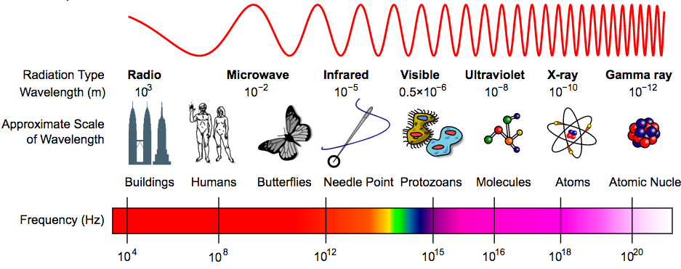
Scale and the electromagnetic spectrum
We use the visible range of the spectrum in our everyday world, we need to use the far end of the spectrum to investigate the structure and behavior of atoms and electrons.
https://courses.lumenlearning.com/introchem/chapter/electromagnetic-spectrum/

Slide 68
Waves
Wave: (traveling waves) oscillation or periodic movement that can transport energy from one point in space to another
A shaken rope
Ripples caused by a pebble thrown into a pond
Thunder (waves of sound)
‘the wave’ by a crowd of people
Kinetic energy is transferred through matter, along the wave, though the matter doesn’t move.
Chemistry OpenStax

Slide 69
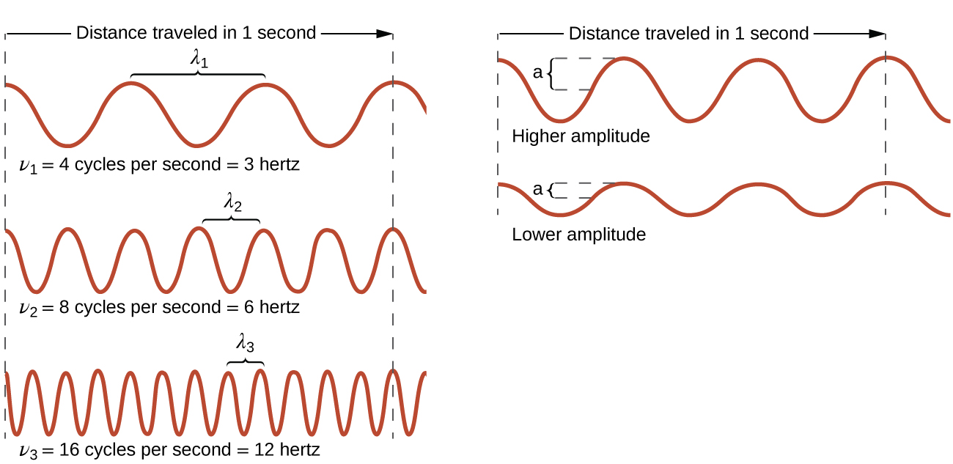
Describing waves: λ, v and amplitude
Wavelength (λ): trough-to-trough or peak-to-peak distance
Frequency (ν): number of cycles per unit time (Hz = cycles/s)
Amplitude: (half) height of waves from origin to peak or trough
Speed of electromagnetic radiation in a vacuum:
c = 2.998 E8 m/s= (λ)(ν)
Chemistry OpenStax

Slide 70
Determining the ν and λ of radiation
A sodium streetlight gives off yellow light with a λ of 589 nm.
What is the frequency of the light?
c = (λ)(ν) → ν = c
λ
ν = 2.998 E8 m 1 E9 nm = 5.09 E14/s
1 s 1 m 589 nm
A common US cell phone frequency is 850 MHz. What is the wavelength of these radio waves?
Chemistry OpenStax

Slide 71
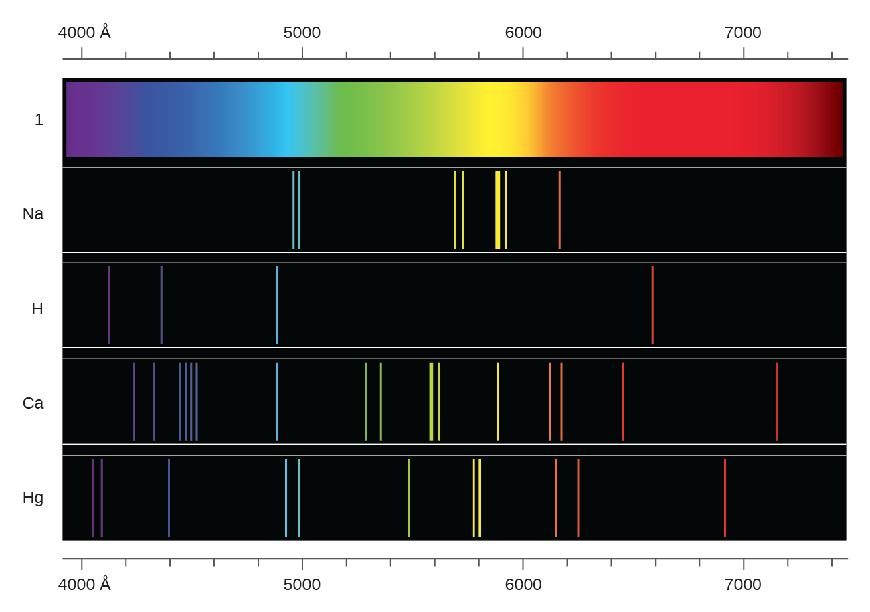
Line spectra
When matter is heated sufficiently it will radiate excess energy as light; as photons. The sun is a mixture of many elements, and sunlight is a continuous spectrum of wavelengths.
Heating, or excitation, of a single element produces line spectra at discrete and characteristic wavelengths.
quantum
•
•
•
Chemistry OpenStax

Slide 72
A closer look at hydrogen
When a ‘neon light’ tube is filled with hydrogen gas, it glows pink.
But when the color is viewed through a prism, we can see that the pink is actually a blend of four line spectra: pink, purple, blue and red.
Chemistry OpenStax; http://www.periodictable.ru/001H/slides/H1.jpg

Slide 73
Elemental spectra in the night skies
The Aurora Borealis (at 3:20)
Chemistry OpenStax; https://vimeo.com/channels/1189865/232307675

Slide 74
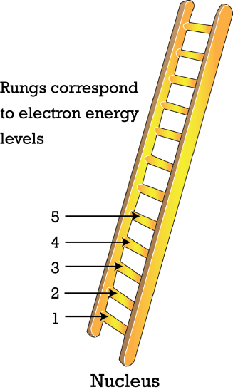
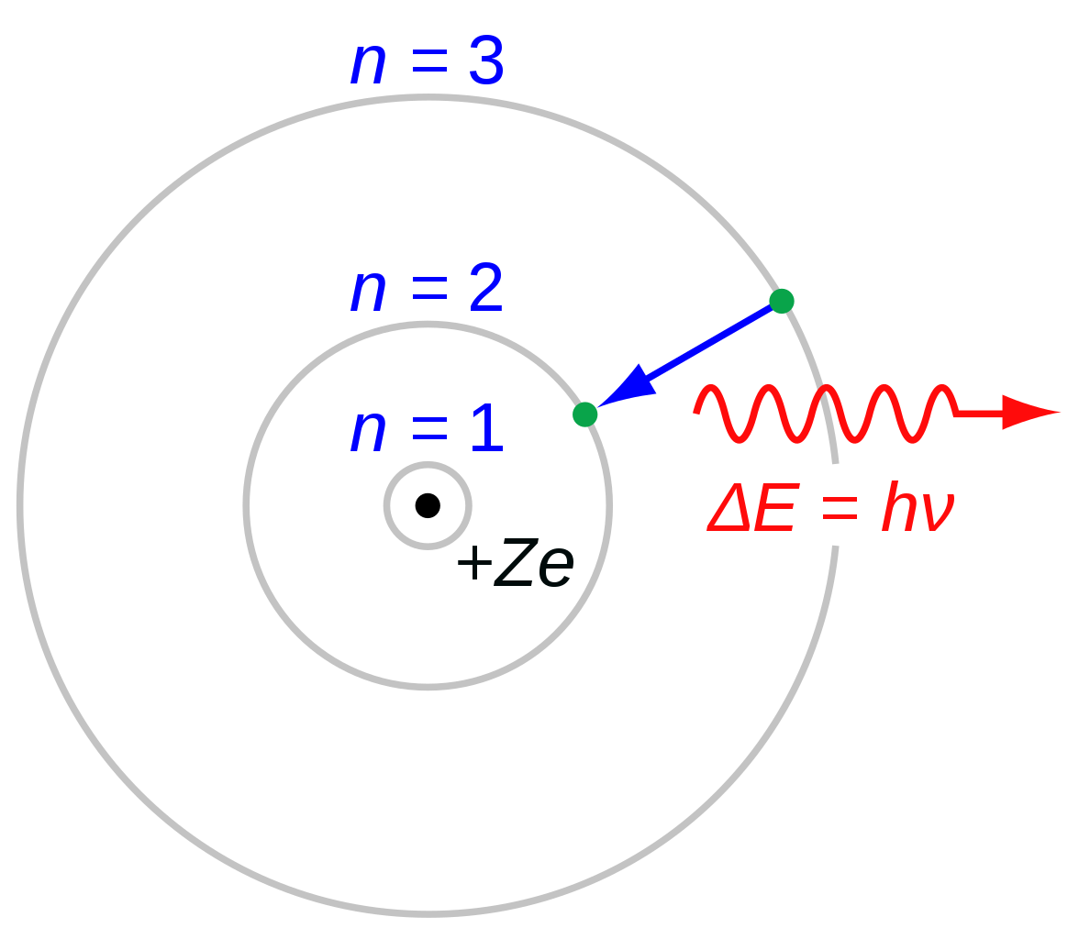
Development of the Bohr model (1)
Rutherford’s nuclear model placed electrons in an amorphous cloud around a tiny central nucleus.
But the nuclear model couldn’t explain the line spectra produced by all atoms.
Niels Bohr created a model that could!
Kept the central nucleus of p+ and n.
Added energy levels for e-.
⌀
Chemistry OpenStax; LibreText Chemistry; Wikipedia

Slide 75
Development of the Bohr model (2)
Bohr’s model is quantum: based on discrete or discontinuous levels of energy
Ladder: your foot (the electron) can only rest on the rungs and never between them.
Line spectra: lines of color represent electrons at quantum energy levels
Ramp: electrons could exist at any level of energy on the ramp
⌀
Chemistry OpenStax; LibreText Chemistry; Wikipedia

Slide 76
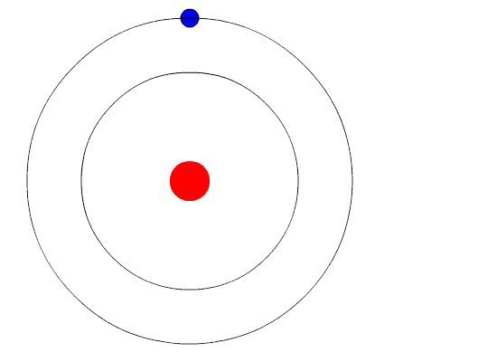
Excitation and emission of photons = line spectra
In Bohr’s model, electrons are ‘assigned’ to a ’ground’ energy level and stay there.
But, if the atom is bombarded with some form of energy, electrons can be briefly excited from the ground state to a higher quantum energy level.
After a brief period of excitation, each electron falls back to the ground state, emitting energy as a photon of light with a specific wavelength.
Those wavelengths correspond to the colors seen in an element’s line spectrum.
Chemistry OpenStax; LibreText Chemistry; Wikipedia

Slide 77
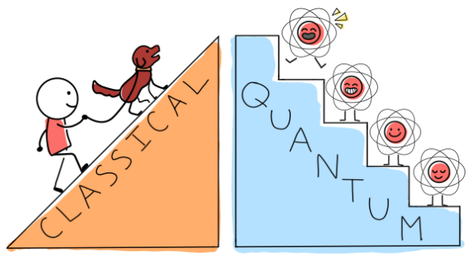
Quantum? Quantized? Quantum mechanics?
I’ll be tossing these terms around quite a bit, so what do they mean?
Quantization: limitation of some property to specific discrete values, not continuous
Quantum mechanics: field of study that includes quantization of energy, wave-particle duality, and the Heisenberg uncertainty principle to describe matter
Quantum number: number having only specific allowed values and used to characterize the arrangement of electrons in an atom
X
Chemistry OpenStax
Wikipedia; https://quantumatlas.umd.edu/entry/QuantumClassical

Slide 78
3.6: Can you?
(1) Understand that electromagnetic radiation has wavelike behavior ?
(2) Understand that waves transfer energy, not always mass?
(3) Describe how wavelength frequency and amplitude describe the structures of waves?
(4) Use simple algebra to calculate a wave characteristic given the other two?
(5) Describe how line spectra form?
(6) Describe how Bohr’s model accounts for line spectra?
(7) Understand the meaning of the term ‘quantum’?

Slide 79
3.6: Assignments
Canvas: Quick review questions quiz 3.6
Canvas: HW set 3, problems 12 - 14
Optional extras – great videos on this topic:
'Emission and absorption spectra’ (Bozeman Science) https://www.youtube.com/watch?v=1uPyq63aRvg
‘The Bohr atom’ (Bozeman Science) https://www.youtube.com/watch?v=fAVPRDnzSpE
‘The rainbow flame test’ (start at 3:30) (Royal Society of Chemistry) https://www.youtube.com/watch?v=TOyDzOc2AaI
‘Scintillation – time-lapse video of the aurora borealis’ (Night Lights Films) (at 3:20) https://vimeo.com/channels/1189865/232307675

Slide 80
Module 3: Atoms, ions, isotopes and atomic models
3.7: The quantum mechanical model of the atom
After Bohr
A quick look at quantum mechanics
Orbitals are 3D shapes where we’re likely to find specific electrons
OpenStax Chemistry 2/e p.135 - 148

Slide 81
Module 3. Atoms, ions, isotopes and atomic models
Big ideas?
Ions and isotopes are variants of atoms with different numbers of electrons or neutrons, respectively.
Quantum mechanics is a strange form of physics that explains that structure and behavior of atoms.

Slide 82
Remember Bohr?
Bohr’s model is beautiful and something most of us can understand. Unfortunately, it only worked for one element: hydrogen!
The physics of our everyday world of big objects owes a debt to Sir Issac Newton (of ‘Newton’s apple’ fame), so we call this physics ‘Newtonian mechanics’. Sadly, even Bohr couldn’t explain electrons and atoms using Newtonian mechanics.
Instead, Bohr and a number of brilliant physicists working at the dawn of the 1900s developed a new school of physics that does describe the behavior of the atom. This physics is based on the quantum concept and is called ‘quantum mechanics’.
You’ll find it weird, but everyone does, so keep calm and carry on.
"Anyone who is not shocked by quantum theory has not understood it.” - Niels Bohr
"I think I can safely say that nobody understands quantum theory" - Richard Feynman
Chemistry OpenStax

Slide 83
A quick look at quantum mechanics
Quantum mechanics: the study of the motion of objects that are atomic or subatomic in size and thus demonstrate wave-particle duality. In classical mechanics, the size and mass of the objects involved effectively obscures any quantum effects so that such objects appear to gain or lose energies in any amounts.
Particles whose motion is described by quantum mechanics gain or lose energy in the small pieces called quanta. (like Bohr’s energy levels)
Matter in the quantum world has a wave-particle duality. It’s both a wave and a particle.
In the quantum world, matter’s location and momentum can never be determined exactly, but only with uncertainty or probability.
Chemistry OpenStax

Slide 84
Orbitals: probable locations of objects in motion
Rather than Bohr’s orbits, quantum mechanics says that we can only locate electrons in orbitals: 3D shapes that are the probable location of electrons.
Analogy: Commercial airlines must maintain a distance of five miles from another plane flying at the same altitude and 2,000 feet above and below another aircraft (1,000 feet if the altitude is less than 29,000 feet). So, each aircraft only has certain positions it is allowed to maintain while it flies.
https://vimeopro.com/natsaero/ae-videos/video/182698627
Chemistry OpenStax

Slide 85
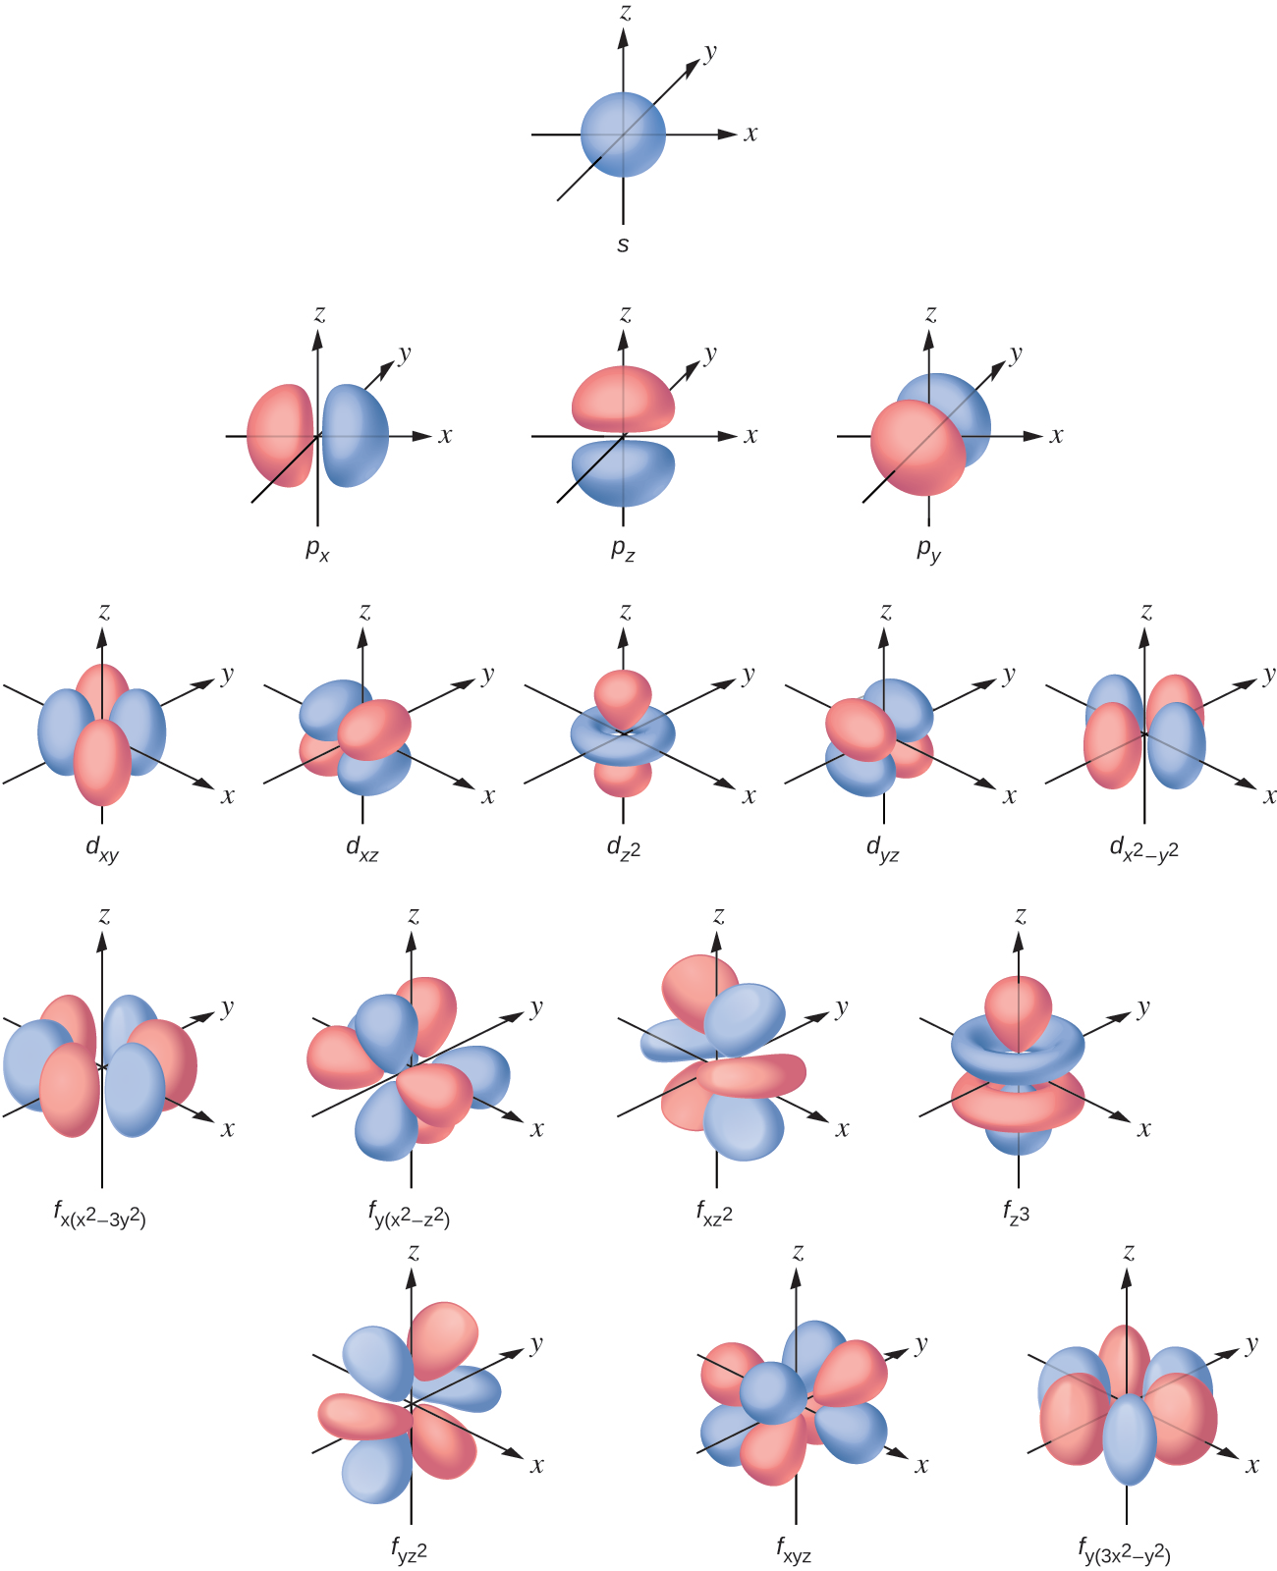
Orbital shapes, numbers and electron capacity
s subshell
One orbital
2 x 1 = 2 e-
Subshells vs. orbitals?
The p subshell contains three orbitals.
Each orbital can hold 2 electrons.
So the p subshell can hold up to 6 e-.
p subshells
2 x 3 = 6 e-
d subshells
2 x 5 = 10 e-
f subshells
2 x 7 = 14 e-
Chemistry OpenStax

Slide 86
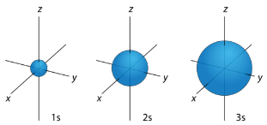
s orbitals
2 x 1 = 2 e-
As principle energy level (n) increases, the size of the orbital increases too.
1 < 2 < 3…
A sphere has only one 3D orientation (ml).
orbital | n | l | ml | ms
s | 1 – 7 | 0 | 0 | +1/2, -1/2
n = principle quantum #
(shell; energy level)
distance from the nucleus
ms= magnetic spin #
up or down
l = angular momentum #
(subshell)
shape occupied by e-
ml = magnetic quantum #
orientation in 3D space
Chemistry OpenStax

Slide 87
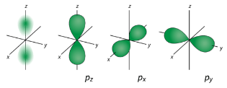
p orbitals
2 x 3 = 6 e-
orbital | n | l | ml | ms
p | 2 – 7 | 1 | -1, 0, +1 | +1/2, -1/2
There are three possible 3D orientations for p orbitals
Chemistry OpenStax; LibreText Chemistry

Slide 88
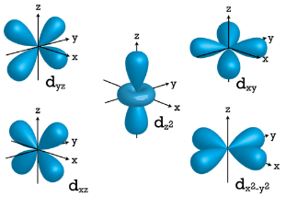
d orbitals
2 x 5 = 10 e-
orbital | n | l | ml | ms
d | 3 – 7 | 2 | -2, -1, 0, +1, +2 | +1/2, -1/2
There are five possible 3D orientations for d orbitals
Chemistry OpenStax; LibreText Chemistry

Slide 89
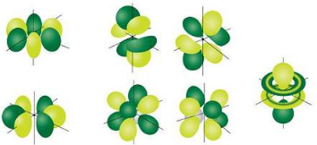
f orbitals
2 x 7 = 14 e-
orbital | n | l | ml | ms
f | 4 – 7 | 3 | -3, -2, -1, 0, +1, +2, +3 | +1/2, -1/2
There are seven possible 3D orientations for f orbitals
Chemistry OpenStax; LibreText Chemistry

Slide 90
3.7: Can you?
(1) Understand the scales at which Newtonian mechanics and quantum mechanics work?
(2) Understand that in the quantum world, tiny objects on the atomic scale lose or gain energy in quanta, exhibit wave-particle duality, and cannot be located with certainty?
(3) Understand that orbits are a probable or ‘fuzzy’ 3D location of electrons?
(4) Describe the shapes, numbers and total electron capacities of orbitals?
(5) Understand how n, l, ml, and ms numbers provide unique identifiers for each electron in an atom.

Slide 91
3.7: Assignments
Canvas: Quick review questions quiz 3.7
Canvas: HW set 3, problems 15 - 17
Optional extras – great videos on this topic:
‘NATS Airspace Explorer’ (NATS) https://vimeopro.com/natsaero/ae-videos/video/182698627
‘Atomic wave functions (animation)’ (massimodipierro) https://www.youtube.com/watch?v=IlkY-HtjrkA
‘Quantum mechanical model’ (Bozeman Science) https://www.youtube.com/watch?v=accyCUzasa0

Slide 92
Module 3: Atoms, ions, isotopes and atomic models
3.8: Electron configuration – key to reactivity
Aufbau is the filling order up energy levels from the nucleus
Electron configuration is the basis of the periodic table
Pauli’s exclusion principle and up and down spin
The Christmas tree filling diagram helps remind us of Aufbau order
Hund’s principle treats orbitals with equal energy … equally
Abbreviated electron configuration is easier
Valence electrons and the periodic table
OpenStax Chemistry 2/e p.148 - 158

Slide 93
Module 3. Atoms, ions, isotopes and atomic models
Big ideas?
Ions and isotopes are variants of atoms with different numbers of electrons or neutrons, respectively.
Quantum mechanics is a strange form of physics that explains that structure and behavior of atoms.

Slide 94
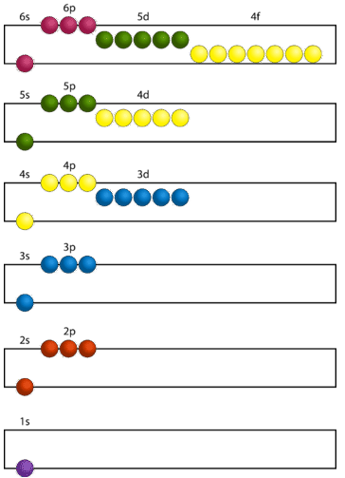
Aufbau
n | subshells | # orbitals | # e– in subshell | total e-
1 | s | 1 | 2 | 2
2 | s | 1 | 2 | 8
 | p | 3 | 6
3 | s | 1 | 2 | 18
 | p | 3 | 6
 | d | 5 | 10
4 | s | 1 | 2 | 32
 | p | 3 | 6
 | d | 5 | 10
 | f | 7 | 14
energy & distance increase
Chemistry OpenStax; LibreText Chemistry
nucleus

Slide 95
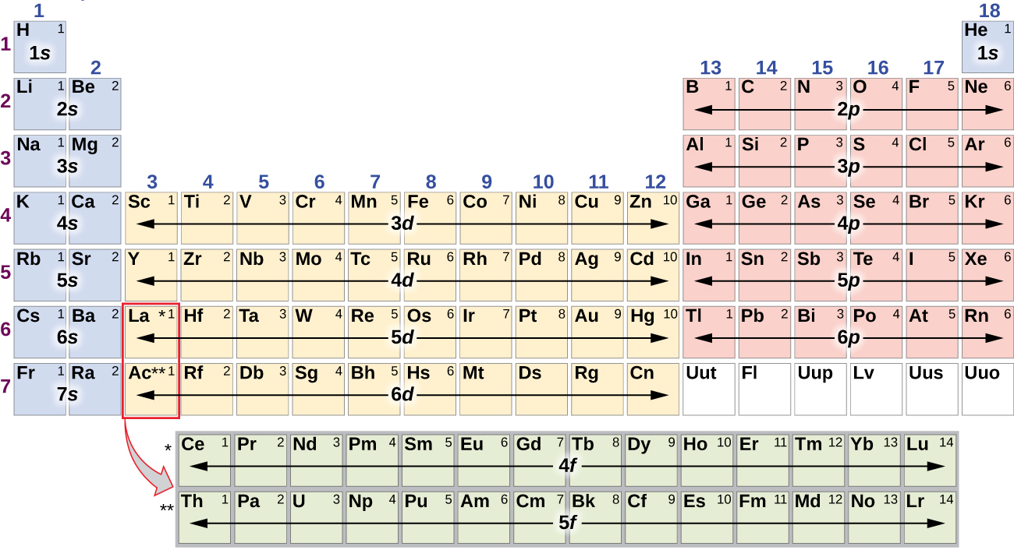
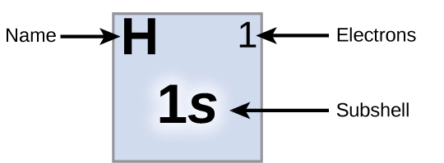
Electron configuration: foundation of the periodic table
The periodic table is organized in valance shells: each row fills a shell!
One e- is added for element from left to right.
s = 2 e-
p = 6 e-
Chemistry OpenStax

Slide 96
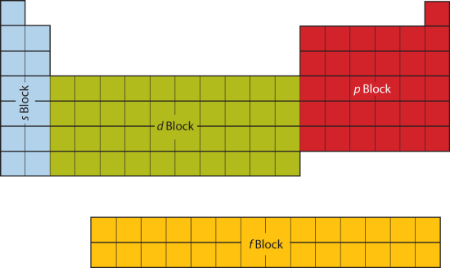
s, p, d and f blocks
These blocks identify elements by the orbital of their valence (outermost) electrons.
LibreText Chemistry

Slide 97
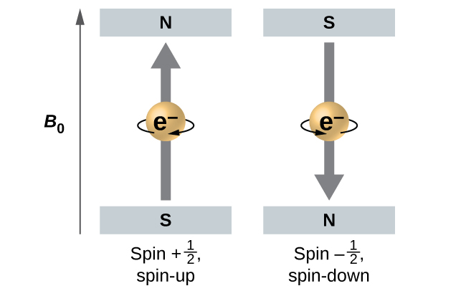
Pauli’s exclusion principle
Pauli’s exclusion principle: no two electrons in an atom can have the same value for all quantum numbers.
So, if two electrons occupy the same orbital, same orientation, in the same principle energy level, they must have opposite spin.
⌀
1
1
1
1
Chemistry OpenStax

Slide 98
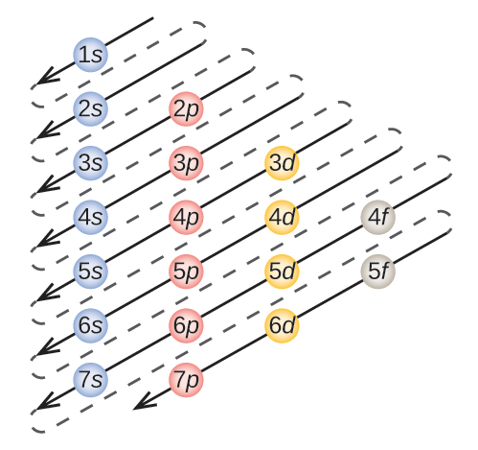
Aufbau: Build your own Christmas tree diagram
This ‘Christmas tree’ diagram shows the order of filling
Sulfur, element 16:
1s² 2s² 2p⁶ 3s² 3p⁴
Chemistry OpenStax

Slide 99
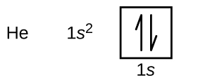
Hund’s rule
Hund’s rule: when filling orbitals with equal energies (like three p orbitals) each orbital receives 1 electron before any receive 2.
This creates the lowest energy (ground state) for every atom.
How does Pauli’s exclusion principle apply here?
The opposing spin of a pair of electron’s sharing an orbital is shown by up and down arrows.
Chemistry OpenStax

Slide 100
Abbreviated electron configuration
We can abbreviate electron configuration to save time and focus on the critical valence shell electrons.
Core electrons are represented by the previous noble gas.
Write the abbreviated electron configurations of:
Ca
O
Si
P
1s²2s²2p⁶ 3s²3p⁶4s²
(8 e-) 1s²2s²2p⁴
(14 e-) 1s²2s²2p⁶ 3s²3p²
(15 e-) 1s²2s²2p⁶ 3s²3p³
Chemistry OpenStax

Slide 101
Try these
Draw the box-arrow diagram of the electron configuration of phosphorus.
Identify the atom from its electron configuration:
[Ar]4s²3d⁶
[Kr] 5s²4d¹⁰5p⁶
Chemistry OpenStax

Slide 102
Valence electrons
Valence electrons: an atom’s outermost shell of electrons
Only valence electrons create chemical bonds and participate in reactions
Core electrons: those between the nucleus and the valence shell
valence shell = 1
valence shell = 2
Chemistry OpenStax

Slide 103
Valence electrons and the periodic table
Row (period): All elements have valence electrons in the same principle energy level (n)
Row 2 = 2nd principle energy level (n = 2)
Column (group):
All elements have the same valence electron configuration
… and similar properties
Column 1 = Xs¹
Chemistry OpenStax

Slide 104
Try this
From the position of these elements in the periodic table, predict their valence electron configurations.
Ti
Cl
Chemistry OpenStax

Slide 105
3.8: Can you?
(1) Understand that Aufbau describes the order of filling of orbitals with electrons; orbitals fill from lowest energy (at the nucleus) to highest?
(2) Explain how the periodic table is organized by electron configuration?
(3) Understand that Pauli’s principle gives each electron a unique identifier and up or down ‘spin’?
(4) Understand how Hund’s principle gives equal rights to orbitals of equal enegy?
(5) Draw and use the Christmas tree diagram for electron configuration?
(6) Use the abbreviated electron configuration notation scheme?
(7) Explain how valence electrons factor into electron configuration and the periodic table?

Slide 106
3.8: Assignments
Canvas: Quick review questions quiz 3.8
Canvas: HW set 3, problems 18 - 19
Optional extras – great videos on this topic:
'Electron configuration’ (Bozeman Science) https://www.youtube.com/watch?v=2AFPfg0Como
Practice quizzes: 'Electron configurations’ https://quizizz.com/admin/quiz/56b3fb47de1a17244b06b295/electron-configurations
Jeopardy: 'Electron configuration’ https://jeopardylabs.com/play/electron-configuration2

