Slide 1
CHE 1020: Introduction to Chemistry
Module 4: Compounds, formulas and naming
4.1: Compounds follow the Law of constant composition
4.2: Chemical formulas are shopping lists
4.3: Formula mass uses subscripts and the periodic table
4.4: Naming ionic, molecular and acid compounds
Resources on Canvas:
Periodic table
Periodic table of ions
Quick summary of Module 4
OpenStax Chemistry, Atoms First 2/e p.19 – 24; 87 – 91; 310 – 312; 205 - 213

Slide 2
Module 4: Chemical bonding, formulas and naming
4.1: Chemical compounds
Compounds differ greatly from their ‘parent’ elements
Compounds vs. elements vs. mixtures
Law of constant composition (aka law of definite proportions)
OpenStax Chemistry, Atoms First 2/e p. 19 - 24

Slide 3
4. Compounds, formulas and naming
Big ideas?
Compounds or molecules form when two or more atoms combine at a constant ratio.
Formulas tell us the ratios or exact numbers of each atom in a compound and allow us to determine a compound’s formula weight.

Slide 4
Compounds are very different from their ’parent’ atoms
When elements combine and react, they form compounds that are very different and new or novel forms of matter.
Reactions (chemical changes) change the identity of the matter involved.
Compounds make up most of the matter we find around us.
Common table salt is sodium chloride (NaCl). It’s made by reacting two very different elements to create something different from both ‘parents’.
2Na(s) + Cl2(g) → 2NaCl(s)
Sugar is sucrose (C12H22O11).
In their elemental states C is a black powder and H2 and O2 are colorless odorless gases. Sugar is much different and more appealing.
12C(s) + 11H2(g) + 11/2O2 (g) → C12H22O11(s)
Chemistry OpenStax

Slide 5
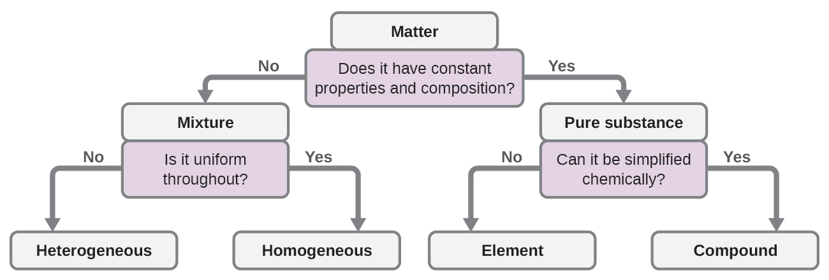
Compounds: atoms combined at a constant ratio
Compounds (~ aka molecules): bonded combinations of atoms combined at a fixed, invariant or constant ratio
This is called the ‘law of constant composition’ or ‘law of definite proportions’.
Can it be simplified physically?
Remember how to determine if matter is a compound vs. element vs. mixture?
Chemistry OpenStax

Slide 6
4.1: Can you?
(1) Understand that compounds have very different physical and chemical properties from their ’parent’ elements?
(2) State and understand the law of definite proportions (aka the law of constant composition)?
(3) Ask a series of questions (or use a number of techiques) to determine whether a substance is a mixture or pure substance and an element or a compound?

Slide 7
4.1: Assignments
Canvas: Quick review questions quiz 4.1
Canvas: HW set 4, problem 1
Optional extras – great videos on this topic:
‘Making table salt from sodium metal and chlorine gas’ (NileRed) https://www.youtube.com/watch?v=ji_25I_q4LQ
Don’t try this at home as the Cl2 gas is very toxic!

Slide 8
Module 4: Chemical bonding, formulas and naming
4.2: Chemical formulas are shopping lists
How to read a formula: subscripts and parentheses
Molecular vs. empirical formulas
Atomic vs. molecular elements
Ionic vs. molecular compounds
Writing formulas for ionic compounds
Ionic compounds with polyatomic ions
OpenStax Chemistry, Atoms First 2/e p.87 - 91

Slide 9
4. Compounds, formulas and naming
Big ideas?
Compounds or molecules form when two or more atoms combine at a constant ratio.
Formulas tell us the ratios or exact numbers of each atom in a compound and allow us to determine a compound’s formula weight.

Slide 10
Formulas show us unique constant ratios of atoms
Chemical formula: an expression showing us the elements in a compound and their relative proportions or fixed ratios
2 (PO4) ⁻³ ions
phosphate ions
calcium phosphate: Ca3(PO4)2
polyatomic ions
3 Ca atoms
(actually 3 Ca⁺² ions)
2 x 4 = 8 O atoms
monoatomic ions
2 x 1 = 2 P atoms
subscripts: tell us how many of each atom there are in the compound
parentheses: group together atoms that bond to form a polyatomic ion – an ion made of many (poly) atoms
Subscripts following parentheses multiply back through the parentheses but no further
Subscript effect stops at the opening parenthesis (
Chemistry OpenStax

Slide 11
Molecular vs. empirical formulas (exact vs. simplified)
Molecular formula: the exact types and numbers of atoms in a molecule
A shopping list for the atom big box store that gives you all the parts you need.
Subscripts give the number of each atom in the molecule.
No subscript is an unwritten subscript of 1: there’s a single atom.
glucose: C6H12O6
Empirical formulas: simplified versions of molecular formulas
You wouldn’t know how many atoms to buy, but you’d get the right ratio.
The simplest whole-number ratio of atoms in a molecule.
All subscripts are divided by a common factor.
glucose: CH2O
Note that empirical formulas are not unique and apply to many compounds.
Chemistry OpenStax

Slide 12
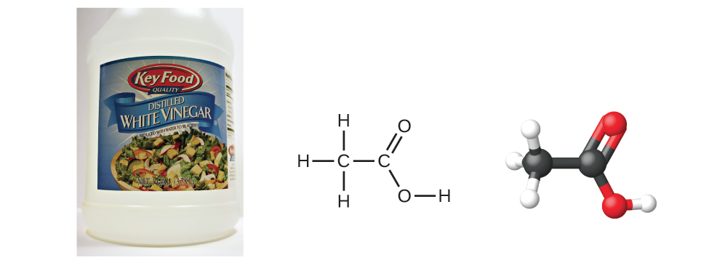
Try this
Write the molecular and empirical formulas of these compounds.
Benzene:
Acetic acid:
Chemistry OpenStax

Slide 13
Atomic vs. molecular elements?
Most elements are shown as single atoms. No subscript? Assume there is 1 atom.
Fe = 1 iron atom
However, some elements exist in a ‘molecular’ form of two or more atoms bonded together.
Why? These atoms are strongly attracted to one another and more stable (in a lower energy state) when together.
Molecules: the smallest part of a substance that has the physical and chemical properties of that substance
aka diatomic molecules
7 diatomic gases: H2, N2, O2, F2, Cl2, I2, Br2
What are the formulas for S and P?
S
P
Chemistry OpenStax; LibreText Chemisty

Slide 14
Ionic vs. molecular compounds
Ionic compounds: combinations of metals and non-metals held together by ionic bonds
Remember how to find metals and nonmetals on the periodic table?
Formulas are empirical (aka formula unit)
magnesium chloride: MgCl2
Molecular compounds: combinations of non-metals held together by covalent bonds
Formulas are either molecular or empirical.
Smallest unit is called a molecule.
glucose: C6H12O6
(CH2O)
Chemistry OpenStax; LibreText Chemisty

Slide 15
Try this
Classify each example as an atomic element, molecular element, molecular compound, or ionic compound.
(a) Ag
(b) PCl3
(c) LiBr
(d) S₈
(e) oxygen gas
Chemistry OpenStax; LibreText Chemisty

Slide 16
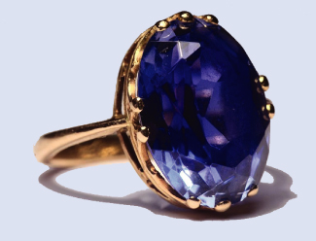
Writing formulas of ionic compounds
When atoms ionize to form ionic compounds, metals (cations) and nonmetals (anions) combine at ratios that create a neutral, uncharged compound.
Formulas of ionic compounds are always ‘empirical’ (simplest ratio).
Sapphires are formed from the ionic compound aluminum oxide. What’s its formula?
Chemistry OpenStax

Slide 17
Try these
What’s the formula of an ionic compound formed from sodium and sulfur?
What’s the formula of the ionic compound formed from calcium and the polyatomic ion dihydrogen phosphate?
Chemistry OpenStax

Slide 18
Criss-cross method
For most ionic compounds:
the charge of the cation becomes the subscript of the anion; and
the charge of the anion becomes the subscript of the cation.
Let’s try lead (IV) oxide. The (IV) tells us that lead, a transition metal whose charge varies, has a charge of +4 here.
Chemistry OpenStax; LibreText Chemistry

Slide 19
Try these
Write the formulas of these ionic compounds.
(a) the calcium ion and the oxygen ion
(b) the 2+ copper ion and the sulfur ion
(c) the 1+ copper ion and the sulfur ion
Write the formula for each ionic compound.
(a) sodium bromide
(b) lithium chloride
(c) magnesium oxide
Chemistry OpenStax; LibreText Chemistry

Slide 20
Polyatomic ions?
Polyatomic ions: ions created by bonding 2 or more atoms
Polyatomic anions combine a nonmetal with one or more O atoms.
Polyatomic charges apply to the entire bonded unit.
(NH4)⁺¹
(NO2)⁻¹
(NO3)⁻¹
ammonium ion
nitrite ion
nitrate ion
Chemistry OpenStax; LibreText Chemistry

Slide 21
You’ll need the periodic table of ions
Chemistry OpenStax

Slide 22
Formulas for ionic compounds with polyatomic ions
Follow the same steps but keep the polyatomic in parentheses.
Ca⁺²
(NO3)⁻¹
→ Ca(NO3)2
1
2
Try writing these formulas. You’ll need the periodic table of ions.
magnesium and carbonate
aluminum and acetate
Chemistry OpenStax; LibreText Chemistry

Slide 23
A compound is ionic if the first element is a metal
To know whether a compound is ionic, identify the nature of the first element.
Ca(NO3)2
PCl3
H(NO3)
Ca is a metal or cation:
ionic
P is a nonmetal:
molecular
H is H:
acid
Identify each compound as ionic or not ionic.
(a) Na2O
(b) PCl3
(c) (NH4)Cl
(d) OF2
Chemistry OpenStax; LibreText Chemistry

Slide 24
4.2: Can you?
(1) Understand how subscripts and parentheses are used to indicate the number of atoms in a molecule?
(2) The difference between molecular and empirical formulas and their relationship?
(3) Explain the difference between atomic and molecular elements?
(4) Explain the difference between ionic and molecular compounds?
(5) Explain the steps for writing ionic compounds?

Slide 25
4.2: Assignments
Canvas: Quick review questions quiz 4.2
Canvas: HW set 4, problems 2 - 9
Optional extras – great videos on this topic:
'Writing Empirical Formulas Practice Problems’ (Tyler DeWitt)
https://www.youtube.com/watch?v=ucU5PD6W3Ik&list=PL3hPm0ZdYhyyWLwHs-N8En7iTuJ9jZQqr&index=2
'Calculating Molecular from Empirical Formula' (Tyler DeWitt) https://www.youtube.com/watch?v=J_MtVs0aBdU&list=PL3hPm0ZdYhyyWLwHs-N8En7iTuJ9jZQqr&index=3

Slide 26
Module 4: Chemical bonding, formulas and naming
4.3: Formula mass uses subscripts and the periodic table
How formula subscripts and parentheses multiply numbers of atoms
Calculating formula or molecular weights
Molecular vs. empirical formulas
Hydrates: ionic compounds with a constant ratio of waters
OpenStax Chemistry, Atoms First 2/e p.310 - 312

Slide 27
4. Compounds, formulas and naming
Big ideas?
Compounds or molecules form when two or more atoms combine at a constant ratio.
Formulas tell us the ratios or exact numbers of each atom in a compound and allow us to determine a compound’s formula weight.

Slide 28
Formula mass of compounds(aka molecular weight)
Formula mass (aka MW): the sum of all the atomic masses in a molecule or compound
Chloroform, CHCl3, was used as a surgical anesthetic and is now used as a building block for creating teflon, tetrafluoroethylene.
NaCl is common table salt.
Chemistry OpenStax

Slide 29
Try calculating MW of these molecular compounds
Calculate the formula masses (aka molecular weights) of these compounds.
Aspirin, C9H8O4 (acetylsalicylic acid)
Ibuprofen, C13H18O2
Chemistry OpenStax

Slide 30
Try calculating MW of these ionic compounds
Calculate the formula masses (aka molecular weights) of these compounds.
Aluminum sulfate, Al2(SO4)3, used to purify water and make paper
Calcium phosphate, Ca3(PO4)2, used to inject DNA into cells
Chemistry OpenStax

Slide 31
Hydrates: ionic compounds with associated water
While all ionic compounds (aka salts) can absorb water (look at your salt-shaker on a really humid day) some salts absorb and hold water at a fixed ratio
Hydrated salts: ionic compounds that hold fixed ratios of water
While they contain water molecules, hydrated salts are solids.
Cu(SO4).5H2O
copper (II) sulfate pentahydrate
1 copper (II) sulfate salt
5 X water
Ionic-dipole bonding between salt and water
formula | name | use
AlCl3.6H2O | aluminum chloride hexahydrate | antiperspirant
Ca(SO4).1/2H2O | calcium sulfate hemihydrate | plaster of Paris (casts)
Ca(SO4).2H2O | calcium sulfate dihydrate | gypsum wallboard
Mg(SO4).7H2O | magnesium sulfate heptahydrate | laxative; bath salt
Na2(SO4)·10H2O | sodium sulfate decahydrate | heat storage material
Chemistry OpenStax

Slide 32
4.3: Assignments
Canvas: Quick review questions quiz 4.3
Canvas: HW set 4, problems 10 - 11
Optional extras – great videos on this topic:
‘How to calculate molar mass: practice problems’ (Tyler DeWitt) https://www.youtube.com/watch?v=Qflq48Foh2w

Slide 33
4. Compounds, formulas and naming
4.4: Naming ionic compounds
Three naming systems: choose the right one!
Ionic compound (note that most bases are ionic)
Molecular compounds
Acid compounds
OpenStax Chemistry, Atoms First 2/e p.205 - 213

Slide 34
4. Compounds, formulas and naming
Big ideas?
Compounds or molecules form when two or more atoms combine at a constant ratio.
Formulas tell us the ratios or exact numbers of each atom in a compound and allow us to determine a compound’s formula weight.

Slide 35
The first element determines the naming system
We only have to look at the first element in a formula to know which of the three naming systems must be used.
AxBy
metal
nonmetal
hydrogen
Rather then memorizing the details of these three naming systems, or becoming bogged down in perfecting your naming skills, I’ll use a series of exercises to help you understand naming rules and use them – with references – when you need to.
ionic
molecular
acid
ionic
exercise
molecular
exercise
acid
exercise
Chemistry OpenStax

Slide 36
Are these examples ionic, acid or molecular?
Fe(OH)2
H(BrO3)
XeO3
Fe2(CO3)3
Cu(NO3)2
SO3
H3(PO4)
CO2
Cd(ClO4)2
SF6
N2O4
Ca(HCO3)
HBr
Sn(II)F2
IF5
P4S6
HClO3
HF
(NH4)2(SO4)
HCN

Slide 37
Naming cations
Cations are positively charged ions - most often metals.
With one exception, cations are monoatomic.
Cations are named for the element they are derived from.
Transition metals (the Midwest) must include charge as (Roman numerals).
Na⁺¹ NH₄⁺¹
Mg⁺²
Fe⁺²
Al⁺³
Cu⁺¹
Sr⁺²
Mn⁺²
Cs⁺¹
Ca⁺²
Sn⁺²
Cr⁺³

Slide 38
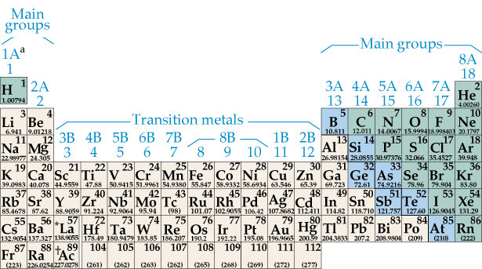
Predicting ionic charge
Use group numbers to predict ionic charge as shown below. Transition metals have varying charges and cannot be predicted this way.
+1
+2
+3
-3
-2
-1

Slide 39
Naming monoatomic anions
Anions are negatively charged ions formed from non-metals.
Anions can be either mono- or polyatomic.
Monoatomic anions consist of a single element (can have multiple copies).
Anions get the root name of their element + -ide suffix.
_________-ide
F⁻¹
P⁻³
O⁻²
Cl⁻¹
N⁻³
I⁻¹
Br⁻¹
S⁻²

Slide 40
Naming polyatomic anions
Polyatomic anions are combinations of a more than one non-metal atom.
Generally, a non-metal & one or more oxygen atom(s).
Naming? Root name of the non-oxygen atom with a suffix:
hypo ____-ite
-ite
-ate
per ______-ate
NO2⁻¹
NO3⁻¹
ClO1⁻¹
ClO2⁻¹
ClO3⁻¹
ClO4⁻¹
HCO3
SO3⁻²
SO4⁻²

Slide 41
Remember the periodic table of ions?
Chemistry OpenStax

Slide 42
Families of polyatomic anions
NH4⁺
Cr ?
CrO4⁻²
Cr2O7⁻²
chromium (x)
ammonium
chromate
dichromate
AsO4⁻³
arsenate
MnO4⁻¹
permanganate
C2H3O2⁻¹
CN⁻¹
SCN⁻¹
CO3⁻²
HCO3⁻¹
acetate
cyanide
thiocyanate
carbonate
hydrogen carbonate
NO2⁻¹
NO3⁻¹
nitrite
nitrate
S⁻²
SO3⁻²
SO4⁻²
H(SO3)⁻¹
SCN⁻¹
sulfide
sulfite
sulfate
hydrogen sulfite
thiocyanate
O2⁻²
OH⁻¹
peroxide
hydroxide
chloride
hypochlorite
chlorite
chlorate
perchlorate
PO4⁻³
H(PO4)-²
H2(PO4)⁻¹
phosphate
hydrogen phosphate
dihydrogen phosphate
Cl⁻¹
ClO⁻¹
ClO2⁻¹
ClO3⁻¹
ClO4⁻¹

Slide 43
Formulas of ionic compounds
All molecules (ionic, molecular, or acid) have a net charge of zero.
So total positive and negative charges must be equal - must cancel out.
How do you ensure a net zero charge?
Check charges…
…and then add subscripts where needed.
CatxAny
Mg Cl Sr (SO4)
Na O Cr (ClO3)
Na F Li (PO4)
Ba Br Ca (NO3)
Fe S Cs (BrO3)
Ni N Fe (CO3)

Slide 44
Practice naming ionic compounds
Naming ionic compounds is fairly straightforward.
Add subscripts for a net-zero charge.
Name the cation first, and the anion second
NEVER include the subscript numbers in the name.
MgCl2 Sr(SO4)
Na2O Cr(ClO3)3
NaF Li3(PO4)
BaBr2 Ca(NO3)
FeS Cs(BrO3)
NiN Fe(CO3)

Slide 45
Molecular names use prefixes
Remember that a molecular compound is two nonmetals.
Elements are named from left to right (as found in the peroidic table):
Molecular compounds use Greek prefixes to ‘name’ subscript numbers.
mono 1
di 2
tri 3
tetra 4
penta 5
hexa 6
hepta 7
octa 8
nona 9
deca 10
Both elements get prefixes EXCEPT when there is only a single atom of the first element.

Slide 46
Naming molecular compounds
Elements are named from left to right (as found in the peroidic table):
Left-hand element gets the element name.
Right-hand element is named for its root + -ide suffix.
Molecular compounds use Greek prefixes to ‘include’ subscript numbers.
(Net charge of molecular compounds is still zero.)
C2O2
CO2
CO
P4S10 SO2
Cl2O PCl5
N2O4 S2Cl2
NF3 SiBr4
NOTE: It’s difficult to predict the formula of molecular compounds.

Slide 47
Naming acids (like ionics, charge is critical)
Remember that acids are compounds that can donate protons (H⁺).
Acid formulas always begin with H: HCl, HBr, H₂SO₄
Since all acids have protons, names are based on the anion name.
MONOatomic acids: hydro root -ic acid
HCl
HBr
H2S
HF
POLYatomic acids: change the suffix & add the word acid (no hydro-)
-ate --> -ic acid
-ite --> -ous acid
H2(SO3) H(ClO)
H2(SO4) H(ClO2)
H(ClO3)
H(ClO4)

Slide 48
Three examples for each naming system
We only have to look at the first element in a formula to know which of the three naming systems must be used.
ionic molecular acid
Na2O NO2 H2S
Fe(SO4) N2O H2(SO3)
Fe3(PO4)2 P4S7 H2(SO4)

Slide 49
4.4: Can you? (after the “Exploring naming” exercises)
Use the first element of a compound to determine which naming system to use?
Understand the that suffixes of ionic anions depend on whether those anions are mono- or polyatomic?
Use subscripts to give ionic compounds a net charge of zero?
Include the charge of transition metals in the names of ionic compounds?
Explain how prefixes are added to the names of molecular compounds to indicate the number of each element in the compound?
(6) Understand why (and how) acids are named depending on the nature of their anion?

Slide 50
4.4: Assignments
Canvas: Quick review questions quiz 4.4
Canvas: Chemical naming activities started in lab
Optional extras – great videos on this topic:
'Naming Compounds - Part 1’ (Bozeman Science) https://www.youtube.com/watch?v=CVkqbHK7VhQ
'Naming Compounds - Part 2' (Bozeman Science) https://www.youtube.com/watch?v=CVkqbHK7VhQ

