Slide 1
CHE 1020: Introduction to Chemistry
Module 5: Molecular bonding, polarity, structure and geometry
5.1: Lewis dots represent valence electrons
5.2: Ionic compounds form when electrons are transferred
5.3: Covalent bonds form when electrons are shared
5.4: Lewis structures show covalent electron sharing
5.5: VSEPR: understanding and predicting molecular geometry
5.6: Bond polarities and molecular dipoles affect properties
5.7: A brief introduction to small organic molecules
Resources on Canvas:
Periodic tables
Table of electronegativities
Guide to drawing Lewis structures
Quick summary of Module 5
OpenStax Chemistry, Atoms First 2/e p.196 – 197; 213-214; 199-206; 214-227; 227-238; 239-242; 1137-

Slide 2
Module 5: Bonding, polarity, structure and geometry
5.1: Lewis dots represent valence electrons
Symbol with one dot per valence electron
Lewis symbols for atoms vs ions
OpenStax Chemistry, Atoms First 2/e p. 196 - 197

Slide 3
Module 5: Bonding, polarity, structure and geometry
Big ideas?
Lewis structures and VSEPR describe the shapes of molecular, covalently bonded molecules.
Molecular geometry and polarity affect the physical and chemical properties of molecules.

Slide 4
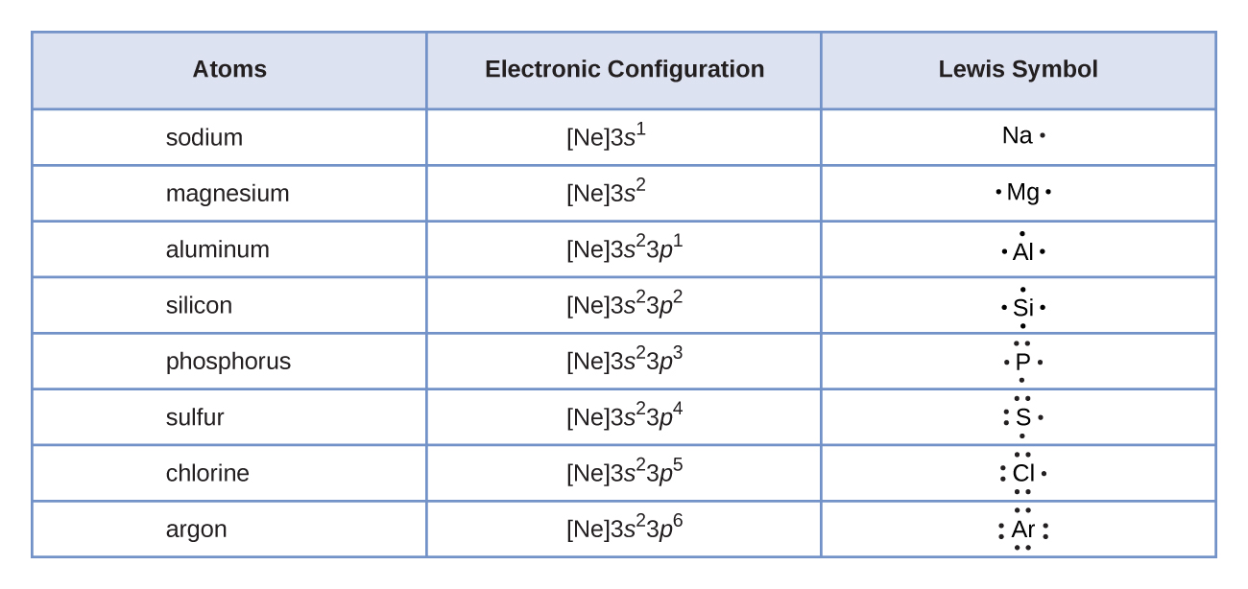
Lewis symbols
Lewis symbols show the number of valence electrons in an atom using a dot for each valence electron.
Example: calcium is in column 2A, so has 2 valence electrons or dots:
.Ca.
Chemistry OpenStax

Slide 5
Lewis symbols in atoms vs. ions
Lewis symbols show that:
metals empty their valence shell when they become cations;
while nonmetals fill their shells to become anions.
Na. Na⁺¹ + e-
Cations go to zero dots.
.Ca. Ca⁺² + 2e-
..
..
:Cl. + e- :Cl:⁻¹
Anions go to eight dots.
..
..
..
..
.S. + 2e- :S:⁻²
..
..
Chemistry OpenStax

Slide 6
Lewis symbols in atoms vs. ions
Na.
Na⁺¹
..
Na⁺¹
⁻¹
:Cl:
..
..
..
:Cl.
:Cl:⁻¹
..
..
Chemistry OpenStax; LibreText Chemistry

Slide 7
5.1: Can you?
Describe how Lewis symbols offer a simple representation of valence electrons?
(2) Explain how ionic compounds are formed by a transfer of electrons and show this process using Lewis dots?

Slide 8
5.1: Assignments
Canvas: Quick review questions quiz 5.1
Canvas: HW set 5, problem 1

Slide 9
Module 5: Bonding, polarity, structure and geometry
5.2: Ionic compounds form when electrons are transferred
Compounds differ greatly from their ‘parent’ elements
Ionic compounds require simultaneous transfer of electrons
Electrostatic attraction between cations and anions forms ionic compounds
Ionic compounds form a crystal lattice whose size varies with repeated empirical formula units
OpenStax Chemistry, Atoms First 2/e p. 213 - 214

Slide 10
Module 5: Bonding, polarity, structure and geometry
Big ideas?
Lewis structures and VSEPR describe the shapes of molecular, covalently bonded molecules.
Molecular geometry and polarity affect the physical and chemical properties of molecules.

Slide 11
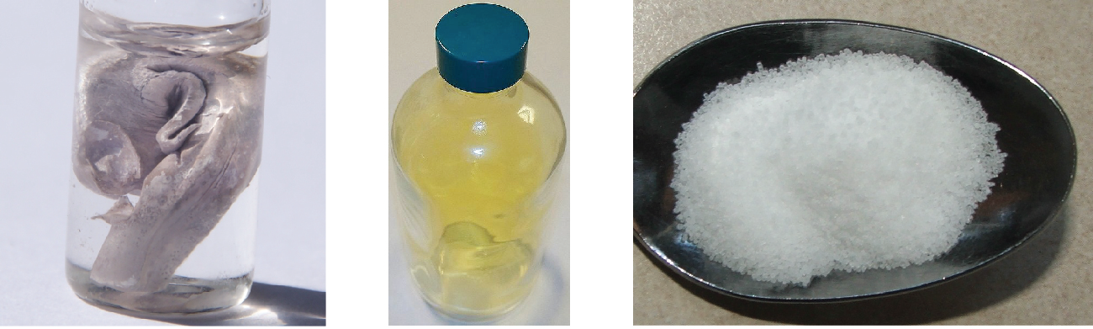
Reminder about ionic compounds
Ionic compounds (aka salts): compounds formed by cations and anions held together by ionic bonds
Ionic bonds: electrostatic forces of attraction between oppositely charged ions
Crystalline structure; rigid and brittle; high melting and boiling points
Dissociate in water and conduct electricity
violent reaction with water
essential for life
toxic!
sodium (Na)
chlorine (Cl₂)
sodium chloride (NaCl)
Chemistry OpenStax

Slide 12
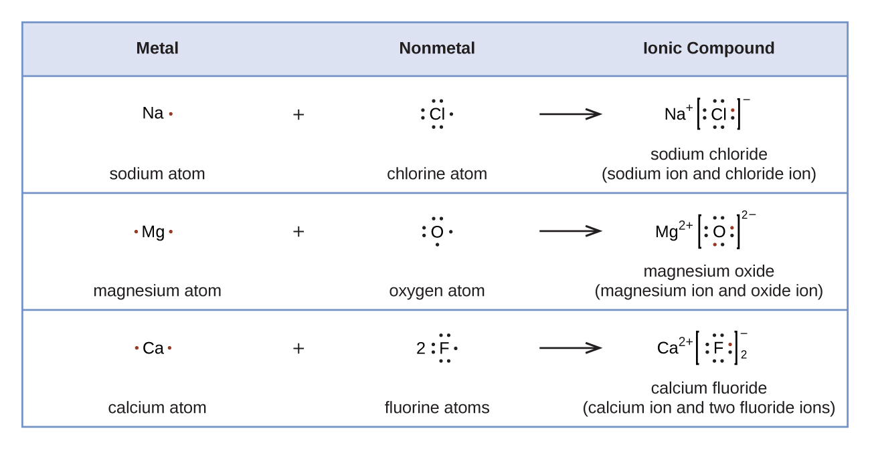
Lewis symbols formation of salts
Lewis symbols show that salts from by spontaneous transfer 0f electrons.
Chemistry OpenStax

Slide 13
Try this
Use Lewis symbols and arrows to diagram out the formation of aluminum fluoride from aluminum and chlorine atoms.
Chemistry OpenStax

Slide 14
Net zero charge
Ionic compounds must have overall, or net, zero charges.
Combine aluminum and oxygen to create an ionic compound.
Remember that the formulas of ionic compounds are always empirical formulas.
In reality, the number of ions in a crystal of ionic compound varies, but the ratio of cations to anions is constant and defined by the salt’s formula.
Chemistry OpenStax

Slide 15
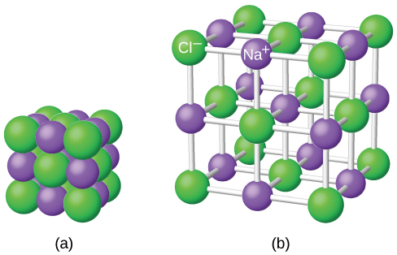
Crystal lattice
Ionic compounds form crystals (aka crystal lattice), as structure in which cations and anions alternate and surround each other.
Ions are held together by electrostatic force (opposite charge, +/- ).
Size of crystals varies with conditions under which the crystal is ‘grown’.
Chemistry OpenStax

Slide 16
5.2: Can you?
Use Lewis symbols to show the transfer of electrons that forms ions and ionic compounds?
(2) Show transfer of electrons produces a net neutral ionic compound?
(3) Understand that a crystal lattice is a multiple of a salt’s empirical formula?
Chemistry OpenStax

Slide 17
5.2: Assignments
Canvas: Quick review questions quiz 5.2
Canvas: HW set 5, problems 2 - 3
Optional extras – great videos on this topic:
‘Making table salt from sodium metal and chlorine gas’ (NileRed) https://www.youtube.com/watch?v=ji_25I_q4LQ
Don’t try this at home as the Cl2 gas is very toxic!

Slide 18
Module 5: Bonding, polarity, structure and geometry
5.3: Covalent compounds form when electrons are shared
Covalent bonds are a shared pair of electrons, one from each atom
Covalent bonds form at a bond distance that overcomes repulsive forces and maximizes attractive forces
Covalent bonds lower atomic energy levels
Electronegativity differences determine bond polarity
Polarity trends: nonpolar covalent < polar covalent < ionic bonds
OpenStax Chemistry, Atoms First 2/e p. 199 - 206

Slide 19
Module 5: Bonding, polarity, structure and geometry
Big ideas?
Lewis structures and VSEPR describe the shapes of molecular, covalently bonded molecules.
Molecular geometry and polarity affect the physical and chemical properties of molecules.

Slide 20
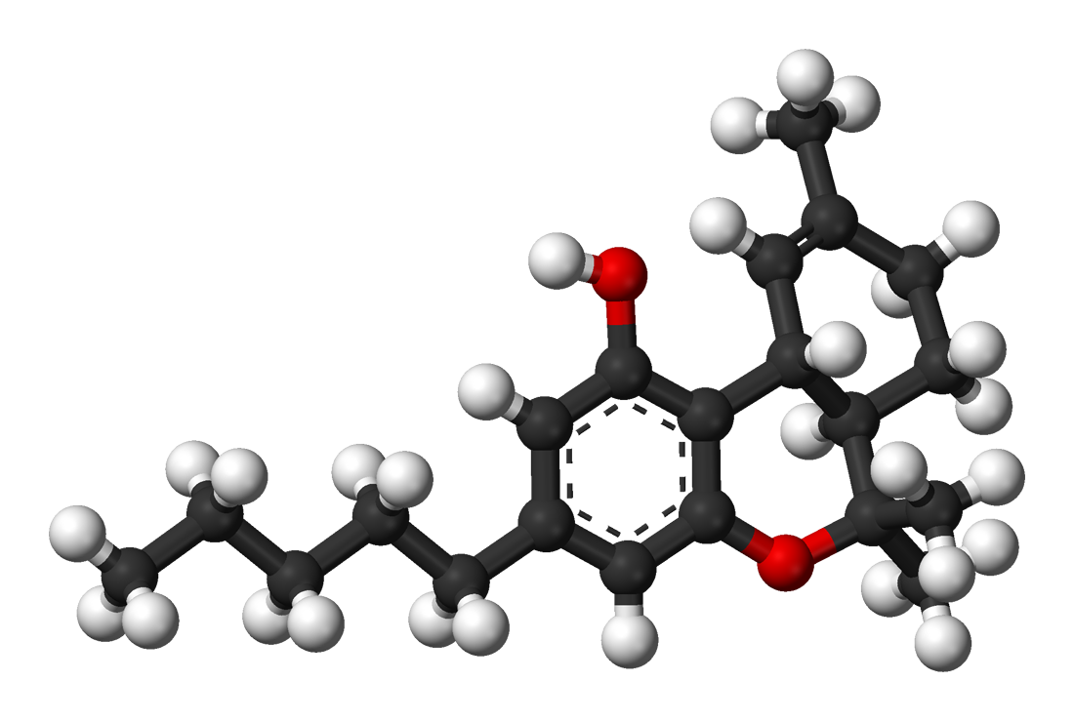
Molecular compounds
Molecular compounds: form when non-metals share electrons, creating covalent bonds
Properties?
Often gases, liquids with low boiling points or solids with low melting points
oxygen
hydrogen
carbon
THC: tetrahydrocannabinol
Chemistry OpenStax; wikicommons

Slide 21
What’s a covalent bond?
Covalent bond: a pair of electrons shared between two atoms.
Each atom contributes one electron.
Non-metals bond covalently.
Covalent bonding gives each atom access to a full valence shell.
Physical properties:
Lower melting and boiling points.
Often gases, liquids or ‘softer’ solids.
Generally insoluble in water.
Poor conductors of heat and electricity.
OpenStax Chemistry

Slide 22
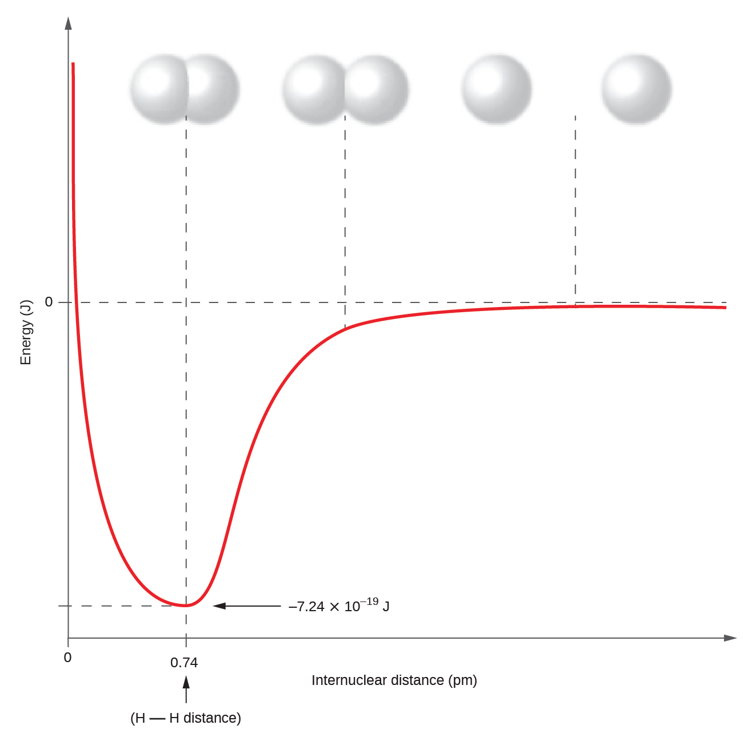
Formation of covalent bonds
max attraction
min repulsion
As 2 atoms approach:
No attraction
(2) ve- shells repel one another
(3) ve- of atom 1 is attracted to nucleus of atom 2 and vv
(4) Nuclei too close and repel the atoms back to bond distance
no attraction
ve- repulsion
energy minima “well”
bond length
OpenStax Chemistry

Slide 23
Covalent bonds lower energy states
When atoms bond covalently (and achieve full valence shells) their energy state decreases and becomes more stable.
Why? Because bonding allows them to fill their valence shells
H2(g) 2H(g) ΔH = 436 kJ
An input of energy is required to break the covalent bond between the two atoms of hydrogen gas (H2) and create two hydrogen atoms as shown by the + ΔH value.
2H(g) H2(g) ΔH = - 436 kJ
And energy is released when a covalent bond forms between the two hydrogen atoms to form hydrogen gas (H2) as shown by the - ΔH value.
OpenStax Chemistry

Slide 24
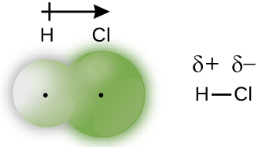
Covalent bonds can be polar or non-polar
Covalent bonds are polar or non-polar depending on how evenly the two electrons are shared between bonded atoms.
Nonpolar covalent: electrons of the bond are shared equally
Polar covalent: electrons of the bond are not shared equally
polarity arrow
dipolar +
dipolar -
Green ‘bubble’ shows distribution of electrons around each atom.
dipolar (δ) = partial charge
EN: 2.1 2.6
OpenStax Chemistry

Slide 25
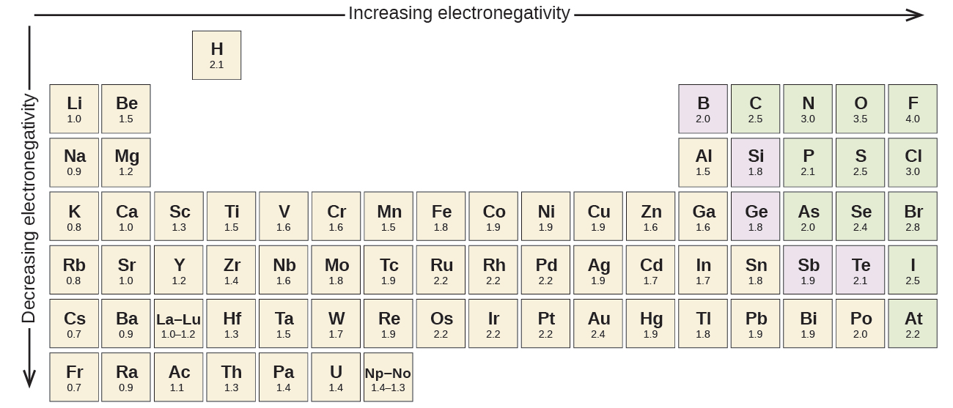
Electronegativity
Electronegativity: a measure of the ability of an atom to keep its own electrons and to attract other electrons towards it
In covalent bonds, electrons are attracted to the more electronegative atom.
Difference in electronegativity determines bond polarity.
more protons in the nucleus
electrons further from nucleus
Chemistry OpenStax

Slide 26
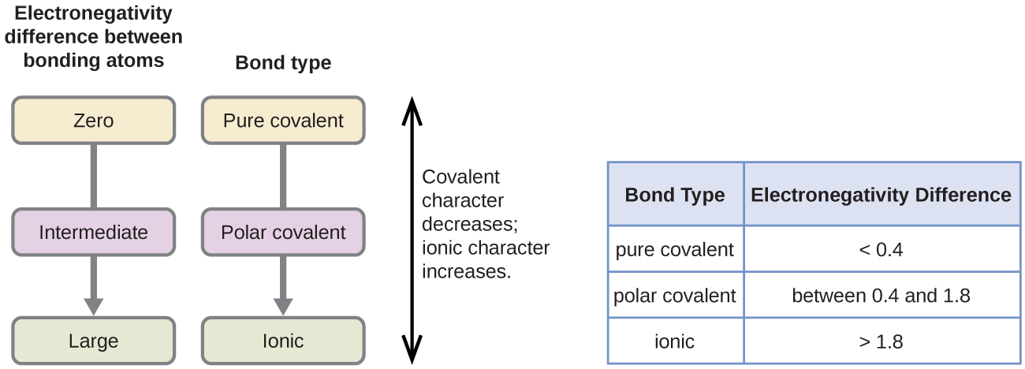
Difference in electronegativity determines bond type
To determine whether bonds are ionic, polar covalent or nonpolar covalent we calculate the difference in electronegativity values of two bonded atoms.
Δen = |en1 – en2|
Chemistry OpenStax

Slide 27
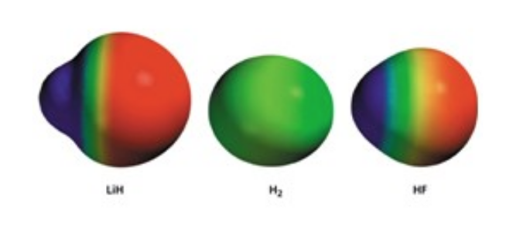
Visualizing polarity and electron distribution
Covalent bonds are polar or non-polar depending on how evenly the two electrons are shared between bonded atoms.
Nonpolar covalent: electrons of the bond are shared equally
Polar covalent: electrons of the bond are not shared equally
LiH, polar H2, nonpolar HF, polar
|0.98 – 2.20| |2.20 – 2.20| |2.20 – 3.98|
= 1.22 = 0 = 1.78
Chemistry OpenStax

Slide 28
Try this
Determine the types of bonds between these atoms and label their polarities.
C – H
S – H
C – N
N – H
C – O
O - H
Chemistry OpenStax

Slide 29
5.3: Can you?
Define the term ‘covalent bond’?
(2) Describe how the properties of covalent compounds differ from those of ionic compounds?
(3) Explain how repulsive and attractive forces, and overall energies, change as atoms approach one another and form covalent bond?
(4) Explain how polar and nonpolar covalent bonds differ and the role of electronegativity in determining bond type.

Slide 30
5.3: Assignments
Canvas: Quick review questions quiz 5.3
Homework set 5, problem 4
Optional extras – great videos on this topic:
‘Covalent bonding tutorial’ (PBS ChemThink) https://pbslm-contrib.s3.amazonaws.com/WGBH/arct15/SimBucket/Simulations/chemthink-covalentbonding/content/index.html
‘Covalent bonding’ (Bozeman Science) https://www.youtube.com/watch?v=Mo4Vfqt5v2A
‘Electronegativity and bonding’ (Khan Academy) https://www.khanacademy.org/science/biology/chemistry--of-life/chemical-bonds-and-reactions/v/electronegativity-and-chemical-bonds
‘Chemical bonds: covalent vs. ionic’ (Bozeman Science) https://www.youtube.com/watch?v=7DjsD7Hcd9U

Slide 31
Module 5: Bonding, polarity, structure and geometry
5.4: Lewis structures show covalent electron sharing
Lewis structures represent the electron structure of molecular compounds
Elements are linked by lines representing covalent bonds (shared pairs)
Free, unbonded, or lone electron pairs are shown as pairs of dots
Polarity arrows can be added to show bond polarity
Exceptions to the octet rule include (1) odd numbers of electrons; (2) central atoms with less than an octet; and (3) hypervalent central atoms
OpenStax Chemistry, Atoms First 2/e p. 214 - 227

Slide 32
Module 5: Bonding, polarity, structure and geometry
Big ideas?
Lewis structures and VSEPR describe the shapes of molecular, covalently bonded molecules.
Molecular geometry and polarity affect the physical and chemical properties of molecules.

Slide 33
Lewis structures
Lewis structures are used to show the structure and bonding patterns of covalent molecules.
A pair of shared e- = : = ---
Remember to show the unbonded electron pairs.
Each H atom has access to the 2 shared ve-; the duet H wants.
H.
+
H.
H:H
H - H
..
..
..
..
..
..
.Cl:
+
.Cl:
:Cl:
Cl:
:Cl -
Cl:
Each Cl atom has access to its 6 ve- and the shared pair; so the octet each Cl atom wants.
..
..
..
..
..
..
The overlapping circles are called Venn diagrams and show shared vs. unshared ‘sets’ or electrons.
Chemistry OpenStax

Slide 34
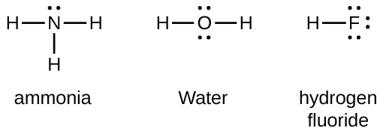
The octet rule
Octet rule: all atoms ionize of bond to achieve a full valence shell.
Most atoms want 8 valence electrons (an octet).
H and He want only 2 valence electrons (a duet).
Count to confirm that each atom has its octet or duet.
Chemistry OpenStax

Slide 35
Double and triple bonds
Multiple bonds are used when there is no other way to give ‘central atoms’ a full valence shell.
Double bond: 2 shared pairs of valence electrons (::)
Triple bond: 3 shared pairs of valence electrons (:::)
Chemistry OpenStax

Slide 36
Writing Lewis structures
Steps:
Count total number of valence electrons (including charge).
Draw symbols for each atom, placing the least electronegative atom (or carbon, or the unique atom) in the center.
(3) Connect each atom with a single bond at a cost of 2 ve- each.
(4) Distribute remaining ve- as lone pairs around the outermost atoms to give each an octet.
(5) Place any remaining ve- on the central atom.
(6) If the central atom doesn’t have an octet, create multiple bonds to it using ve- from the outer atoms.
H |
1.90
2.20
SiH4
H – Si – H
#ve- = 4 + (4x1) = 8
| H
Chemistry OpenStax

Slide 37
Try these
Draw Lewis structures for these:
CHO2⁻¹
NO⁺¹
OF2
Chemistry OpenStax

Slide 38
Try this
Determine the types of bonds in potassium nitrate and show polarity arrows.
K⁺¹ (NO3)⁻¹
:O:
N
⁺¹
K⁺¹
:O:
:O:
..
..
⁻¹
⁻¹
Chemistry OpenStax

Slide 39
Try these
NASA’s Cassini-Huygens mission detected a cloud of toxic hydrogen cyanide (HCN) on Titan, one of Saturn’s moons. Titan’s atmosphere also includes ethane (H3CCH3), acetylene (HCCH) and ammonia (NH3). Draw their Lewis structures!
Chemistry OpenStax

Slide 40
One more
Both carbon monoxide and carbon dioxide are produced by combustion of fossil fuels. Draw their Lewis structures.
Chemistry OpenStax

Slide 41
Exceptions to the octet rule
Chemistry is a field full of exceptions.
There are three types of exceptions to the octet rule.
Molecules with an odd number of valence electrons (an unpaired electron).
(2) Molecules whose central atom has less than an octet.
(3) Hypervalent molecules whose central atom has more than an octet.
Chemistry OpenStax

Slide 42
(1) Odd number of valence electrons
Molecules with an odd number of electrons are called free radicals.
nitric oxide (NO)
Chemistry OpenStax

Slide 43
(2) Less than an octet: e- deficient molecules
Electron deficient molecules generally have central atoms from groups 2A and 12A, outer hydrogen or other atoms that don’t form double bonds.
berylium dihydride (BeH2)
boron trifluoride (BF3)
Chemistry OpenStax

Slide 44
(3) More than an octet: hypervalent molecules
Elements below the second row of the periodic table can accommodate more than an octet using d orbitals.
phosphorus pentachloride (PCl5)
sulfur hexafluoride (SF6)
Chemistry OpenStax

Slide 45
Try this
Write Lewis structures for XeF2, XeF4, XeF6 identify any exceptions to the octet rule.
Chemistry OpenStax

Slide 46
Resonance: structures with alternate bonding patterns
Notice that the two possible structures for the nitrite ion (NO2⁻¹) are resonance structures: identical except for the placement of bonds or electrons.
The double head arrow ( ) indicates resonance structures.
Notice the difference between these structures is placement of single vs. double bonds.
From these structures, you might guess that NO2⁻¹ has two different N-O bond lengths since single bonds are longer than double bonds.
However, experiments show that there is only one N-O bond length and that it’s between the lengths of a single and double bond: the resonance hybrid or average.
Each N-O bond in the hybrid is ~1.5 bonds long.
Chemistry OpenStax

Slide 47
Try this
Draw one Lewis structure of the carbonate ion, CO3⁻².
Draw all other resonance structures.
What determines the number of resonance structures?
Draw the resonance hybrid.
25
Chemistry OpenStax

Slide 48
5.4: Can you?
Define the term ‘Lewis symbol’.
(2) Use Lewis symbols to diagram out formation of an ionic compound?
(3) List the steps required to draw the Lewis structure of a covalently bonded compound?
(4) Draw Lewis structures for a wide variety of covalently bonded compounds from their molecular formulas?
(5) List and explain the three types of exceptions to the octet rule?
(6) Explain what differentiates molecules with resonance from those that lack resonance?
(7) Draw resonance structures and resonance hybrids and explain why hybrids are more relevant?

Slide 49
5.4: Assignments
Canvas: Quick review questions quiz 5.4
Homework set 5, problems 5 - 6
Optional extras – great videos on this topic:
‘Drawing Lewis dot diagrams’ (Bozeman Science) https://www.youtube.com/watch?v=ulyopnxjAZ8
‘How to draw Lewis structures – 5 easy steps’ https://www.youtube.com/watch?v=1ZlnzyHahvo
‘Resonance’ (Khan Academy) https://www.youtube.com/watch?v=6XOm3Km7r30

Slide 50
Module 5: Bonding, polarity, structure and geometry
5.5: VSEPR: understanding & predicting molecular geometry
Molecules have three-dimensional shape
VSERP makes some predictions about molecular geometry
OpenStax Chemistry, Atoms First 2/e p. 227 - 238

Slide 51
Module 5: Bonding, polarity, structure and geometry
Big ideas?
Lewis structures and VSEPR describe the shapes of molecular, covalently bonded molecules.
Molecular geometry and polarity affect the physical and chemical properties of molecules.

Slide 52
What about 3 dimensional (3D) structures?
Lewis structures provide us with decent 2D molecular structure but don’t provide much 3D structure.
To move from 2D to 3D structure we’d need more information:
Bond distances; and
Bond angles.
Formaldehyde (CH2O) is still 2D: its four atoms are in the plane of this screen.
Chemistry OpenStax

Slide 53
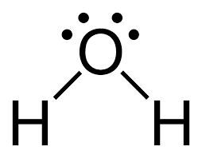
VSEPR suggests a molecule’s 3D shape
Valence shell electron pair repulsion (VSEPR) helps determine the shape of small molecules.
The covalent bonds and free electron pairs of Lewis structures are electrons and therefore negatively charged.
Negative charges repel one another, so bonds and free pairs push as far away from others as possible. This urge to maximize ‘personal space’ determines 3D structure.
BeH2
2 e- groups: each bonding
CO2
6 e- groups: 2 bonding;
4 free pairs
H2O
4 e- groups: 2 bonding;
2 free pairs
For VSEPR, what really counts are electron groups on the central atom.
H2O has 2 bonding groups and 2 free pairs
Chemistry OpenStax; LibreText Chemistry

Slide 54
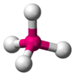
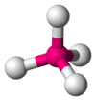
Simplified VSEPR chart
# e- groups on central atom | # of bonding groups | # free e- pairs | e- pair geometry | molecular geometry
2 | 2 | 0 | linear | linear
3 | 3 | 0 | trigonal planar | trigonal planar
3 | 2 | 1 | trigonal planar | bent
4 | 4 | 0 | tetrahedral | tetrahedral
g | 3 | 1 | tetrahedral | trigonal pyramid
4 | 2 | 2 | tetrahedral | bent
e- pair geometry
molecular geometry
Chemistry OpenStax; LibreText Chemistry; Wikipedia VSEPR theory

Slide 55
Try this
What is the approximate shape of each molecule?
(a) PCl3
(b) NOF
Chemistry OpenStax

Slide 56
Try these
What is the approximate shape of CH2Cl2?
What is the approximate shape of C2H4?
Hint: consider each C to be a central atom
Chemistry OpenStax; LibreText Chemistry

Slide 57
5.5: Can you?
Explain what VSEPR stands for?
(2) Describe why free electron pairs seek to maximize their ‘personal’ 3D space?
(3) Explain how to use a VSEPR chart?
(4) Explain the difference between electron pair geometry and molecular geometry?

Slide 58
5.5: Assignments
Canvas: Quick review questions quiz 5.5
Homework set 5, problems 7 - 8
Optional extras – great videos on this topic:
‘VSEPR theory: introduction’ (Tyler DeWitt) https://www.youtube.com/watch?v=nxebQZUVvTg
‘VSEPR theory practice problems’ (Tyler DeWitt) https://www.youtube.com/watch?v=xwgid9YuH58

Slide 59
Module 5: Bonding, polarity, structure and geometry
5.6: Bond polarity & molecular dipoles affect properties
Dipole moment (aka molecular polarity) depends on both bond polarity and molecular geometry
Polar molecules have dipole moments
Polarity alters molecular properties and interactions
OpenStax Chemistry, Atoms First 2/e p. 1137 -

Slide 60
Module 5: Bonding, polarity, structure and geometry
Big ideas?
Lewis structures and VSEPR describe the shapes of molecular, covalently bonded molecules.
Molecular geometry and polarity affect the physical and chemical properties of molecules.

Slide 61
Molecular polarity and dipole moments
You’ve seen that atomic electronegativity values help us determine whether covalent bonds are polar or nonpolar.
R - O - H
Well, molecules can have an overall polarity called dipole moment (μ): a separation of charges that gives the molecule overall dipolar positive and dipolar negative ‘ends’
μ = Qr where Q = magnitude of partial charges r = distance separating those charges
Chemistry OpenStax

Slide 62
Overall dipolar moments are vector sums
Overall dipole moments of molecules are sums of the bond polarities within that molecule.
Dipoles act as vectors and cancel when in opposing directions but add when directions align.
Dipoles depend on bond polarity and molecular geometry.
For H2O, the horizontal components of the two O-H vectors cancel, but their vertical components add to create a ‘vertical up’ dipole moment (μ).
Chemistry OpenStax

Slide 63
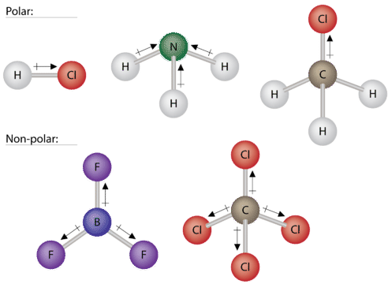
Molecular dipoles = polarity and geometry
Notice that one of the tetrahedral molecules has a dipole while the other isn’t.
Which of these molecular geometries has a different electron pair geometry?
Fill in missing electron pairs to find out!
Chemistry OpenStax; LibreText Chemistry

Slide 64
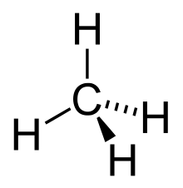
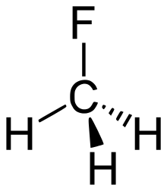
Try this
Do these molecules have dipole moments (μ)?
In these 3D diagrams the ‘wedge’ comes forward and the ‘dashed-wedge’ points back into the screen. All bond angles are equal!

Slide 65
Dipole moments align in electromagnetic fields
When molecules with dipole moments are placed into electromagnetic fields the align in response to that field.
Notice the ‘nose-to-tail’ alignment here; think of dogs greeting one another…!
Dipole moments and the alignments they effect physical properties.
Water is more viscous (thicker and slower flowing) than expected because of these sorts of effects.
Chemistry OpenStax

Slide 66
Other effects of molecular dipoles?
Molecules with molecular dipoles are called polar molecules and polarity affects these physical and chemical properties.
Polar molecules:
have higher melting points than nonpolar molecules;
have higher boiling points than nonpolar molecules;
be more soluble in water (dissolve better) than nonpolar molecules; and
have lower vapor pressures than nonpolar molecules.
”like dissolves like”
Chemistry OpenStax; LibreText Chemistry

Slide 67
Try this
Label each molecule as polar or nonpolar.
(a) water, H2O
(b) methanol, CH3OH
(c) hydrogen Cyanide, HCN
(d) oxygen, O2
(e) propane, C3H8
Chemistry OpenStax; LibreText Chemistry

Slide 68
5.6: Can you?
(1) Explain how bond polarities of a molecule sum to an overall dipole moment?
(2) Describe how and why molecules with dipole moments align in an electric field?
(3) Describe some of the effects of dipole moment and molecular polarity on the physical properties of molecules?

Slide 69
5.6: Assignments
Canvas: Quick review questions quiz 5.6
Homework set 5, problem 9
Optional extras – great videos on this topic:
‘Dipole forces’ (Bozeman Science) https://www.youtube.com/watch?v=cERb1d6J4-M
‘Molecular polarity’ (Khan Academy) https://www.khanacademy.org/science/chemistry/chemical-bonds/copy-of-dot-structures/v/dipole-moment

Slide 70
Module 5: Bonding, polarity, structure and geometry
5.7: A brief introduction to small organic molecules
Organic molecules are based on carbon chemistry
Hydrocarbons are the most basic organic molecules
Naming and drawing simple hydrocarbons
Functional groups do the work
Meet some simple examples
OpenStax Chemistry, Atoms First 2/e p. 1137 -

Slide 71
Module 5: Bonding, polarity, structure and geometry
Big ideas?
Lewis structures and VSEPR describe the shapes of molecular, covalently bonded molecules.
Molecular geometry and polarity affect the physical and chemical properties of molecules.

Slide 72
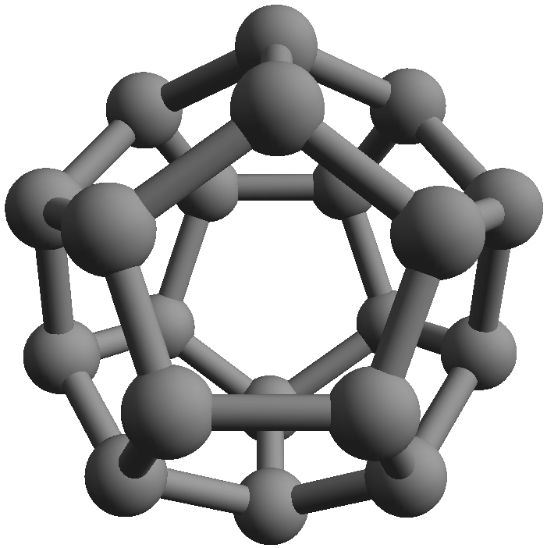
Organic molecules: a massive, carbon-based family
One database of organic molecules has 10 million entries, and the actual number of different organic molecules is estimated at over 10⁶⁰, an unbelievably massive number!
Organic molecules could also be called:
carbon-based;
the molecules of life; and
biomolecules
octane, C8H18
Why carbon? It’s abundant and forms strong bonds in a variety of geometries.
fullerene, C60
Chemistry OpenStax; LibreText Chemistry

Slide 73
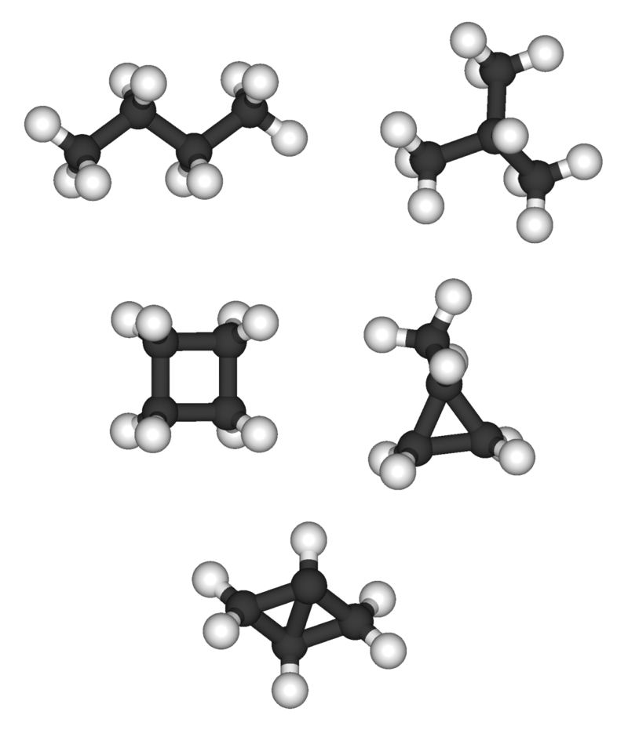
Hydrocarbons (aka alkanes, alkenes and alkynes)
The simplest organic compounds are hydrocarbons: combinations of C and H.
Hydrocarbons are found throughout the natural world, living and dead.
plants and animals;
Fossil fuels
linear
branched
… and they are commonly made by man via synthetic organic chemistry.
polymer: many repeating units
cyclic
Hydrocarbons have a variety of shapes: linear, branched, cyclic, polymerized.
Chemistry OpenStax; LibreText Chemistry; Wikipedia

Slide 74
Naming alkanes (single-bonded hydrocarbons)
-ane suffix means single bonds only
meth = 1 C
eth = 2 C
pent = 5 C
Chemistry OpenStax; LibreText Chemistry; Wikipedia

Slide 75
Try this
For each of these alkanes, draw the Lewis structure and write the formula.
methane
ethane
propane
butane
pentane
hexane
heptane
octane
nonane
decane
Chemistry OpenStax; LibreText Chemistry; CSET Chemistry Study Guide

Slide 76
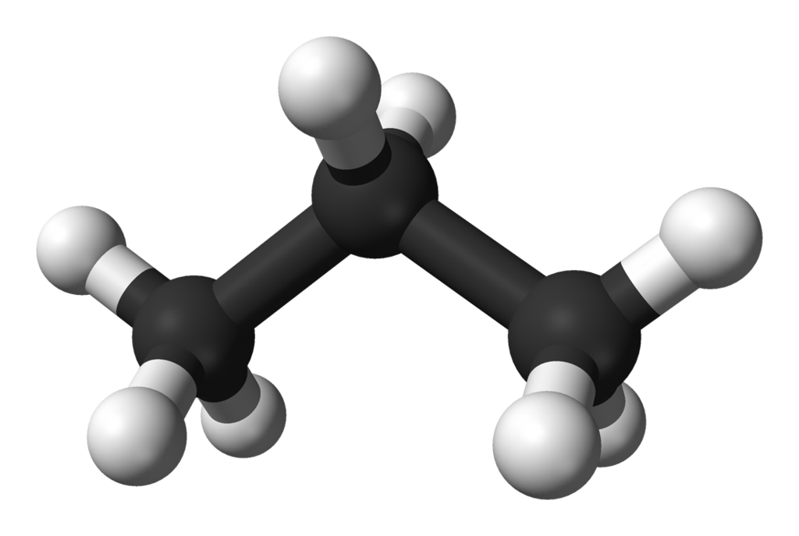
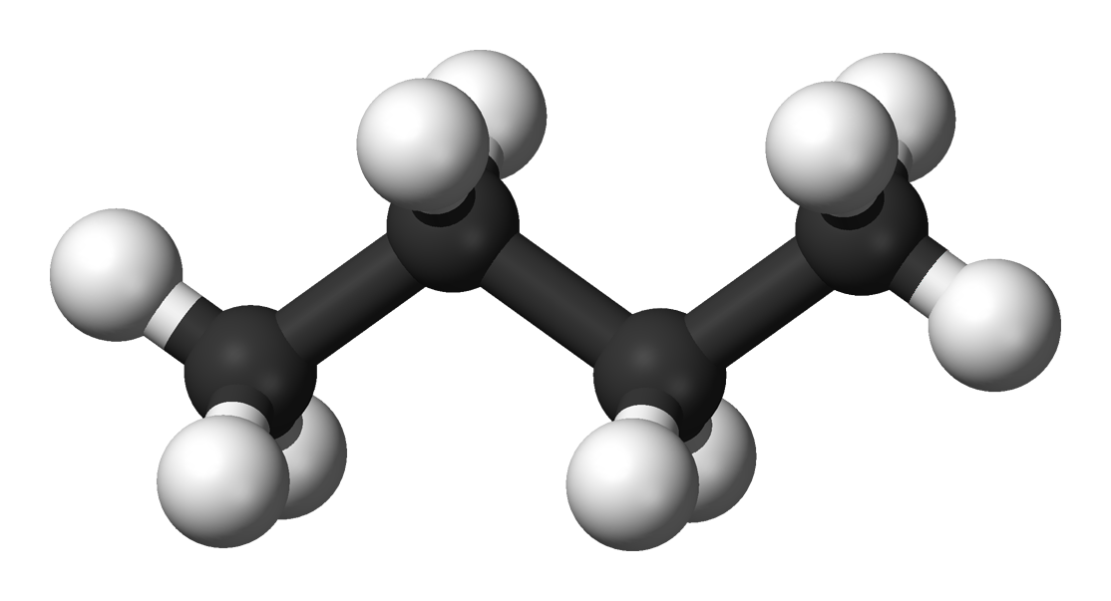
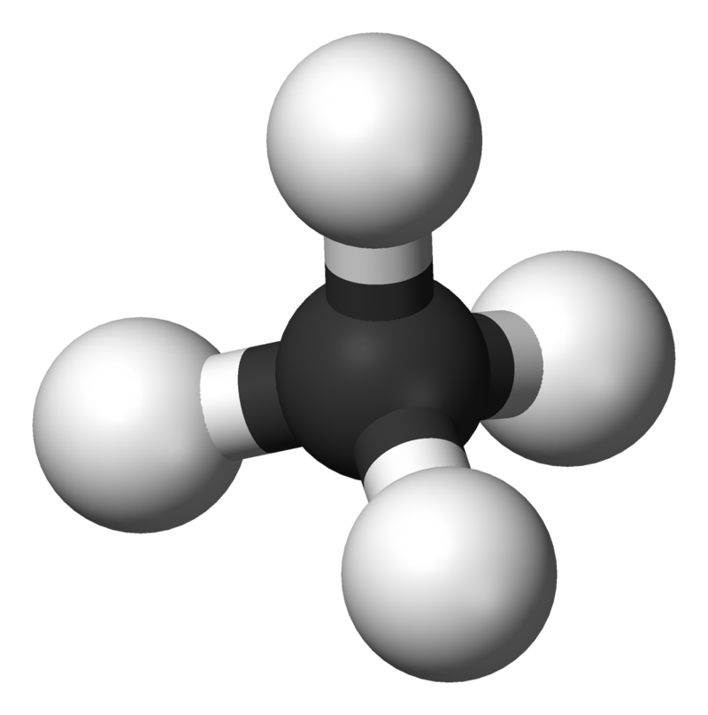
Hydrocarbons are great fuels
Hydrocarbons are nonpolar molecules that are soluble in other nonpolar molecules but not water.
The bonds in hydrocarbons store energy and the simple molecules burn cleanly.
natural gas
propane; LNG
lighter fluid
gasoline
But… hydrocarbons don’t do a lot more because they lack functional groups.
Chemistry OpenStax; LibreText Chemistry; Wikipedia

Slide 77
Functional groups make molecules work
Hydrocarbons give molecules structural framework, but functional groups give them purpose.
ether
alcohol
ethanol
Chemistry OpenSta; LibreText Chemistry; Wikipedia

Slide 78
Alcohols, ethers and rings = sugars
alcohol
ether
Chemistry OpenSta; LibreText Chemistry; Wikipedia

Slide 79
Esters: smells and flavors of fruits
ester
Chemistry OpenSta; LibreText Chemistry; Wikipedia

Slide 80
Carboxylic acids: VFAs and biological buffers
Carboxylic acids are biological / biochemical weak acids that serve as biological buffers.
Acetic acid is a 2-carbon carboxylic acid common in nature.
Vinegar is a weak solution of acetic acid.
Cow’s incredibly efficient digestive system breaks food down into volatile fatty acids(VFAs) of 2 to 6 carbons.
Their rumen transports these VFAs directly into the blood stream.
Acetic acid is cow’s favorite VFA and provides up to 70% of their dietary energy.
acidic H
carboxylic acid
Chemistry OpenSta; LibreText Chemistry; Wikipedia

Slide 81
Amines: basic, bitter and … interesting
Amines are N-based functional groups that are slightly basic and are found in many classes of biological molecules.
These molecules are all alkaloids, produced by plants as part of their natural defense against being eaten; they taste bitter. They also have profound physiological affects:
eradication of pain;
high; and
addiction
amine
Chemistry OpenStax

Slide 82
5.7: Can you?
(1) Identify the element that organic molecules are based on?
(2) Define the term hydrocarbon?
(3) Describe the naming system for linear alkanes of 1 – 10 carbons?
(4) Describe the role of functional groups in small organic molecules?

Slide 83
5.7: Assignments
Canvas: Quick review questions quiz 5.7
Homework set 5, problems 10 - 11
Optional extras – great videos on this topic:
‘Hydrocarbon overview’ (Khan Academy) https://www.khanacademy.org/science/biology/properties-of-carbon/hydrocarbon-structures-and-functional-groups/v/hydrocarbon-overview
‘Biological molecules’ (Bozeman Science) https://www.youtube.com/watch?v=PYH63o10iTE
‘The molecules of life’ (Bozeman Science) https://www.youtube.com/watch?v=QWf2jcznLsY

