Slide 1
CHE 1020: Introduction to Chemistry
Module 8: Moles: chemistry’s central unit
8.1: The mole: a big number for tiny objects
8.2: Formulas can be used as conversion factors
8.3: Percent composition from mass vs. formulas
8.4: Calculating empirical vs. molecular formulas
8.5: Molarity measures solution concentration
Resources on Canvas:
Periodic table
Mole maps
Quick summary of Module 8
OpenStax Chemistry Atoms First 2/e p.309 - 327

Slide 2
Module 8: Moles – chemistry’s central unit
8.1: The mole: a big number for a tiny object
The scale of atoms and molecules is small enough that we tend to count the number in a mass
The mole allows us to ‘talk’ about atoms and molecules without using scientific notation all the time
Avogadro’s number is 6.02 E23 _______ per mole
It’s a conversion factor!
It’s hard for humans to grasp numbers this large
Atomic mass can be expressed as g / mole or amu
OpenStax Chemistry 2/e p.309 - 312

Slide 3
Module 8: Moles – chemistry’s central unit
Big ideas?
The mole is the central unit of chemistry and represents a massive number of atoms or molecules.
Subscripts and coefficients are molar.

Slide 4
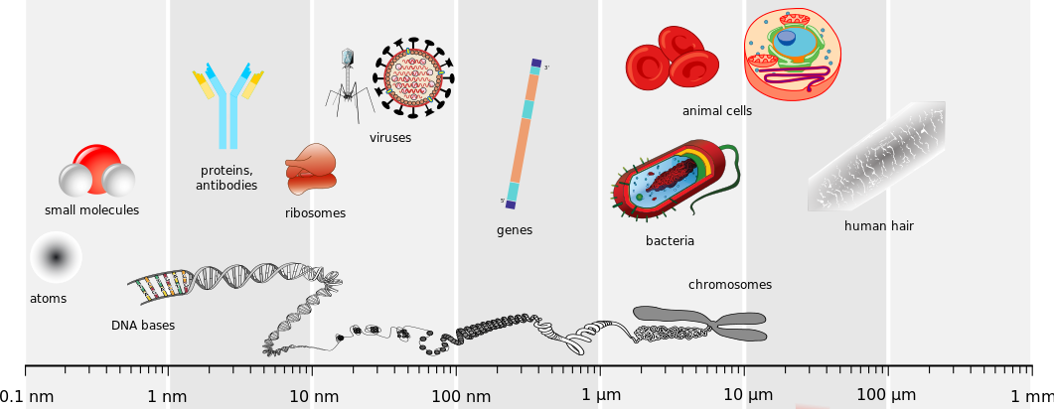
Atoms and molecules are wicked tiny
It’s hard to conceptualize of the size of atoms and molecules.
Chemistry OpenStax

Slide 5
To quantitate tiny objects, we weigh rather than count
Nails used to be sold by the pound. Useful for the seller, but the buyer needs to know roughly how many nails are in that pound. How does she work that out?
How many dozen nails would that be?
We’re going to take the same approach to counting atoms, ions, isotopes and molecules.
Chemistry OpenStax

Slide 6
The mole: chemistry’s central unit
Mole: the ‘counting’ unit for matter on the atomic scale.
It’s like a dozen, or gross; equal to a number of objects.
From the Latin ‘moles’: mass, massive, barrier
1 mole = 6.02 E23 atoms or ions or molecules
1 mole .
6.02 E23 XXX
called Avogadro’s number when expressed as a conversion factor
Consider: If you had one mole of marbles— 6.02 E23 marbles — and you spread them all over the entire surface of the Earth, how thick would the layer of marbles be?
Chemistry OpenStax

Slide 7
This says it all

Slide 8
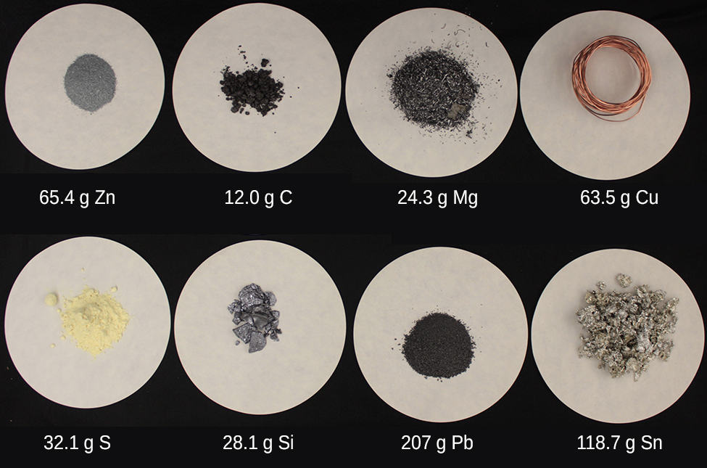
Compare a mole of eight different elements
So:
1 mole of Zn weighs either: 65.4 amu; or 65.4 grams.
To be practical, we express atomic and molecular weights in units of grams/mole.
Chemistry OpenStax

Slide 9
Converting mass to moles
Atomic mass or formula mass (MW) can be used to convert mass to moles (and back).
USDA nutritional guidelines suggest a daily intake of 4.7 g of potassium. What’s the requirement in moles of K?
The periodic table show’s K’s atomic mass to be 39.10 amu.
Now, we’ll leave amu for a more useful unit → 39.10 grams/1 mole
Beryllium, a very light element, is used to make transparent x-ray windows for imagining devices. How many moles of Be are in a thin window that weighs 3.24 g?
Chemistry OpenStax

Slide 10
Let’s start building a mole map
By the end of this course you’ll be using a host of conversion factors to make the change of chemistry happen. It helps to have a map to guide your choice of conversion factors.
atoms
mass (g)
moles
molecules
atomic or
formula mass
(g/mol)
Avogadro’s
6.02 E23
(____/mol)
Flip conversion factors to solve for ‘destination’ units; to choose the direction of the arrow.
Chemistry OpenStax

Slide 11
8.1: Can you?
(1) Understand just how tiny atoms are and how massive Avogadro’s number is?
(2) Understand how and why a mole of different elements and compounds can have radically different masses?
(3) See that Avogadro’s number is a conversion factor?
(4) See that ‘mole map’ can help you choose conversion factors and the number of steps for conversion problems?

Slide 12
8.1: Assignments
Canvas: Quick review questions quiz 8.1
Canvas: HW set 8, problem 1
Optional extras – great videos on this topic:
'A mole of moles' (XKCD) https://what-if.xkcd.com/4/
'How big is a mole?' (TEDEd)
https://ed.ted.com/lessons/daniel-dulek-how-big-is-a-mole-not-the-animal-the-other-one#watch
'Very common mole questions’ (Tyler DeWitt)
https://www.youtube.com/watch?v=BO9M1hbs88s
'Converting between grams and moles - part 1’ (Tyler DeWitt) https://www.youtube.com/watch?v=CMnkSb2YsXI

Slide 13
Module 8: Moles – chemistry’s central unit
8.2: Formulas can be used as conversion factors
The sum of a formula’s atomic mass is its formula weight
Formula weights have units of amu or g/mole
Formula weights are conversion factors
Formula subscripts represent atoms/molecule…
… and are also conversion factors
Synonyms: formula weight, molar mass, molecular weight (MW)
OpenStax Chemistry 2/e p.310 - 312

Slide 14
Module 8: Moles – chemistry’s central unit
Big ideas?
The mole is the central unit of chemistry and represents a massive number of atoms or molecules.
Subscripts and coefficients are molar.

Slide 15
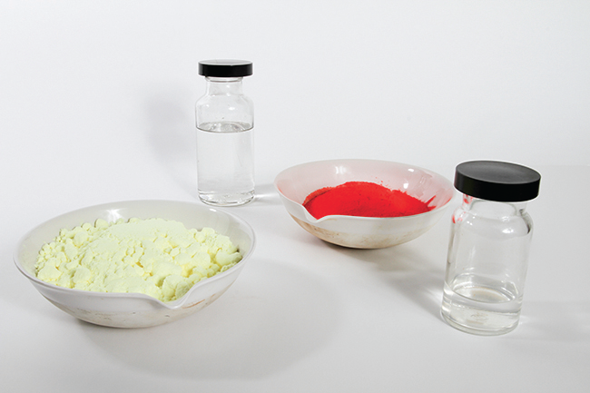
Compare a mole of compounds in different states
C8H17OH
octanol
MW 130.2 g/mol
CH3OH
methanol
MW 32.0 g/mol
S8
Elemental sulfur
MW 256.5 g/mol
HgI2
mercury (II) iodide
MW 454.4 g/mol
Chemistry OpenStax

Slide 16
Formula mass (aka molar mass, molecular weight)
Formula mass (aka MW): the sum of all the atomic masses in a molecule or compound
Chloroform, CHCl3, was used as a surgical anesthetic and is now used as a building block for creating teflon, tetrafluoroethylene.
NaCl is common table salt.
Chemistry OpenStax

Slide 17
Try calculating MW of these molecular compounds
Calculate the formula masses (aka molecular weights) of:
Aspirin, C9H8O4 (acetylsalicylic acid)
Ibuprofen, C13,H18O2
Chemistry OpenStax

Slide 18
Try calculating MW of these ionic compounds
Calculate the formula masses (aka molecular weights) of:
Aluminum sulfate, Al2(SO4)3, used to purify water and make paper
Calcium phosphate, Ca3(PO4)2, used to inject DNA into cells
Chemistry OpenStax

Slide 19
Build: add (1) formula mass, (2) formula subscripts
By the end of this course you’ll be using a host of conversion factors to make the change of chemistry happen. It helps to have a map to guide your choice of conversion factors.
atoms
mass (g)
moles
formula
subscripts
molecules
atomic or
formula mass
(g/mol)
Avogadro’s
6.02 E23
(____/mol)
Flip conversion factors to solve for ‘destination’ units; to choose the direction of the arrow.
Chemistry OpenStax

Slide 20
First test drive with the mole map
Vitamin C has the molecular formula C6H8O6.
The recommended daily dose for kids aged 4-8 years is 1.42 E-4 moles. How many grams should you give them?
Chemistry OpenStax

Slide 21
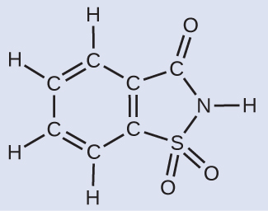
Long trip back
Saccharin, C7H5NO3S, is the old ‘pink’ sugar substitute.
How many g of sacchirin have 9.20 E21 carbon atoms?
Chemistry OpenStax

Slide 22
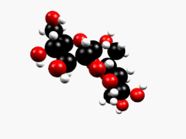
Using formula subscripts as a conversion factor
Sucrose, C12H22O11, is common table sugar.
Its formula allows us to create three simple conversion factors
12 C atoms 22 H atoms 11 O atoms
1 molecule 1 molecule 1 molecule
How many atoms of hydrogen in 89 molecules of sucrose?
Chemistry OpenStax Wikipedia

Slide 23
Try this
Our bodies make amino acids, the building blocks of proteins. The simplest amino acid is glycine, C2H5O2N. How many moles of glycine molecules are there in 28.35 g?
How many hydrogen atoms in the 28.35 g?
Chemistry OpenStax

Slide 24
8.2: Can you?
(1) Calculate a formula mass or molecular mass (aka molar mass or molecular weight, MW) from the formula and the periodic table?
(2) Use atomic mass, molar mass, Avogadro’s number and formula subscripts as a conversion factor to convert mass to moles to molecules to atoms?
(3) Expand your ‘mole map’ to include formula weight
(4) Use formula subscripts as conversion factors to convert molecules to atoms?

Slide 25
8.2: Assignments
Canvas: Quick review questions quiz 8.2
Canvas: HW set 8, problems 2 - 4
Optional extras – great videos on this topic:
'Very common mole questions’ (Tyler DeWitt)
https://www.youtube.com/watch?v=BO9M1hbs88s
'Converting between grams and moles - part 1’ (Tyler DeWitt) https://www.youtube.com/watch?v=CMnkSb2YsXI

Slide 26
Module 8: Moles – chemistry’s central unit
8.3: Percent composition from mass vs. formula
Percent composition is a compound’s ”mass” formula
Percent composition can be calculated from formula using formula weight as an intermediate
OpenStax Chemistry 2/e p.313 - 314

Slide 27
Module 8: Moles – chemistry’s central unit
Big ideas?
The mole is the central unit of chemistry and represents a massive number of atoms or molecules.
Subscripts and coefficients are molar.

Slide 28
Have an unknown compound?
What can you do to figure out what it is?
What elements does it contain?
What percent of its mass is made up of each element (ie percent composition)
For example, a gas is found to contain only carbon and hydrogen. Analysis of a 10.0-g sample finds 2.5 g are C and 7.5 g are H. What’s the compound’s percent composition?
Chemistry OpenStax

Slide 29
Try this
A 12.04-g sample of an unknown liquid is analyzed & found to contain 7.34 g C, 1.85 g H and 2.85 g N.
Calculate its percent composition.
Chemistry OpenStax

Slide 30
Calculating percent composition from formulas
What if you only have the formula?
First calculate the compound’s formula weight, sub-totalling each element.
Then calculate the percent of each element’s mass.
Dichlorine heptoxide (Cl2O7) is a highly reactive compound used in some organic synthesis reactions. Calculate the percent composition of dichlorine heptoxide.
Chemistry OpenStax

Slide 31
Try this
Aspirin’s formula is C9H8O4. Calculate its percent composition.
Chemistry OpenStax

Slide 32
8.3: Can you?
(1) Calculate a compound’s percent composition from elemental masses?
(2) Calculate percent composition from formulas by calculating formula mass first?

Slide 33
8.3: Assignments
Canvas: Quick review questions quiz 8.3
Canvas: HW set 8, problems 5 - 6
Optional extras – great videos on this topic:
'Percent composition by mass' (Tyler DeWitt) https://www.youtube.com/watch?v=lywmGCfIUIA&list=PLWvb8s5wOwkIx91YY57WkFZ1pmA-yCV0W&index=127
'Calculating percent composition and empirical formulas' (Mr. Causey) https://www.youtube.com/watch?v=mdNYDMoQ6As

Slide 34
Module 8: Moles – chemistry’s central unit
8.4: Calculating empirical vs. molecular formulas
Percent composition can be converted to mass, then moles to create an empirical formula
The ratio of formula weight to molecular weight allows empirical formula to be converted to molecular formula
OpenStax Chemistry 2/e p.314 - 320

Slide 35
Module 8: Moles – chemistry’s central unit
Big ideas?
The mole is the central unit of chemistry and represents a massive number of atoms or molecules.
Subscripts and coefficients are molar.

Slide 36
Reverse to calculate empirical formula from % comp.
How can we work this process the other way and use percent composition to calculate empirical formula?
A sample contains 1.71 g of C and 0.287 g of H. What’s its empirical formula?
Chemistry OpenStax

Slide 37
What about molecular formulas?
With one more piece of information, formula mass or MW, we can determine the molecular formula as well as the empirical formula.
Nicotine, responsible for tobacco addictive is 74.02% C, 8.710% H, 17.27% N. And 40.57 g of nicotine contains 0.2500 moles.
What is the molecular formulas of nicotine?
Chemistry OpenStax

Slide 38
Try this
What’s the molecular formula of a compound with 49.47 % C, 5.201 % H, 28.84 % N and 16.48% O. The formula mass is 194.2 g/mol.
Chemistry OpenStax

Slide 39
8.4: Can you?
(1) Convert percent composition to empirical formula using mass to moles conversions?
(2) Calculate empirical formula weight and its ratio to molecular weight?
(3) Use the ratio of empirical to molecular weights to convert empirical formula to molecular formula?

Slide 40
8.4: Assignments
Canvas: Quick review questions quiz 8.4
Canvas: HW set 8, problems 7 - 8
Optional extras – great videos on this topic:
'Calculating percent composition and empirical formulas' (Mr. Causey) https://www.youtube.com/watch?v=mdNYDMoQ6As
'Chemical analysis' (Bozeman Science) https://www.youtube.com/watch?v=QcC4OsSxWYU

Slide 41
Module 8: Moles – chemistry’s central unit
8.5: Molarity measures solution concentration
Percent composition can be converted to mass, then moles to create an empirical formula
The ratio of formula weight to molecular weight allows empirical formula to be converted to molecular formula
OpenStax Chemistry 2/e p.320 - 327

Slide 42
Module 8: Moles – chemistry’s central unit
Big ideas?
The mole is the central unit of chemistry and represents a massive number of atoms or molecules.
Subscripts and coefficients are molar.

Slide 43
Molarity = moles solute / L solution
Concentration is a measure of the amount of solute in solvent.
Molarity (M) is a unit that we’ll use to express solution concentration.
Note that M uses the volume of solutions, not solvents. Why?
molarity (M) = mol solute
1 L solution
A 335-mL soft drink contains 0.133 mol of sucrose (table sugar).
What is the molar concentration of sucrose in the drink?
Chemistry OpenStax; Diabetes UK

Slide 44
Try this
A teaspoon of sugar has 0.01 mol of sucrose. What’s the molarity of sucrose if the sugar is dissolved in a cup of tea with a volume of 200 mL?
A sip of tea has a volume of 10 mL. How many moles of sucrose are there in one sip?
Chemistry OpenStax

Slide 45
Add molarity to the mole map
volume
(L)
M
(mol/ 1L)
atoms
mass (g)
moles
formula
subscripts
molecules
atomic or
formula mass
(g/mol)
Avogadro’s
6.02 E23
(____/mol)
Avogadro’s
6.02 E23
(____/mol)
Flip conversion factors to solve for ‘destination’ units; to choose the direction of the arrow.
Chemistry OpenStax

Slide 46
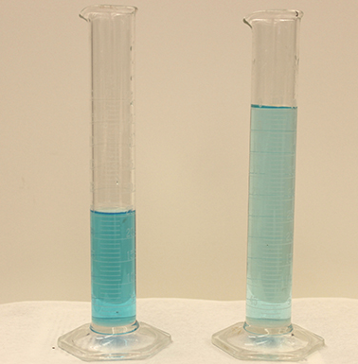
Dilution adds solvent and decreases concentration
Dilution: the process of adding more solvent to decrease the concentration of a solution
Also the process of preparing solutions at the desired concentration from more concentrated stock solutions or from dry (solid) compounds.
n = (M)(L) where n = moles
M1L1 = M2L2 where 1 and 2 are solutions of different concentrations
concentrated dilute
Both contain the same mass of Cu.
Chemistry OpenStax

Slide 47
Apply the dilution ‘formula’
If 0.850 L of a 5.00 M solution of copper (II) nitrate is diluted to a volume of 1.80L by the addition of water, what is the molarity of the diluted solution?
Sanity check: should the M increase or decrease?
Chemistry OpenStax

Slide 48
Try this: a different angle on dilution
What volume of 0.12 M HBr can be prepared from 11 mL of 0.45 M solution?
23
Note that volume can take any units as long as they are the same on both sides of the dilution ‘equation’.
Sanity check: should the volume increase or decrease?
Chemistry OpenStax

Slide 49
8.5: Can you?
Understand that molarity (M) is equal to moles of solute per L of solution?
(2) Calculate molarity from moles or mass and volume?
(3) Use molarity as a conversion factor?
(4) Use the dilution ‘formula’?

Slide 50
8.5: Assignments
Canvas: Quick review questions quiz 8.5
Canvas: HW set 8, problems 9 - 14
Optional extras – great videos on this topic:
'Molarity practice problems' (Tyler DeWitt) https://www.youtube.com/watch?v=SXf9rDnVFao
‘Molarity practice problems – part 2’ (Tyler DeWitt) https://www.youtube.com/watch?v=sWfn8hbXRp8

