Slide 1
CHE 1031: General Chemistry I
Atoms, molecules & ions
2.1: Early ideas about atomic theory
2.2: Evolution of atomic theory
2.3: Atomic structure & symbolism
2.4: Chemical formulas
2.5: The periodic table
2.6: Molecular & ionic compounds
2.7: Naming chemical compounds
covered in lab

Slide 2
2. Atoms, molecules & ions
2.1: Early ideas about atomic theory
State the postulates of Dalton’s atomic theory
Use postulates of Dalton’s atomic theory to explain the laws of definite & multiple proportions

Slide 3
Dalton’s atomic theory
1806, English school teacher John Dalton used experiments to revive the ancient concept of a universal element of matter & proved the existence of the atom.
1. Matter is composed of tiny particles called atoms: smallest unit of an element that can participate in chemical change.
2. Every element is made of one type of atom with a characteristic mass. All atoms of one element are identical.
3. The atoms of each element differ & are found only in that element.
4. A compound is made by combining atoms of two or more elements at a constant, whole-number ratio.
5. Chemical reactions neither create nor destroy atoms, but rearrange them to create new substances.

Slide 4
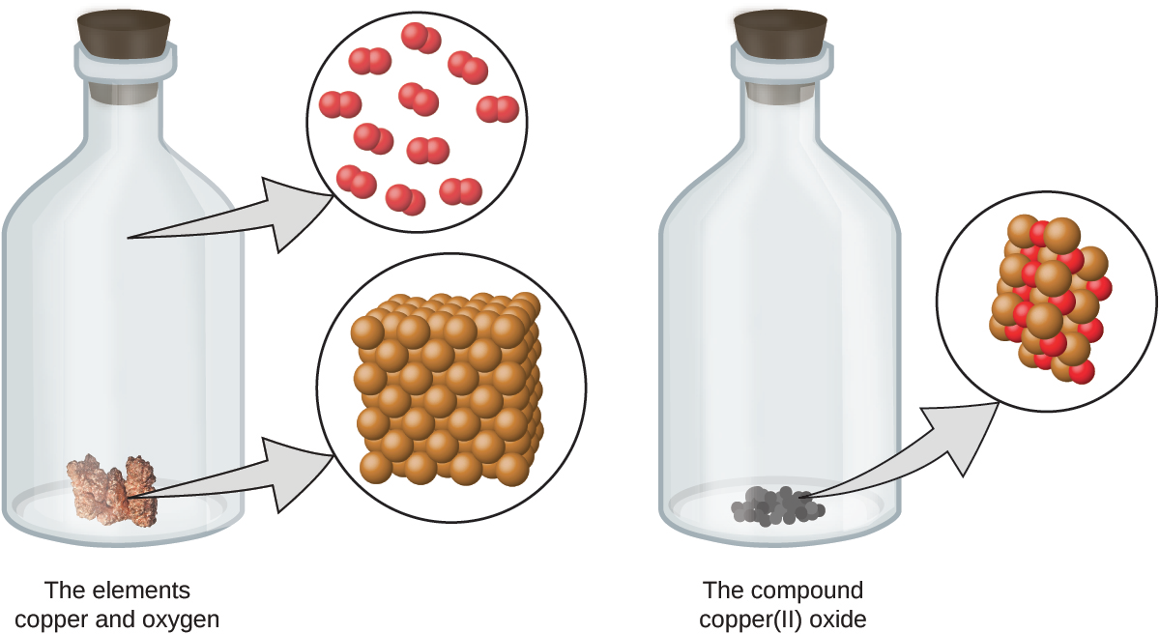
Visualize a chemical reaction
chemical reaction
Chemistry Openstax

Slide 5
Obeying Dalton’s postulates?
Do the chemical reactions shown here obey the five postulates of Dalton’s atomic theory? If not, why?
1
Chemistry Openstax

Slide 6
Law of definite proportions
Aka Law of constant composition: all samples of one compound have the same elements in the same proportion by mass, or the same atomic ratio
sample* | carbon (g) | hydrogen (g) | mass ratio (C : H)
A | 14.82 | 2.78 | 5.33 : 1.00
B | 22.33 | 4.19 | 5.33 : 1.00
C | 19.40 | 3.64 | 5.33 : 1.00
*isooctane, C8H18
Dalton knew of this work done by the French chemist Joseph Proust.

Slide 7
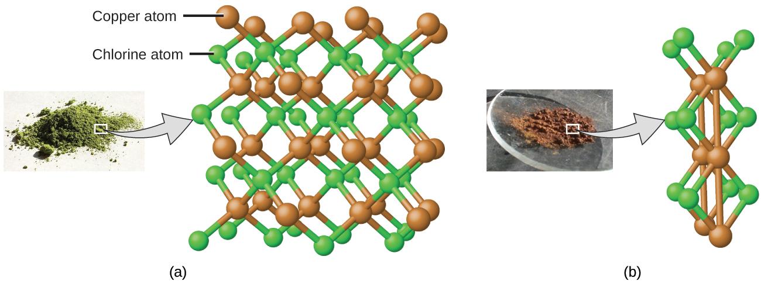
Law of multiple proportions
Law of multiple proportions: two elements can be combined in a number of different proportions or ratios to create a number of different compounds
Multiple proportions produce multiple compounds
Here Dalton riffed on Proust’s work, adding his own experiments.
Chemistry Openstax

Slide 8
Try this
Compounds A & B are both clear & odorless gases.
A sample of compound A is found to contain 4.27 g of C and 5.69 g of O. A sample of compound B is found to have 5.19 g of C and 13.84 g of O.
Are A & B examples of the law of definite proportions, the law of multiple proportions, or neither?
2

Slide 9
Can you?
(1) State all the postulates of Dalton’s atomic theory?
(2) State the law of definite proportions describe how it relates
to molecular formulas?
(3) Explain the law of multiple proportions & give an example?

Slide 10
2. Atoms, molecules & ions
2.2: Evolution of atomic theory
Outline milestones in the development of atomic theory
Summarize & interpret the results of the experiments of Thomson, Millikan & Rutherford
Describe the three subatomic particles of atoms
Define isotopes & give examples of several elements

Slide 11
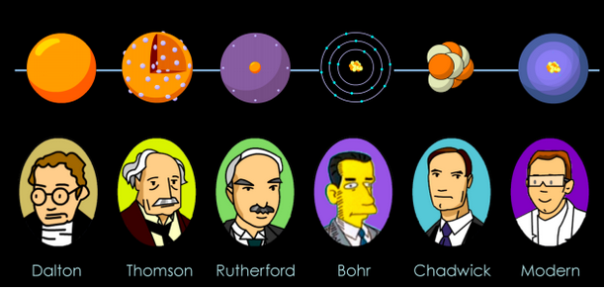
Atomic structure timeline
400 BC
1808
1897
1911
1913
1932
Note that a lack of technology, not a lack of intelligence or human imagination, kept our knowledge of the atom from advancing more quickly.

Slide 12
Thomson discovers electrons
1897, JJ Thomson used a cathode ray tube to discover the first subatomic particle, the electron.
Partially evacuated glass tube containing a cathode & anode.
When electricity is applied, a cathode ray flowed from the cathode toward the anode.
Magnets deflected the beam, showing it was negatively charged.
Calculations showed the particle was much lighter than an atom.
Chemistry Openstax

Slide 13
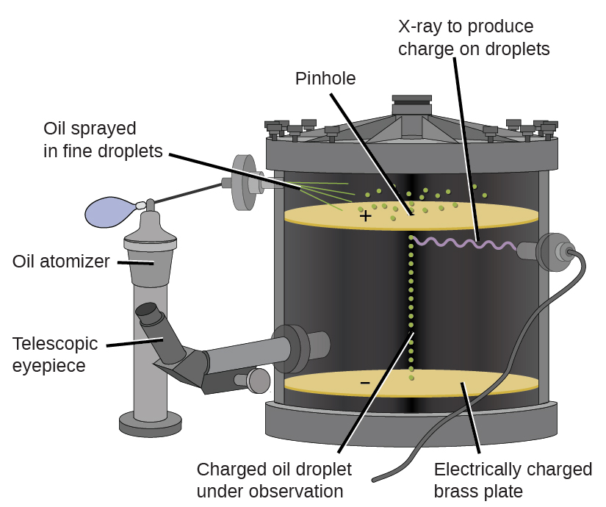
Millikan discovers electron’s charge
1909, Robert Millikan coated tiny droplets of oil with electrons & determined their charge.
The speed at which e-coated oil droplets fell could be changed by an electric field.
Calculations showed that electrons have a charge of 1.6 E-19 Coulombs & mass of 9.107 E-28 g.
Chemistry Openstax

Slide 14
New model for the atom?
So, where were the electrons located? Competing models:
Plum pudding model (Thomson)
The atom is a positively charged mass, studded with randomly placed & negatively charged electrons.
Saturn model (Nagaoka)
The atom is a positively charged mass, orbited by negatively charged electrons.
Chemistry Openstax

Slide 15
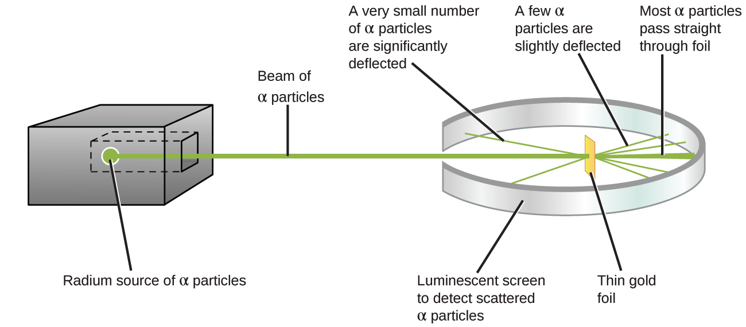
Rutherford goes nuclear
1911, Ernest Rutherford’s gold foil experiment shows that Nagaoka’s model is better → ‘nuclear’ model of the atom.
Heavy alpha particles were aimed at gold foil 1-2 atoms thick.
Most particles passed through without deflection, showing that most of the atom held light electrons.
All dense material is in the tiny central nucleus.
Chemistry Openstax

Slide 16
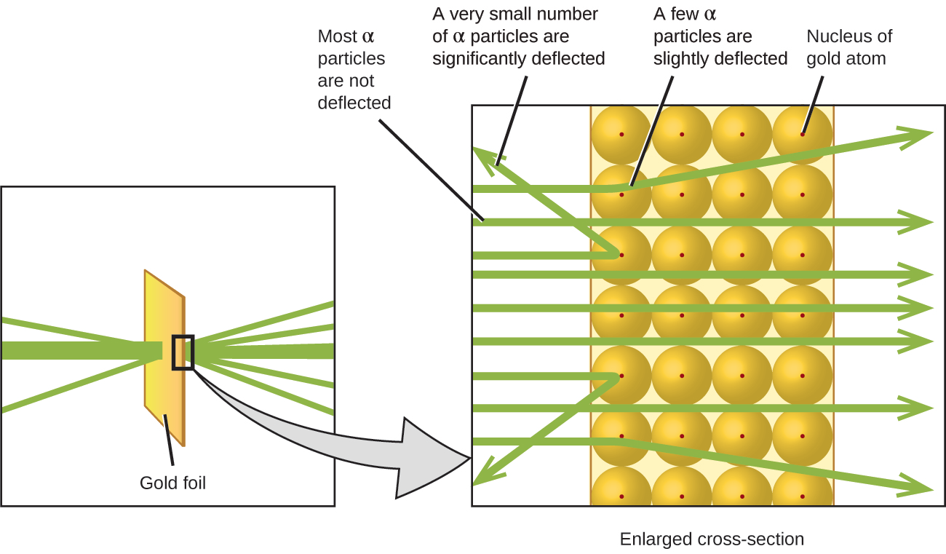
The nuclear model
How tiny is the nucleus?
The size of a tiny pea suspended in the world’s largest stadium.
Heavy alpha particles were aimed at gold foil 1-2 atoms thick.
Most particles passed through without deflection, showing that most of the atom held light electrons.
All dense material is in the tiny central nucleus.
Chemistry Openstax

Slide 17
Isotopes
Isotopes: atoms of the same element that differ in mass
Isotopes have the same number of protons & electrons, but the number of neutrons differs.
Neutrons are heavy, uncharged particles that – together with positively charged protons – are found in the nucleus.
Chemistry Openstax

Slide 18
Can you?
(1) Explain how Thomson used a cathode ray tube to discover the electron?
(2) Describe the essential difference between Thomson’s plum
pudding model and Nagaoka’s Saturn model?
(3) Explain how the nuclear model was developed from the data
Rutherford collected in his gold foil experiment?
(4) Explain how isotopes differ from ‘standard’ atoms of an element?
Chemistry Openstax

Slide 19
2. Atoms, molecules & ions
2.3: Atomic structure & symbolism
Write & interpret symbols that depict atomic number, atomic mass and charge of atoms & ions
Define the atomic mass unit & average atomic mass
Calculate average atomic mass & isotopic abundance

Slide 20
Picturing atoms
Most of the volume of the atom is occupied by electrons & is called the electron cloud.
The tiny & dense nucleus is located in the center of the atom & holds all of the heavy particles: protons & neutrons.
If an atom is the size of a superdome stadium, the nucleus is the size of a blueberry.
The angstrom (Å; 1 E-10 m) is used to measure atoms.
Chemistry Openstax

Slide 21
Protons, neutrons & electrons
Compare the atom’s three subatomic particles:
particle | location | charge (C) | charge | mass (amu) | mass (g)
electron | cloud | - 1.602 E-19 | -1 | 0.00056 | 0.00091 E-24
proton | nucleus | + 1.602 E-19 | +1 | 1.00727 | 1.67363 E-24
neutron | nucleus | none | 0 | 1.00866 | 1.67493 E-24
C is Coulomb, a unit of electric charge.
Amu is atomic mass unit, an arbitrary & comparative unit of mass.

Slide 22
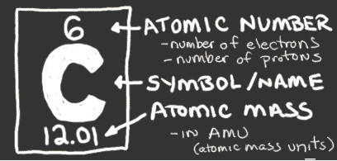
Atomic number & mass
Atomic number: the unique identifier for each atom
the number of protons in each element
also number of electrons in an atom
Atomic mass: the mass of each atom (amu or g/mole)
roughly = #p + # n
Number of neutrons: = atomic mass – atomic number
http://www.chem4kids.com/files/elements/006_shells.html

Slide 23
Calculating atomic contents
Iodine is atomic number 53 and has a mass of 127 amu. Iodine gains one electron to form iodide ions, I⁻¹.
How many protons, neutrons & electrons are there in an iodide ion?
3

Slide 24
Try this
An ion of platinum has a mass number of 195 and has 74 electrons.
How many protons & neutrons does it have?
What is its charge?
4

Slide 25
Isotope symbols
While atoms are represented by a letter or two, the symbol for an isotope must also include isotopic mass, since the mass of an isotope can be lighter or heavier than that of other atoms of the same element.
Magnesium (Mg) has three isotopes with masses of 24, 25 & 26:
²⁴Mg, ²⁵Mg, ²⁶Mg ‘magnesium 24”
All isotopes of Mg have 12 protons. Numbers of neutrons differ:
²⁴Mg 24 – 12 = 12 n
²⁵Mg 25 – 12 = 13 n
²⁶Mg 26 – 12 = 14 n
Chemistry Openstax

Slide 26
Isotope abundance
Each element can have a number of different isotopes and they occur at different abundances or frequencies (%).
element | symbol | atomic # | # p | # n | mass (amu) | %
hydrogen | ¹H | 1 | 1 | 0 | 1.0…... | 99.9885
deuterium | ²H | 1 | 1 | 1 | 2.0141 | 0.0115
tritium | ³H | 1 | 1 | 2 | 3.01605 | trace
helium | ³He | 2 | 2 | 1 | 3.01603 | 0.00013
 | ⁴He | 2 | 2 | 2 | 4.0026 | <100
carbon | ¹²C | 6 | 6 | 6 | 12.0000 | 98.89
 | ¹³C | 6 | 6 | 7 | 13.0034 | 1.11
 | ¹⁴C | 6 | 6 | 8 | 14.0032 | trace
Chemistry Openstax

Slide 27
Average atomic mass
The frequency of isotopes for each elements determines the average atomic mass shown in the periodic table.
Weighted average takes frequency & mass into account.
average atomic mass = Σ (isotopic mass)(isotopic frequency)
Boron occurs in two isotopes: 19.9% have a mass of 10.0129 amu & 80.1% have a mass of 11.0093.
Calculate the average atomic mass of boron.
5

Slide 28
Try this
A meteorite found in central Indiana contains traces of neon gas picked up from solar wind. Analysis shows 91.84% ²⁰Ne (19.9924 amu), 0.47% ²¹Ne (20.9940 amu), and 7.69% ²²Ne (21.9914 amu).
Calculate the average atomic mass of neon in solar wind.
6

Slide 29
Tougher!
Naturally occurring chlorine has two isotopes, ³⁵Cl (34.96885 amu) and ³⁷Cl (36.96590 amu). The average atomic mass is 35.453 amu.
Calculate the abundance (frequency) of each chlorine isotope.
7

Slide 30
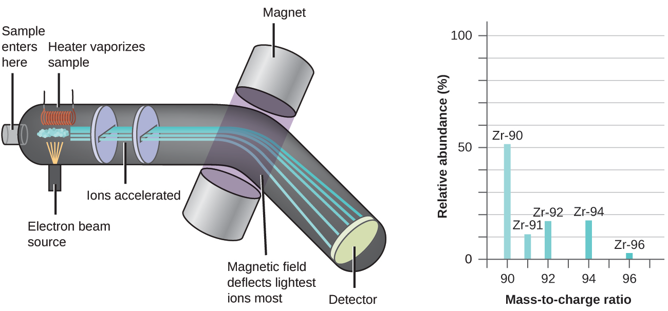
Mass spectrometer
An incredibly useful instrument called a mass spectrometer can determine the presence & frequency of elements & isotopes in a sample whose identity is unknown.
see CSI
Chemistry Openstax

Slide 31
Can you?
(1) Describe the nuclear model of the atom?
(2) List the three subatomic particles, their relative masses &
charges?
(3) Give the number of protons, neutrons & electrons found in any
atom using the periodic table?
(4) Describe the number added to an atomic symbol to identify an
isotope?
(5) Calculate average atomic mass from isotopic mass & frequency?
(6) Give a basic description of how a mass spec separates isotopes?

Slide 32
2. Atoms, molecules & ions
2.4: Chemical formulas
Symbolize the composition of molecules using molecular formulas & empirical formulas
Represent the bonding arrangement of atoms within molecules using structural formulas

Slide 33
Molecular formulas
Molecular formula: the exact types & numbers of atoms in a molecule
Subscripts give the number of each atom in the molecule.
No subscript means there’s a single atom.
Structural formula: shows how the atoms in a molecule are connected or bound together
Ball & stick: shows geometry of bonded atoms
Space-filling: shows relative sizes of bonded atoms
Chemistry Openstax

Slide 34
Examples
In nature sulfur is found as S₈, called elemental sulfur.
In nature hydrogen is found as hydrogen gas, H2.
Chemistry Openstax

Slide 35
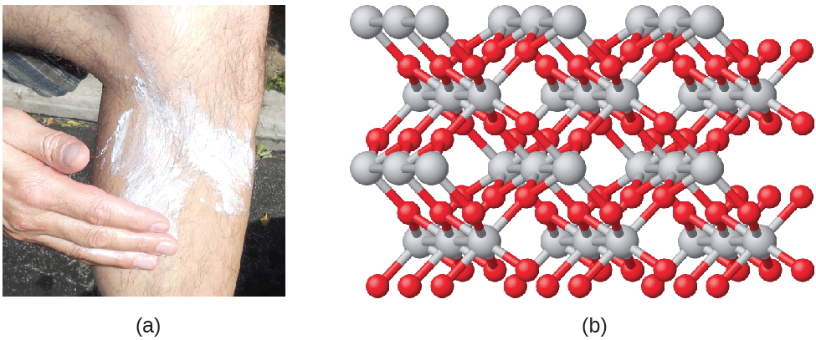
Empirical formula
Empirical formulas are simplified versions of molecular formulas.
The simplest whole-number ratio of atoms in a molecule.
TiO2 (titanium dioxide) is the empirical formula for the molecule shown below & used as a sunblock.
Note that the molecule can include many repeats of the empirical formula.
Chemistry Openstax

Slide 36
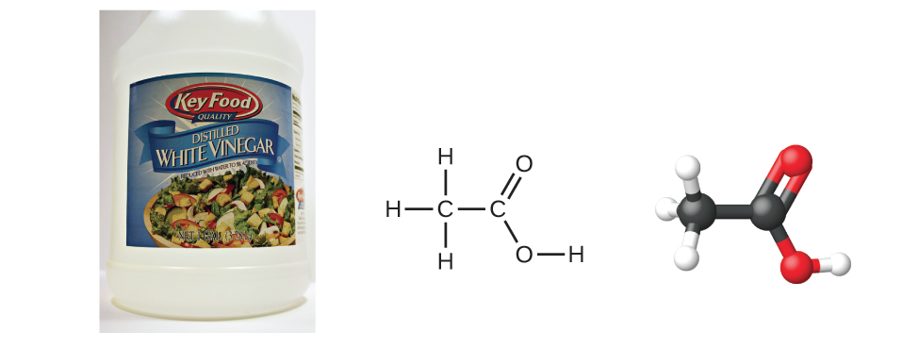
Molecular & empirical formulas?
Benzene:
8
Acetic acid:
Chemistry Openstax

Slide 37
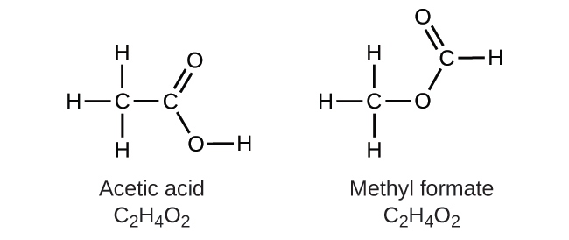
Structural isomers
Structural isomers: distinct & different molecules that share the same molecular formula but have different structural formulas
Isomers have different physical & chemical properties
Chemistry Openstax

Slide 38
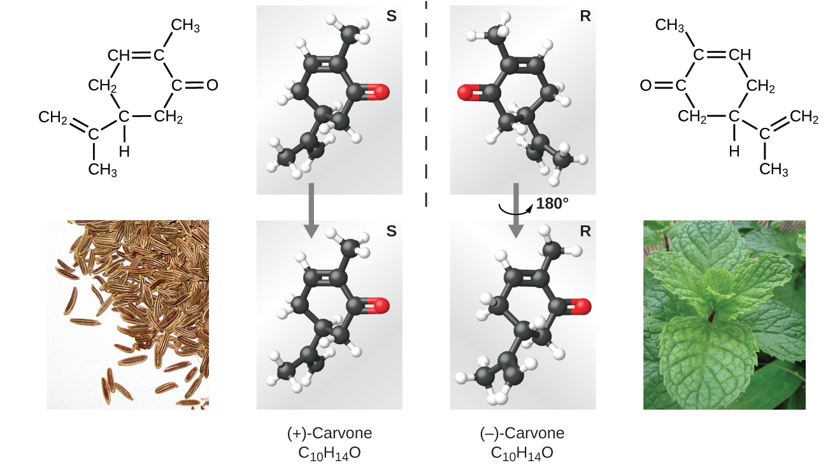
Spatial isomers
Spatial isomers: distinct & different molecules that share the same molecular formula and structural formulas, but different arrangements in 3D space
Many properties are the same but others differ.
Chemistry Openstax

Slide 39
Can you?
Describe the differences between molecular formula, empirical formula, structural formula, ball & stick models & space-filling models?
(2) Derive empirical formulas from molecular formulas?
Explain why structural isomers have distinct physical &
chemical properties?
Describe the difference between structural isomers & spatial
isomers?

Slide 40
2. Atoms, molecules & ions
2.5: The periodic table
State the periodic law & explain the organization of elements in the periodic table
Predict general properties of elements based on their location in the periodic table
Identify metals, nonmetals & metalloids by their properties and/or location in the periodic table

Slide 41
Periodic law
Periodic law: properties of elements are periodic functions of their atomic numbers
Period (row) = valence shell #
Group (column) = same e- configuration
Chemistry Openstax

Slide 42
Metals, nonmetals & metalloids
Metals: shiny, malleable, ductile, conduct electricity & heat
Nonmetals: dull, poor conductors of electricity & heat
Metalloids: intermediate between metals & non; somewhat conductive
Chemistry Openstax

Slide 43
Can you?
State the periodic law?
Describe what is common to elements in the same column vs. those in the same row?
(3) Describe the location of metals, non-metals, transition metals and metalloids in the periodic table and the differences between these types of elements?
(4) Locate these types of elements in the periodic table?
Alkali metals
Alkali earth metals
Halogens
Noble gases

Slide 44
2. Atoms, molecules & ions
2.6: Molecular & ionic compounds
Define ionic & molecular (covalent) compounds
Predict the type of compound formed from elements based on their location within the periodic table
Determine formulas for simple ionic compounds

Slide 45
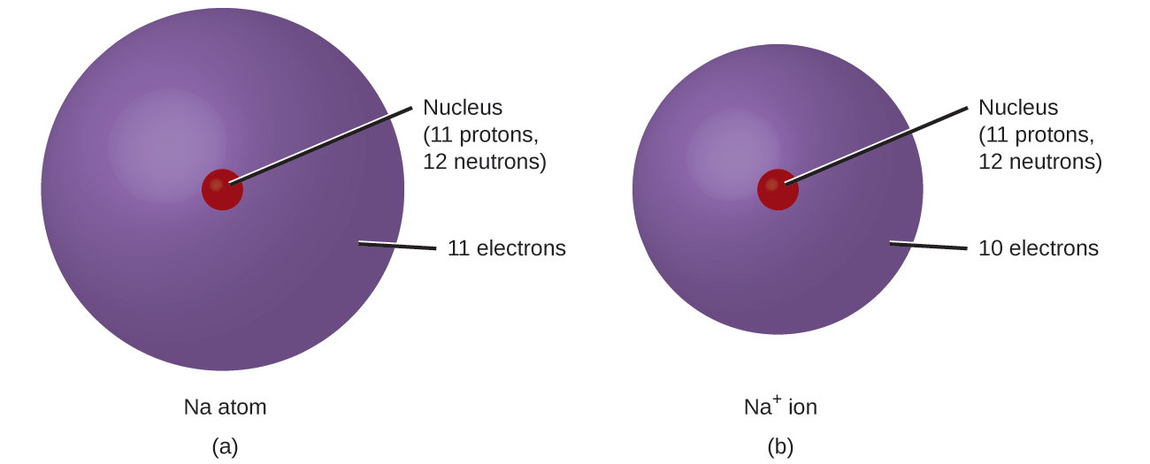
Monoatomic ions
Monoatomic ions: single atoms that have lost or gained electrons & are therefore electrically charged
Metals: lose enough e- to leave the number of e- of the preceding noble gas; become + cations
Nonmetals: gain enough e- to give the number of e- of the next noble gas; become - anions
Chemistry Openstax

Slide 46
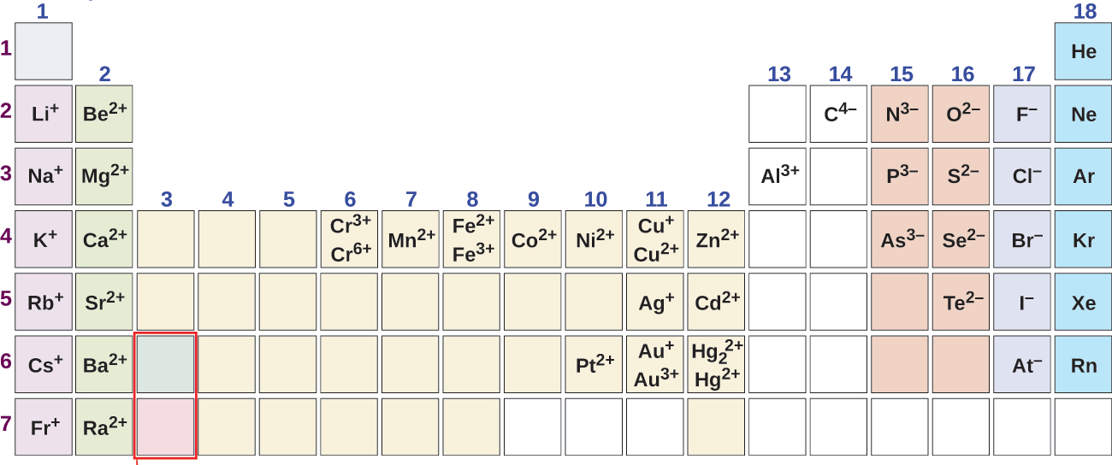
Predicting ionic charge
Notice the pattern that relates charge to column.
Why is charge consistent within a column?
9
Chemistry Openstax

Slide 47
Try these
Some antiperspirants use an element with 13 protons that has 10 electrons when it forms an ions?
What is the element & what is its ionic charge?
10
Magnesium & nitrogen can react to form an ionic compound.
Predict the charges for each ion.
11

Slide 48
Polyatomic ions
Polyatomic ions: charged molecules, a group of bonded atoms with an electric charge
Name | formula
ammonium | NH4⁺¹
hydronium | H3O⁺¹
peroxide | O2⁻²
hydroxide | OH⁻¹
acetate | CH3COO⁻¹
cyanide | CN⁻¹
azide | N3⁻¹
carbonate | CO3⁻²
bicarbonate | HCO3⁻²
nitrate | NO3⁻¹
nitrite | NO2⁻¹
sulfate | SO4⁻²
Most are oxyanions: a non-metal combined with oxygen atoms, creating a unit with a negative charge
We’ll cover this in detail in lab.

Slide 49
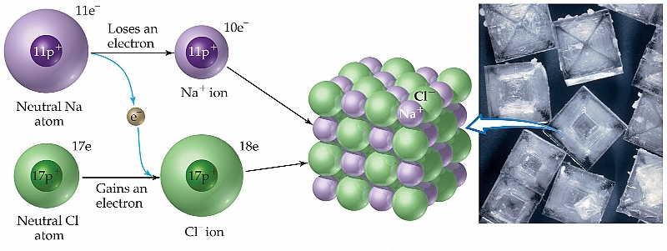
Ionic compounds
Ionic compounds: form when metals react with nonmetals, causing transfer of electrons from metals to nonmetals, creating ions with opposing & attractive forces that bond via charge or ionic bonds.
Motivation? Ions are more stable, have a lower energy, than atoms & so both atoms are stabilized.
Notice that e- transfer obeys the law of conservation of mass.

Slide 50
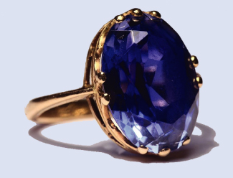
Formulas of ionic compounds
When atoms ionize to form ionic compounds, cations & anions combine at ratios that create a neutral, uncharged compound.
Formulas of ionic compounds are always ‘empirical’.
Sapphires are formed from the ionic compound aluminum oxide. What’s its formula?
13
Chemistry Openstax

Slide 51
Try these
What’s the formula of a compound formed from sodium and sulfur?
14
What’s the formula of a compound formed from calcium and the polyatomic ion dihydrogen phosphate?
15

Slide 52
Molecular compounds
Molecular compounds: form when non-metals share electrons, creating covalent bonds
Properties?
Often gases, liquids with low boiling points or solids with low melting points
Chemistry Openstax

Slide 53
Ionic or molecular?
Predict whether these compounds are ionic or molecular:
16
KI
H2O2
CHCl3
Li2(CO3)
Chemistry Openstax

Slide 54
Can you?
Define the terms ion, cation and anion?
Differentiate between monoatomic and polyatomic (and oxyanions) ions?
Use the periodic table to predict the charge of monoatomic
ions?
Explain why the formation of cations and anions is inextricably
linked?
Add subscripts to create proper (empirical) formulas for ionic
compounds?
(6) Identify ionic vs. molecular vs. compounds by their formulas?

Slide 55
Lecture 2, Atoms, etc.: terms to know
actinide
alkali metal
alkali earth metal
alpha (α) particle
anion
atomic mass
atomic mass unit
atomic number
cation
chalcogen
chemical symbol
covalent bond
covalent compound
Dalton’s atomic theory
electron
empirical formula
group
halogen
inert gas
inner transition metals
ion
ionic bond
ionic compound
isomer
isotope
lanthanide
law of constant composition
law of definite proportions
law of multiple proportions
main group element
metal
metalloid
molecular compound
molecular formula
monoatomic ion
neutron
noble gas
nomenclature
nonmetal
nucleus
oxyanion
period
periodic law
periodic table
pnictogen
polyatomic ion
proton
spatial isomer
structural formula
structural isomer
transition metal

