Slide 1
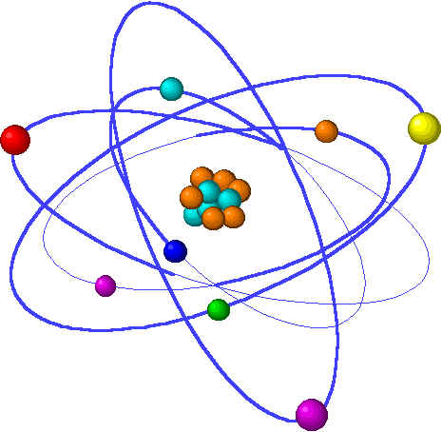
CHE1031 Lecture 10: Reaction kinetics
Lecture 10 topics Brown chapter 14
1. Reaction rates
Factors that effect reaction rates 14.1
Visualizing rates & units 14.2
Average reaction rates
Instantaneous reaction rates
Stoichiometry & reaction rates
2. Concentration & reaction rates 14.3
Rate laws
Reaction orders
3. Change in concentration with time 14.4
First- & second-order reactions
Half-life
4. Temperature & reaction rate 14.5
Collision, orientation & Ea
5. Reaction mechanisms 14.6
Elementary
Multistep
6. Catalysis ` 14.7

Slide 2
Change in concentration with time
First- and second-order reactions
Half-lives
Notes:
The general process of advancing scientific knowledge by making experimental observations and by formulating hypotheses, theories, and laws.
It’s a systematic problems solving process AND it’s hands-on….. Experiments must be done, data generated, conclusions made.
This method is “iterative”; it requires looping back and starting over if needed. [Why do you think they call it REsearch?] Often years, decades or more of experiments are required to prove a theory.
While it’s possible to prove a hypothesis wrong, it’s actually NOT possible to absolutely prove a hypothesis correct as the outcome may have had a cause that the scientist hasn’t considered.

Slide 3
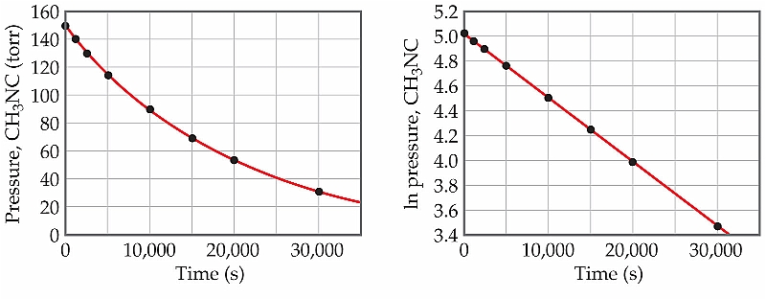
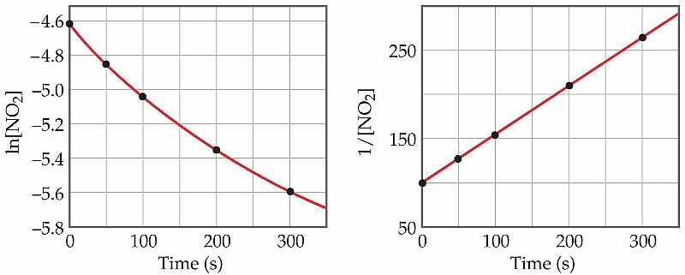
Change in concentration with time
Plotting the change in concentration of a reactant with time can help to determine whether the reaction is first or second order. Try plotting:
[reactant] vs. time
ln [reactant] vs. time
1/[reactant] vs. time
→ First-order
→ Second-order
CH3NC → CH3CN
ln[A]_{t} = -kt + ln[A]₀
y = mx + b
NO2 → NO + 1/2O2
1 = kt + 1
[A]_{t} [A]₀
y = mx + b
p. 569 - 71

Slide 4
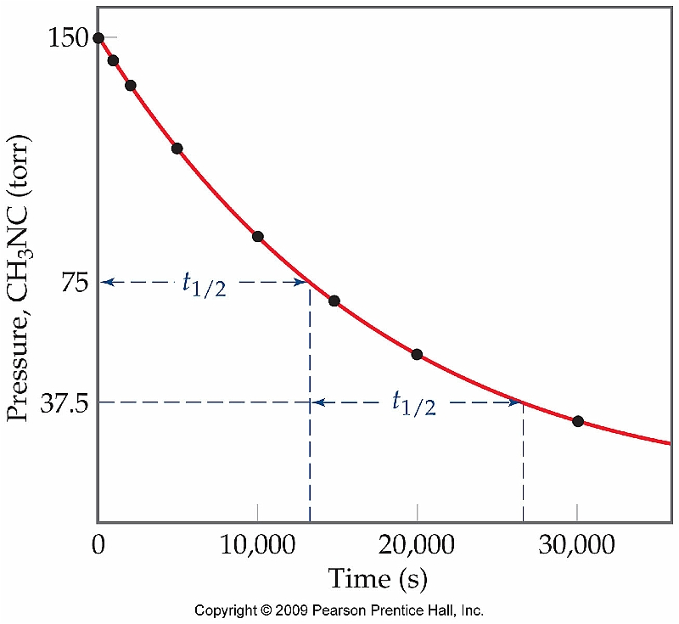
Half-life
Half-life is the time required for the concentration of a reactant to decrease to ½ its initial value (t1/2).
Half-lives differ for first- & second-order reactions:
1st t1/2 = 0.693
k
2nd t1/2 = 1 _
k[A]₀
p. 571 - 5

