Slide 1
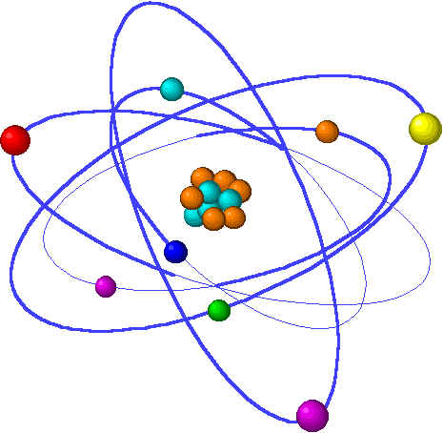
CHE1031 Lecture 11: Chemical equilibrium
Lecture 11 topics Brown chapter 1
1. Concept of equilibrium 15.1
Equilibrium reactions are reversible
2. The equilibrium constant 15.2
Law of mass action
Equilibrium constant expressions
3. Working with equilibrium expressions 15.3
What does Kc tell us?
Kc & direction of reaction
4. Le Chatelier’s Principle 15.7
Application to Haber reaction
Changes of concentration
Changes in volume & pressure
Changes in temperature
5. Catalysts & equilibrium

Slide 2
What does Kc tell us?
The ‘direction’ of reaction
Notes:
The general process of advancing scientific knowledge by making experimental observations and by formulating hypotheses, theories, and laws.
It’s a systematic problems solving process AND it’s hands-on….. Experiments must be done, data generated, conclusions made.
This method is “iterative”; it requires looping back and starting over if needed. [Why do you think they call it REsearch?] Often years, decades or more of experiments are required to prove a theory.
While it’s possible to prove a hypothesis wrong, it’s actually NOT possible to absolutely prove a hypothesis correct as the outcome may have had a cause that the scientist hasn’t considered.

Slide 3
What can Kc tell us?
The magnitude of Kc can tell us about the relative concentrations of reactants & products that exist at equilibrium.
Kc >> 1 [products] >> [reactants]
Kc =1 [products] = [ reactants]
Kc << 1 [products] << [reactants]
products
reactants
reactants
products
Kc >> 1
Kc << 1
p. 635-7

Slide 4
Direction of reaction?
If you’ve calculated Kc for the forward reaction, the Kc for the reverse reaction is simply the inverse: 1/Kc
N2O4 2NO2 Kc = [NO2]² = 0.212 @ 100°C
[N2O4]
2NO2 N2O4 Kc = [N2O4] = 1 = 4.27 @ 100°C
The equilibrium constant for the reaction shown below is, Kc = 1x10⁻³⁰ @ 25C.
N2 + O2 2NO
So, write the equilibrium expression, and calculate Kc for this reaction:
2NO N2 + O2
Kc = [N2][O2] = 1 = 1 = 1x10³⁰
[NO]² Kc 1x10⁻³⁰
p. 635-7

