Slide 1
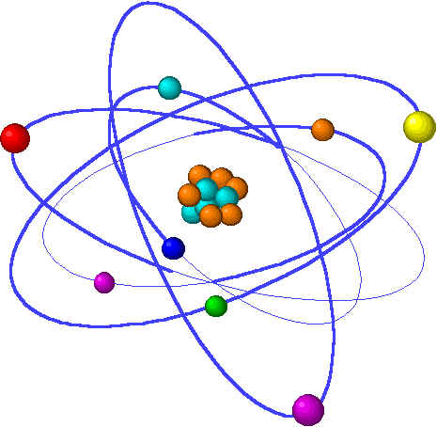
CHE1031 Lecture 11: Chemical equilibrium
Lecture 11 topics Brown chapter 1
1. Concept of equilibrium 15.1
Equilibrium reactions are reversible
2. The equilibrium constant 15.2
Law of mass action
Equilibrium constant expressions
3. Working with equilibrium expressions 15.3
What does Kc tell us?
Kc & direction of reaction
4. Le Chatelier’s Principle 15.7
Application to Haber reaction
Changes of concentration
Changes in volume & pressure
Changes in temperature
5. Catalysts & equilibrium

Slide 2
Chapter 15: Terms to Know
Static equilibrium
Dynamic equilibrium
Chemical equilibrium
Forward & reverse reactions
Haber reaction
Law of Mass Reaction
Equilibrium expression
Le Châtelier’s Principle
“disturbance”
Notes:
PLEASE note that the formula calculates a weighted average, so there’s not need to add and then divide the sum by the number of isotopes in the problem. This is an incredibly common student error so don’t get caught!

