Slide 1
1. Essential ideas
1.2 Phases & classification of matter
Describe the basic properties of physical states
Define atoms & molecules
Classify matter as elements, compounds, or homo- or heterogeneous mixtures
Distinguish between mass & weight
Apply the law of conservation of matter

Slide 2
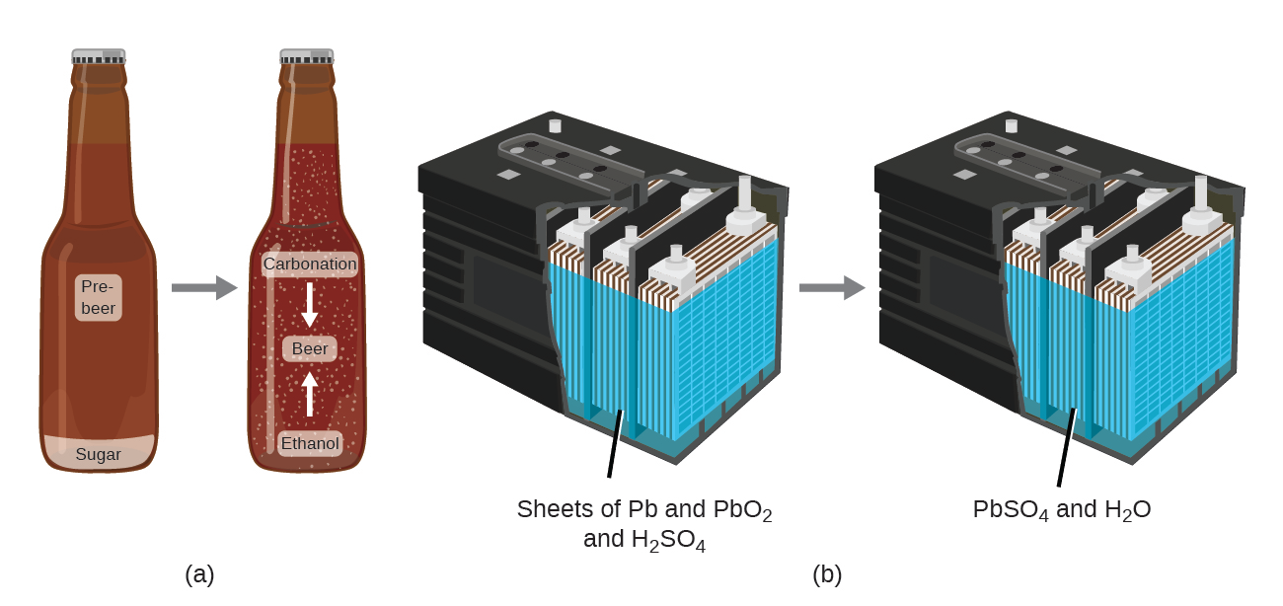
Law of conservation of mass
Much of what we do this semester will seek to obey the law of conservation of mass:
Mass is conserved, neither created nor destroyed… by physical and chemical change.
Fermentation changes sugar to alcohol or CO2, but mass doesn’t change
Redox reactions cause the battery to produce electric current & change the chemical nature of its components.
But the battery’s mass doesn’t change.
Chemistry Openstax

Slide 3
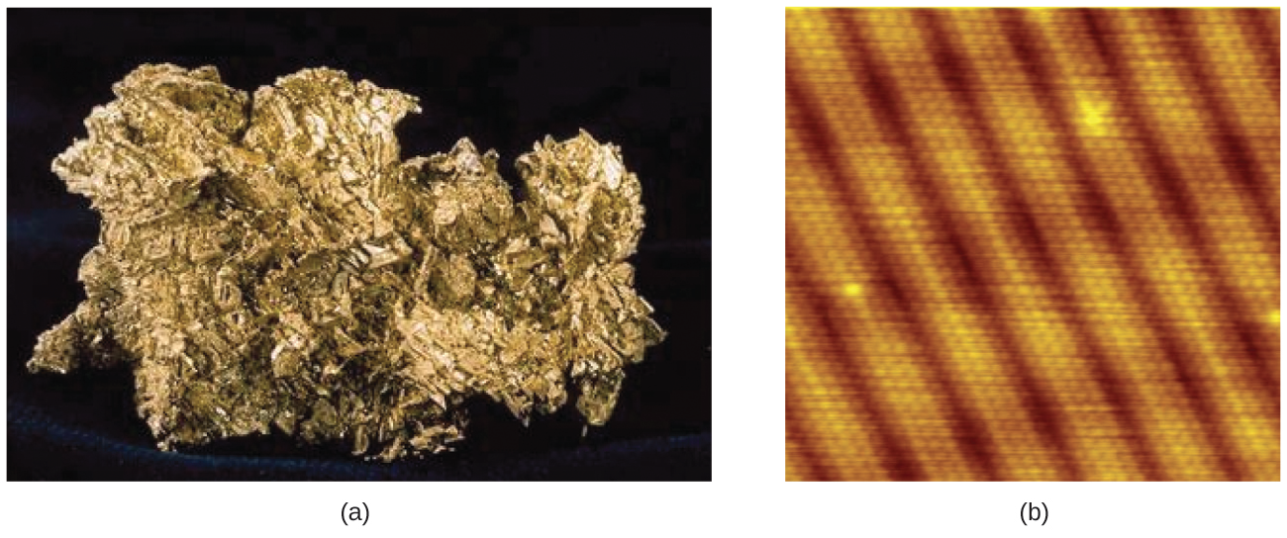
Atoms of elements
Atoms: the smallest unit of matter that has the properties of that matter & can undergo chemical reaction
From the Greek atomos: indivisible or ‘uncuttable’
Atoms vs. elements?
The periodic table has more than 100 elements.
Each element has distinct physical & chemical properties.
Each element can exist in varying amounts, and atom is the smallest amount of any element.
nugget of pure gold (Au)
Atoms of gold in a gold crystal (SEM)
Chemistry Openstax

Slide 4
Atomic scale
molecular close up showing atoms
1.5 E-8 cm each
single strand of cotton (SEM, higher mag)
cotton boll
single strand of cotton (X40)
0.0001 cm
molecular model of cotton fiber
Chemistry Openstax

Slide 5
Molecules
Molecules: two or more atoms combined at a constant ratio
That’s the law of constant composition
Chemical bonds: strong forces joining the atoms in molecules
Molecular formulas: the types & numbers of atoms in a molecule
Note that some define molecules & compounds differently. I’m going to use these terms as synonyms.
diatomic
Chemistry Openstax

Slide 6
Classifying matter
Pure substance: has constant composition
Mixture: has varying composition of elements or molecules
Element: can’t be chemically broken down or simplified
Homogenous: uniform throughout (smooth)
Solution = liquid homogenous mixture
Compound (molecule): can be chemically broken down into elements
Heterogeneous: not uniform throughout (chunky)

Slide 7
Decomposition of molecules
Here’s an example of how compounds or molecules can be broken down (decomposed) into simpler compounds or elements by a chemical reaction:
2HgO (s) + heat → 2Hg (l) + O2 (g)
Openstax VIDEOS
HgO (mercury II oxide)
→
adding heat to cause decomposition
Hg(l)+ O2(g)
Chemistry Openstax

Slide 8
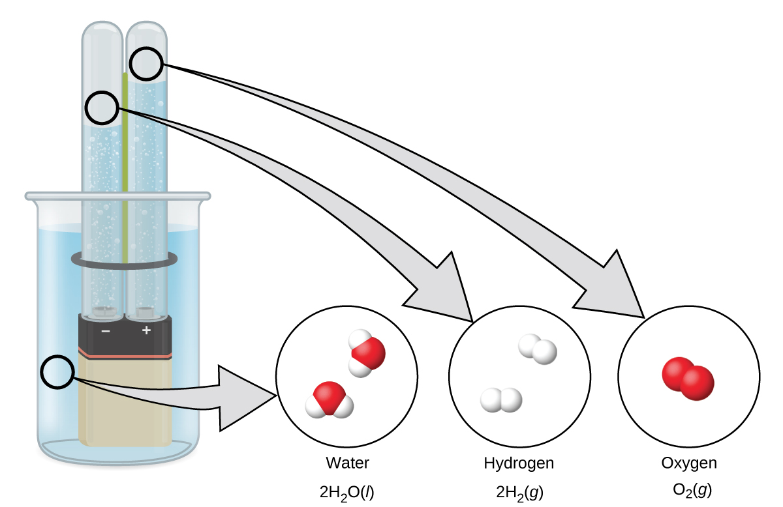
Physical decomposition
XXX
Here electricity is used to decompose water into hydrogen & oxygen gases:
H2O (l) + e- → H2 (g) + O2 (g)
What’s the ratio of H2 to O2?
Chemistry Openstax

Slide 9
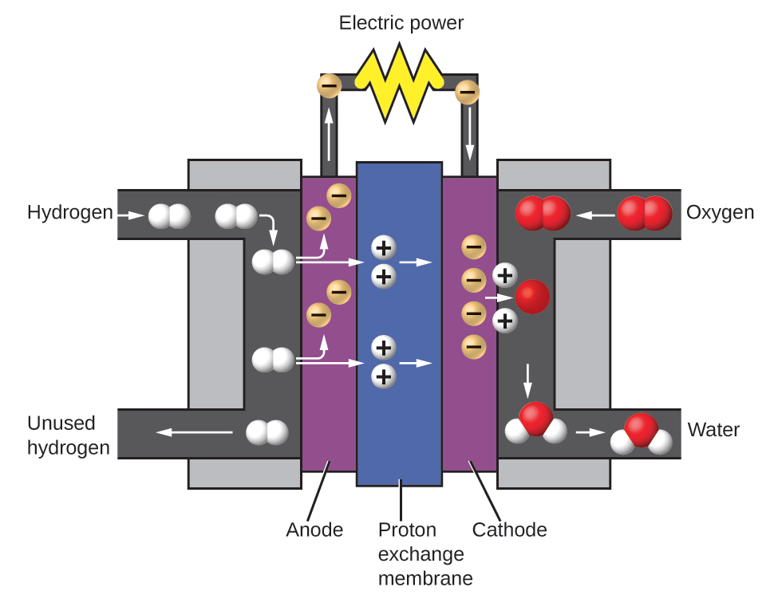
Practical application: fuel cells
Electrolysis of water can be used to store electricity as hydrogen gas.
Hydrogen gas can then be used to produce electricity using fuel cell technology
Chemistry Openstax

Slide 10
Homo- vs. heterogeneous mixtures
heterogeneous mixture
homogenous mixture
A salad dressing of oil & vinegar has distinct & visible parts.
As the mixture settles droplets of oil are visible.
Sports drink solutions are uniform throughout.
Mixtures occur in all physical states. Examples?
3
Chemistry Openstax

Slide 11
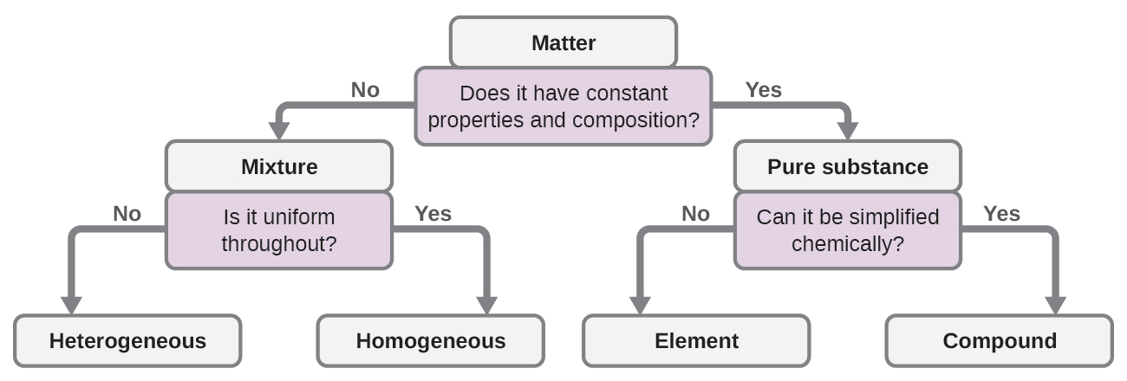
Ask yourself these questions
During this course you may find it useful to organizing information into flowcharts, lists of steps, or using diagrams like this one.
Chemistry Openstax

Slide 12
Can you?
(1) Differentiate between the physical states of matter?
(2) Explain the difference between mass and weight?
(3) Explain why the law of conservation of mass is particularly important to chemistry?
(4) Define and differentiate between atoms, elements &
molecules?
(5) Differentiate between pure substances & mixtures?
(6) Differentiate between homogeneous & heterogeneous
mixtures?

