Slide 1
1. Essential ideas
1.4 Measurements
Explain the process of measurement
Identify three basic parts of a measure of quantity
Describe the properties & units of length, mass, volume, density, temperature & time
Perform basic unit calculations & conversions

Slide 2
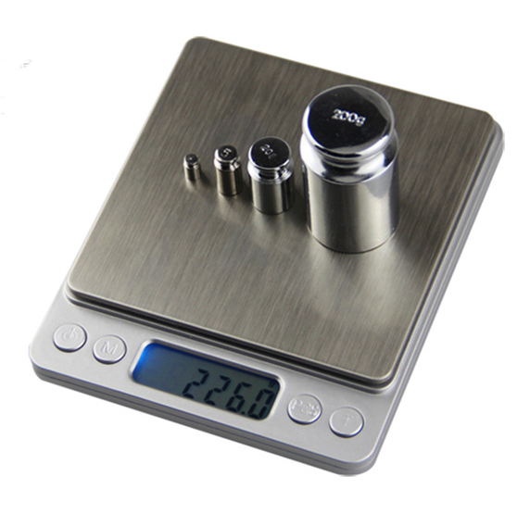
Every measurement has three parts
In science, every measurement has three essential elements:
Number or value
Unit
Uncertainty
226.0
g (grams)
226.0 ± 0.1 g
Chemistry Openstax

Slide 3
Scientific notation
Scientific notation allows us to express very large or small values while focusing on significant digits.
The maximum takeoff weigh of a jet is:
298,000 kg
5
2.98 x 10⁵ kg
2.98 E5 kg
The average weight of a mosquito is:
0.0000025 kg
6
2.5 x 10⁻⁶ kg
2.5 E-6 kg
What’s the best way to use a calculator for scientific notation?
7
Use EE! I strongly advise against the ‘^’.

Slide 4
Units
Science uses the metric system, or SI units.
quantity | unit | symbol
length | meter | m
mass | gram | g
time | second | s
temperature | Celsius / Kelvin | C / K
amount | mole | mol
The Kelvin scale is used to measure the temperature of gases.
Kevin = Celsius + 273.15

Slide 5
Unit prefixes
Unit prefixes can be used in place of scientific notation.
Express these with unit prefixes instead of scientific notation:
8 E9 years
3,000,000 Hz
2 E-3 moles
1 E-6 L
prefix | symbol | factor
tera | T | 10¹²
giga | G | 10⁹
mega | M | 10⁶
kilo | k | 10³
centi | c | 10⁻²
milli | m | 10⁻³
micro | μ | 10⁻⁶
nano | n | 10⁻⁹
pico | p | 10⁻¹²
femto | f | 10⁻¹⁵
8
8 Gyr
3 MHz
2 mmol
1 μL
Notice the pattern? Exponents change by 3.

Slide 6
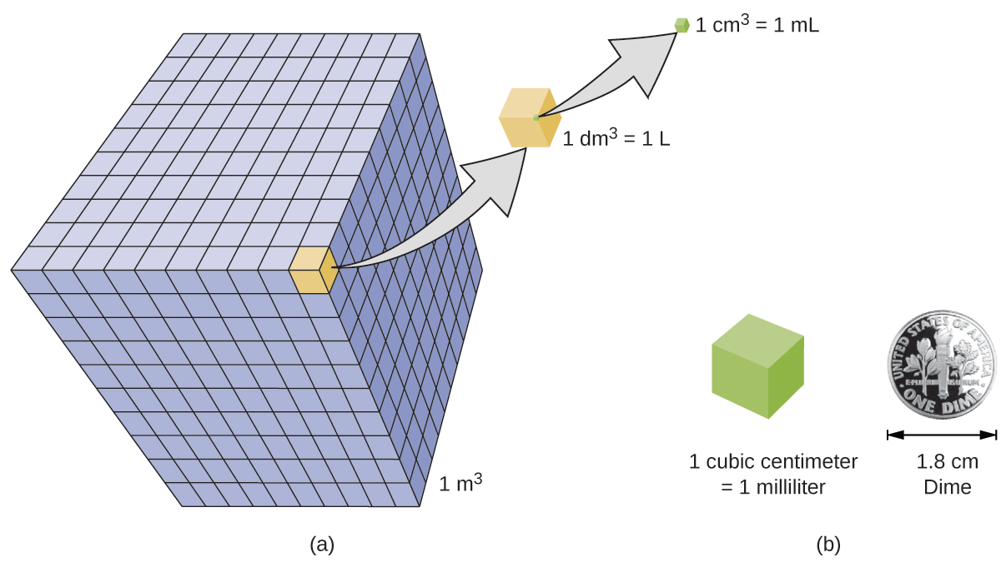
Derived units
Derived unit are created by combining SI units.
Volume can be expressed as a cubic length.
Chemistry Openstax

Slide 7
Density
Density: the ratio of mass to volume (g/mL)
density (ρ) = mass .
volume
Is density an intensive or extensive property? Why?
9
solids (g/mL)
liquids (g/mL)
gases (g/L)
ice | 0.92 | water | 1.0 | dry air | 1.20
oak | 0.60- 0.90 | ethanol | 0.79 | oxygen | 1.31
iron | 7.9 | acetone | 0.79 | nitrogen | 1.14
copper | 9.0 | glycerin | 1.26 | CO2 | 1.80
lead | 11.3 | olive oil | 0.92 | helium | 0.16
silver | 10.5 | gasoline | 0.70-0.77 | neon | 0.83
gold | 19.3 | mercury | 13.6 | radon | 9.1
Notice that the density of gases is measured in g/L as it’s significantly lower.

Slide 8
Calculating density
What is the density of a cube of lead each side of the cube measures 2.00 cm and the cube’s mass is 90.7 g?
10
volume = cubic length = (2.00 cm)³ = 8.00 cm³
density = mass = 90.7 g = 11.3 g/cm³
volume 8.00 cm³
What is the volume of a cube with edge lengths of 0.843 cm?
volume = cubic length = (0.834 cm)³ = 0.599 cm³
11
If the mass of that cube is 5.34 g, what is the density of the cube?
12
density = mass = 5.34 g = 8.91 g/cm³
volume 0.599 cm³

Slide 9
Can you?
(1) Describe the three parts of any measurement?
(2) Convert numbers in and out of scientific notation?
(3) Replace scientific notation with metric prefixes?
(4) Relate density to mass and volume and solve for any of the
three given the other two?

