Slide 1
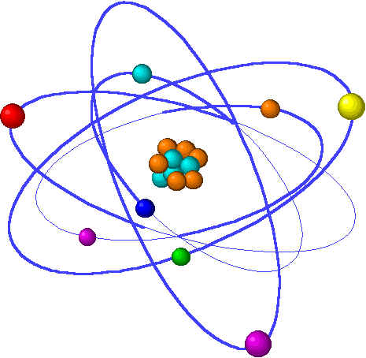
Lecture 2: Atoms, isotopes, ions & molecules
Topics Brown, chapter 2
1. Dalton’s Atomic Theory 2.1
Four postulates
2. Molecules & formulas 2.6
Molecular vs. empirical
3. Discovery of atomic structure 2.2
Subatomic particles
Radioactivity
Nuclear atom
4. Sub-atomic particles & the periodic table 2.3
Atomic number & mass
Isotopes
5. Atomic weights 2.4
Average atomic mass
Mass spectroscopy
6. Periodic table 2.5
7. Ions & ionic compounds 2.7
Ionic charges
8. Naming chemical compounds 2.8
Ionic compounds (salts), molecular compounds, & acids
Notes:
“Grey” topics will be covered next week. Labor day has made this week bit short for a full chapter.

Slide 2
Discovery of atomic structure
Electrons: the first sub-atomic particle discovered
Nuclear structure replaces the plum pudding model.
Notes:
The general process of advancing scientific knowledge by making experimental observations and by formulating hypotheses, theories, and laws.
It’s a systematic problems solving process AND it’s hands-on….. Experiments must be done, data generated, conclusions made.
This method is “iterative”; it requires looping back and starting over if needed. [Why do you think they call it REsearch?] Often years, decades or more of experiments are required to prove a theory.
While it’s possible to prove a hypothesis wrong, it’s actually NOT possible to absolutely prove a hypothesis correct as the outcome may have had a cause that the scientist hasn’t considered.

Slide 3
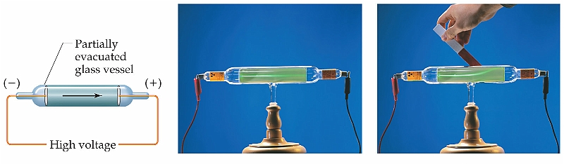
Charged subatomic particles: electrons (1897)
We now know that atoms are made of smaller subatomic particles, and that some of these are oppositely charged. How was this discovered? …. Well in the mid-1800s people began to play with electricity - at the time a new force not well understood.
A cathode ray tube (old TV set) is a partially evacuated tube to which a high voltage charge is applied, producing radiation. Magnets could deflect the rays, showing that they were charged.
J.J. Thompson showed that these rays were negatively charged - first demonstrated proof of electrons.
p.39-40
Notes:
Thompson also showed that electrons could be emitted from a number of different elements. This suggested that electrons existed in many different types of atoms.
Experiments by others, like Millikan, described the mass and charge of electrons (see p.40 - 41 and references).
What’s a cathode ray tube? A glass tube with a partial vacuum & a strong electrical current sent through it. Scientists spent a lot of time playing with electricity at the turn of the 20th century. The electric current produced radiation in the tube; the radiation caused some materials (like GLASS) to fluoresce, allowing scientists to see the radiation with the naked eye. 1897 - JJ Thompson observed that all materials produced the same ray, & that the ray was negatively charged.
(Attracted to a + charge magnet.)

Slide 4
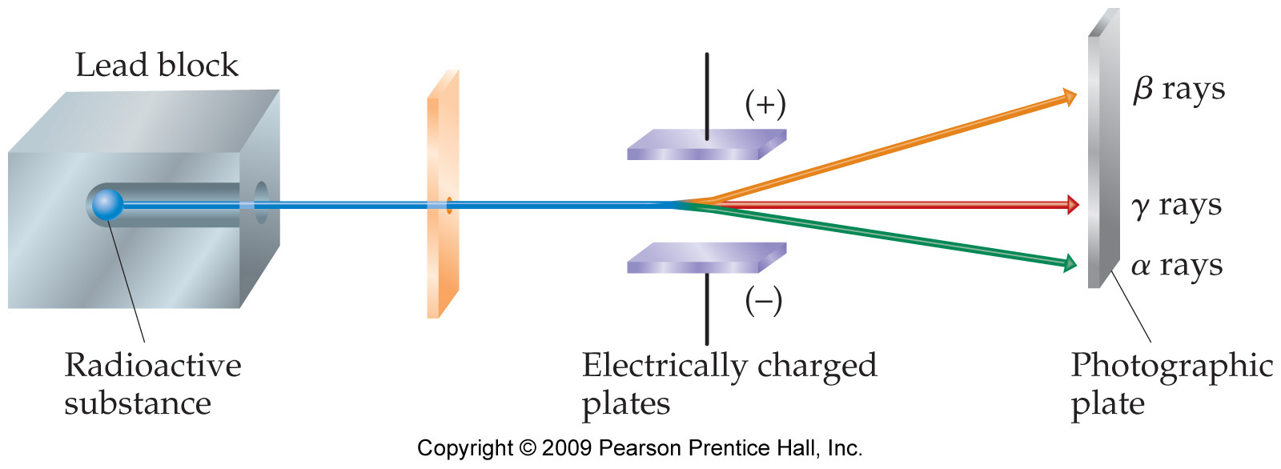
Radioactivity (1896)
Scientists studying certain ores and materials discovered that
these materials spontaneously emitted radiation - they called it
radioactivity.
Early experiments showed that there were three principal types of
radioactivity.
Alpha - fast-moving particles with a charge of +2
Beta - fast moving particles with a charge of -1
Gamma - NO particles - just a high-energy radiation - similar to x-rays
p.41

Slide 5
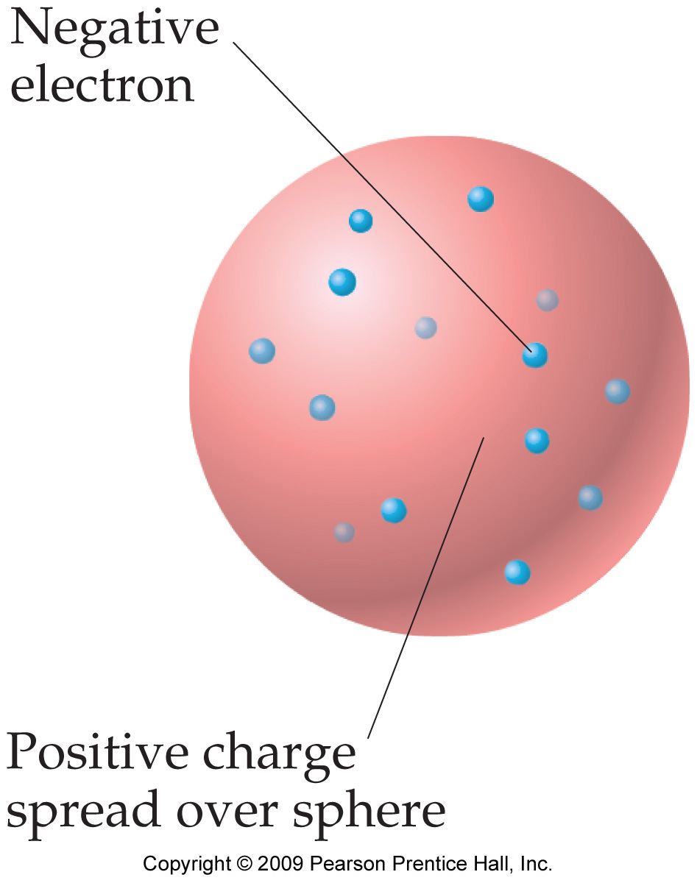
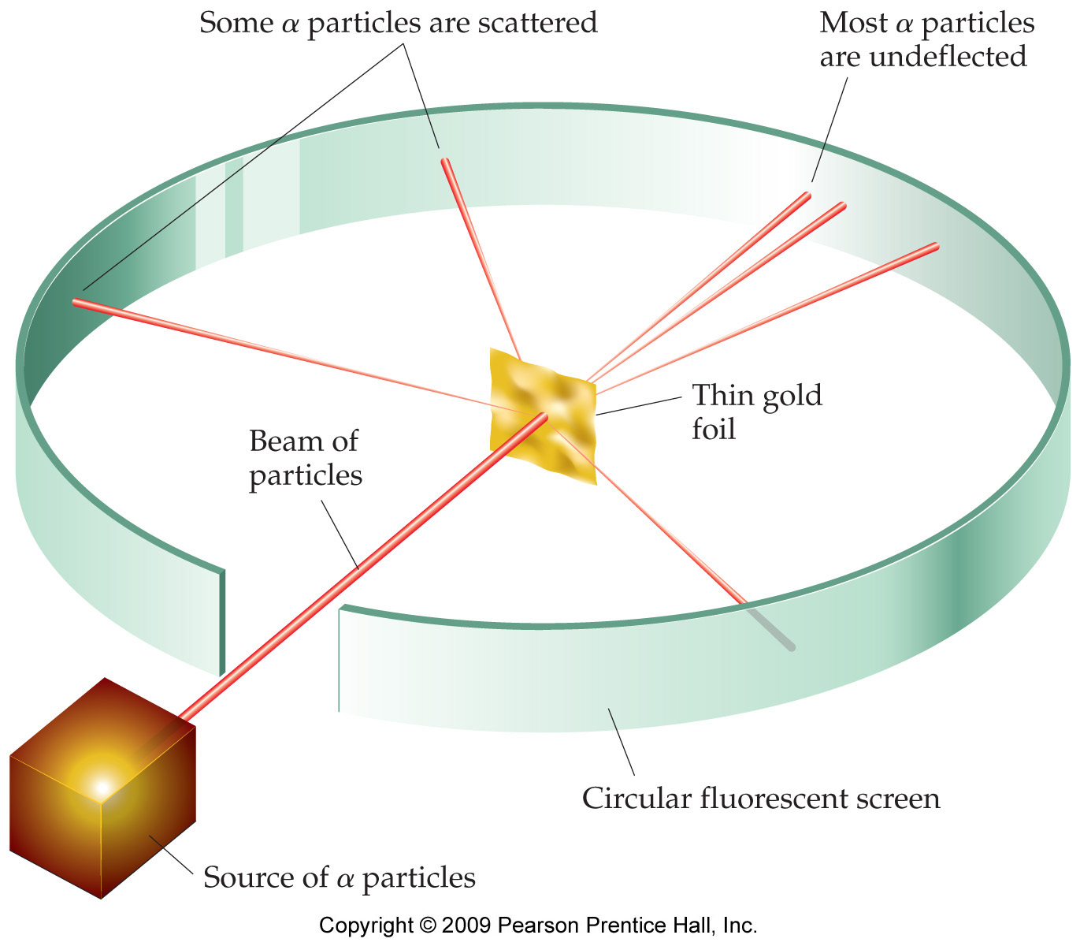
Plum pudding vs. a dense nucleus (1910)
By the early 1900s it was clear that electrons were only a
small part of the atom. But it wasn’t clear what atoms looked like.
Thompson proposed that electrons were embedded in a sphere of
positively charged matter - the plum pudding model
Seeking to gain fame & fortune by proving a famous
scientist right or wrong, young Rutherford designed
a very elegant atomic experiment - the gold foil exp’t.
Most alpha particles passed through the single layer of atoms without deflecting, indicating that they were passing though a space devoid of dense protons & neutrons. This large “empty” space is the electron cloud of modern atomic structure. Led to the nuclear model.
p.42
Notes:
Gold foil experiment:
Pound a piece of gold foil until its just a few atoms thick.
Surround the foil with a flourescent screen to detect high-energy particles.
Shoot a beam of “heavy” radioactive alpha particles at the gold foil.
Use the screen to see whether the alphas either pass through the gold atoms or are deflected by them.

Slide 6
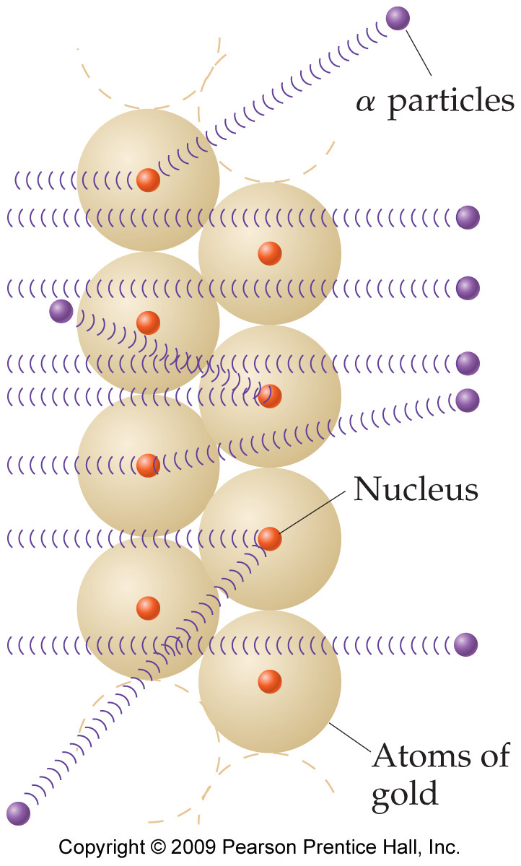
Gold foil leads to a new nuclear model!
So what did Rutherford find? He prove that the plum
pudding model couldn’t be correct.
Notice that most of the heavy alpha particles
passed right through the gold atoms. Why?
Rutherford proposed the modern nuclear model to explain his experimental data.
Dense & tiny central nucleus
Large diffuse cloud of electrons
Show animation!
p.42-3
Notes:
Most of the alpha particles passed through the gold atoms because very light electrons occupy most of the volume of the atom, while the heavy parts (capable of deflecting alphas) occupy only a very small and central portion of the atom. Alphas are statistically unlikely to encounter the dense “nucleus”.
Protons were finally discovered in 1919 by Rutherford. And in 1932 Chadwick discovered neutrons.

