Slide 1
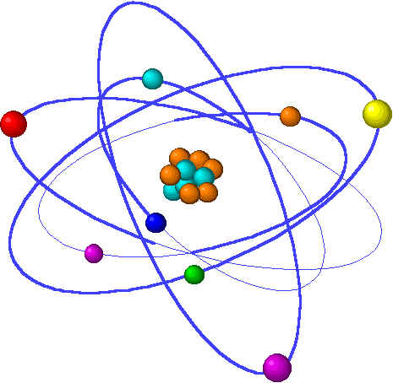
Lecture 2: Atoms, isotopes, ions & molecules
Topics Brown, chapter 2
1. Dalton’s Atomic Theory 2.1
Four postulates
2. Molecules & formulas 2.6
Molecular vs. empirical
3. Discovery of atomic structure 2.2
Subatomic particles
Radioactivity
Nuclear atom
4. Sub-atomic particles & the periodic table 2.3
Atomic number & mass
Isotopes
5. Atomic weights 2.4
Average atomic mass
Mass spectroscopy
6. Periodic table 2.5
7. Ions & ionic compounds 2.7
Ionic charges
8. Naming chemical compounds 2.8
Ionic compounds (salts), molecular compounds, & acids
Notes:
“Grey” topics will be covered next week. Labor day has made this week bit short for a full chapter.

Slide 2
Naming molecules or compounds
We’ll tackle this in a lab exercise.
Notes:
The general process of advancing scientific knowledge by making experimental observations and by formulating hypotheses, theories, and laws.
It’s a systematic problems solving process AND it’s hands-on….. Experiments must be done, data generated, conclusions made.
This method is “iterative”; it requires looping back and starting over if needed. [Why do you think they call it REsearch?] Often years, decades or more of experiments are required to prove a theory.
While it’s possible to prove a hypothesis wrong, it’s actually NOT possible to absolutely prove a hypothesis correct as the outcome may have had a cause that the scientist hasn’t considered.

Slide 3
Naming Chemical Compounds
Not the most popular of topics for this course….. ;)
There are three systems of chemical “nomenclature”, one for each type or class of molecule:
Ionic
Molecular
Acid
Rather than tackle all of this in class, we’ll be covering it in lab using handouts and worksheets.
Ionic: MgF2 magnesium fluoride
Fe2O3 iron (III) oxide
Molecular: P4S10 tetraphosphorous decasulfide
CO carbon monoxide
Acid: H2S hydrosulfuric acid
H2SO4 sulfuric acid
p.59 - 65
Notes:
PLEASE note that the formula calculates a weighted average, so there’s not need to add and then divide the sum by the number of isotopes in the problem. This is an incredibly common student error so don’t get caught!

