Slide 1
2. Atoms, molecules & ions
2.4: Chemical formulas
Symbolize the composition of molecules using molecular formulas & empirical formulas
Represent the bonding arrangement of atoms within molecules using structural formulas

Slide 2
Molecular formulas
Molecular formula: the exact types & numbers of atoms in a molecule
Subscripts give the number of each atom in the molecule.
No subscript means there’s a single atom.
Structural formula: shows how the atoms in a molecule are connected or bound together
Ball & stick: shows geometry of bonded atoms
Space-filling: shows relative sizes of bonded atoms
Chemistry Openstax

Slide 3
Examples
In nature sulfur is found as S₈, called elemental sulfur.
In nature hydrogen is found as hydrogen gas, H2.
Chemistry Openstax

Slide 4
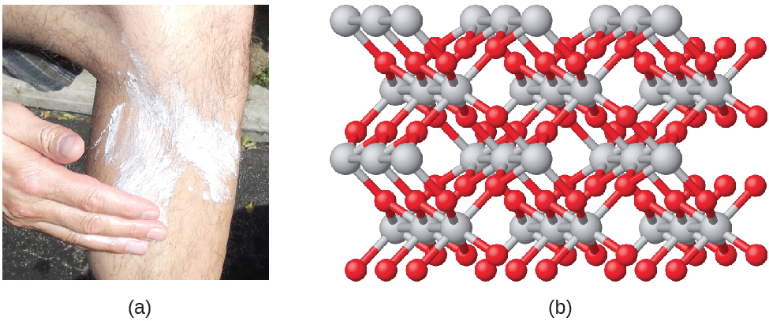
Empirical formula
Empirical formulas are simplified versions of molecular formulas.
The simplest whole-number ratio of atoms in a molecule.
TiO2 (titanium dioxide) is the empirical formula for the molecule shown below & used as a sunblock.
Note that the molecule can include many repeats of the empirical formula.
Chemistry Openstax

Slide 5
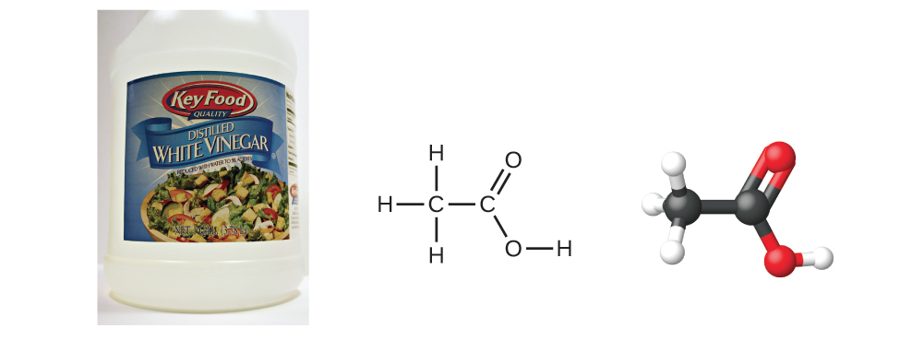
Molecular & empirical formulas?
Benzene:
molecular: C6H6 empirical: CH
8
Acetic acid:
molecular: C2H4O2 empirical: CH2O
Chemistry Openstax

Slide 6
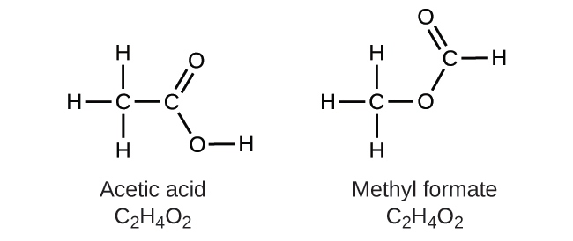
Structural isomers
Structural isomers: distinct & different molecules that share the same molecular formula but have different structural formulas
Isomers have different physical & chemical properties
colorless liquid
sharp, pungent odor
m.p. 16-17C
b.p. 118C
density 1.049 g/mL
colorless liquid
pleasant ‘ethereal’ odor
m.p. -100c
b.p. 32c
density 0.98 g/mL
Chemistry Openstax

Slide 7
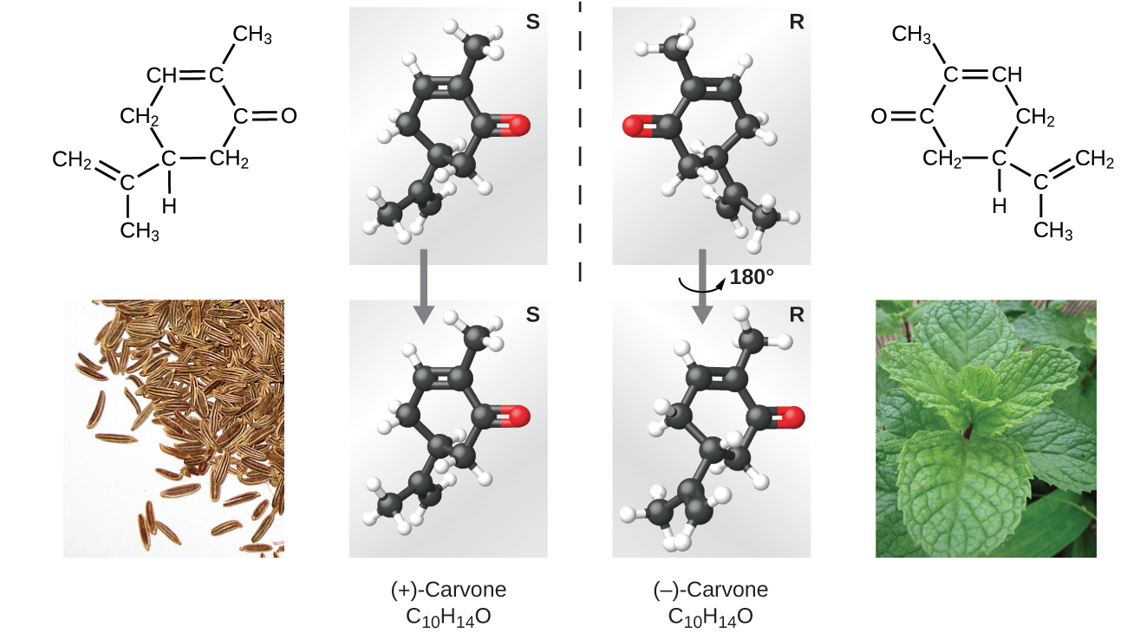
Spatial isomers
Spatial isomers: distinct & different molecules that share the same molecular formula and structural formulas, but different arrangements in 3D space
Many properties are the same but others differ.
Chemistry Openstax

Slide 8
Can you?
Describe the differences between molecular formula, empirical formula, structural formula, ball & stick models & space-filling models?
Derive empirical formulas from molecular formulas?
Explain why structural isomers have distinct physical & chemical properties?
Describe the difference between structural isomers & spatial isomers?

Slide 9
2. Atoms, molecules & ions
2.5: The periodic table
State the periodic law & explain the organization of elements in the periodic table
Predict general properties of elements based on their location in the periodic table
Identify metals, nonmetals & metalloids by their properties and/or location in the periodic table

Slide 10
Periodic law
Periodic law: properties of elements are periodic functions of their atomic numbers
Period (row) = valence shell #
Group (column) = same e- configuration
Chemistry Openstax

Slide 11
Metals, nonmetals & metalloids
Metals: shiny, malleable, ductile, conduct electricity & heat
Nonmetals: dull, poor conductors of electricity & heat
Metalloids: intermediate between metals & non; somewhat conductive
Chemistry Openstax

Slide 12
Main group vs. transition & others
Main group
transition
lanthanides
actinides
Chemistry Openstax

Slide 13
By column
alkali metals
noble gases
alkali earth metals
pnictogens
chalcogens
halogens
Chemistry Openstax

Slide 14
Can you?
State the periodic law?
Describe what is common to elements in the same column vs. those in the same row?
Describe the location of metals, non-metals, transition metals and metalloids in the periodic table and the differences between these types of elements?
Locate these types of elements in the periodic table?
Alkali metals
Alkali earth metals
Pnictogens
Chalcogens
Halogens
Noble gases

