Slide 1
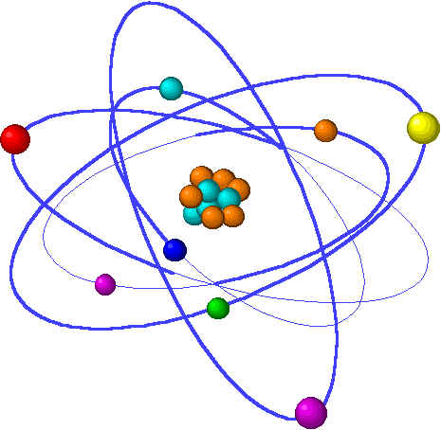
Moles, Formulas, Reactions & Stoichiometry
Lecture 3 Topics Brown, chapter 3
1. Moles 3.4
Molecular mass (aka molecular weight) 3.3
2. Molar converstions
Percent composition 3.3
Empirical formulas 3.5
3. Stoichiometry: balancing chemical equations 3.1
4. Patterns of Chemical Reactivity 3.2
Combination
Decomposition
Combustion
Exchange
5. Stoichiometry & Conversions 3.6
Limiting reactants 3.7
Theoretical & percent yield

Slide 2
Moles are the unit of measurement for amount of atoms, ions, molecules.
Atomic & molecular masses: g/mol
Formulae are based on molar ratios.
Notes:
The general process of advancing scientific knowledge by making experimental observations and by formulating hypotheses, theories, and laws.
It’s a systematic problems solving process AND it’s hands-on….. Experiments must be done, data generated, conclusions made.
This method is “iterative”; it requires looping back and starting over if needed. [Why do you think they call it REsearch?] Often years, decades or more of experiments are required to prove a theory.
While it’s possible to prove a hypothesis wrong, it’s actually NOT possible to absolutely prove a hypothesis correct as the outcome may have had a cause that the scientist hasn’t considered.

Slide 3
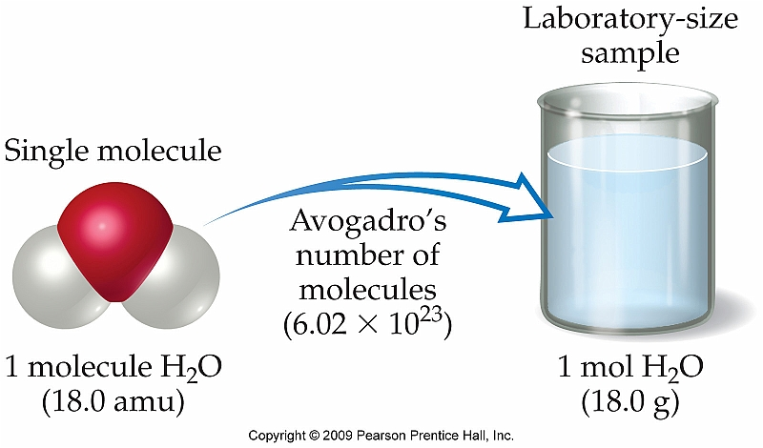
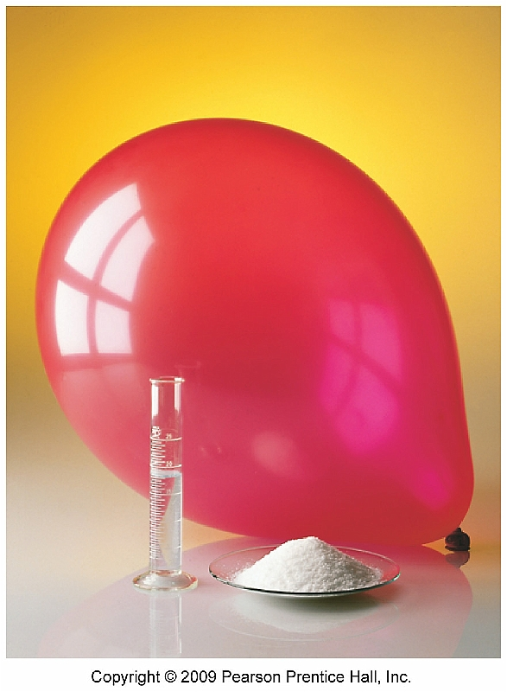
What’s a mole?
Even miniscule amounts of material contain enormous numbers of atoms, ions, or molecules.
A teaspoon of water ~ 2 x 10²³ water molecules.
So, the MOLE was proposed as a unit of molecules that makes discussing these enormous numbers ‘easier’.
Analogies = a dozen, a six-pack, a case, a gross
1 MOLE = 6.02 x 10²³ molecules (or atoms or ions)
Why this odd number?
A guy named Avoragado decided to create this new & useful unit by counting the
Number of atoms in 12 grams of ¹²C. There were 6.02x10²³ atoms in 12 g of ¹²C.
How big is this number, the mole? Really, really, really big!
p.89 - 90
Notes:
This is a big number: This many marbles would produce a 3-mile high layer over the Earth’s surface.
A row of 6.02x10²³ pennies placed side-by-side would circle the globe 300 trillion times.
But just twenty pre-1982 pennies contain a mole of copper atoms.

Slide 4
Example: moles
Without a calculator arrange these examples in order of increasing number of carbon atoms:
a. 12 g of ¹²C
b. 1 mole of C2H2
c. 9 x 10²³ molecules of CO2
Since ¹²C has an atomic weight of 12 g/mole, 12 g = 1 mole of carbon. LOW
b. Each C2H2 molecule has 2 atoms of carbon.
So one mole of molecules = 2 moles carbon. HIGH
c. Each molecule of CO2 has 1 atom of carbon. So each molecule = 1 mole of carbon. 9 x 10²³ is 1.5 moles of carbon. MEDIUM
How many hydrogen atoms are there in 0.350 moles of C6H12O6?
0.350 mol C6H12O6 6.02 x 10²³ molecules 12 H atoms = 2.53 x 10²⁴ atoms H 1 mol C6H12O6 1 molecule
p.89 - 90

Slide 5
Atomic & molar mass
So the mole is just another unit:
the unit used to describe amounts of atoms, molecules or ions
Atomic mass can be expressed in two different units:
amu (atomic mass units)
grams/mole: the mass of 6.02 x 10²³ atoms of an element
g/mol is a far more useful unit
If an experiment calls for 2 moles of carbon you could simply weigh out carbon powder on a scale => 2 moles 12.01 g = 24.02 g of carbon
1 mole
Molecular mass = molar mass = molecular weight (MW)
Also expressed as either amu or g/mol
Calculated as the sum of all atoms in a molecule.
What’s the molar mass (MW) of hydrogen peroxide, H2O2?
H2O2 H (2)(1.01 g/mol) = 2.02 g/mol
O (2)(15.99 g/mol) = 31.98 g/mol
34.00 g/mol → MW
p.91 - 92

Slide 6
Formulae, subscripts & molar masses
Chemical formulas have a lot in common with mathematical expressions Subscripts are used to denote the ratio of atoms in a molecule:
H2O Fe(OH)2
H2O2 Fe(NH4)2
= 2xH; 1xO
= 1xFe; 2xO; 2xH
Subscripts act as multipliers of elements they follow. Subscripts following parentheses multiply back through subscripts of elements within.
= 2xH; 2xO
= 1xFe; 2xN; 8xH
Molar mass is the mass of a molecule; the sum of all atomic masses.
H₂SO₄
H 2 x 1.0079 So, one mole of acid weighs 98.07 g.
S 1 x 32.066 AND that one mole is 6.02x10²³ molecules of acid.
O 4 x 15.994
98.073 g/mol
What about sig figs?
In class we will go to
2 digits after the
decimal for MW.
NaOH
Na 1 x 22.99 x 1
O 1 x. 15.9994
H 1 x 1.0079
40.00 g/mol
C6Cl5OH
C 6 x 12.01
Cl 5 x. 35.45
O 1 x 15.9994
H 1 x 1.0079
266.32 g/mol
p.91 - 92
Notes:
Note that molar mass is also known as molecular weight or formula weight.

Slide 7
Examples: molar mass
What’s the mass (g) of 1.000 mol of glucose, C6H12O6?
C 6 x 12.01 So this means that one mole of sugar weighs 180.18 g.
H 12 x 1.01
O 6 x 16.00
180.18 g/mol
How many moles of glucose are there in 5.380 g?
5.380 g 1 mol = 0.02986 mol
180.18 g
What’s the mass (g) of 0.433 moles of calcium nitrate, Ca(NO3)2?
Ca 1 x 40.08
N 2 x 14.01
O 6 x 16.00
164.10 g/mol
0.433 mol 164.10 g = 71.1 g
1 mol
p.91 - 92

