Slide 1
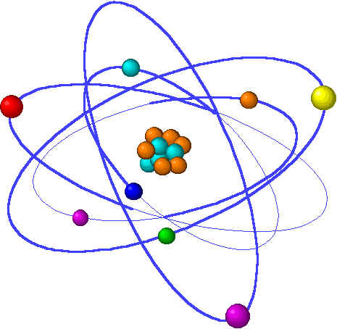
Moles, Formulas, Reactions & Stoichiometry
Lecture 3 Topics Brown, chapter 3
1. Moles 3.4
Molecular mass (aka molecular weight) 3.3
2. Molar converstions
Percent composition 3.3
Empirical formulas 3.5
3. Stoichiometry: balancing chemical equations 3.1
4. Patterns of Chemical Reactivity 3.2
Combination
Decomposition
Combustion
Exchange
5. Stoichiometry & Conversions 3.6
Limiting reactants 3.7
Theoretical & percent yield

Slide 2
Types of chemical reactions
Combinations join atoms or small molecules.
Decompositions disassemble large molecules.
Combustions “burn” carbon-based fuels.
Exchange reactions switch cation/anion partners.
Notes:
The general process of advancing scientific knowledge by making experimental observations and by formulating hypotheses, theories, and laws.
It’s a systematic problems solving process AND it’s hands-on….. Experiments must be done, data generated, conclusions made.
This method is “iterative”; it requires looping back and starting over if needed. [Why do you think they call it REsearch?] Often years, decades or more of experiments are required to prove a theory.
While it’s possible to prove a hypothesis wrong, it’s actually NOT possible to absolutely prove a hypothesis correct as the outcome may have had a cause that the scientist hasn’t considered.

Slide 3
Types of chemical reactions
Combustion:
the burning of a carbon-based compound in presence of O2 gas
C5H12 + O2 →
5CO2 + 6H2O
8
Products are always CO2 & H2O.
Combination:
the combining of 2 atoms/compounds to form 1 larger compound
2
Mg + O2 →
2MgO
Make product by combining elements & adjusting subscripts.
Decomposition:
the breaking down of 1 ‘large’ compounds to form 2 (or more) smaller compounds or atoms; often require heat
2
NaN3 →
2Na + 3N2
State of reactants & products: (s) = solid (l) = pure liquid
(g) = gas (aq) = aqueous sol’n
Practice balancing these:
Fe(s) + O₂(g) → Fe₂O₃(s)
C₂H₄(g) + O₂(g) → CO₂(g) + H₂O(g)
Al(s) + HCl(aq) → AlCl₃(aq) + H₂(g)
4 3 2
1 3 2 2
2 6 2 3
p.84 - 86

Slide 4
Examples: balance & identify type
Mg + O₂ MgO
combination
2
2
C + O₂ CO₂
combustion/combination
3
combination
N₂ + H₂ NH₃
2
CaO + H₂O Ca(OH)₂
combination
3
decomposition
KClO₃ KCl + O₂
2
2
3
4
CH₃OH + O₂ CO₂ + H₂O
combustion
2
2
PbCO₃ PbO + CO₂
decomposition
6
6
6
C₆H₁₂O₆ + O₂ CO₂ + H₂O
combustion
p.84 - 86

Slide 5
Exchange reactions
Reactions in which two ionic compounds meet, react, and exchange ionic partners.
Exchange reactions can be used to predict products
“inner-inner”
NaCl + KBr
KCl + NaBr
‘You come to the party with one anion, and leave with another.’
“outer-outer”
Note that the products combine the two “inner” ions (K & Cl) & the two “outer” ions (Na & Br). So associating exchange reactions with “inner-inner; outer-outer” sometimes helps students to remember how they work.
Use exchange reactions when it’s not a combustion, combination or decomposition reaction.
Exchange & balance these reactions:
Ca(OH)₂ + MgCl₂
CaCl₂ + Mg(OH)₂
2
CsI + NiO
Cs₂O + NiI₂

