Slide 1
3. Composition of substances & solutions
3.4: Other units for solution concentrations
Define the concentration units of mass percentage, volume percentage, mass-volume percentage, parts per million (ppm), & parts per billion (ppb)
Perform calculations relating a solution’s concentration and its components’ volume and / or masses with these units
optional

Slide 2
Mass percentage
Mass percentage: the ratio of solute mass to solution mass, multiplied by 100
% mass or % (w/w)
The label of a bottle of bleach lists its active ingredient, sodium hypochlorite (NaOCl), as 7.4%.
So, 100.0 grams of bleach would contain 7.4 g of NaOCl.
optional
A 5.0-g sample of spinal fluid contains 3.75 mg of glucose. What is the percent by mass of glucose in spinal fluid?
24
3.75 mg 1 g . (100) = 0.075% (w/w)
1 E3 mg 5.0 g

Slide 3
Using mass percentage
Concentrated hydrochloric acid is a 37.2% aqueous solution with a density of 1.19 g/mL. What mass of HCl is there in 0.500 L of concentrated HCl solution?
25
Strategy: volume → mass → mass HCl
mL/g %
0.500 L 1 E3 mL 1.19 g 37.2 g HCl = 222 g HCl
1 L 1 mL 100 g sol’n
optional

Slide 4
Volume percentage
Volume percentage: expresses the concentration of a liquid solute dissolved in a liquid solvent, % (v/v)
% (v/v) = volume solute (100)
volume solution
Rubbing alcohol (isopropanol) is usually sold as a 70% (v/v) aqueous solution. If the density of isopropanol is 0.785 g/mL, how many grams of isopropyl alcohol are present in 355 mL of rubbing alcohol?
optional
26
Strategy: volume → volume→ g isopropyl alcohol
sol’n iso
% density
355 mL 70 mL HCl 0.785 g = 195 g isopropyl alcohol
100 mL sol’n 1 mL

Slide 5
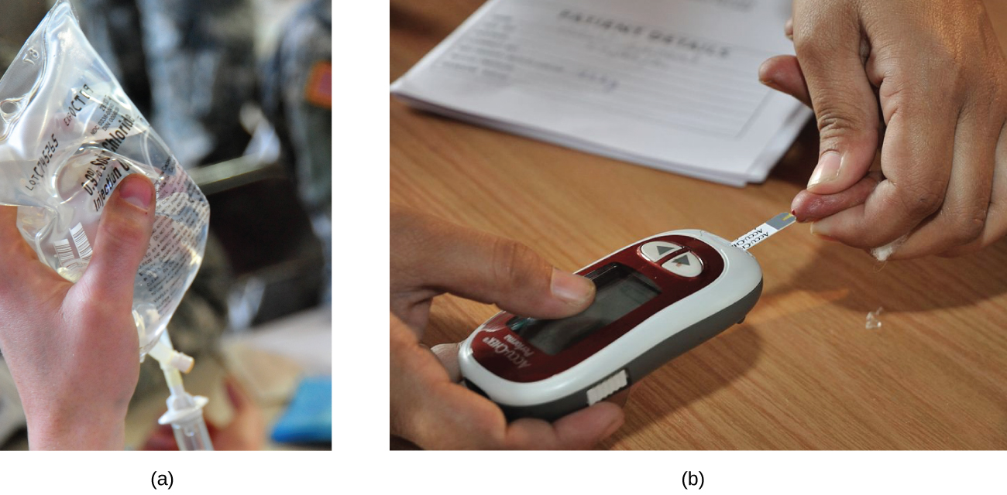
Mass-volume percentage
Mass-volume percentage: expresses the ratio of a solute’s mass to the solution’s volume as a percentage
% (w/v) = g solute .
100 mL sol’n
Fasting blood glucose should be 70-100 mg/dL
optional
saline sol’n = 0.9% (w/v) NaCl
Chemistry Openstax

Slide 6
ppm & ppb
Very low solute concentrations are often expressed as parts per million (ppm) or parts per billion (ppb).
ppm = mass solute (1 E6) ppm.
mass sol’n
ppb = mass solute (1 E9) ppb
mass sol’n
Some wells in Vermont are contaminated with PFOA (perfluorooctanoic acid). Vermont has set safe levels at 20 ppt, parts per trillion.
optional
Chemistry Openstax; https://en.wikipedia.org/wiki/Perfluorooctanoic_acid
http://www.healthvermont.gov/health-environment/drinking-water/perfluorooctanoic-acid-pfoa

Slide 7
Try this
EPA rules say that if lead levels in drinking water reach 15 ppb, remedies must be taken.
(a) Convert this to ppm.
(b) What mass of lead (ug) would be in a 300-mL glass of water?
27
15 ppb 1 E6 ppm = 0.015 ppm 1 E9 ppb
optional
(b) ppb = mass solute (1 E9) → mass solute = (ppb)(mass sol’n)
mass sol’n 1 E9 ppb
mass solute = (15 ppb)(300 mL 1.0 g/mL) = 4.5 E-6 g lead
1 E9 ppb

Slide 8
Can you?
Define the terms mass percentage, volume percentage, ppm and ppb?
(2) Use mass percentage, volume percentage and mass-volume
percentage ‘equations’ in calculations?
(3) Convert ppm and ppb to other units of concentration?
optional

