Slide 1
4. Stoichiometry of chemical reactions
4.5: Quantitative chemical analysis
Describe the fundamental aspects of titrations & gravimetric analysis
Perform stoichiometric calculations using typical titration & gravimetric data

Slide 2
Quantitative analysis
Quantitative analysis: the determination of the amount or concentration of a substance in a sample using chemical reactions
Example: 18th century – the strength (aka concentration) of vinegar was determined by measuring how much potassium carbonate had to be added before bubbling stopped.
2H(CH3COO) + K2(CO3) → H2(CO3) + 2K(CH3COO)
2H(CH3COO) + K2(CO3) → CO2 + H2O + 2K(CH3COO)

Slide 3
Titration
Titration: a technique that uses finely calibrated instruments (like burets) to measure the amounts of two reactants needed to react completely (the equivalence point).
Stoichiometry (balanced chemical equation) must be known.
The concentration (or amount) of one reactant must be known.
End point indicator, showing reaction completion, must be used.
Example: 18th century – the strength (aka concentration) of vinegar was determined by measuring how much potassium carbonate had to be added before bubbling stopped.
2H(CH3COO) + K2(CO3) → CO2 + H2O + 2K(CH3COO)
stoichiometry
amount
(g added)
endpoint
fizzing stops

Slide 4
Titration calculations
Steps:
BCE → associate numerical info & goal.
Start with the known reactant and go to moles.
Stoichiometry to moles of the unknown.
Solve for volume or mass or concentration of the unknown.
The endpoint of titration of a 50.00-mL sample of aqueous HCl is reached after adding 35.23 mL of 0.250 M Na(OH) titrant.
What is the molarity of the HCl?
HCl(aq) + Na(OH)(aq) → NaCl(aq) + H2O(l)
29
50.00 mL 35.23 mL
X M 0.250 M (mol/L)
mol
L
0.03523 L 0.250 mol Na(OH) 1 mol HCl = 0.1762 mol = M
1 L 1 mol Na(OH) 0.050000 L 1 L

Slide 5
Try this
A 20.00-mL sample of aqueous oxalic acid, H2C2O4, was titrated with a 0.09113 M solution of permanganate, (MnO4)⁻¹. A volume of 23.24 mL was required to reach the end point. What was the molarity of the oxalic acid?
5H2C2O4 + 2(MnO4)⁻¹ + 6H⁺¹ → 10CO2 + 2Mn⁺² +8H2O
30
5H2C2O4 + 2(MnO4)⁻¹ + 6H⁺¹ → 10CO2 + 2Mn⁺² +8H2O
20.00 mL 23.24 mL
X M 0.09113 M (mol/L)
mol
L
0.02324 L 0.09113 mol (MnO4)⁻¹ 5 mol H2C2O4 = 0.2648 mol = M
1 L 2 mol (MnO4)⁻¹ 0.02000 L 1 L

Slide 6
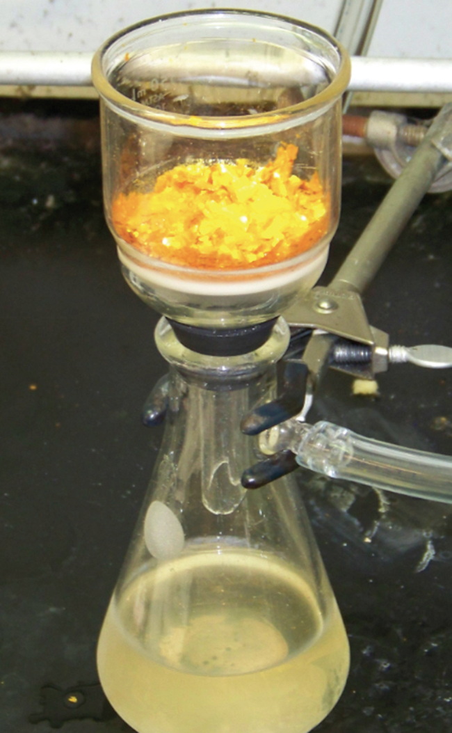
Gravimetric analysis
Gravimetric analysis: a sample is subjected to a change in physical state that allows separation of sample components.
Mass measurement or titration can then be used to quantitate components.
Examples:
(1) the amount of water in a sample of forage is determined by measuring the mass of the sample before and after drying;
(2) an element is precipitated and filtered out of a mixture.
Chemistry Openstax

Slide 7
Gravimetric analysis via precipitation
A 0.4550-g solid mixture containing Mg(SO4) is dissolved in water and reacted with excess Ba(NO3)2, causing precipitation of 0.6168 g of Ba(SO4):
Mg(SO4)(aq) + Ba(NO3)2(aq) → Ba(SO4)(s)⬇ + Mg(NO3)2(aq)
What was the percentage of Mg(SO4) in the original mixture?
31
Strategy: g Ba(SO4) → moles → moles Mg(SO4) → g → %
MW Ba(SO4) = 233.35 g/mol
MW Mg(SO4) = 120.33 g/mol
0.6168 g 1 mol Ba(SO4) 1 mol Mg(SO4) 120.33 g 100 = 69.90%
233.35 g 1 mol Ba(SO4) 1 mol Mg(SO4) 0.4550 g

Slide 8
Try this
What is the percent of chloride ion in a sample of 1.1324 g of the sample produces 1.0881 g of AgCl when treated with excess silver ions?
Ag⁺¹(aq) + Cl⁻¹(aq) → AgCl(s)⬇
32
Strategy: g AgCl → moles AgCl → moles Cl⁻¹→ g → %
MW AgCl = 143.32 g/mol
MW Cl⁻¹ = 35.45 g/mol
1.0881 g 1 mol AgCl 1 mol Cl⁻¹ 35.45 g 100 = 23.76%
143.32 g 1 mol AgCl 1 mol Cl⁻¹ 1.1324 g

Slide 9
Gravimetric analysis via combustion
Combustion analysis: a sample is combusted with excess oxygen, producing gaseous products that are separated and absorbed onto media, increasing the mass of that media.
Mass of each gas is calculated and used in analysis.
Goal? Determination of empirical formula
Chemistry Openstax

Slide 10
Combustion analysis of a hydrocarbon
Polyethylene is a hydrocarbon polymer used in food storage bags and flexible plastics. A combustion analysis of a 0.00126-g sample of polyethylene yields 0.00394 g of CO2 and 0.00161 g of H2O.
What is the empirical formula of polyethylene?
CxHy(s) + O2(g) → xCO2(g) + y/2H2O(g)
Strategy: mass CO2 → mol CO2 → mol C ___ mol ratios
mass H2O → mol H2O → mol H
0.00394 g 1 mol CO2 1 mol C = 8.96 E-5 mol C
43.99 g 1 mol CO2
0.00161 g 1 mol H2O 2 mol H = 1.79 E-4 mol H
18.01 g 1 mol H2O
1.79 E-4 mol H = 1.9977 → 2 so CH2
8.96 E-5 mol C
Chemistry Openstax

Slide 11
Try this
Polystyrene is a hydrocarbon polymer used to make transparent but brittle products. A combustion analysis of a 0.00215-g sample of polyethylene yields 0.00726 g of CO2 and 0.00148 g of H2O.
What is the empirical formula of polystyrene?
33
CxHy(s) + O2(g) → xCO2(g) + y/2H2O(g)
Strategy: mass CO2 → mol CO2 → mol C ___ mol ratios
mass H2O → mol H2O → mol H
0.00726 g 1 mol CO2 1 mol C = 1.65 E-4 mol C
43.99 g 1 mol CO2
0.00148 g 1 mol H2O 2 mol H = 1.64 E-4 mol H
18.01 g 1 mol H2O
1.64 E-4 mol H = 1 so CH
1.65 E-4 mol C
Chemistry Openstax

Slide 12
Can you?
Use logic and all the beautiful manifestations of stoichiometric conversion to solve quantitative chemistry word problems?

