Slide 1
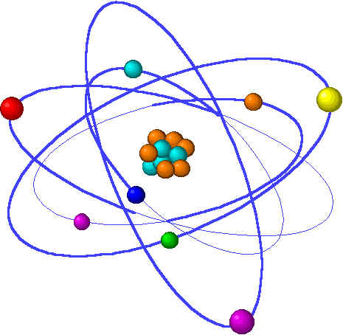
Lecture 5: Electrochemistry
Lecture 5 Topic Chapter 20
1. Redox agents & half-equations
Reducing & oxidizing agents 20.1
Solving redox by half-equation 20.2
Steps!
2. Voltaic cells are redox reactions 20.3
Separate “half-cells”
3. Batteries
Electromotive force 20.4
Batteries & Calculating Ecell 20.7
Fuel Cells
4. Corrosion & Electrolysis
Corrosion 20.8
Electrolysis 20.9

Slide 2
Voltaic cells make electricity
Voltaic cells are linked half-cells.
Voltaic cell reactions are spontaneous.
Electromotive force measures half-cell ‘power’.
Notes:
The general process of advancing scientific knowledge by making experimental observations and by formulating hypotheses, theories, and laws.
It’s a systematic problems solving process AND it’s hands-on….. Experiments must be done, data generated, conclusions made.
This method is “iterative”; it requires looping back and starting over if needed. [Why do you think they call it REsearch?] Often years, decades or more of experiments are required to prove a theory.
While it’s possible to prove a hypothesis wrong, it’s actually NOT possible to absolutely prove a hypothesis correct as the outcome may have had a cause that the scientist hasn’t considered.

Slide 3
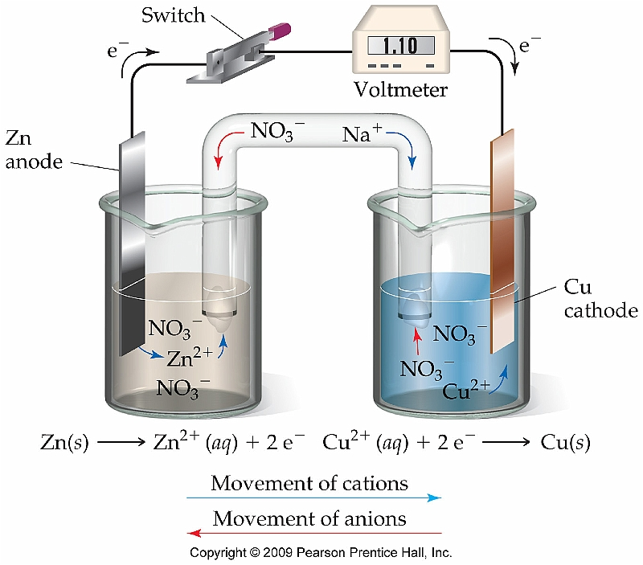
Voltaic cells: redox makes electricity
p. 835

Slide 4
Voltaic cells are redox reactions
Redox reactions occur spontaneously (no energy input needed) but they release energy in the form of electrons. Those electrons can be harvested, or stored, for use as electric power.
RED
Copper ions contact the Zn strip and oxidize the Zn atoms.
Zn(s) + Cu⁺²(aq) → Zn⁺²(aq) + Cu(s)
OX
Copper metal is deposited on Zn.
Oxidized Zn ions move into the sol’n.
Zn+2
Cu+2
In a single cell, e- move but aren’t captured or harvested.
Zn
2e-
Cu
Anode is oxidized. (source of e-)
Cathode is reduced.
(destination of e-)
cathode
anode
(Fig 20.3, p.856)
p. 835 - 6

Slide 5
Separate voltaic (half) cells
A battery can be created by separating the oxidizing and reducing agents; e- are harvested as they pass from one half-“cell” into the other.
Half-cells contain half reactions
Half-cells must remain electrically neutral, so ions are allowed to pass between cells via a permeable barrier (aka “salt bridge”)
Positive ions (oxidized Zn⁺²) move towards the cathode(+)
Negative counter-ions (NO3⁻¹ or SO4⁻²) move to the anode
E- flow (electricity) is channeled through a circuit on the way to cathode
e- flow
Oxidation half-cell: Zn(NO3)2
Reduction half-cell: Cu(NO3)2
Zn strip
(anode)
Cu strip (cathode)
As the Zn strip is oxidized it releases zinc cations into the solution.
oxidation
-
+
reduction
As the copper is reduced and copper atoms are deposited on the strip, nitrate anions are freed up.
Exchange of these soluble ions allows the cells to remain electrically neutral.
Cation+
Anion -
(Fig 20.6, p.858)
p. 835 - 6

Slide 6
Close-up of a voltaic cell
What’s happening at an atomic/ionic level?
e- flow
Zn strip
(anode)
Cu strip (cathode)
oxidation
-
+
reduction
e- flow
Cation+
e- flow
Anion -
Cu+2
Zn+2
anode
anode
cathode
cathode
p. 835 - 6

Slide 7
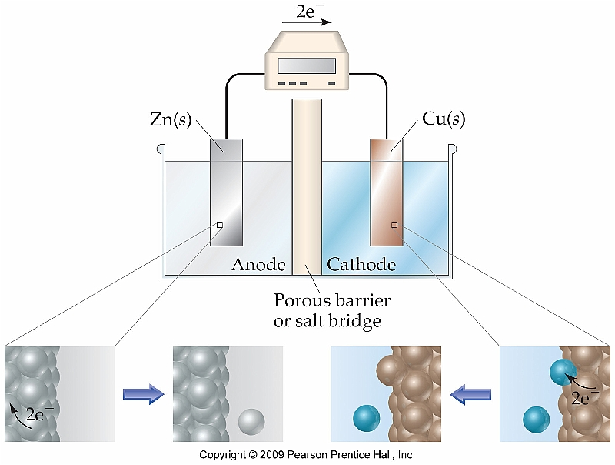
Close-up of a voltaic cell
oxidation
reduction
cations
anions
p. 835 - 6

Slide 8
Electromotive force (aka cell potential)
The potential charge difference between two half-cells of a voltaic cell. (aka cell voltage; abbreviated Ecell)
In order to provide a flow of electrons to a circuit, a voltaic cell must have a positive Ecell value.
We will consider Ecell values under standard conditions (1 atm, 25°C)
Zn(s) + Cu⁺²(aq) → Zn⁺²(aq) + Cu(s) Ecell = +1.10 V
How do we know what reactions can be used to make voltaic cells?
Table 20.1 (p.863) shows Standard Reduction Potentials
Zn(s) → Zn⁺²(aq) + 2e- (reversed) Ecell = +.76 V
Cu⁺²(aq) + 2e- → Cu(s) Ecell = +.34 V
1.10 V
Steps
1. Break the reaction into half-reactions
2. Find the associated Ecell value from the table
3. Reverse the sign of the Ecell value if you have to reverse the equation.
4. Balance & add the half-reactions (remember that e- should cancel)
5. Is the summed Ecell value positive?
p. 838 - 9

Slide 9
Will these function as voltaic cells?
Cr2O7⁻²(aq) + 14H⁺¹(aq) + 6I⁻¹(aq) → 2Cr⁺³(aq) + 3I2(s) + 7H2O(l)
E cell
Cr2O7⁻²(aq) + 14H⁺¹(aq) + 6e- → 2Cr⁺³(aq) + 7H2O(l)
+ 1.33 V
6I⁻¹(aq) → 3I2(s) + 6e- (reversed)
- 0.54 V
+ 0.79 V so YES cell will work
2Al(s) + 3I2(s) → 2Al⁺³(aq) + 6I⁻¹(aq)
2Al(s) → 2Al⁺³(aq) + 6e- (reversed) Ecell = +1.66 V
3I2(s) + 6e- → 6I⁻¹(aq) Ecell = +.54 V
2.20 V so YES
Note: You don’t multiply Ecell values to account for stoichiometry;
potential is an intensive property.
p. 838 - 42

