Slide 1
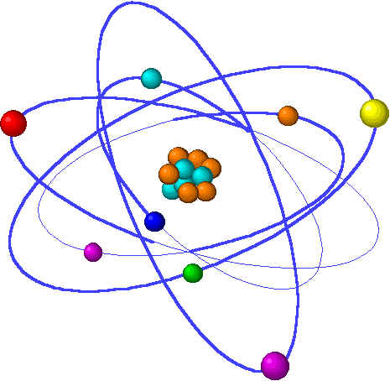
Lecture 8: Electrochemistry
Lecture 8 Topic Chapter 20
1. Redox agents & half-equations
Reducing & oxidizing agents 20.1
Solving redox by half-equation 20.2
Steps!
2. Voltaic cells are redox reactions 20.3
Separate “half-cells”
3. Batteries
Electromotive force 20.4
Batteries & Calculating Ecell 20.7
Fuel Cells
4. Corrosion & Electrolysis
Corrosion 20.8
Electrolysis 20.9

Slide 2
Lecture 8: Terms to Know
Oxidizing agent
Reducing agent
Half equation
Voltaic cell
Half cell
Anode
Cathode
Salt bridge
Electromotive force (cell potential)
Standard conditions
Battery
Fuel cell
Corrosion
Spontaneous
Rust
Galvanize
Sacrificial anode
Cathodic protection
Electrolysis
Plating
Notes:
PLEASE note that the formula calculates a weighted average, so there’s not need to add and then divide the sum by the number of isotopes in the problem. This is an incredibly common student error so don’t get caught!

