Slide 1
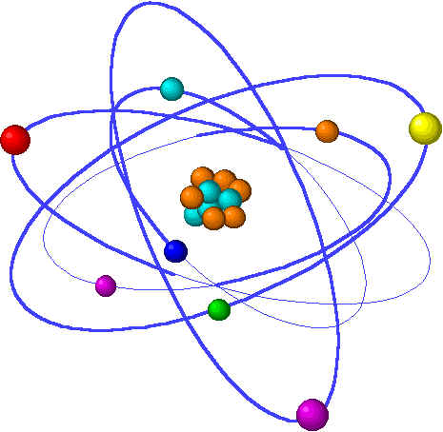
Lecture 6: Sub-atomic & quantum structure
Lecture 6 Topics: Brown, chapter 6 & 7
1. Atomic properties from e- configuration 7.1
2. The true nature of the atom? 6.1
Light (and electrons) behave as waves & particles
3. Developing a new physics for atoms 6.2 – 6.4
A quick tour of quantum mechanics
4. Bohr’s quantum planetary model 6.2
5. Applying quantum mechanics to the atom
Electrons inhabit orbitals 6.6 – 6.7
6. Orbital filling and electron configuration 6.8 – 6.9
Aufbau & orbital diagrams

Slide 2
Applying quantum mechanics to the atom
Electrons inhabit orbitals.
Orbitals are 3D shapes.
Orbitals have energy levels.
Orbitals have orientation.
Electrons have spin.
Notes:
The general process of advancing scientific knowledge by making experimental observations and by formulating hypotheses, theories, and laws.
It’s a systematic problems solving process AND it’s hands-on….. Experiments must be done, data generated, conclusions made.
This method is “iterative”; it requires looping back and starting over if needed. [Why do you think they call it REsearch?] Often years, decades or more of experiments are required to prove a theory.
While it’s possible to prove a hypothesis wrong, it’s actually NOT possible to absolutely prove a hypothesis correct as the outcome may have had a cause that the scientist hasn’t considered.

Slide 3
Shells with orbitals
A simple modification of Bohr’s model allows us to see one effect of orbitals on the configuration of electrons around the nucleus.
p.228-
3d
Shells Subshells #e- e- pairs
3p
1 s 2 1
2p
2 s 2 1 p 6 3
3s
1s
2s
s 2 1 p 6 3 d 10 5
p/n
Notice that each subshell (or orbital) can only hold a max of 2 electrons.
How many electrons in an atom? Atomic #
Which is the valance shell? Outermost; here 3rd shell
What causes chemical bonding? Overlapping, or interaction, of electrons in valence shells of 2 atoms.

Slide 4
Orbitals: electron density plots
p.232-
Since orbitals are wave functions, they are also probabilities. The energy and shape of an orbital describe the space in which you will most likely find the electron at any one time; 90% of the time. AKA electron density map
Imagine drawing a probability map of your whereabouts for a given day of the week.
Imagine drawing a probability map of your whereabouts for a given day of the week. Sure you’re going to take unexpected trips, but for the most part it’s pretty simple to predict where you’ll be. Imagine carrying a transmitter all day. If it sent a signal every minute or two you’d have a pretty good dot plot or “probability map”.
p.224-

Slide 5
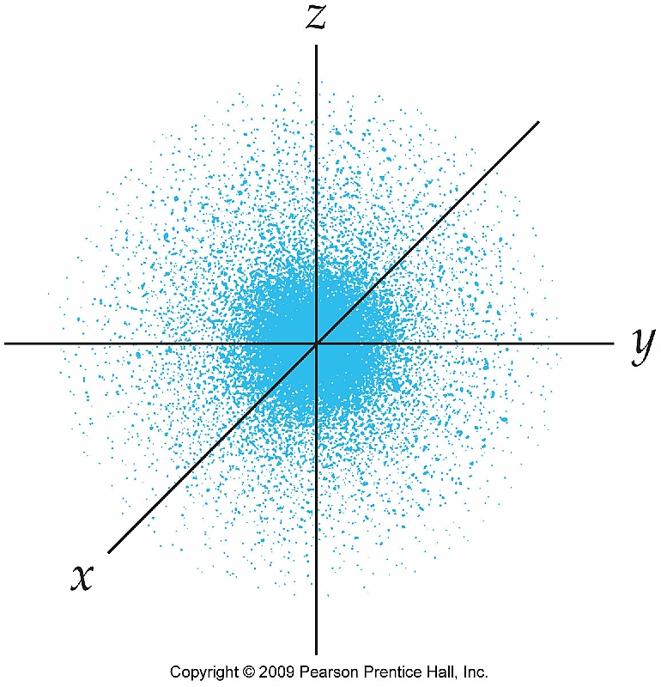
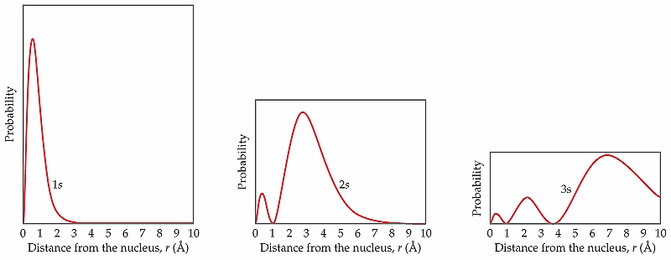
Orbitals: density dictates shape
p.225-
Of course, the shape of the space occupied by the electrons is shown by the probability plot as seen here:
Here probability is shown on the y-axis and radial distance from the nucleus for s orbitals in shells 1, 2 & 3. Notice that the bulk of electrons are located in the same type of ‘shape’, but further from the nucleus in each successive shell.
Total densities are the same, but distributed more broadly in 2 & 3.
1s
2s
3s
p.224-32

Slide 6
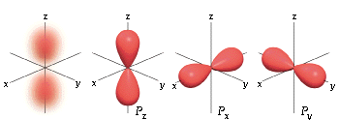
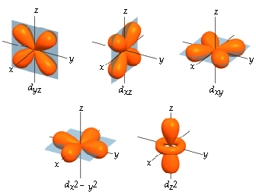
Orbital shapes:
Remember that each orbital can contain, at most, 2 electrons. So the single s orbital holds 2. But there are 3 p orbitals, that can hold a total of 6 electrons. And the 5 d orbitals can hold a total of 10 electrons.
s orbital
p orbital
d orbital
p.228-32

Slide 7
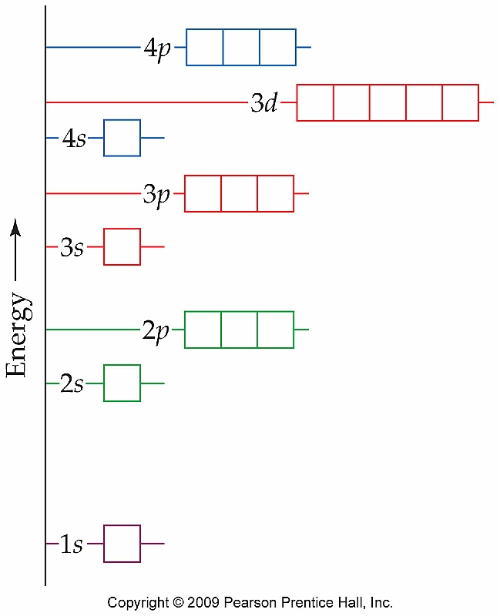
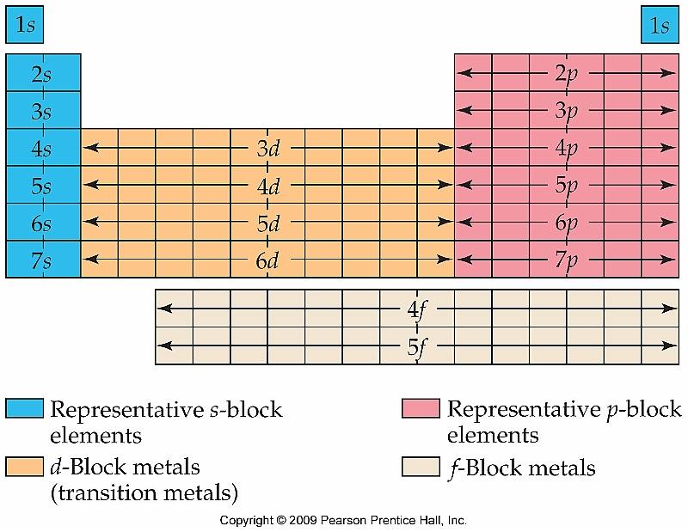
Orbital energy levels
The energy levels of orbitals increase in a straightforward manner until we reach the junction of the 3rd & 4th shells.
This table shows which orbitals are filled for each column of elements. 1) electropositive metals (IA, IIA) 2) transition metals (d orbitals) 3) non-metals (& metalloids) (other As)
p.232-4, 240

Slide 8
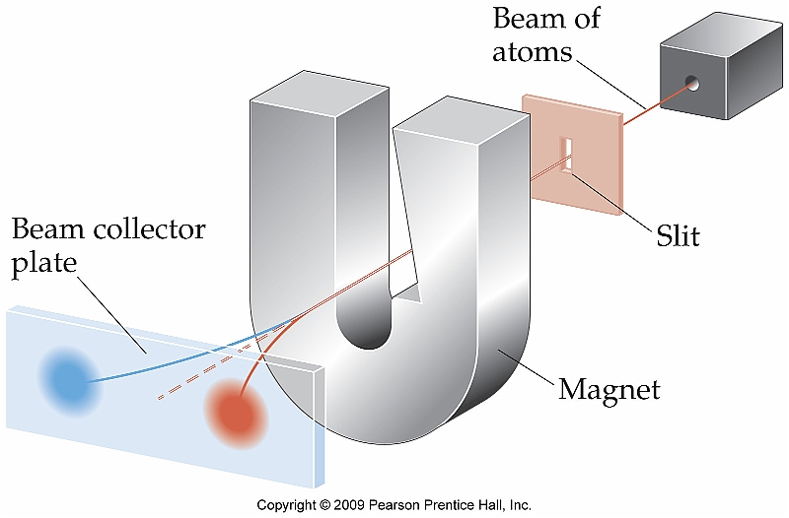
Electron spin
p.242-
Pauli’s exclusion principle states that each orbital can contain no more than two electrons. And if two electrons occupy a single orbital they
must have opposite spin.
Stern- Gerlach exp’t
This gives rise to the intrinsic spin of some molecules – particularly those with a single valence electron. This allows NMR & MRI.
And so we use “up” & “down” arrows when describing configuration.
p.234

