Slide 1
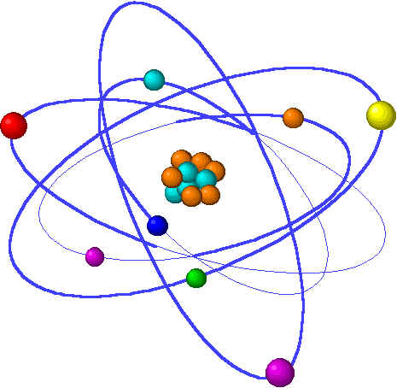
Lecture 6: Sub-atomic & quantum structure
Lecture 6 Topics: Brown, chapter 6 & 7
1. Atomic properties from e- configuration 7.1
2. The true nature of the atom? 6.1
Light (and electrons) behave as waves & particles
3. Developing a new physics for atoms 6.2 – 6.4
A quick tour of quantum mechanics
4. Bohr’s quantum planetary model 6.2
5. Applying quantum mechanics to the atom
Electrons inhabit orbitals 6.6 – 6.7
6. Orbital filling and electron configuration 6.8 – 6.9
Aufbau & orbital diagrams

Slide 2
Orbital filling & electron configuration
Hund’s rule: electrons fill one at a time
Pauli’s exclusion principle: opposite spin
Configuration & the periodic table
Notes:
The general process of advancing scientific knowledge by making experimental observations and by formulating hypotheses, theories, and laws.
It’s a systematic problems solving process AND it’s hands-on….. Experiments must be done, data generated, conclusions made.
This method is “iterative”; it requires looping back and starting over if needed. [Why do you think they call it REsearch?] Often years, decades or more of experiments are required to prove a theory.
While it’s possible to prove a hypothesis wrong, it’s actually NOT possible to absolutely prove a hypothesis correct as the outcome may have had a cause that the scientist hasn’t considered.

Slide 3
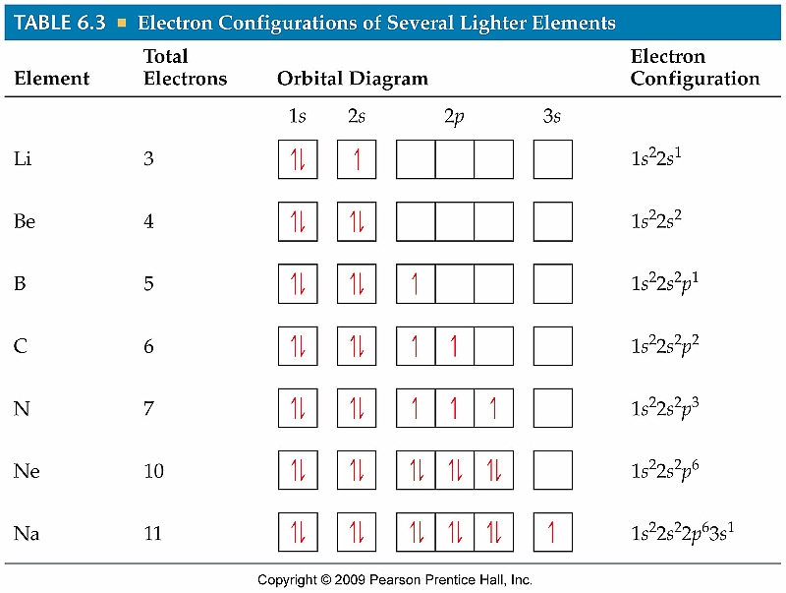
Orbital diagrams
p.235
Notice that the orbital ‘boxes’ fill one electron (e-) at a time. What property of e- explains their desire to be ‘alone’?
Negative charge -> repulsion. Notice that the two e- occupying an orbital have opposite ‘spin’. Electron spin creates magnetic fields, minimized by opposite spin. Two e- with opposite spin are ‘paired’.

Slide 4
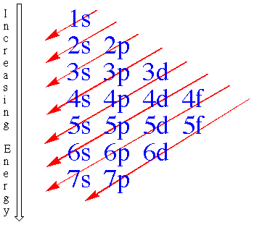
Orbital filling: Aufbau
H
Li
Na
K
Rb
Cs
Fr
He
Ne
Ar
Kr
Xe
Rn
??
1s²
2s² 2p⁶
3s² 3p⁶
4s² 3d¹⁰ 4p⁶
5s² 4d¹⁰ 5p⁶
6s² 4f¹⁴ 5d¹⁰ 6p⁶
7s² 5f¹⁴ 6d¹⁰ 7p⁶
p.233

Slide 5
Examples: orbital filling
Draw the orbital diagram for oxygen.
O is element 8:
1s²2s²2p⁴
Draw the electron configuration of phosphorous.
Atomic number 15: 1s²2s²2p⁶3s²3p³
Notice that three of the electrons are unpaired.
What valence electron configuration is common to all halogens?
Halogens are the elements found in column VIIA. Their valence (or outermost) electron shell has 7 ve- (column number). Let’s try them: F #9 1s²2s²2p⁵
Cl #17 1s²2s²2p⁶3s²3p⁵
Br #35 1s²2s²2p⁶3s²3p⁶4s²3d¹⁰4p⁵
I #53 1s²2s²2p⁶3s²3p⁶4s²3d¹⁰4p⁶5s²4d¹⁰5p⁵
So the common valence configuration is p⁵. Soon, we’ll see that all halogen ions have a charge of -1 to fill that p orbital.
p.235-

Slide 6
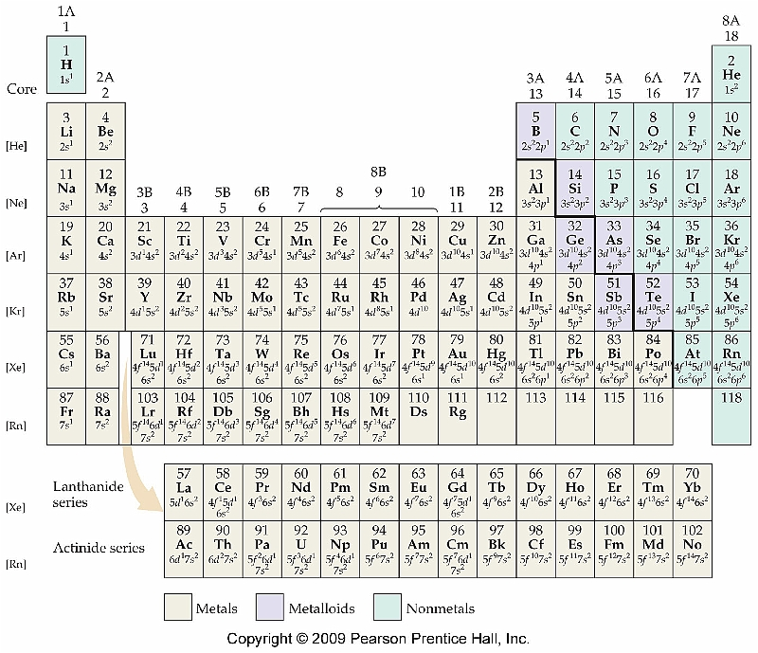
Electron configuration & the periodic table
p.242

