Slide 1
6. Electronic structure, periodic properties
6.1: Electromagnetic energy
Explain the basics behavior of waves, including travelling & standing waves
Describe the wave nature of light
Use appropriate equations to calculate related light-wave properties such as period, frequency, wavelength & energy
Distinguish between line and continuous emission spectra
Describe the particle nature of light
Before this section, please check for a Flip exercise!
(Posted on the Module 6 page)

Slide 2
Thinking about light: a quick history
Newton: light is corpuscular: tiny particles traveling at very high
speed
Huygens: light is waves traveling through ‘luminiferous aether’
Young: definitely waves rather than particles
Maxell: light is the visible part of the huge spectrum of
electromagnetic radiation
waves (moving & standing)
electromagnetic spectrum
interference
3 paradoxes
Today? Wave-particle duality

Slide 3
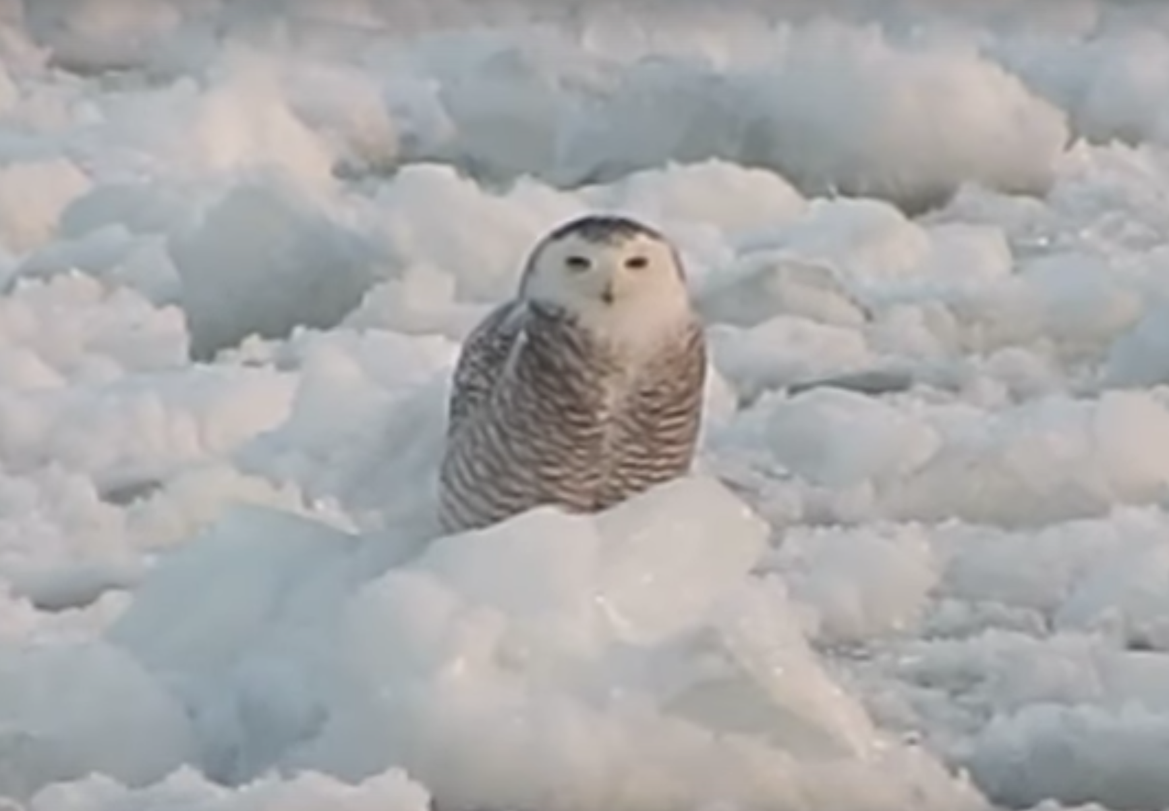
Waves
Wave: (traveling waves) oscillation or periodic movement that can transport energy from one point in space to another
A shaken rope
Ripples caused by a pebble thrown into a pond
Thunder (waves of sound)
‘the wave’ by a crowd of people
Kinetic energy is transferred through matter, along the wave, though the matter doesn’t move.
https://www.youtube.com/watch?v=bpojDpZ4m7Y

Slide 4
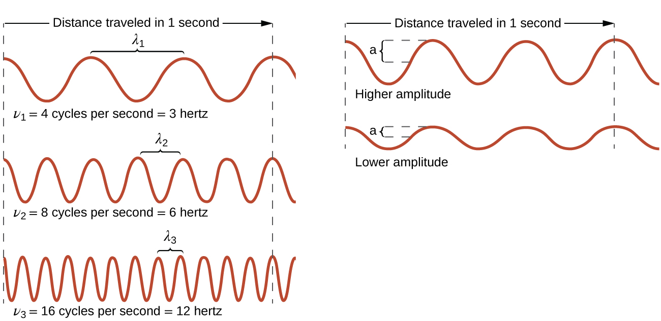
Describing waves
Wavelength (λ): trough-to-trough or peak-to-peak distance
Frequency (ν): number of cycles per unit time (Hz = cycles/s)
Amplitude: (half) height of waves from origin to peak or trough
Speed of electromagnetic radiation in a vacuum:
c = 2.998 E8 m/s= (λ)(ν)
Chemistry Openstax

Slide 5
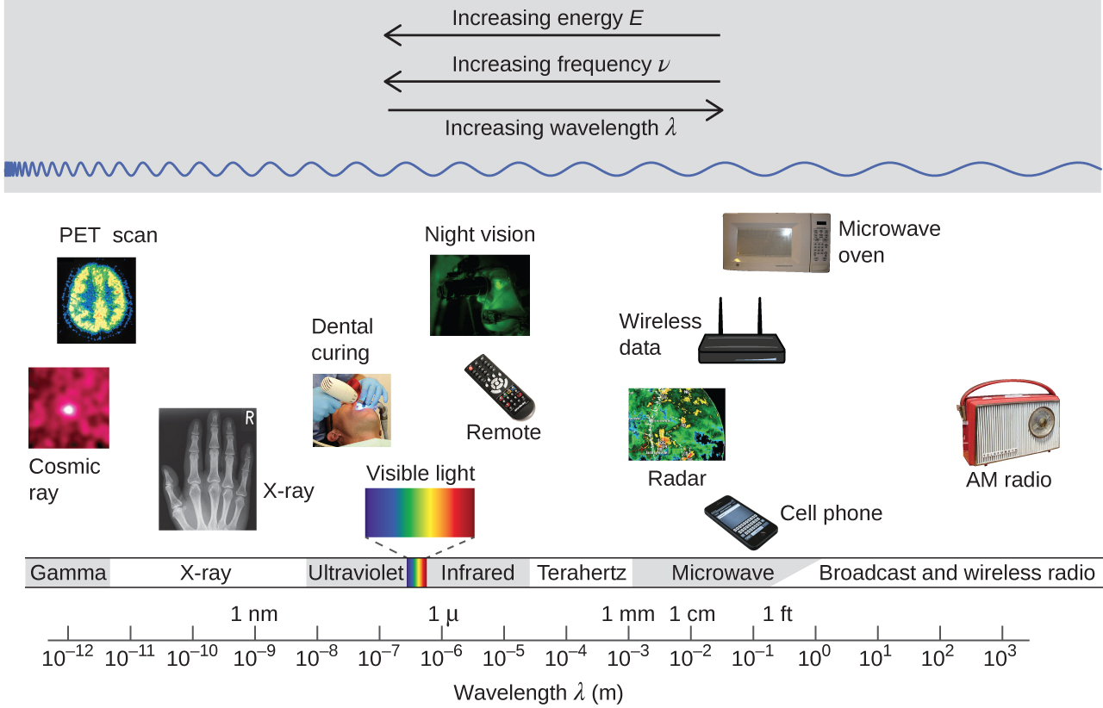
Electromagnetic spectrum
Chemistry Openstax

Slide 6
Determining ν & λ of radiation
A sodium streetlight gives off yellow light with a λ of 589 nm.
What is the frequency of the light?
1
c = (λ)(ν) → ν = c
λ
ν = 2.998 E8 m 1 E9 nm = 5.09 E14/s
1 s 1 m 589 nm
A common US cell phone frequency is 850 MHz. What is the wavelength of these radio waves?
2
c = (λ)(ν) → λ = c
ν
λ = 2.998 E8 m 1 E9 nm 1 s = 3.53 E8 nm = 0.352 m
1 s 1 m 8.5o E8

Slide 7
Interference patterns
Interference patterns arise when light passes through two narrow slits placed about a λ apart.
Light forms two new wave as it passes through the slit.
The two waves collide and interfere either:
Constructively or;
Destructively.
Red = constructive interference = in-phase peaks adding
Black = destructive interference = out-of-phase peaks adding
Chemistry Openstax

Slide 8
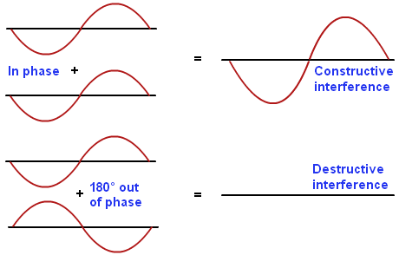
Visualizing interference
http://physics.tutorcircle.com/waves/wave-interference.html

Slide 9
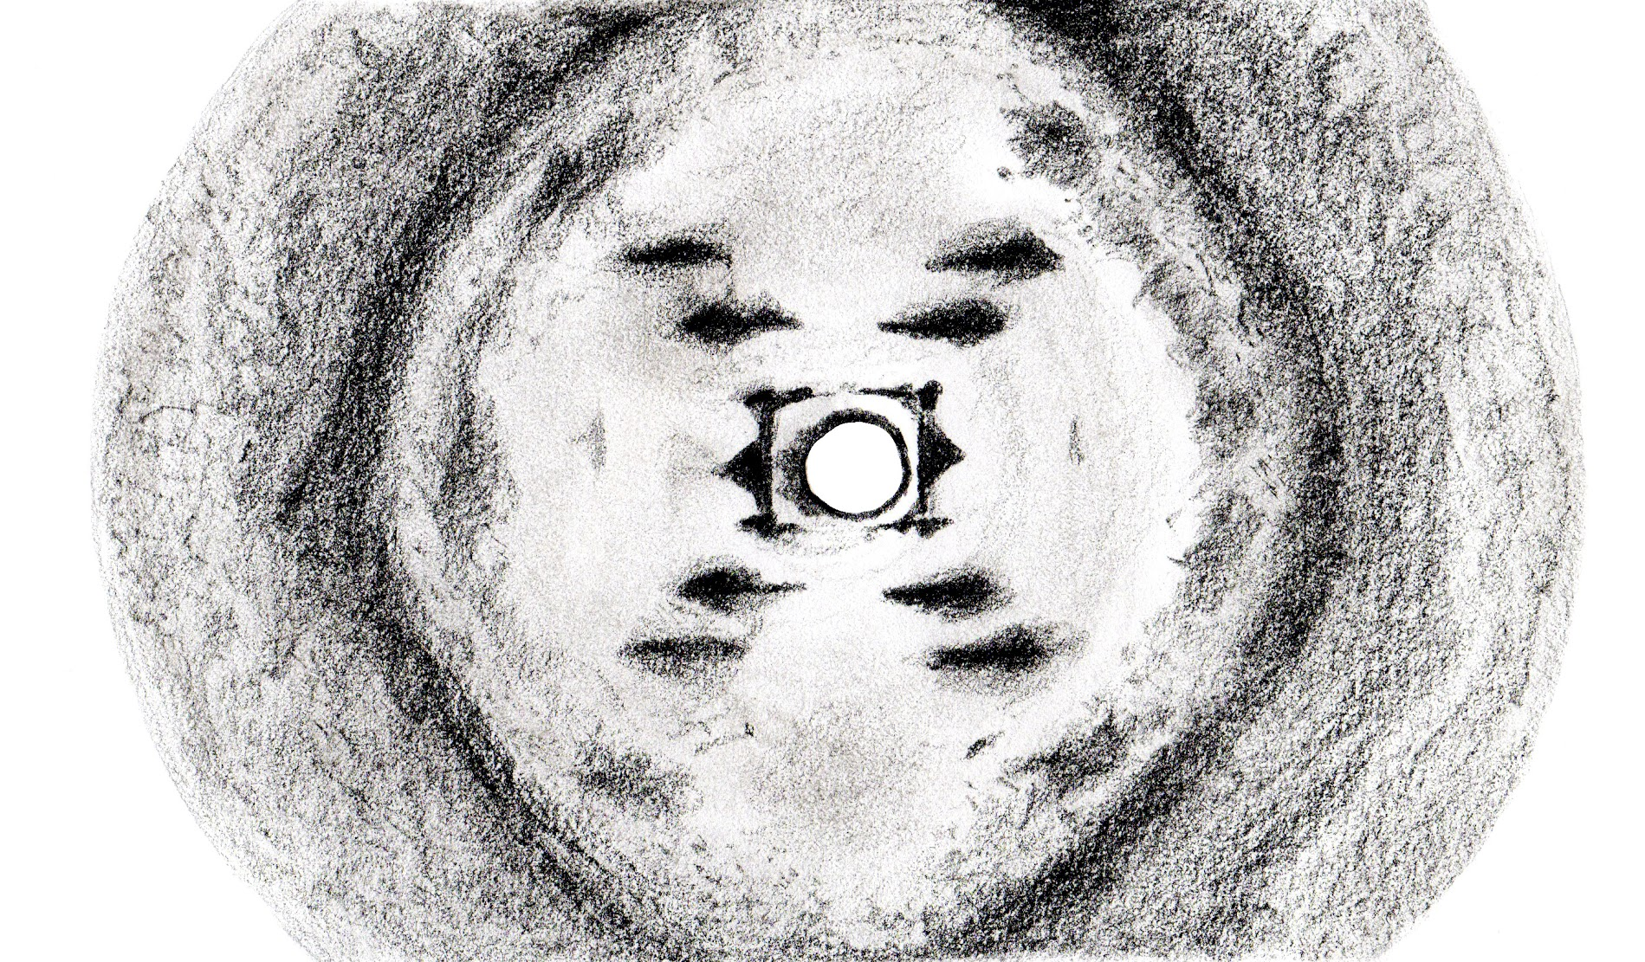
Interference ~ diffraction
https://www.youtube.com/watch?v=y0v2rZvNU2c
https://rampages.us/teclerh/2016/02/29/rosalind-franklin/

Slide 10
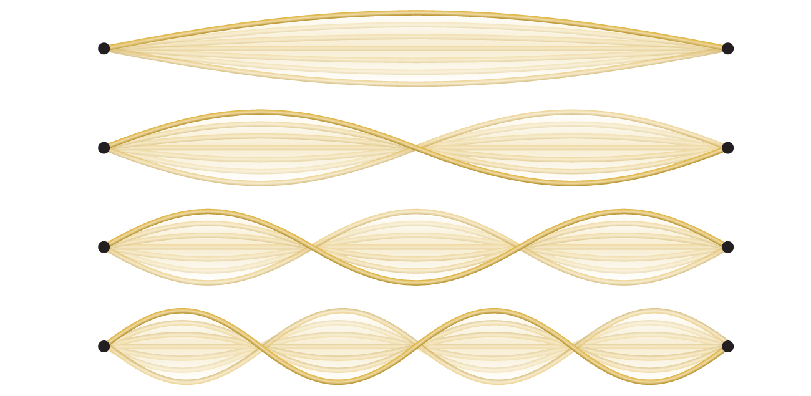
Standing waves: 1D
Standing waves don’t move but remain fixed in place; one-dimensional
Only integer number (n) of (half) waves can form.
Nodes (places where no motion occurs form (n– 1).
Quantization!
Only discrete values are observed.
Chemistry Openstax

Slide 11
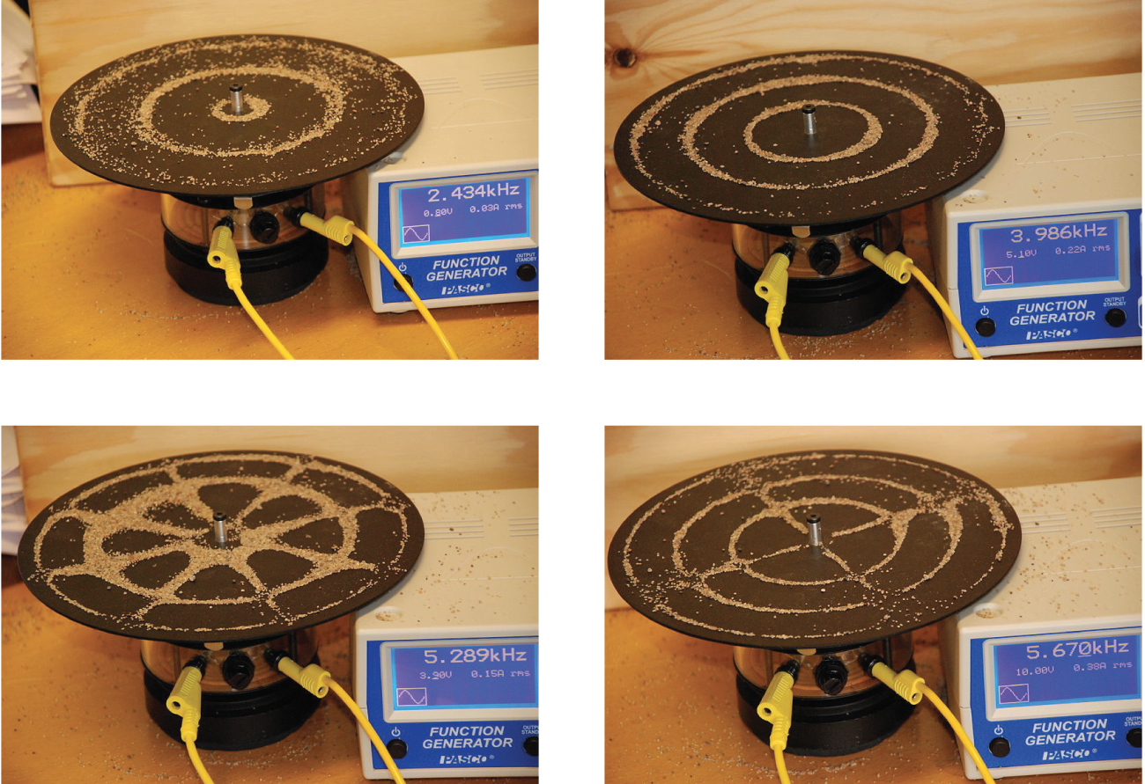
Standing waves: 2D
radial nodes
Sand at the nodes of standing waves caused by vibration.
angular nodes
Chemistry Openstax

Slide 12
The 3 paradoxes that led to ‘quantum’
In the late 1800s to early 1900s, physicists observed, and struggled to explain, three paradoxical phenomena:
Black-body radiation;
Photoelectric effect; &
Line-spectra.

Slide 13
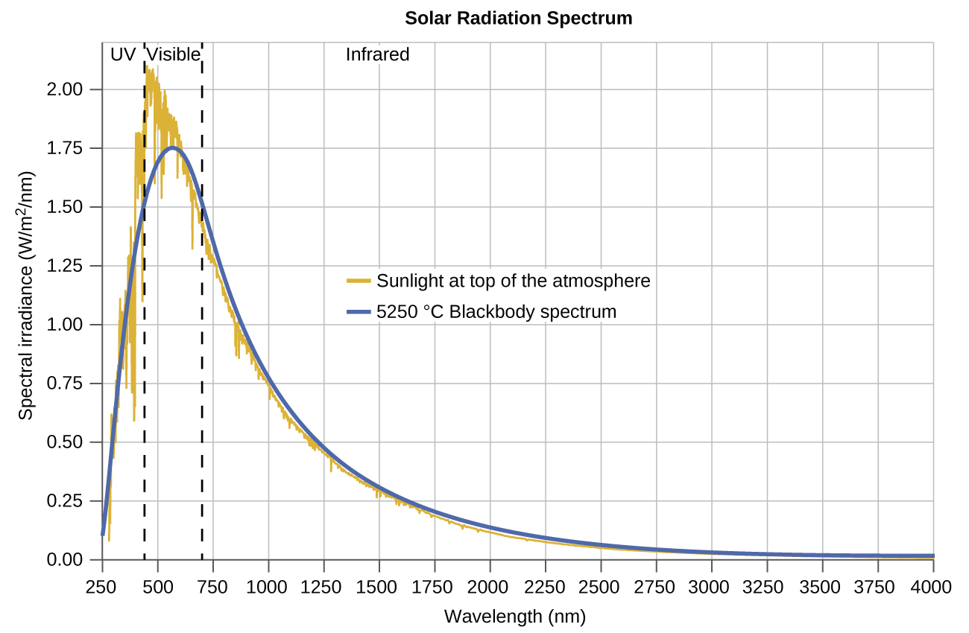
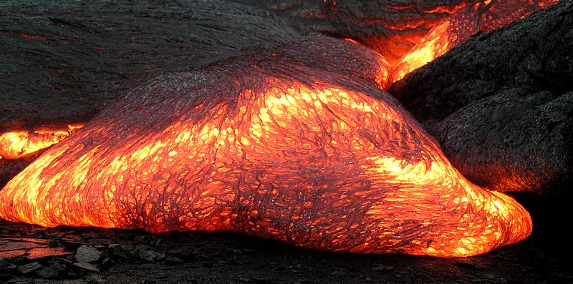
(1) Black-body radiation
Note the overlap of the spectra of sunlight & black-body radiation.
Black-body radiation: the color of the lava correlates with its temperature.
Chemistry Openstax;
https://en.wikipedia.org/wiki/Black-body_radiation

Slide 14
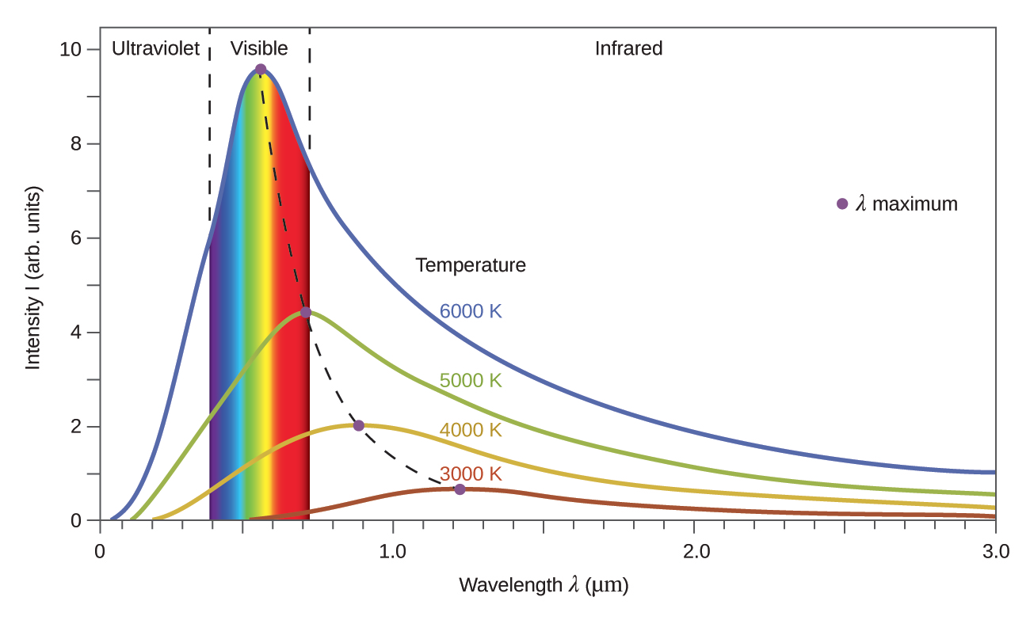
Black-body observation vs theory
Observation: each temperature corresponds to one peak λ.
Black-body radiation: the color of the lava correlates with its temperature.
Theory: physicists were unable to model, or explain, blackbody radiation using existing ideas
Ultraviolet catastrophe: modeling predicted that room temp objects should
emit lots of uv light;
wrong!
Chemistry Openstax;
https://en.wikipedia.org/wiki/Black-body_radiation
Chemistry Openstax

Slide 15
Black-body radiation is also quantum
After years of study, and self-doubt, in 1900, German physicist Max Planck found a theoretical explanation of the black-body phenomenon.
E = nhν
energy (J)
frequency (cycles/s)
integer
Planck’s constant (6.626 E-34 J-s)
Two critical points:
n must be an integer; discrete thus quantum.
Quantization of energy is only observed at a very microscopic scale; note the exponent of Planck’s constant.
Chemistry Openstax

Slide 16
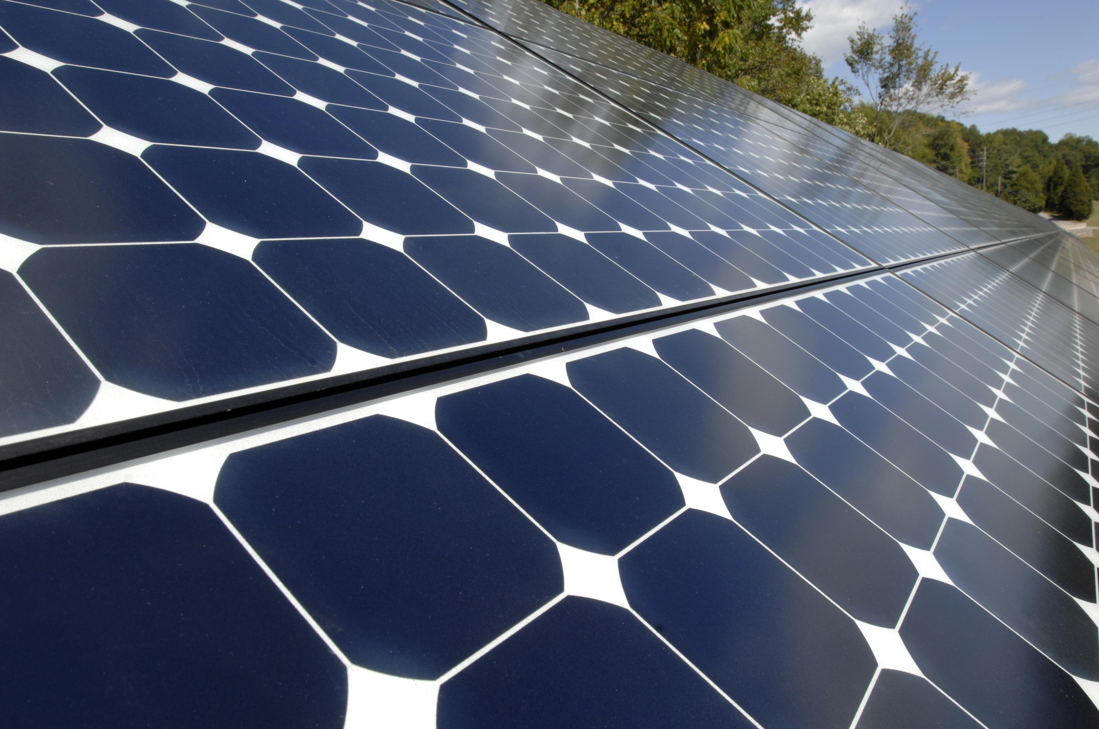
(2) The photoelectric effect
Photoelectric effect: electrons are ejected from a metal surface if light with a frequency greater than a certain threshold is shined on that surface.
The light must have more energy than than is holding the electrons onto the metal surface to eject them.
Observation:
Frequency matters but intensity does not.
Classic wave theory:
Intensity should matter, frequency should not.
https://energy.gov/eere/solar/downloads/oak-ridge-visitors-center-solar-array

Slide 17
The photoelectric effect is quantum
In 1905, Albert Einstein was able to explain the photoelectric effect by applying Planck’s work and the concept of quantization.
E = hν
E = hc/λ
wavelength (nm)
energy (J)
frequency (cycles/s)
Planck’s constant (6.626 E-34 J-s)
speed of light
(2.998 E8 m/s)
Here, light behaves like particles (called photons) not as a wave.
Each photon (greater than threshold ν) can eject one electron from the surface. (ν corresponds to vmax.)
The more photons (brighter light), the more e- can be ejected.
Chemistry Openstax

Slide 18
So, we can calculate energy of radiation
Neon lights are created by exciting Ne atoms with electricity. If the wavelength of neon light is 640 nm, what is the energy of the photon being emitted by the light?
3
E = hc/λ
E = (6.626 E-34 J/s)(2.998 E8 m/s) = 3.10 E-19 J
(640 nm)(1 m/1 E9 nm)
Microwaves have a wavelength that heats water molecules in food, but not materials with low water contents. Microwave frequency is about 3 E9 Hz.
What is the energy of a microwave photon?
4
E = hν
E = (6.626 E-34 J-s)(3 E9 s) = 2 E-24 J

Slide 19
Understanding the photoelectric effect?
Read these statements of the photoelectric effect.
Identify those that are false.
Change them to make them true.
5
(1) Increasing the brightness of incoming light increases the kinetic energy of ejected electrons.
False: only if light energy is increased
(2) Increasing the wavelength of incoming light increases the kinetic energy of ejected electrons.
False: only increasing frequency
(3) Increasing the brightness of incoming light increases the number of ejected electrons.
True: increasing brightness increases collisions
(4) Increasing the frequency of incoming light can increase the number of ejected electrons.
True if this increases the number of photons over the threshold frequency

Slide 20
Try this
Calculate the threshold energy (kJ/mol) of electrons in Al if the lowest frequency for the photoelectric effect is 9.87 E14 Hz.
6
The energy for one photon is given by E = hν.
E = (6.626 E-34 J-s)(9.87 E14 s) = 6.54 E-19 J
6.54 E-19 J 6.02 E23 photons = 3.94 E5 J/mol → 394 kJ/mol
1 photon 1 mole

Slide 21
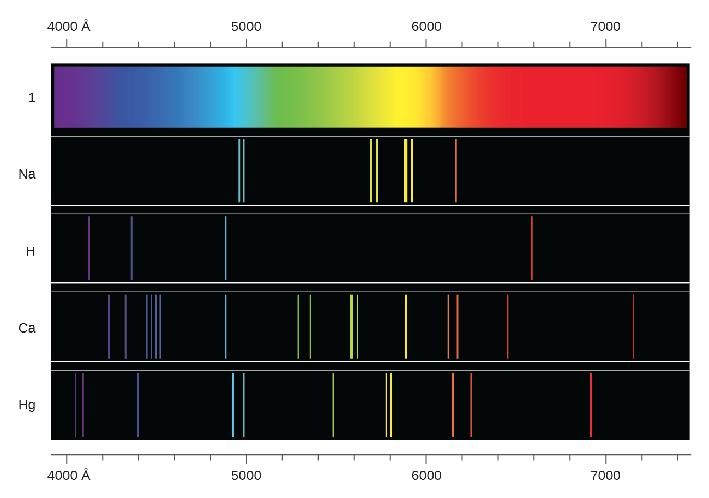
(3) Line spectra
When matter is heated sufficiently it will radiate excess energy as light; as photons. The sun is a mixture of many elements, and sunlight is a continuous spectrum of wavelengths.
Heating, or excitation, of a single element produces line spectra at discrete & characteristic wavelengths.
quantum
•
•
•
Chemistry Openstax

Slide 22
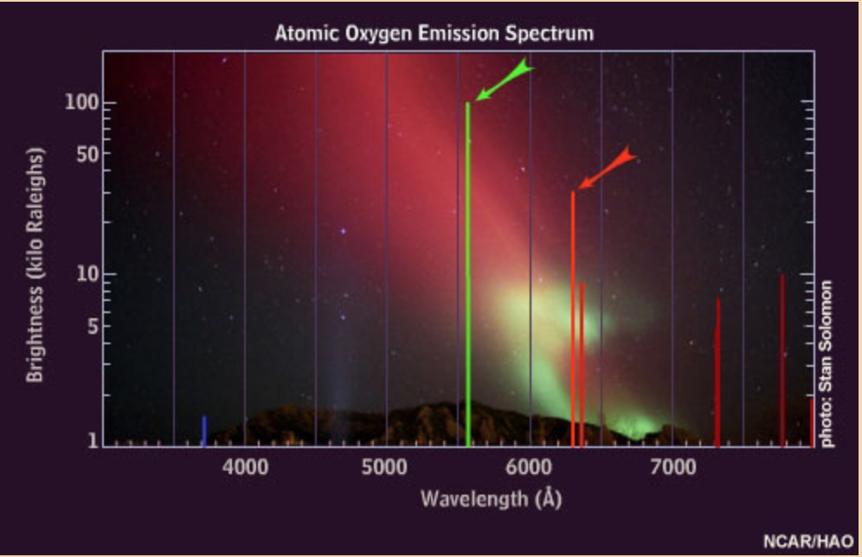
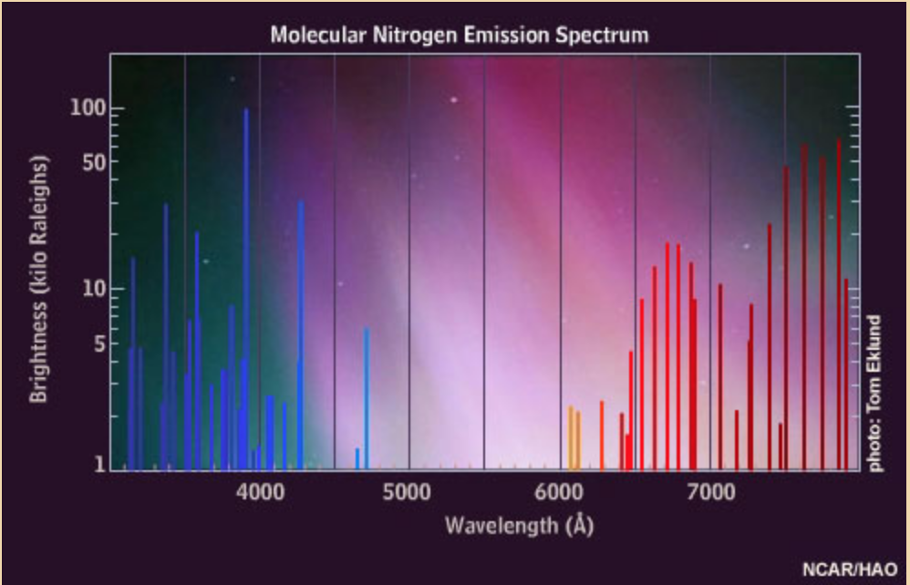
(3) Line spectra of the aurora borealis
https://www.windows2universe.org/earth/Magnetosphere/tour/tour_earth_magnetosphere_09.html

Slide 23
Can you?
Explain the difference between waves and particles and define critical characteristics of each?
(2) Describe the phenomena of wave interference and standing waves?
(3) List and describe the three phenomena that demonstrate that Newtonian physics isn’t able to explain the behavior of light and subatomic particles?
(4) Use equations provided to calculate basic parameters of waves, light, electrons and atoms?

