Slide 1
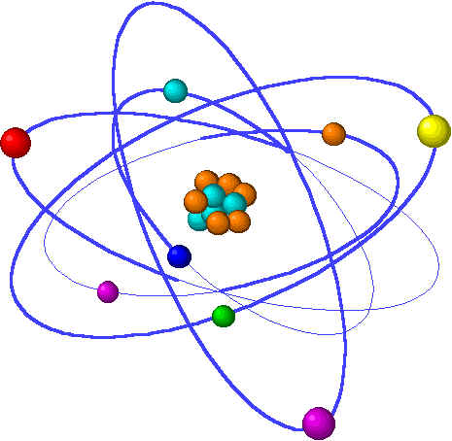
Lecture 7: Chemical bonding
Lecture 7 Topics Brown, chapter 8
Basic bonding background information 8.1
Types of chemical bonds
Valence electrons & Lewis structures
The ‘octet rule’
Ionic bonding 8.2
Lattice energy
Charge & size affect lattice energy
Transition metal ions
Covalent bonding 8.3
Lewis structures & unequal sharing
Unequal sharing & electronegativity 8.4
Bond polarity
Guidelines for Lewis Structures 8.5
Dipole moment & overall molecular polarity
Multiple bonds & formal charge
Resonance structures 8.6
Exceptions to the octet rule 8.7

Slide 2
Types of chemical bonding
Ionic bonding creates salts
Covalent bonding creates biomolecules
Notes:
The general process of advancing scientific knowledge by making experimental observations and by formulating hypotheses, theories, and laws.
It’s a systematic problems solving process AND it’s hands-on….. Experiments must be done, data generated, conclusions made.
This method is “iterative”; it requires looping back and starting over if needed. [Why do you think they call it REsearch?] Often years, decades or more of experiments are required to prove a theory.
While it’s possible to prove a hypothesis wrong, it’s actually NOT possible to absolutely prove a hypothesis correct as the outcome may have had a cause that the scientist hasn’t considered.

Slide 3
Chemical bonding
There are 3 basic types of chemical bonds:
1. Ionic
2. Covalent
3. Metallic
= electrostatic forces between ions of opposite charge
formed by transfer of e- from one atom to another
generally a metal and a non-metal
= sharing of electrons between atoms
commonly between 2 non-metals
organic compounds (C, H, O…..N)
= metal atoms bonded to neighboring metal atoms
e- are free to move through the 3D structure
conductivity & luster
p.289

Slide 4
Ionic vs. covalent bonding
p.290

Slide 5
Valence electrons & the octet rule
Bonding involves only valence electrons.
All atoms want a full valence shell…
… and they get it via bonding.
Notes:
The general process of advancing scientific knowledge by making experimental observations and by formulating hypotheses, theories, and laws.
It’s a systematic problems solving process AND it’s hands-on….. Experiments must be done, data generated, conclusions made.
This method is “iterative”; it requires looping back and starting over if needed. [Why do you think they call it REsearch?] Often years, decades or more of experiments are required to prove a theory.
While it’s possible to prove a hypothesis wrong, it’s actually NOT possible to absolutely prove a hypothesis correct as the outcome may have had a cause that the scientist hasn’t considered.

Slide 6
Valence electrons: shown by Lewis symbols
Remember that valence electrons are those in an atom’s outermost shell. Valence e- are the first to meet when two atoms come together, & it is valence e- that form all chemical bonds.
How many valence electrons does an atom have? Use the group (or column) number;
it’s equal to the number of valence electrons.
..
S
Sulfur?
Sulfur is in column 6A of the periodic table.
.
.
Thus, sulfur has 6 valence electrons.
..
p.290-1

Slide 7
The octet rule
‘Atoms tend to gain, lose or share e- in order to achieve the same number of e- as the noble gas in their row of the periodic table.’
‘Atoms try to be surrounded by 8 valance e-’s (or a full valence shell).’
Why? Noble gases have stable electron configurations.
(configurations = arrangement of electrons around the atom’s nucleus)
What makes for a stable electron configuration? A full valance shell! This is why atoms whose valence shells are not full will attempt to either gain or lose electrons to fill (or completely empty) their valence shell?
What about H?
Will these atoms gain or lose electrons? K?
C?
Ar? N?
Fe?
Lose
Neither! Carbon is both half-full & -empty.
Neither… already has a full valence shell! Gain
Lose
Atoms whose valence shells are less than half-full (<4) lose electrons; atoms whose shells are more than half-full gain electrons.
NOTE: There are many exceptions to the octet rule, but it will be our guiding principle.
p.290-1

