Slide 1
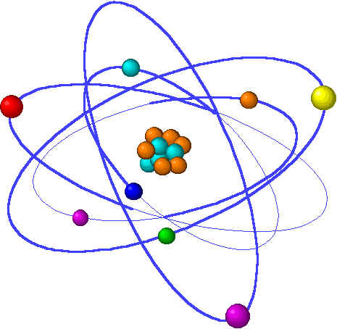
Lecture 7: Chemical bonding
Lecture 7 Topics Brown, chapter 8
Basic bonding background information 8.1
Types of chemical bonds
Valence electrons & Lewis structures
The ‘octet rule’
Ionic bonding 8.2
Lattice energy
Charge & size affect lattice energy
Transition metal ions
Covalent bonding 8.3
Lewis structures & unequal sharing
Unequal sharing & electronegativity 8.4
Bond polarity
Guidelines for Lewis Structures 8.5
Dipole moment & overall molecular polarity
Multiple bonds & formal charge
Resonance structures 8.6
Exceptions to the octet rule 8.7

Slide 2
Covalent bonds are shared valence electron pairs
Covalent bonds join non-metals.
Equal sharing forms non-polar bonds.
Unequal sharing forms polar bonds.
Notes:
The general process of advancing scientific knowledge by making experimental observations and by formulating hypotheses, theories, and laws.
It’s a systematic problems solving process AND it’s hands-on….. Experiments must be done, data generated, conclusions made.
This method is “iterative”; it requires looping back and starting over if needed. [Why do you think they call it REsearch?] Often years, decades or more of experiments are required to prove a theory.
While it’s possible to prove a hypothesis wrong, it’s actually NOT possible to absolutely prove a hypothesis correct as the outcome may have had a cause that the scientist hasn’t considered.

Slide 3
Covalent bonding
Covalent molecules are not crystalline & brittle like ionic compounds.
Biomolecules, the molecules of life, are formed by covalent bonding.
Covalent bonds: formed by sharing of a e- pair between two non-metal atoms.
What motivates atoms to share electrons?
It’s the old octet rule again. Non-metal atoms (except for H) generally have 4 or more valence electrons & sharing with other non-metals allows both atoms to obtain an octet without losing or gaining electrons.
H₂ molecule is the simplest example.
What happens when two atoms meet?
So the majority of e- are found between the 2 nuclei = shared e-’s.
‘electrostatic glue’
p.296

Slide 4
Lewis structures & equal sharing
Lewis dot diagrams allow us to represent atoms & their valence e- & to show covalent bonding.
Atomic symbol surrounded by one dot per valence electron
H. + H. --> H:H
Here electron sharing is equal as the two atoms are identical.
The Venn diagrams show how many e- each atom has access to (anything within its circle), & how many e- are shared (in the overlapping area of the circles.
..
:Cl.
..
:Cl.
..
:Cl:
..
Cl:
+
-->
..
..
..
..
Shared e- pair often shown as line.
H-H
Sharing more than one pair of e- forms multiple bonds between two atoms.
Multiple bonding may be needed to give both atoms a full valence shell.
..
..
:N:::N:
:O::C::O:
Sharing more atoms shortens the distance between two atoms.
Think of this as more electrostatic glue holding the two atoms more tightly together.
N - N N = N N = N
=
p.297
1.47 Å
1.24 Å
1.10 Å

Slide 5
Examples: two Lewis dot structures
Draw the Lewis dot structures of:
NF3
CH4
H
..
..
..
:F
N
F:
H
C
H
..
..
:F:
H
..
p.297

Slide 6
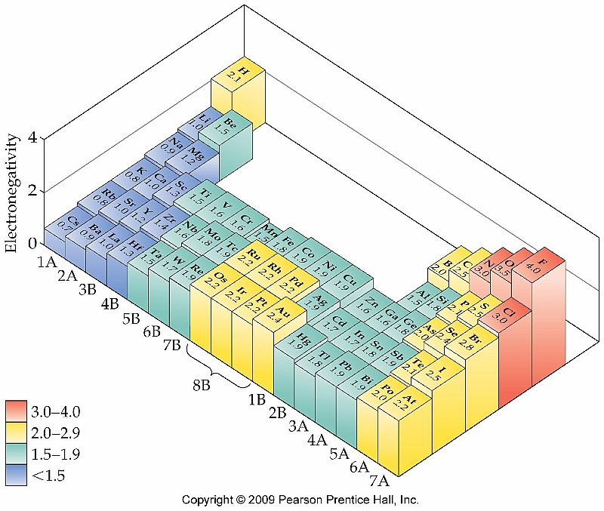
Unequal sharing & electronegativity
Electrons in covalent bonds between non-identical atoms are often shared unequally. Why?
Atoms have differing (& characteristic) abilities to gain or lose, and to hold, electrons.
Ionization energy - explains how tightly electrons are held by the atom
Electron affinity - explains ‘desire’ to gain more electrons
Electronegativity combines both of these properties and describes, in a net or overall sense, how well an element grabs & keeps electrons.
High en - grabs and holds well; low en - grabs and holds poorly
Note how en changes in the periodic table.
equal vs. unequal sharing:
p.299

Slide 7
Bond polarity
Unequal sharing of electrons creates polar bonds and partial (dipolar) charges.
Type of bond Δ EN values
Nonpolar covalent F2
Polar covalent HF
Ionic LiF
4.0 - 4.0 = 0 <0.5
4.0 - 2.1 = 1.9 0.5 - 2.0
4.0 - 1.0 = 3.0 > 2.0
So H-F’s bond is covalent but very polar; e-s are shared very unequally.
Most electrons are pulled to the more electronegative fluorine and this causes partial (dipolar) charges on both atoms.
So polar covalent bonds have a somewhat ‘ionic’ character. Polarity increases as the Δen increases.
δ+
δ-
Polar molecules align in a charge- determined manner. Positive to negative or ‘head-to-tail’
HF
H-F
H-F
H-F
H-F
H-F
H-F
p.299 - 300

Slide 8
Lewis structures show the structure of covalently bonded molecules.
Multiple bonds are used to satisfy octets.
Arrows show bond polarity
Formal charge determines charge location.
Notes:
The general process of advancing scientific knowledge by making experimental observations and by formulating hypotheses, theories, and laws.
It’s a systematic problems solving process AND it’s hands-on….. Experiments must be done, data generated, conclusions made.
This method is “iterative”; it requires looping back and starting over if needed. [Why do you think they call it REsearch?] Often years, decades or more of experiments are required to prove a theory.
While it’s possible to prove a hypothesis wrong, it’s actually NOT possible to absolutely prove a hypothesis correct as the outcome may have had a cause that the scientist hasn’t considered.

Slide 9
Guidelines for drawing Lewis structures
1. Sum the ve- of all atoms in the molecule.
2. Write the symbols of each element & attach with lines for bonds.
The line (a bond) represent 2 valence electrons.
If formula has no multiple atoms, write the symbols left-to-right.
If there are multiple elements place the single symbol in the center & surround it with multiples in a symmetrical manner.
3. Complete the octets of the atoms bonded to the central atom…
…as free electron pairs.
4. Place any leftover ve- on the central atom.
5. If there are not enough ve- on the central atom, use multiple bonds.
..
-OH⁻¹
-PO₄⁻³
:O:- | -:O - P - O:- |
:O:-
#ve- = 6 + 1 + 1 = 8
#ve- = 5 + (4x6) + 3 = 32
..
+
..
..
..
-
..
:O - H
..
..
p.305

Slide 10
Examples of Lewis structures
..
H-F:
F in in 7A; needs to share 1 e- to form an octet. H is in 1A; needs to share 7 e- to form an octet.
..
..
H-O:
| H
O is in 6A; needs to share a total of 2 e- to form an octet.
Each H is in 1A; needs to share a total of 7 e- to form an octet.
..
H-N-H
|
H
N is in 5A; needs to share a total of 3 e- to form an octet.
Each H is in 1A; needs to share a total of 7 e- to form an octet.
H
|
H - C - H
|
H
N is in 6A; needs to share a total of 4 e- to form an octet.
Each H is in 1A; needs to share a total of 7 e- to form an octet.
p.314-16

Slide 11
Examples: Lewis structures & bond polarities
Phosphorous chloride, PCl₃.
#ve- = 5 + (3x7) = 26
..
..
..
..
..
ΔEN = Cl - P = 3.0 - 2.1 = 0.9
So somewhat polar
Cl - P - Cl | Cl
:Cl - P - Cl: | :Cl:
:Cl - P - Cl: | :Cl:
..
..
..
..
.
..
..
CH₂Cl₂ (dichloromethane)?
#ve- = (1x4) + (2x1) + (2x7) = 20
..
:Cl:
|
H - C - H
|
:Cl:
ΔEN = Cl - C = 3.0 - 2.5 = 0.5 …. On the cusp of nonpolar to very slightly polar
ΔEN = C - H = 2.5 - 2.1 = 0.4 nonpolar
..
Know how to compare bonds and determine which is more polar.
p.305-6

Slide 12
Multiple bonds & formal charge
Formal charge of an atom is calculated by subtracting number of valence electrons ‘owned’ by that atom from its valence number.
Number of valence e- owned = ‘dots + sticks’
..
H - N - H | H
H
|
H - N - H | H
NH4⁺¹
8 ve-
H = 1 - (0 + 1) = o N = 5 - (0 + 4) = +1
NH3
8 ve-
H = 1 - (0 + 1) = o N = 5 - (2 + 3) = 0
.. +1 .. :O = N = O:
O = 6 - (4 + 2) = o N = 5 - (0 + 4) = +1
Generally, if a molecule has a formal charge it will be carried by the most electro- negative atom.
If there are two possible Lewis structures for a molecule, use the one with the lowest formal charges
NO2⁺¹
16 ve-
H = 1 - (0 + 1) = o
C = 4 - (0 + 4) = o N = 5 - (3 + 2) = 0
HCN
10 ve-
=
H - C = N:
.. :O - C = O:
O = 6 - (6 + 1) = -1 C = 4 - (0 + 4) = 0 O = 6 - (2 + 3) = +1
.. .. :O = C = O:
O = 6 - (4 + 2) = o C = 4 - (0 + 4) = 0
=
CO2
16 ve-
..
p.307-8

