Slide 1
CHE 1031: General Chemistry I
7. Chemical bonding
7.1: Ionic bonding [sidebar]
7.2: Covalent bonding
7.3: Lewis symbols & structures
7.4: Formal charges & resonance
7.5: Strengths of ionic & covalent bonds
7.6: Molecular structure & polarity [sidebar]

Slide 2
7. Chemical bonding
7.2: Covalent bonding
Describe the formation of covalent bonding
Define electronegativity and assess the polarity of covalent bonds

Slide 3
What’s a covalent bond?
Covalent bond: a pair of electrons shared between two atoms.
Each atom contributes one electron.
Non-metals bond covalently.
Covalent bonding gives each atom access to a full valence shell.
Physical properties:
Lower mp & boiling points.
Often gases, liquids or ‘softer’ solids.
Generally insoluble in water.
Poor conductors of heat and electricity.

Slide 4
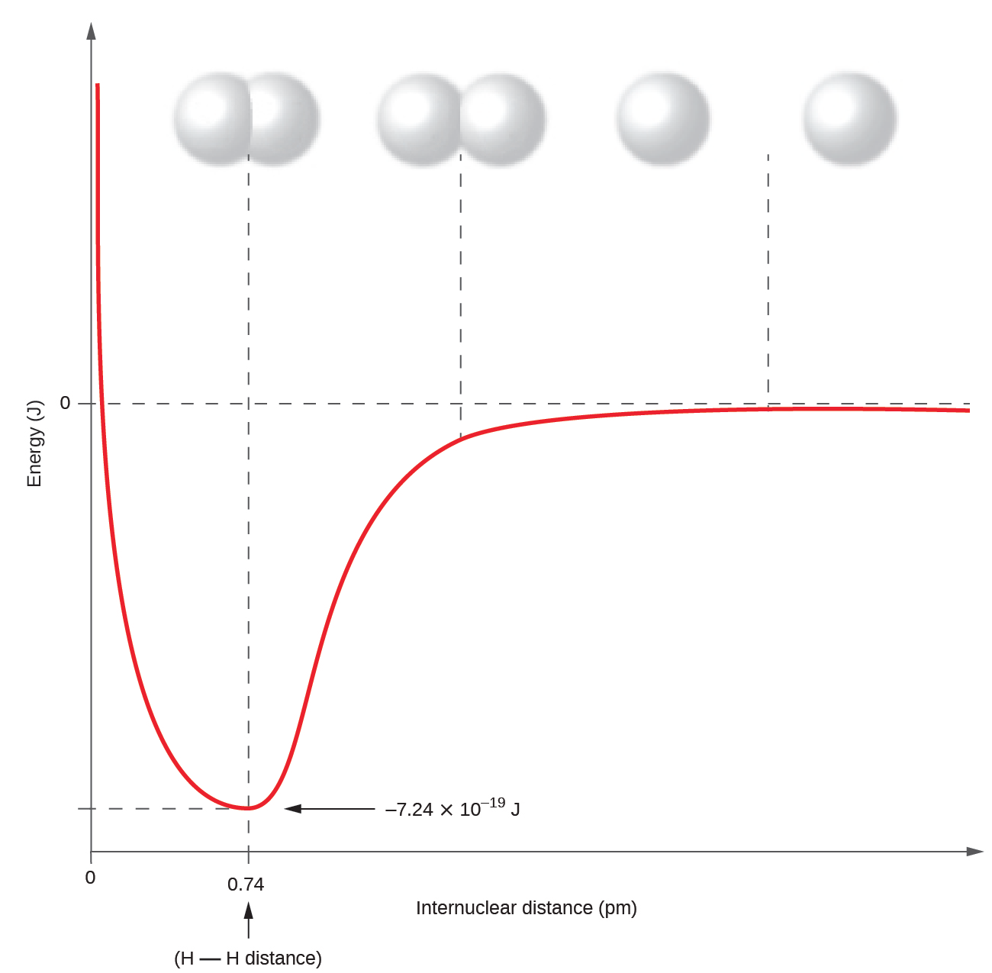
Formation of covalent bonds
As 2 atoms approach:
No attraction.
ve- shells repel.
Ve- of atom 1 is attracted to nucleus of atom 2 and vv.
Nuclei close enough to repel.
max attraction
min repulsion
no attraction
ve- repulsion
energy minima “well”
bond length
OpenStax Chemistry

Slide 5
Covalent bonds lower energy states
When atoms bond covalently (and achieve full valence shells) their energy state decreases and becomes more stable.
H2(g) 2H(g) ΔH = 436 kJ
An input of energy is required to break the covalent bond between the two atoms of hydrogen gas (H2) and create two hydrogen atoms as shown by the + ΔH value.
2H(g) H2(g) ΔH = - 436 kJ
And energy is released when a covalent bond forms between the two hydrogen atoms to form hydrogen gas (H2) as shown by the - ΔH value.

Slide 6
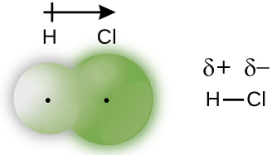
Polar or non-polar?
Covalent bonds are polar or non-polar depending on how evenly the two electrons are shared between bonded atoms.
Nonpolar covalent: electrons of the bond are shared equally
Polar covalent: electrons of the bond are not shared equally
polarity arrow
dipolar +
dipolar -
Green ‘bubble’ shows distribution of electrons around each atom.
dipolar (δ) = partial charge
EN: 2.1 2.6

Slide 7
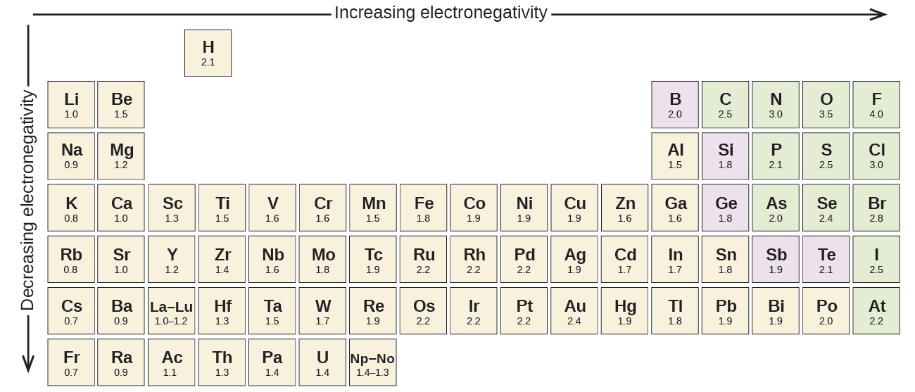
Electronegativity
Electronegativity: a measure of the ability of an atom to keep its own electrons and to attract other electrons towards it
In covalent bonds, electrons are attracted to the more electronegative atom.
Difference in electronegativity determines bond polarity.
more protons in the nucleus
electrons further from nucleus

Slide 8
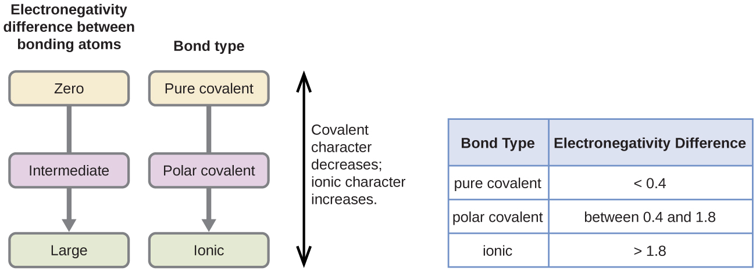
Difference in electronegativity (Δen)
To determine whether bonds are ionic, polar covalent or nonpolar covalent we calculate the difference in electronegativity values of two bonded atoms.
Δen = |en1 – en2|

Slide 9
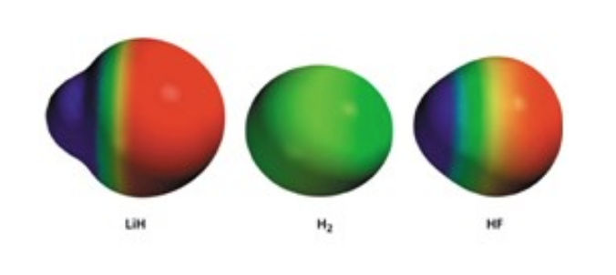
Difference in electronegativity (Δen)
Covalent bonds are polar or non-polar depending on how evenly the two electrons are shared between bonded atoms.
Nonpolar covalent: electrons of the bond are shared equally
Polar covalent: electrons of the bond are not shared equally
polar nonpolar polar
|0.98 – 2.20| |2.20 – 2.20| |2.20 – 3.98|
= 1.22 = 0 = 1.78

Slide 10
Try this
Determine the types of bonds between these atoms and label their polarities.
C – H
S – H
C – N
N – H
C – O
O - H
6
|2.5 – 2.1| = 0.4 nonpolar
|2.5 – 2.1| = 0.4 nonpolar
|2.5 – 3.0| = 0.5 polar-ish
|3.0 – 2.1| = o.9 polar
|2.5 – 3.5| = 1.0 polar
|3.5 – 2.1| = 1.4 polar

Slide 11
Try this
Determine the types of bonds in potassium nitrate and show polarity arrows.
K⁺¹ (NO3)⁻¹
7
3.5
:O:
3.0
|3.5 – 3.0| = 0.5 polar
|0.8 – 3.5| = 2.7 ionic
N
⁺¹
K⁺¹
:O:
:O:
..
..
⁻¹
⁻¹
0.8
3.5
3.5

Slide 12
Can you?
Define the term ‘covalent bond’?
(2) Describe how the properties of covalent compounds differ
from those of ionic compounds?
(3) Explain how repulsive and attractive forces, and overall energies, change as atoms approach one another and form covalent bond?
(4) Explain how polar and nonpolar covalent bonds differ and the role of electronegativity in determining bond type.

