Slide 1
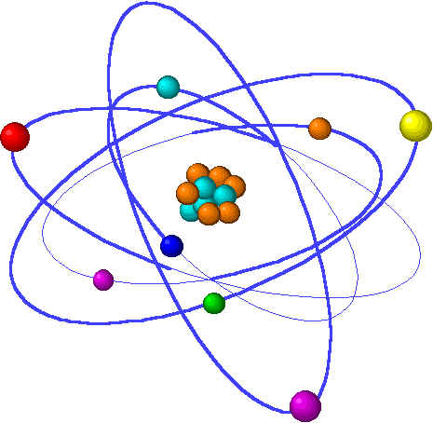
Lecture 8: Thermochemistry
Lecture 8 Topics Brown chapter 5
8.1: Kinetic vs. potential energy 5.1
8.2: Transferring energy as heat & work
Thermal energy
8.3: System vs. surroundings
Closed systems
8.4: First Law of Thermodynamics 5.2
Internal energy of chemical reactions
Energy diagrams
ΔE, system & surroundings
8.5: Enthalpy 5.3
Exothermic vs. endothermic
Guidelines thermochemical equations 5.4
Hess’s Law 5.6
8.6: Calorimetry
Constant pressure calorimetry
8.7: Enthlapy of formation 5.7

Slide 2
Kinetic vs. potential energy
Chemical energy is a form of potential energy.
Notes:
The general process of advancing scientific knowledge by making experimental observations and by formulating hypotheses, theories, and laws.
It’s a systematic problems solving process AND it’s hands-on….. Experiments must be done, data generated, conclusions made.
This method is “iterative”; it requires looping back and starting over if needed. [Why do you think they call it REsearch?] Often years, decades or more of experiments are required to prove a theory.
While it’s possible to prove a hypothesis wrong, it’s actually NOT possible to absolutely prove a hypothesis correct as the outcome may have had a cause that the scientist hasn’t considered.

Slide 3
Kinetic vs. potential energy
Kinetic energy: the energy of motion; dependent on mass and speed
E_{k} increases as: 1) mass increases; 2) speed increases
For example, think of different model cars traveling at different speeds.
2 volkswagen beetles drag racing – the faster has greater kinetic energy
Beetle & SUV crashing head-on at identical speeds - SUV has more kinetic energy
Potential Energy: stored energy… either physical or chemical
Caused by the attractions & repulsions an object experiences in relation to other objects.
Chemical potential energy?
A gallon of gasoline
Reagents which undergo
spontaneous redox reactions
zero kinetic energy, maximum potential energy
kinetic energy, reduced potential energy
total potential energy
energy
zero kinetic energy, zero potential energy
p. 161

Slide 4
Energy within the atom
Chemical potential energy: energy stored in the structure of the atom or in the chemical bonds of a molecule
Results from electrostatic attractions between:
-
electrons & nucleus
cations & anions
covalently bonded atoms with EN differences
+
Chemical reactions may release potential energy.
Example: combustion of gasoline (octane, C8H18)
+ heat
51 bonds created, so net energy release
33 bonds broken
p. 161

Slide 5
Example: calculating kinetic energy
What is the kinetic energy (J) of:
An Ar atom moving at 650 m/s
A mole of Ar atoms moving at 650 m/s
Ar = 39.95 g/mol = 0.03995 kg 1 mol = 6.636 x 10⁻²⁶ kg/atom
1 mol 6.02 x 10²³ atoms
Ek of one mole of Ar = (1/2)(0.03995 kg)(650² m²/s²) = 8.4 x 10³ J
Ek of one atom of Ar = (1/2)(6.636 x 10⁻²⁶ kg)(650² m²/s²) = 1.4 x 10⁻²⁰ J
p. 164

