Slide 1
CHE 1031: General Chemistry I
8. Thermochemistry
8.1: Energy basics
8.2: Calorimetry
8.3: Enthalpy

Slide 2
8. Thermochemistry
8.1: Energy basics
Define energy, distinguish between types of energy, and describe the nature of energy changes that accompany physical and chemical changes.
Distinguish between heat, thermal energy & temperature.
Define and distinguish specific heat and heat capacity and describe the physical implications of both.
Perform calculations involving heat, specific heat and changes in temperature.

Slide 3
Chemical changes ~ energy changes
Many, if not most, of the chemical changes we observe and use daily involve changes in energy:
Cooking food to make nutrients more bioavailable;
Burning fuels to provide heat, motive power and electricity; &
Chemical processing of raw materials to create materials for use to use.
More than 90% of our energy comes from the sun, though it may flow to us through physical changes (wind) and chemical changes (photosynthesis).
Chemistry Openstax

Slide 4
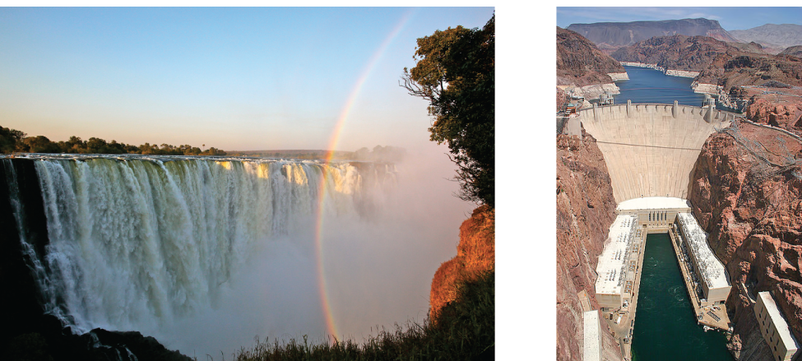
Energy
Energy: the capacity to supply heat (q) or do work (w)
Moving objects in opposition to forces like friction & gravity
Potential energy: the energy an object possesses by virtue of its
position; stored energy
Chemical energy is potential energy. (batteries, fuels)
Kinetic energy: the energy of objects in motion
Chemistry Openstax

Slide 5
First law of thermodynamics
First law of thermodynamics: energy is conserved, neither created nor destroyed, but only transferred or transformed
Transfer? From one object to another
Heat always flows from hot objects to cooler objects
Transformed? From one form to another
Kinetic energy can become potential energy (or vv).
Potential or kinetic energy can become heat.
You push a watermelon off out of a third-floor window. How is energy transferred or transformed?
1
A watermelon sitting on a third-floor windowsill has potential energy, but no kinetic energy. As you push it off the sill, kinetic energy increases and potential energy decreases. When it hits the ground, kinetic energy is transferred into heat of friction and work as the melon hits the ground and ‘explodes.

Slide 6
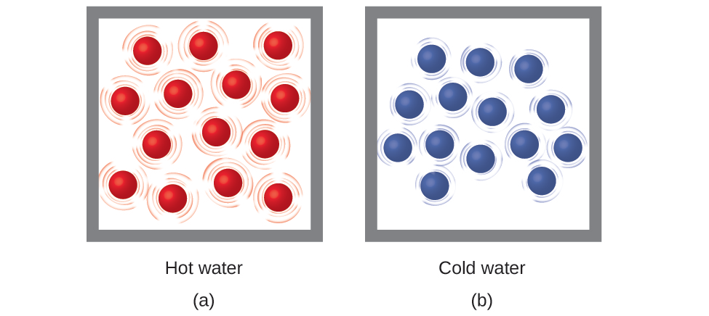
Thermal energy
Thermal energy: kinetic energy of the random motion of atoms and molecules
Temperature: quantitative measure of ‘hot’ and ‘cold’
Faster kinetic motion (sometimes called vibration) results in more thermal energy and a higher temperature.
slower motion
cooler temp
contraction
faster motion
warmer temp
expansion
Chemistry Openstax

Slide 7
Heat
Heat (q) (heat flow): the transfer of thermal energy between two bodies at different temperatures: from hot to cold.
Heat flow continues until both bodies are the same temperature.
(1) initial difference
(2) heat flow!
(3) same temps
Chemistry Openstax

Slide 8
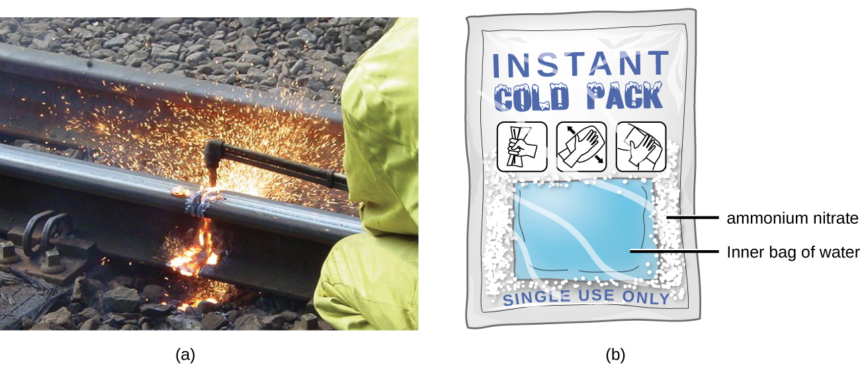
Endo- vs. exothermic reactions
Endothermic: processes that require an input of energy or heat in order to occur.
ΔH = +
Example: dehydration of a hydrated salt
Exothermic: processes that release energy or heat as they occur.
ΔH = -
Example: combustion of gasoline
exothermic
exothermic
Chemistry Openstax

Slide 9
Units & heat capacity
Joule (J): the amount of energy used when a force of 1 Newton is used to move an object 1 meter
1 J = 1 kg m²/s²
1 kJ = 1000 J
Heat capacity: the amount of energy needed to raise an object’s temperature by 1 degree C
c = q .= J .
ΔT °C
Calculate the heat capacity of two cast-iron frying pans, one large and one small. The temperature of each pan is increased by 50 degrees. That requires an input of 18,150 J of energy for the small pan, and 90,700 J for the large pan.
2
c = q = 18,150 J = 363 J/°C° = 90,700 J = 1814 J/°C
ΔT 50°C 50°C

Slide 10
Specific heat
Specific heat: the amount of energy used to raise the temperature of 1 g of substance by 1 °C
Unit: J/g-°C
Water = 4.184 J/g-°C
c = q .= J .
(m)(ΔT) g- °C
Calculate the specific heat of two cast-iron frying pans, one large and one small. The temperature of each pan is increased by 50 degrees. That requires an input of 18,150 J of energy for the small pan, and 90,700 J for the large pan. The mass of the small pan is 808 g and the large pan is 4040 g.
3
c = 18,150 J = 0.449 J/°g-C° c = 90,700 J = 0.449 J/g-°C
(808 g)(50°C) (4040 g)(50°C)

Slide 11
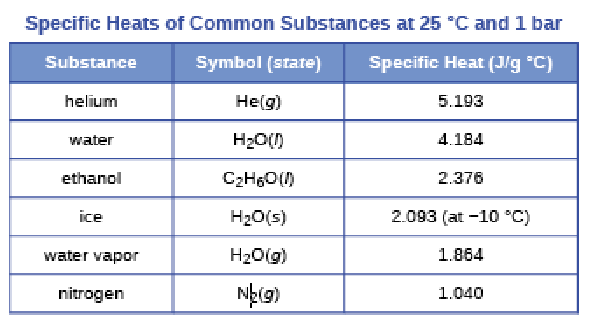
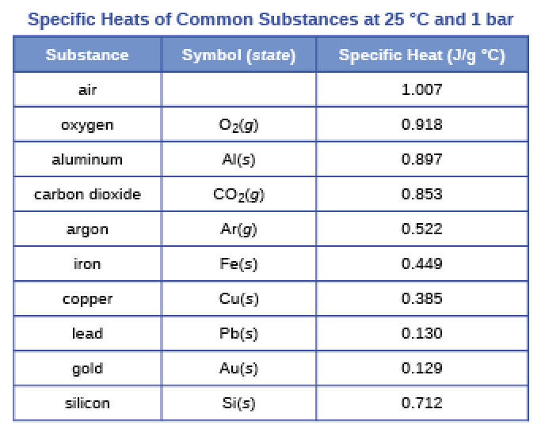
Common specific heat values
Chemistry Openstax

Slide 12
Calculating change of heat
If we know the mass of a substance, its specific heat and the change in temperature, we can calculate the heat flow using:
q = (c)(m)(ΔT)
units: J = (J/g-°C)(g)(°C)
q = ΔH
+ΔH = endothermic
- ΔH = exothermic
A flask containing 8.0 E2 g of water is heated and the temperature of the water increases from 21 to 85°C. How much heat was used?
4
q = (c)(m)(ΔT) = (4.184 J/g-°C)(8.0 E2 g)(85 – 21°C) = 2.1 E5 J = 21 kJ

Slide 13
Calculating other parameters
A piece of metal has a mass of 348 g and absorbs 6.64 kJ of heat as its temperature increases from 22.4 to 43.6°C.
Calculate the specific heat of the metal, and try to identify it.
5
q = (c)(m)(ΔT) → c = q = 6.64 E3 J = 0.900 J/g-°C
(m)(ΔT) (348 g)(43.6 – 22.4°C) Al?
A piece of metal weighs 217 g and absorbs 1.43 kJ of heat.
Its temperature increases from 24.5 to 39.1°C. Calculate the metal‘s specific heat.
6
q = (c)(m)(ΔT) → c = q = 1.43 E3 J = 0.450 J/g-°C
(m)(ΔT) (217 g)(39.1 – 24.5°C) Fe?

Slide 14
Using molten salt to store energy
A solar power plant stores energy overnight by melting salt: a mixture of sodium nitrate and potassium nitrate.
If one ton of this salt, with a heat capacity of 1.53 J/g-°C, is heated from 260 to 550°C, how much energy can be stored?
7
1 ton = 2000 lb 454 g = 9.08 E5 g
1 lb
q = (c)(m)(ΔT)
q = (1.53 J/g-°C)(9.08 E5 g)(550 - 260°C) = 4.0 E8 J = 400 MJ

Slide 15
Can you?
Define the term ‘energy’ and differentiate between potential, kinetic and chemical energy?
(2) State the first law of thermodynamics?
(3) Explain the relationship between thermal energy and heat? What do thermometers measure?
(4) Define, and differentiate between, processes that are endothermic and exothermic?
(5) Define (and know the units for) heat capacity and specific heat?
(6) Use specific heat, mass and change in temperature to calculate heat changes?

