Slide 1
CHE 1031: General Chemistry I
8. Thermochemistry
8.1: Energy basics
8.2: Calorimetry
8.3: Enthalpy

Slide 2
8. Thermochemistry
8.3: Enthalpy
State the first law of thermodynamics
Define enthalpy and explain its classification as a state function.
Write and balance thermochemical equations.
Calculate enthalpy changes for chemical reactions.
Explain Hess’s law and use it to calculate enthalpies of reactions.

Slide 3
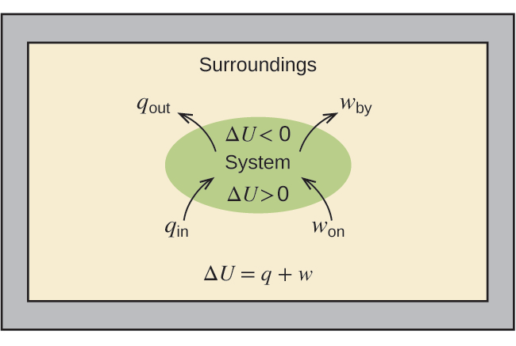
Internal energy (U)
Internal energy (U): the sum of all types of energy in a system
ΔU = q + w where q is heat & w is work
+ q, + w mean that heat & work are being transferred from the surroundings into the system.
- q, - w mean that heat & work are being transferred from the system into the surroundings.
Chemistry Openstax

Slide 4
Enthalpy change (ΔH)
For processes that occur at constant pressure and that don’t involve change of pressure and volume, enthalpy is the heat flow resulting from the chemical reaction.
qp = ΔH
Thermochemical equations: balanced chemical equations that include heat flows as ΔH.
H2(g) + 1/2O2(g) → H2O(l) ΔH = -286 kJ (exothermic)
Rules for using thermochemical equations:
ΔH is extensive: the amount of energy varies with mass.
ΔH depends on physical state.
When the direction of a reaction is reversed, the sign of ΔH is changed.

Slide 5
Properties of thermochemical equations
H2(g) + 1/2O2(g) → H2O(l) ΔH = -286 kJ
2H2(g) + O2(g) → 2H2O(l) ΔH = (2)(-286 kJ)
½H2(g) + ¼O2(g) → ½H2O(l) ΔH = -286 kJ/2
extensive
physical
state
(2) H2(g) + 1/2O2(g) → H2O(g) ΔH = -242 kJ
(3) H2O(l) → H2(g) + 1/2O2(g) ΔH = +286 kJ
reversible

Slide 6
Thermochemical equations: distributive
H2(g) + 1/2O2(g) → H2O(l) ΔH = -286 kJ
The distributive property of thermochemical equations allows us to make conversion factors from them.
1 mole H2 ½ mole O2 1 mole H2O
- 286 kJ - 286 kJ - 286 kJ
And each can be flipped.
How much energy is produced when 28.5 g of water are made?
MW of water = 18.01 g/mol
28.5 g 1 mol - 286 kJ = - 453 kJ The negative sign
18.01 g 1 mol H2O indicates that energy is released.
12

Slide 7
Try this
When 0.0500 mol of HCl reacts with 0.0500 mol of NaOH to form 0.0500 mol of NaCl, 2.9 kJ of heat are produced.
What is ΔH per mole of acid?
13
HCl(aq) + NaOH(aq) → NaCl(aq) + H2O(l)
What we know: ΔH = - 2.9 kJ = - 58 kJ/mol
0.0500 mol HCl
When 1.34 g of Zn reacts with 60.0 ml of 0.750 M HCl, 3.14 kJ of heat are produced. Determine the enthalpy change per mole of Zn:
Zn(s) + HCl(aq) → ZnCl2(aq) + H2(g)
14
- 3.14 kJ 65.38 g = - 153 kJ/mol
1.34 g 1 mol Zn

Slide 8
Hess’s law
Hess’s law: if a process can be broken into several steps, the ΔH of the whole process is equal to the sum of ΔH values for each step.
Allow’s calculation of enthalpy changes of complex reactions from databases of simpler reactions without experimental work.
What if we want the calculate the ΔH of this combustion reaction but don’t have a bomb calorimetere (needed for combustion reactions)? C(s) + O2(g) → CO2(g) ΔH = ___________
We can find this information:
C(s) + 1/2O2(g) → CO(g) ΔH = - 111 kJ
CO(g) + 1/2O2(g) → CO2(g) ΔH = - 283 kJ
+
C(s) + O2(g) → CO2(g) ΔH = - 394 kJ

Slide 9
Consider extensive & reversible-ness
Determine the ethalpy of formation of FeCl3 from these equations:
Fe(s) + Cl2(g) → FeCl2(s) ΔH = - 341.8 kJ
FeCl2(s) + ½Cl2(g) → FeCl3(s) ΔH = - 57.7 kJ
- 399.5 kJ
Want: Fe(s) + 3/2Cl2(g) → FeCl3(s) ΔH = ______
Look for species unique to each given equation and the equation you want.
Are they on the same side? If not, reverse equation given.
Are there the right number of moles? If not, fudge factor

Slide 10
Try this
Use reactions 1-3 to calculate the enthalpy for this reaction:
ClF(g) + F2(g) → ClF3(g) ΔH = ______
(1) 2OF2(g) → O2(g) + 2F2(g) ΔH = - 49.4 kJ
(2) 2ClF(g) + O2(g) → Cl2O(g) + OF2(g) ΔH = +205.6 kJ
(3) ClF3(g) + O2(g) → 1/2Cl2O(g) + 3/2OF2(g) ΔH = +266.7 kJ
15
reverse
2
/ 2
reverse
(1) 1/2O2(g) + F2(g) → OF2(g) ΔH = + 24.7 kJ
(2) ClF(g) + 1/2O2(g) → 1/2Cl2O(g) + 1/2OF2(g) ΔH = +102.8 kJ
(3) 1/2Cl2O(g) + 3/2OF2(g) → ClF3(g) + O2(g) ΔH = -266.7 kJ
-139.2 kJ

Slide 11
One more
Aluminum chloride can be formed from its elements:
2Al(s) + 3Cl2(g) → 2AlCl3(s) ΔH = ______
(1) HCl(g) → HCl(aq) ΔH = - 74.8 kJ
(2) H2(g) + Cl2(g) → 2HCl(g) ΔH = - 185.0 kJ
(3) AlCl3(aq) → AlCl3(s) ΔH = + 323 kJ
(4) 2Al(s) + 6HCl(aq) → 2AlCl3(aq) + 3H2(g) ΔH = - 1049 kJ
16
X 6
X 3
X 2
no Δ
(1) 6HCl(g) → 6HCl(aq) ΔH = - 448.8 kJ
(2) 3H2(g) + 3Cl2(g) → 6HCl(g) ΔH = - 555 kJ
(3) 2AlCl3(aq) → 2AlCl3(s) ΔH = + 646 kJ
(4) 2Al(s) + 6HCl(aq) → 2AlCl3(aq) + 3H2(g) ΔH = - 1049 kJ
- 1406.8 kJ

Slide 12
Can you?
Define the term ‘internal energy’ and relate it to heat and work?
(2) Define the term ‘thermochemical equation’ and describe its
properties?
(3) Create conversion factors from thermochemical equations and use them to solve problems?
(4) State Hess’s law and use it to calculate the enthalpies of complex chemical reactions from simpler reactions?

