Slide 1
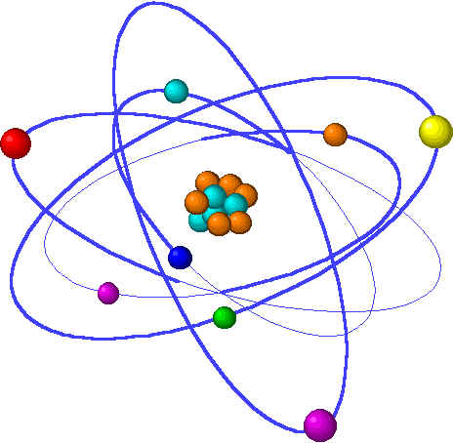
Lecture 7: Chemical bonding
Lecture 7 Topics Brown, chapter 8
Basic bonding background information 8.1
Types of chemical bonds
Valence electrons & Lewis structures
The ‘octet rule’
Ionic bonding 8.2
Lattice energy
Charge & size affect lattice energy
Transition metal ions
Covalent bonding 8.3
Lewis structures & unequal sharing
Unequal sharing & electronegativity 8.4
Bond polarity
Guidelines for Lewis Structures 8.5
Dipole moment & overall molecular polarity
Multiple bonds & formal charge
Resonance structures 8.6
Exceptions to the octet rule 8.7

Slide 2
Lecture 7: Terms to Know
Chemical bond
Ionic bond (salts = ionics)
Covalent bond
Metallic bond
Valence electron
Lewis symbol
Octet rule
Electron configuration
Valence shell
Noble element / gas
Lattice energy
Biomolecule
Law of electrostatic attraction
Lewis structures
Electronegativity
Ionization energy
Electron affinity
Bond polarity
Dipolar charge
Polar bond
Non-polar bond
Ionic bond
Formal charge
Resonance
Resonance structure
Resonance hybrid
Notes:
PLEASE note that the formula calculates a weighted average, so there’s not need to add and then divide the sum by the number of isotopes in the problem. This is an incredibly common student error so don’t get caught!

