Slide 1
CHE 1031: General Chemistry I
Atoms, molecules & ions
2.1: Early ideas about atomic theory
2.2: Evolution of atomic theory
2.3: Atomic structure & symbolism
2.4: Chemical formulas
2.5: The periodic table
2.6: Molecular & ionic compounds
2.7: Naming chemical compounds
covered in lab

Slide 2
2. Atoms, molecules & ions
2.1: Early ideas about atomic theory
State the postulates of Dalton’s atomic theory
Use postulates of Dalton’s atomic theory to explain the laws of definite & multiple proportions

Slide 3
Dalton’s atomic theory
1806, English school teacher John Dalton used experiments to revive the ancient concept of a universal element of matter & proved the existence of the atom.
1. Matter is composed of tiny particles called atoms: smallest unit of an element that can participate in chemical change.
2. Every element is made of one type of atom with a characteristic mass. All atoms of one element are identical.
3. The atoms of each element differ & are found only in that element.
4. A compound is made by combining atoms of two or more elements at a constant, whole-number ratio.
5. Chemical reactions neither create nor destroy atoms, but rearrange them to create new substances.

Slide 4
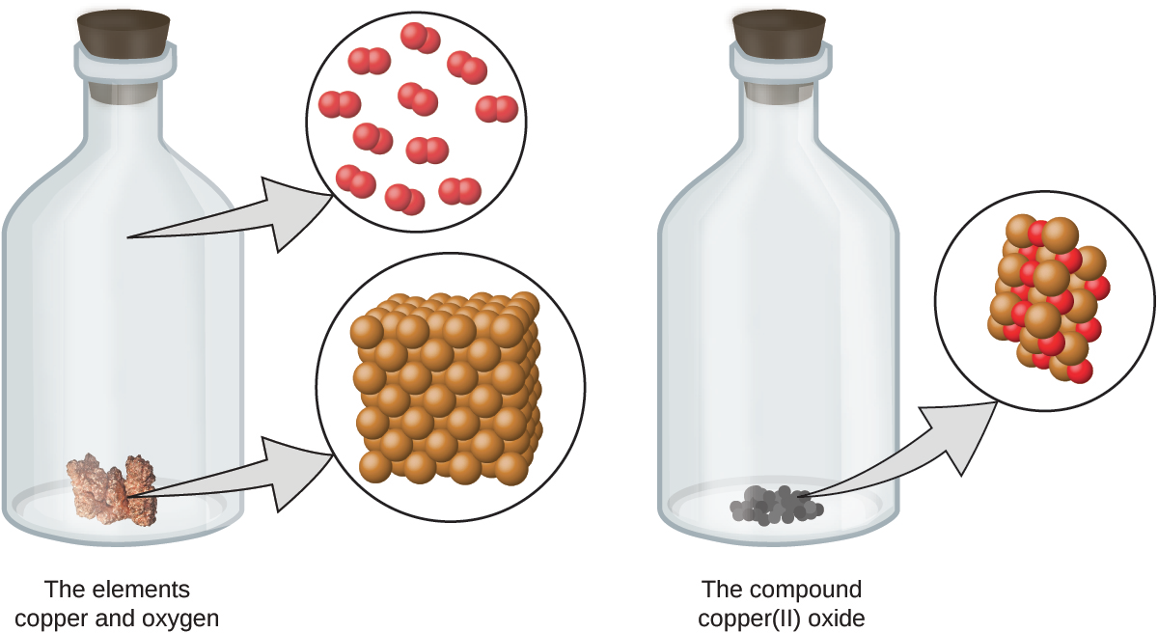
Visualize a chemical reaction
chemical reaction
Chemistry Openstax

Slide 5
Obeying Dalton’s postulates?
Do the chemical reactions shown here obey the five postulates of Dalton’s atomic theory? If not, why?
1
Nope.
Matter is not conserved as the product is missing two atoms, one blue, one green.
Yes!
Matter is conserved here.
Chemistry Openstax

Slide 6
Law of definite proportions
Aka Law of constant composition: all samples of one compound have the same elements in the same proportion by mass, or the same atomic ratio
sample* | carbon (g) | hydrogen (g) | mass ratio (C : H)
A | 14.82 | 2.78 | 5.33 : 1.00
B | 22.33 | 4.19 | 5.33 : 1.00
C | 19.40 | 3.64 | 5.33 : 1.00
*isooctane, C8H18
Dalton knew of this work done by the French chemist Joseph Proust.

Slide 7
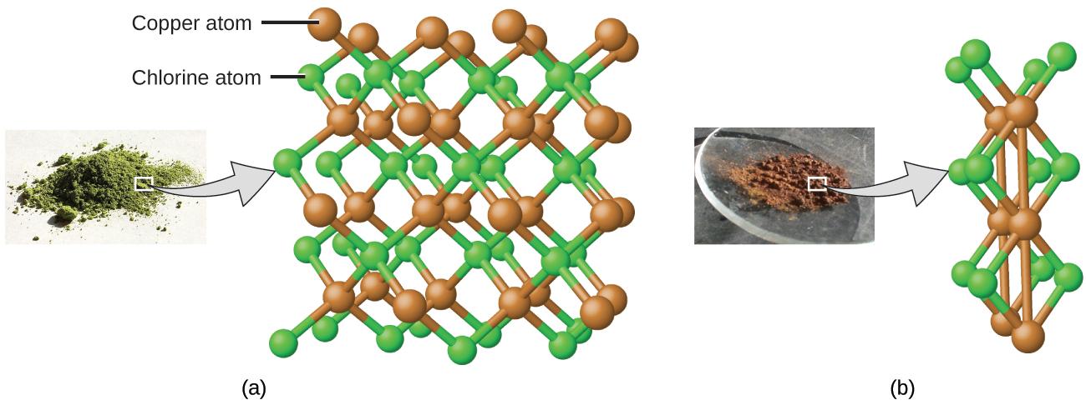
Law of multiple proportions
Law of multiple proportions: two elements can be combined in a number of different proportions or ratios to create a number of different compounds
Multiple proportions produce multiple compounds
Cu : Cl
1.0 g : 0.558 g
Cu : Cl
1.0 g : 1.116 g
Here Dalton riffed on Proust’s work, adding his own experiments.
Chemistry Openstax

Slide 8
Try this
Compounds A & B are both clear & odorless gases.
A sample of compound A is found to contain 4.27 g of C and 5.69 g of O. A sample of compound B is found to have 5.19 g of C and 13.84 g of O.
Are A & B examples of the law of definite proportions, the law of multiple proportions, or neither?
2
A 5.69 g O = 1.33 g O
4.27 g C 1.00 g C
B 13.84 g O = 2.67 g O
5.19 g C 1.00 g C
A & B illustrate the law of multiple proportions.

Slide 9
Can you?
(1) State all the postulates of Dalton’s atomic theory?
(2) State the law of definite proportions describe how it relates
to molecular formulas?
(3) Explain the law of multiple proportions & give an example?

