Slide 1
CHE 1031: General Chemistry I
Atoms, molecules & ions
2.1: Early ideas about atomic theory
2.2: Evolution of atomic theory
2.3: Atomic structure & symbolism
2.4: Chemical formulas
2.5: The periodic table
2.6: Molecular & ionic compounds
2.7: Naming chemical compounds
covered in lab

Slide 2
2. Atoms, molecules & ions
2.2: Evolution of atomic theory
Outline milestones in the development of atomic theory
Summarize & interpret the results of the experiments of Thomson, Millikan & Rutherford
Describe the three subatomic particles of atoms
Define isotopes & give examples of several elements

Slide 3
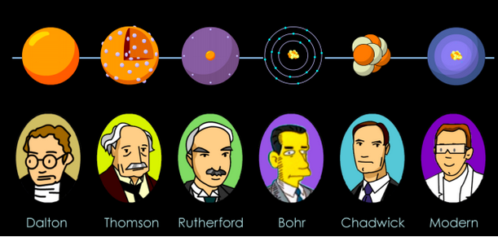
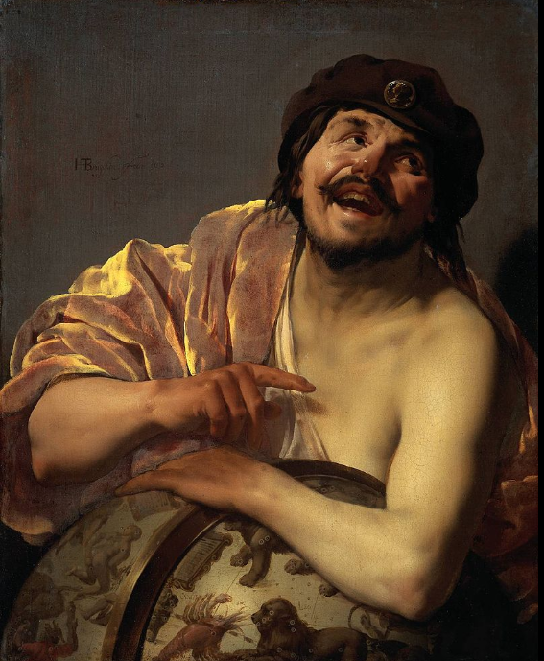
Atomic structure timeline
400 BC
1808
1897
1911
1913
1932
Note that a lack of technology, not a lack of intelligence or human imagination, kept our knowledge of the atom from advancing more quickly.

Slide 4
Thomson discovers electrons
1897, JJ Thomson used a cathode ray tube to discover the first subatomic particle, the electron.
Partially evacuated glass tube containing a cathode & anode.
When electricity is applied, a cathode ray flowed from the cathode toward the anode.
Magnets deflected the beam, showing it was negatively charged.
Calculations showed the particle was much lighter than an atom.
Chemistry Openstax

Slide 5
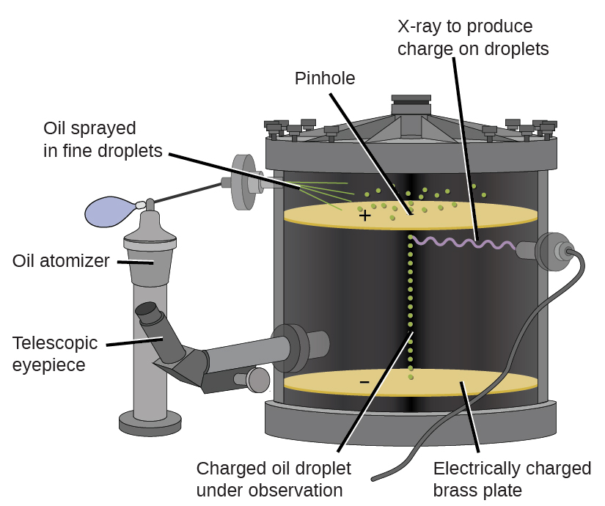
Millikan discovers electron’s charge
1909, Robert Millikan coated tiny droplets of oil with electrons & determined their charge.
The speed at which e-coated oil droplets fell could be changed by an electric field.
Calculations showed that electrons have a charge of 1.6 E-19 Coulombs & mass of 9.107 E-28 g.
Chemistry Openstax

Slide 6
New model for the atom?
So, where were the electrons located? Competing models:
Plum pudding model (Thomson)
The atom is a positively charged mass, studded with randomly placed & negatively charged electrons.
Saturn model (Nagaoka)
The atom is a positively charged mass, orbited by negatively charged electrons.
Chemistry Openstax

Slide 7
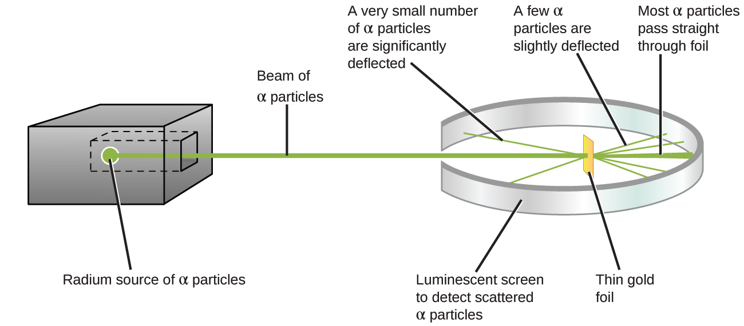
Rutherford goes nuclear
1911, Ernest Rutherford’s gold foil experiment shows that Nagaoka’s model is better → ‘nuclear’ model of the atom.
Heavy alpha particles were aimed at gold foil 1-2 atoms thick.
Most particles passed through without deflection, showing that most of the atom held light electrons.
All dense material is in the tiny central nucleus.
Chemistry Openstax

Slide 8
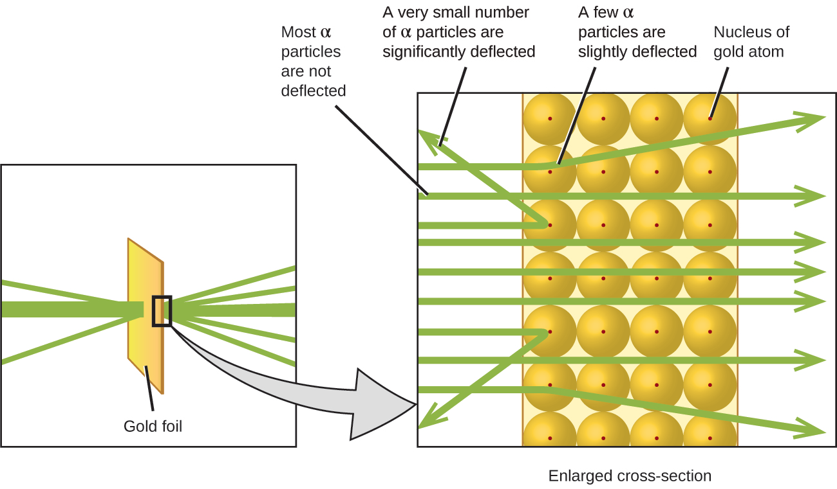
The nuclear model
How tiny is the nucleus?
The size of a tiny pea suspended in the world’s largest stadium.
Heavy alpha particles were aimed at gold foil 1-2 atoms thick.
Most particles passed through without deflection, showing that most of the atom held light electrons.
All dense material is in the tiny central nucleus.
Chemistry Openstax

Slide 9
Isotopes
Isotopes: atoms of the same element that differ in mass
Isotopes have the same number of protons & electrons, but the number of neutrons differs.
Neutrons are heavy, uncharged particles that – together with positively charged protons – are found in the nucleus.
Chemistry Openstax

Slide 10
Can you?
(1) Explain how Thomson used a cathode ray tube to discover the electron?
(2) Describe the essential difference between Thomson’s plum
pudding model and Nagaoka’s Saturn model?
(3) Explain how the nuclear model was developed from the data
Rutherford collected in his gold foil experiment?
(4) Explain how isotopes differ from ‘standard’ atoms of an element?
Chemistry Openstax

