Slide 1
CHE 1031: General Chemistry I
Atoms, molecules & ions
2.1: Early ideas about atomic theory
2.2: Evolution of atomic theory
2.3: Atomic structure & symbolism
2.4: Chemical formulas
2.5: The periodic table
2.6: Molecular & ionic compounds
2.7: Naming chemical compounds
covered in lab

Slide 2
2. Atoms, molecules & ions
2.3: Atomic structure & symbolism
Write & interpret symbols that depict atomic number, atomic mass and charge of atoms & ions
Define the atomic mass unit & average atomic mass
Calculate average atomic mass & isotopic abundance

Slide 3
Picturing atoms
Most of the volume of the atom is occupied by electrons & is called the electron cloud.
The tiny & dense nucleus is located in the center of the atom & holds all of the heavy particles: protons & neutrons.
If an atom is the size of a superdome stadium, the nucleus is the size of a blueberry.
The angstrom (Å; 1 E-10 m) is used to measure atoms.
Chemistry Openstax

Slide 4
Protons, neutrons & electrons
Compare the atom’s three subatomic particles:
particle | location | charge (C) | charge | mass (amu) | mass (g)
electron | cloud | - 1.602 E-19 | -1 | 0.00056 | 0.00091 E-24
proton | nucleus | + 1.602 E-19 | +1 | 1.00727 | 1.67363 E-24
neutron | nucleus | none | 0 | 1.00866 | 1.67493 E-24
C is Coulomb, a unit of electric charge.
Amu is atomic mass unit, an arbitrary & comparative unit of mass.

Slide 5
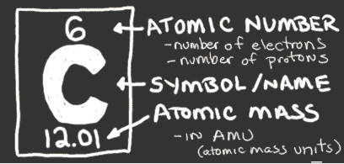
Atomic number & mass
Atomic number: the unique identifier for each atom
the number of protons in each element
also number of electrons in an atom
Atomic mass: the mass of each atom (amu or g/mole)
roughly = #p + # n
Number of neutrons: = atomic mass – atomic number
http://www.chem4kids.com/files/elements/006_shells.html

Slide 6
Calculating atomic contents
Iodine is atomic number 53 and has a mass of 127 amu. Iodine gains one electron to form iodide ions, I⁻¹.
How many protons, neutrons & electrons are there in an iodide ion?
3
Iodine atoms & iodide ions both have 53 protons.
The number of protons in an atom never changes.
Iodine atoms have the same number of protons & electrons, so 53 electrons. But iodide ions have gained one electron to create the charge of -1. So, iodide ions have 53 + 1 = 54 electrons.
The number of neutrons = 127 – 53 = 74
The number of neutrons is the same in atoms & ions.

Slide 7
Try this
An ion of platinum has a mass number of 195 and has 74 electrons.
How many protons & neutrons does it have?
What is its charge?
4
Pt has atomic number 78, so it has 78 protons.
With 74 electrons, it’s lost 4 electrons & must have a charge of +4.
Neutrons = 195 – 78 = 117

Slide 8
Isotope symbols
While atoms are represented by a letter or two, the symbol for an isotope must also include isotopic mass, since the mass of an isotope can be lighter or heavier than that of other atoms of the same element.
Magnesium (Mg) has three isotopes with masses of 24, 25 & 26:
²⁴Mg, ²⁵Mg, ²⁶Mg ‘magnesium 24”
All isotopes of Mg have 12 protons. Numbers of neutrons differ:
²⁴Mg 24 – 12 = 12 n
²⁵Mg 25 – 12 = 13 n
²⁶Mg 26 – 12 = 14 n
Chemistry Openstax

Slide 9
Isotope abundance
Each element can have a number of different isotopes and they occur at different abundances or frequencies (%).
element | symbol | atomic # | # p | # n | mass (amu) | %
hydrogen | ¹H | 1 | 1 | 0 | 1.0…... | 99.9885
deuterium | ²H | 1 | 1 | 1 | 2.0141 | 0.0115
tritium | ³H | 1 | 1 | 2 | 3.01605 | trace
helium | ³He | 2 | 2 | 1 | 3.01603 | 0.00013
 | ⁴He | 2 | 2 | 2 | 4.0026 | <100
carbon | ¹²C | 6 | 6 | 6 | 12.0000 | 98.89
 | ¹³C | 6 | 6 | 7 | 13.0034 | 1.11
 | ¹⁴C | 6 | 6 | 8 | 14.0032 | trace
Chemistry Openstax

Slide 10
Average atomic mass
The frequency of isotopes for each elements determines the average atomic mass shown in the periodic table.
Weighted average takes frequency & mass into account.
average atomic mass = Σ (isotopic mass)(isotopic frequency)
Boron occurs in two isotopes: 19.9% have a mass of 10.0129 amu & 80.1% have a mass of 11.0093.
Calculate the average atomic mass of boron.
5
average atomic mass = (10.0129)(0.199) + (11.0093)(0.801)
= 10.8110 amu
Remember to move the decimal 2 places when multiplying by a percentage.

Slide 11
Try this
A meteorite found in central Indiana contains traces of neon gas picked up from solar wind. Analysis shows 91.84% ²⁰Ne (19.9924 amu), 0.47% ²¹Ne (20.9940 amu), and 7.69% ²²Ne (21.9914 amu).
Calculate the average atomic mass of neon in solar wind.
6
= (19.9924)(0.9184) + (20.9940)(0.0047) + (21.9914)(0.0769)
= 18.3610 + 0.09867 + 1.6911 = 20.1508 amu

Slide 12
Tougher!
Naturally occurring chlorine has two isotopes, ³⁵Cl (34.96885 amu) and ³⁷Cl (36.96590 amu). The average atomic mass is 35.453 amu.
Calculate the abundance (frequency) of each chlorine isotope.
7
35.453 = (34.96885)(x) + (36.96590)(1-x)
35.453 = (34.96885x) + (36.96590) – (36.96590x)
1.99705x = 1.513
x = 1.513 = 0.70576 So, 1 – x = 0.2424
1.99705
³⁵Cl = 70.576%
³⁷Cl = 24.24%

Slide 13
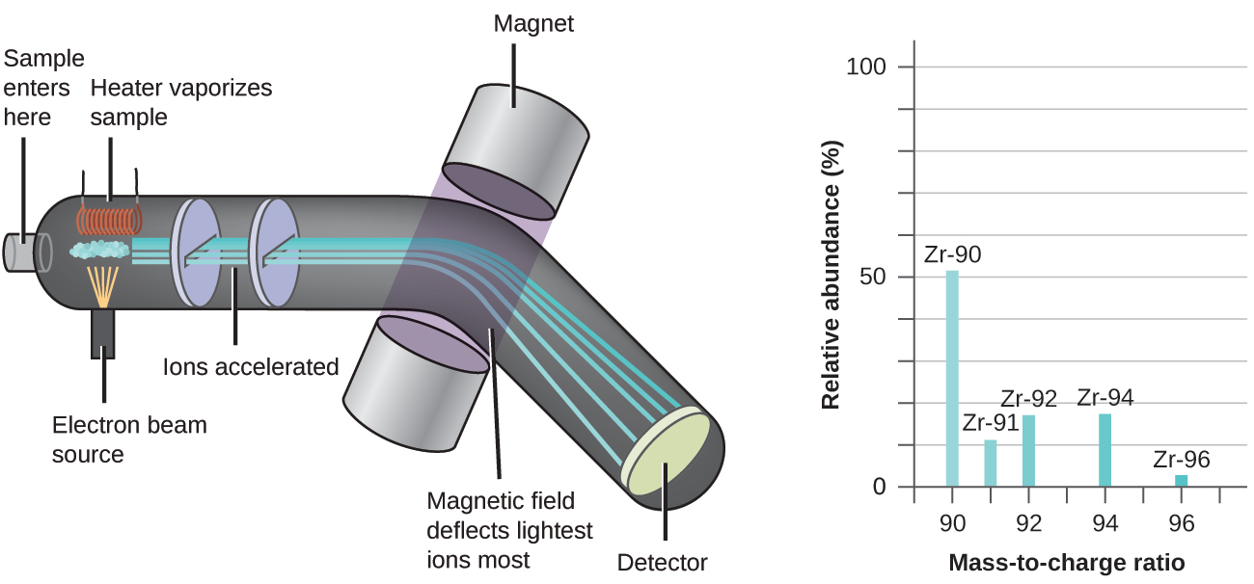
Mass spectrometer
An incredibly useful instrument called a mass spectrometer can determine the presence & frequency of elements & isotopes in a sample whose identity is unknown.
see CSI
Chemistry Openstax

Slide 14
Can you?
(1) Describe the nuclear model of the atom?
(2) List the three subatomic particles, their relative masses &
charges?
(3) Give the number of protons, neutrons & electrons found in any
atom using the periodic table?
(4) Describe the number added to an atomic symbol to identify an
isotope?
(5) Calculate average atomic mass from isotopic mass & frequency?
(6) Give a basic description of how a mass spec separates isotopes?

