Slide 1
CHE 1031: General Chemistry I
Atoms, molecules & ions
2.1: Early ideas about atomic theory
2.2: Evolution of atomic theory
2.3: Atomic structure & symbolism
2.4: Chemical formulas
2.5: The periodic table
2.6: Molecular & ionic compounds
2.7: Naming chemical compounds
covered in lab

Slide 2
2. Atoms, molecules & ions
2.4: Chemical formulas
Symbolize the composition of molecules using molecular formulas & empirical formulas
Represent the bonding arrangement of atoms within molecules using structural formulas

Slide 3
Molecular formulas
Molecular formula: the exact types & numbers of atoms in a molecule
Subscripts give the number of each atom in the molecule.
No subscript means there’s a single atom.
Structural formula: shows how the atoms in a molecule are connected or bound together
Ball & stick: shows geometry of bonded atoms
Space-filling: shows relative sizes of bonded atoms
Chemistry Openstax

Slide 4
Examples
In nature sulfur is found as S₈, called elemental sulfur.
In nature hydrogen is found as hydrogen gas, H2.
Chemistry Openstax

Slide 5
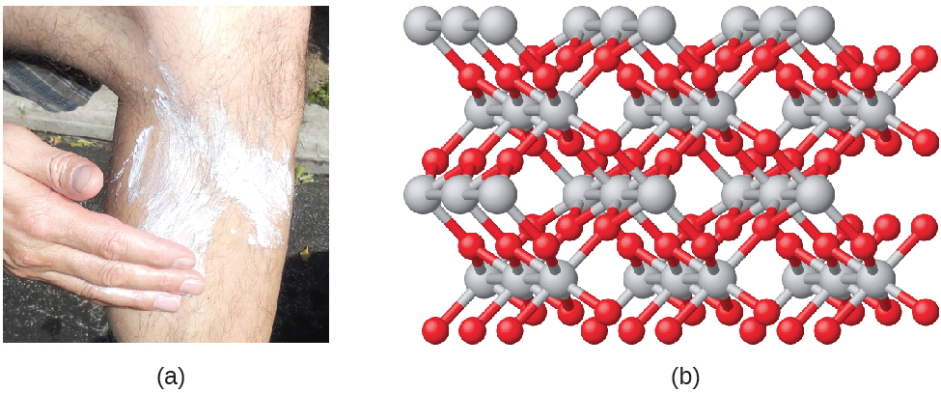
Empirical formula
Empirical formulas are simplified versions of molecular formulas.
The simplest whole-number ratio of atoms in a molecule.
TiO2 (titanium dioxide) is the empirical formula for the molecule shown below & used as a sunblock.
Note that the molecule can include many repeats of the empirical formula.
Chemistry Openstax

Slide 6
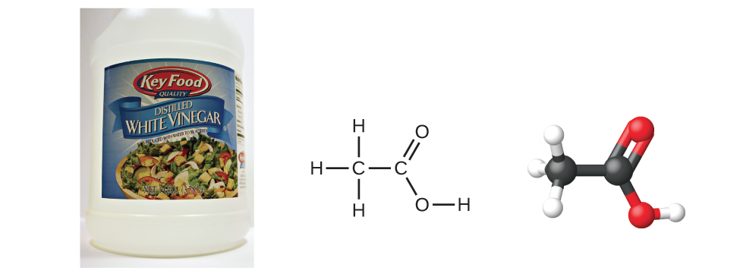
Molecular & empirical formulas?
Benzene:
molecular: C6H6 empirical: CH
8
Acetic acid:
molecular: C2H4O2 empirical: CH2O
Chemistry Openstax

Slide 7
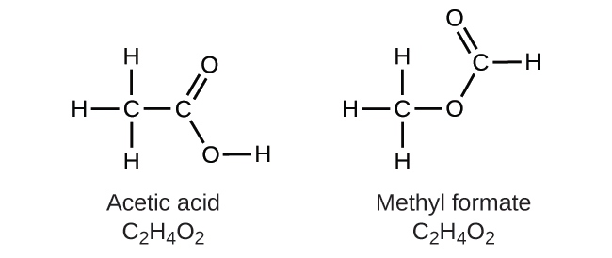
Structural isomers
Structural isomers: distinct & different molecules that share the same molecular formula but have different structural formulas
Isomers have different physical & chemical properties
colorless liquid
sharp, pungent odor
m.p. 16-17C
b.p. 118C
density 1.049 g/mL
colorless liquid
pleasant ‘ethereal’ odor
m.p. -100c
b.p. 32c
density 0.98 g/mL
Chemistry Openstax

Slide 8
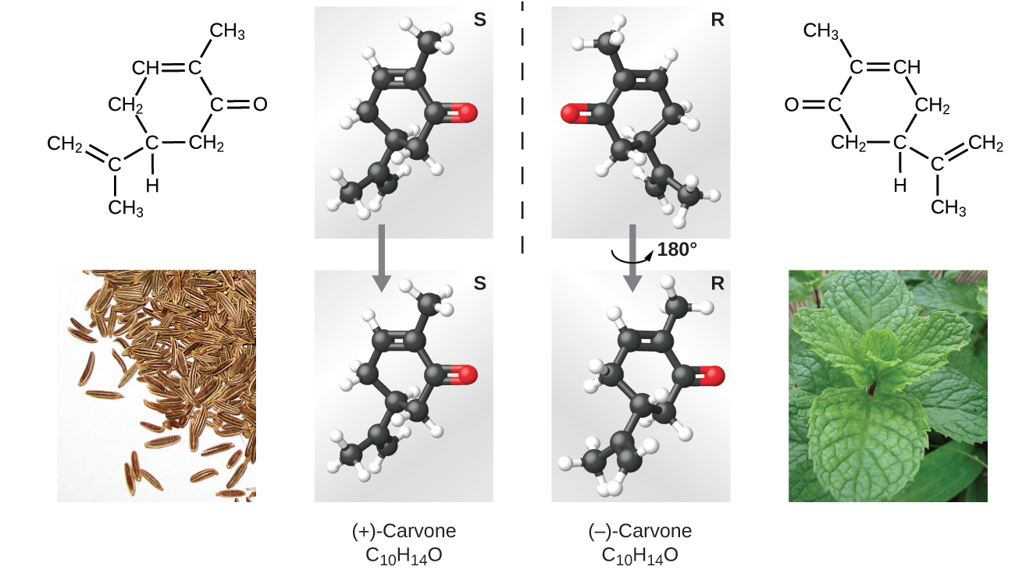
Spatial isomers
Spatial isomers: distinct & different molecules that share the same molecular formula and structural formulas, but different arrangements in 3D space
Many properties are the same but others differ.
Chemistry Openstax

Slide 9
Can you?
Describe the differences between molecular formula, empirical formula, structural formula, ball & stick models & space-filling models?
(2) Derive empirical formulas from molecular formulas?
Explain why structural isomers have distinct physical &
chemical properties?
Describe the difference between structural isomers & spatial
isomers?

