Slide 1
CHE 1031: General Chemistry I
Atoms, molecules & ions
2.1: Early ideas about atomic theory
2.2: Evolution of atomic theory
2.3: Atomic structure & symbolism
2.4: Chemical formulas
2.5: The periodic table
2.6: Molecular & ionic compounds
2.7: Naming chemical compounds
covered in lab

Slide 2
2. Atoms, molecules & ions
2.6: Molecular & ionic compounds
Define ionic & molecular (covalent) compounds
Predict the type of compound formed from elements based on their location within the periodic table
Determine formulas for simple ionic compounds

Slide 3
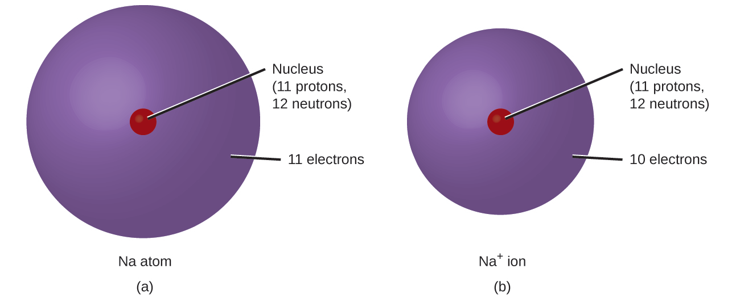
Monoatomic ions
Monoatomic ions: single atoms that have lost or gained electrons & are therefore electrically charged
Metals: lose enough e- to leave the number of e- of the preceding noble gas; become + cations
Nonmetals: gain enough e- to give the number of e- of the next noble gas; become - anions
Chemistry Openstax

Slide 4
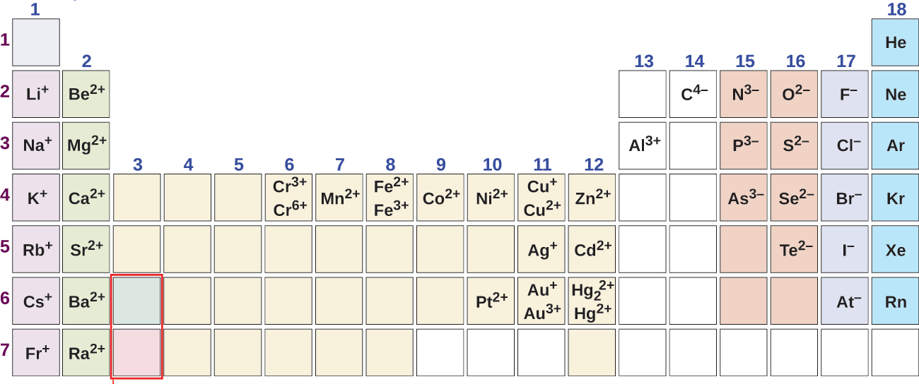
Predicting ionic charge
Notice the pattern that relates charge to column.
Why is charge consistent within a column?
9
Because of the periodic law!
There is a consistent pattern relating the number of electrons for the element in each column position to the number of electrons in the noble gas of that row.
Chemistry Openstax

Slide 5
Try these
Some antiperspirants use an element with 13 protons that has 10 electrons when it forms an ions?
What is the element & what is its ionic charge?
10
The element with 13 p+ must be aluminum.
An ion of aluminum with 10 e- would have a charge of +3; 3 more p+ than e-.
The preceding noble gas is neon, element 10, so the Al⁺³ ion ‘wants’ 10 e-
Magnesium & nitrogen can react to form an ionic compound.
Predict the charges for each ion.
11
Mg is a metal in row 3. It ‘wants’ to have the same number of e- as the preceding noble gas, Ne, element 10. So, Mg loses 2 e- creating Mg⁺² cation.
N is a nonmetal in row 2, element number 7. It ‘wants’ to have the same number of e- as the noble gas in its row 2, Ne, element 10. So, N gains 3 e- creating N⁻³ anion.

Slide 6
Polyatomic ions
Polyatomic ions: charged molecules, a group of bonded atoms with an electric charge
Name | formula
ammonium | NH4⁺¹
hydronium | H3O⁺¹
peroxide | O2⁻²
hydroxide | OH⁻¹
acetate | CH3COO⁻¹
cyanide | CN⁻¹
azide | N3⁻¹
carbonate | CO3⁻²
bicarbonate | HCO3⁻²
nitrate | NO3⁻¹
nitrite | NO2⁻¹
sulfate | SO4⁻²
Most are oxyanions: a non-metal combined with oxygen atoms, creating a unit with a negative charge
We’ll cover this in detail in lab.

Slide 7
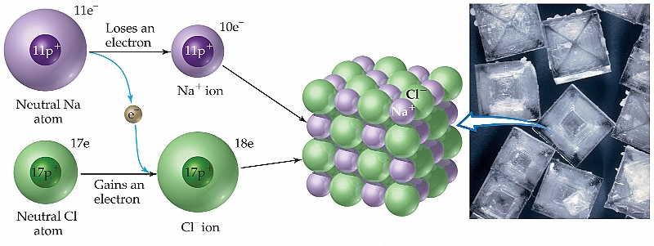
Ionic compounds
Ionic compounds: form when metals react with nonmetals, causing transfer of electrons from metals to nonmetals, creating ions with opposing & attractive forces that bond via charge or ionic bonds.
Motivation? Ions are more stable, have a lower energy, than atoms & so both atoms are stabilized.
Notice that e- transfer obeys the law of conservation of mass.

Slide 8
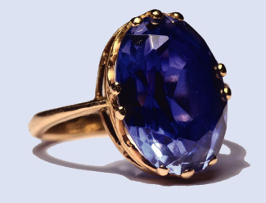
Formulas of ionic compounds
When atoms ionize to form ionic compounds, cations & anions combine at ratios that create a neutral, uncharged compound.
Formulas of ionic compounds are always ‘empirical’.
Sapphires are formed from the ionic compound aluminum oxide. What’s its formula?
13
Al⁺³
O⁻²
2
3
Al2O3
+6
-6
Odd & even charges make it challenging to create a net charge of zero.
Least common product? 2 x 3 = 6
Chemistry Openstax

Slide 9
Try these
What’s the formula of a compound formed from sodium and sulfur?
14
Na⁺¹
S⁻²
2
Na2S
+2
-2
What’s the formula of a compound formed from calcium and the polyatomic ion dihydrogen phosphate?
15
Ca⁺²
H2PO4⁻¹
2
Ca(H2PO4)2
+2
-2

Slide 10
Molecular compounds
Molecular compounds: form when non-metals share electrons, creating covalent bonds
Properties?
Often gases, liquids with low boiling points or solids with low melting points
Chemistry Openstax

Slide 11
Ionic or molecular?
Predict whether these compounds are ionic or molecular:
16
KI
H2O2
CHCl3
Li2(CO3)
Ionic: metal + non
molecular: H acting as a nonmetal
molecular: all nonmetals
ionic: metal + nonmetal polyatomic anion
Chemistry Openstax

Slide 12
Can you?
Define the terms ion, cation and anion?
Differentiate between monoatomic and polyatomic (and oxyanions) ions?
Use the periodic table to predict the charge of monoatomic
ions?
Explain why the formation of cations and anions is inextricably
linked?
Add subscripts to create proper (empirical) formulas for ionic
compounds?
(6) Identify ionic vs. molecular vs. compounds by their formulas?

