Slide 1
CHE 1031: General Chemistry I
Electrochemistry
5.1: Galvanic cells (aka voltaic cells)
5.2: Standard reduction potentials
5.3: Batteries & fuel cells
5.4: Corrosion

Slide 2
5. Electrochemistry
5.1: Galvanic (aka voltaic) cells
Use cell notation to describe galvanic cells
Describe the basic components of galvanic cells

Slide 3
What are galvanic cells?
Galvanic cells (aka voltaic cells) are electrochemical cells in which spontaneous redox reactions produce a flow of electrons, ie electricity.
Example:
A piece of copper wire is placed in a solution of silver (I) nitrate. Immediately, silver metal begins to plate onto the copper metal (reduction), and the copper metal becomes copper ions (oxidation).
Aristotle
Cu → Cu⁺² + 2e-
2 (Ag⁺¹ + e- → Ag)
Cu + 2Ag⁺¹ + 2e- → Cu⁺² + 2Ag + 2e-
Wright’s gas pump experiments
Chemistry Openstax

Slide 4
Spontaneous? Check the activity series
How does it work?
An elemental metal is spontaneously oxidized by ions of any metal below it on the activity series.
most easily oxidized
Aristotle
Think back to lab:
Mg is oxidized by H⁺¹ ions.
Cu is not oxidized by H⁺¹ ions.
‘precious metals’
least easily oxidized

Slide 5
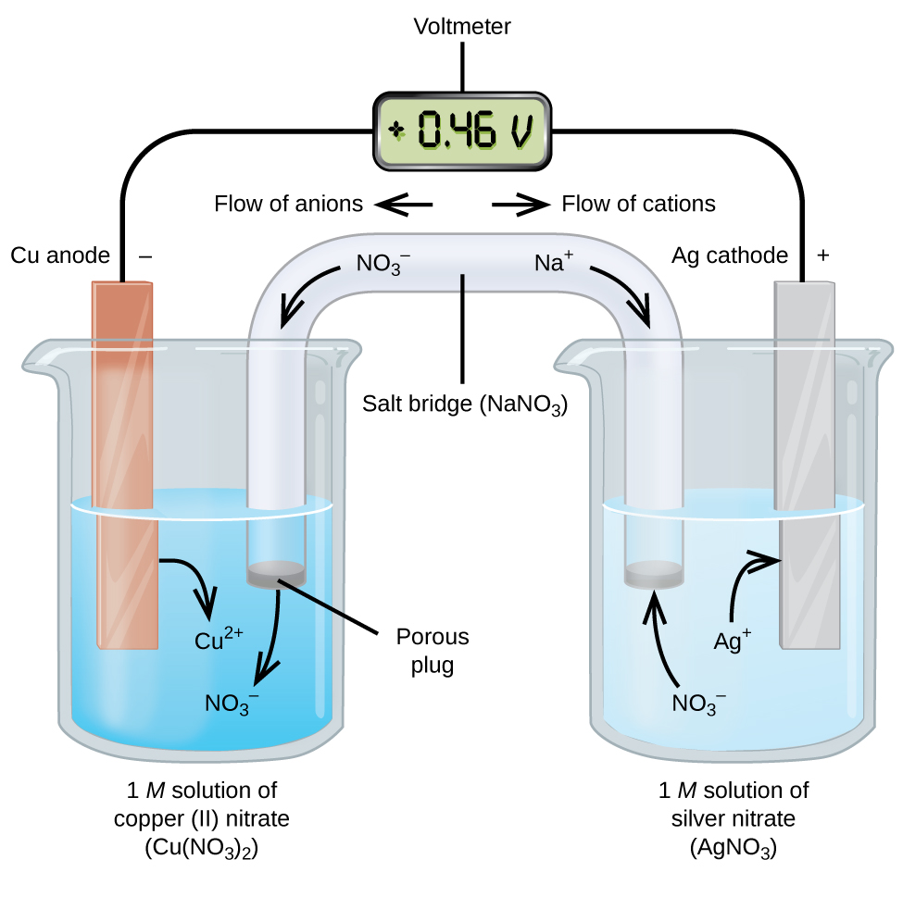
Galvanic cell diagram
Here the redox reaction has been physically separated into two half-cells, each corresponding to one half-reaction.
The flow of electrons from the anode to the cathode produces electric current.
Chemistry Openstax

Slide 6
Galvanic cell diagram
Anode: electrode where oxidation occurs
Electrons flow from the anode.
A negative electrode
Cell potential (V)
V = J/C
Cathode: electrode where reduction occurs
Electrons flow to the cathode
cathode
Chemistry Openstax

Slide 7
Galvanic cell diagram
Salt bridge: tube that only ions can flow through
Equalizes the charge of the half cells; maintains redox
Anions flow to the anode (opposing e- flow)
Cations flow to the cathode
Chemistry Openstax

Slide 8
Galvanic cell recap
To summarize what’s going on in a galvanic cell:
Electrons flow from the anode to the cathode.
The flow of electrons is harvested as electricity.
The anode slowly degrades as its metal atoms ionize.
The cathode grows as ions are deposited on it as atoms.
The salt bridge allows cations to flow to the cathode. This keeps the cathode from becoming so negative that electrons won’t flow to it.
The salt bridge allows anions to flow to the anode. This keeps the anode from becoming too positive as it loses electrons.
Without the salt bridge the flow of electrons would stop!

Slide 9
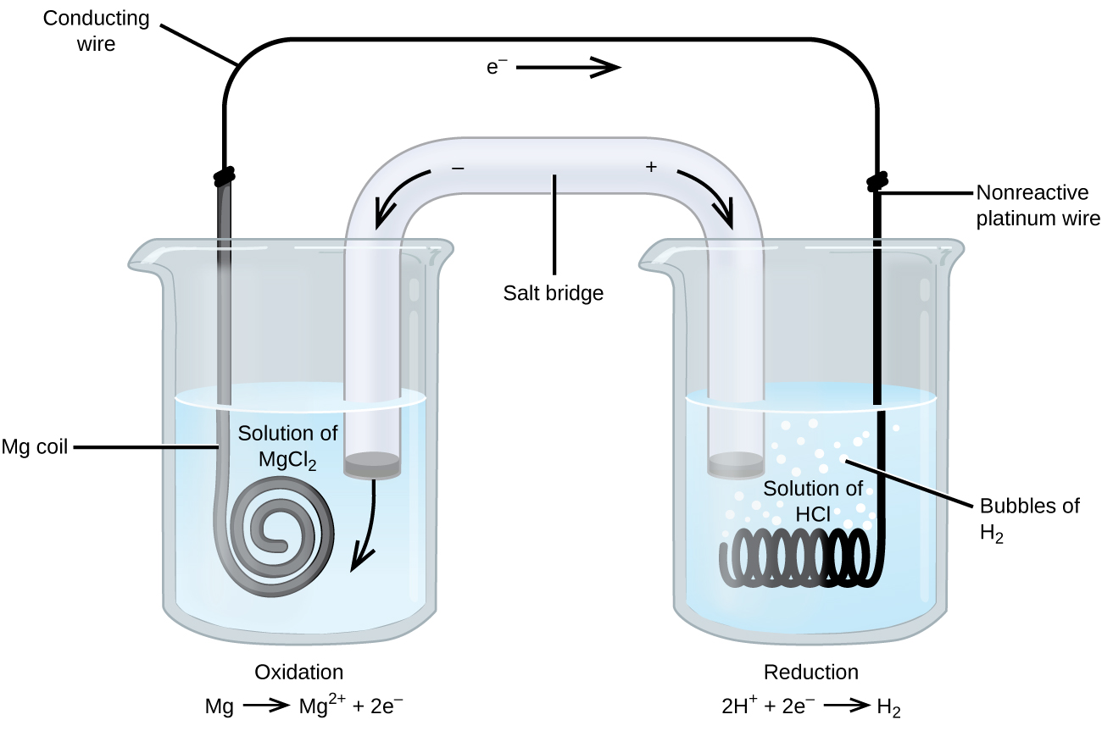
Inert electrodes
When redox reactions involve metals that are poor conductors, an inert electrode, made of a conductive metal that does not participate in the redox reaction, is used.
Here an inert Pt electrode is used.
unreactive
Chemistry Openstax

Slide 10
Galvanic cell shorthand
We can use this shorthand to describe a galvanic cell:
Cu(s) | Cu⁺² (1 M) || Ag⁺¹ (1 M) | Ag(s)
anode on the left
cathode on the right
phase boundary
salt bridge
A galvanic cell can be made with this reaction:
2Cr(s) + 3Cu⁺²(aq) → 2Cr⁺³(aq) + 3Cu(s)
Write oxidation & reduction half-equations.
Label them as oxidation or reduction.
Diagram the half-cells using galvanic cell shorthand.
1
2Cr(s) → 2Cr⁺³ + 6e- oxidation
3Cu⁺² + 6e- → 3Cu(s) reduction
Cr(s) | Cr⁺³(aq) || Cu⁺²(aq) | Cu(s)

Slide 11
Example
A galvanic cells is created using a magnesium anode immersed in a solution of acid. Hydrogen gas is produced and an inert platinum cathode is used.
Write oxidation & reduction half-equations.
Label them as oxidation and reduction. Diagram the half-cells using galvanic cell shorthand.
2
Mg(s) → Mg⁺² + 2e- oxidation
2H⁺¹ + 2e- → H2(g) reduction
Mg(s) | Mg⁺²(aq) || H⁺²(aq) | H2(g) | Pt(s)

Slide 12
Example
Consider a galvanic cells using this reaction:
5Fe⁺²(aq) + MnO4⁻¹(aq) + 8H⁺¹(aq) → 5Fe⁺³(aq) + Mn⁺²(aq) + 4H2O(l)
Write oxidation & reduction half-equations.
Label them as oxidation and reduction.
Identify the cathode and the anode.
Diagram the half-cells using galvanic cell shorthand.
3
5(Fe⁺²(aq) → Fe⁺³ + e-)
MnO4⁻¹(aq) + 8H⁺¹(aq) + 5e- → Mn⁺²(aq) + 4H2O(l)
oxidation (Fe) reduction (Mn)
anode (Fe) cathode (Mn)
(d) Pt(s) | Fe⁺², Fe⁺³(aq) || MnO4⁻¹, Mn⁺², H⁺¹(aq) | Pt(s)
Note that no solid metals exist in the reaction, hence Pt electrodes.

Slide 13
Can you?
(1) Define the term ‘galvanic cell’ (aka voltaic cell)?
(2) Create a diagram of a galvanic cell?
(3) Locate and identify the functions of: anode; cathode; salt bridge; half-cells.
(4) Explain what an inert electrode is and when it is used?
(6) Represent a galvanic cell using symbols for phase separation and the salt bridge?

