Slide 1
CHE 1031: General Chemistry I
Electrochemistry
5.1: Galvanic cells (aka voltaic cells)
5.2: Standard reduction potentials
5.3: Batteries & fuel cells
5.4: Corrosion

Slide 2
5. Electrochemistry
5.4: Corrosion
Define corrosion
List some methods to slow or prevent corrosion

Slide 3
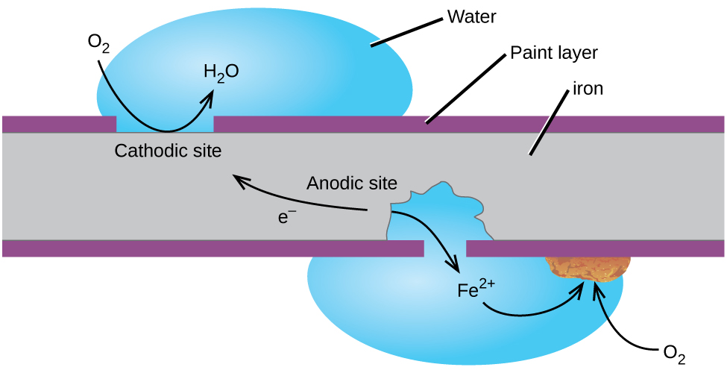
Corrosion
Corrosion: the undesirable degradation of metals due to spontaneous electrochemical (redox) reactions
Aka rust, tarnish, verdigris
In the US, corrosion causes half a trillion dollars of damage annually.
Chemistry Openstax

Slide 4
Rust
Iron rusts where it is exposed to oxygen gas and water.
Fe(s) → Fe+2 + 2e- E° = - 0.44 V
O2 + 4H⁺¹ + 4e- → 2H2O E° = +1.23 V
2Fe(s) + O2 + 4H⁺¹ → 2Fe⁺² + 2H2O E° = + 1.67
← spontaneous
4Fe⁺² + O2 + (4 + 2x) H2O → 2Fe2O3-xH2O + 8H⁺¹
Rust forms when iron ions continue to react with O2 & H2O.
Chemistry Openstax

Slide 5
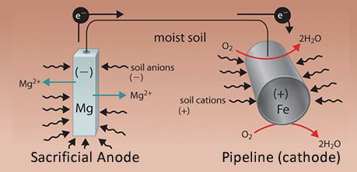
Preventing corrosion?
Corrosion can be prevented by preventing access of air and water to metals. Paint works but must be kept intact.
Alloys can prevent corrosion from within. The chromium added to stainless steel collects near the surface, reacts with air to form an oxide that seals and protects the body of the metal.
Galvanization (Zn-plating) coats valuable metals with a more easily oxidized metal (lower reduction potential).
The Zn (sacrificial anode) is oxidized & protects coated metal.
Galvanization is also called cathodic protection.
Wired sacrificial anodes
Trickle charging
Chemistry Openstax

Slide 6
Can you?
(1) Define the term corrosion?
(2) Use SRP to determine whether a redox reaction could produce corrosion?
(3) Draw a diagram to show where corrosion occurs relative to the
anode and cathode of a redox reaction?
(4) List three methods for preventing corrosion?
(5) Explain the concept of self-limiting corrosion?
(6) Explain how sacrificial anodes can provide cathodic protection?

