Slide 1
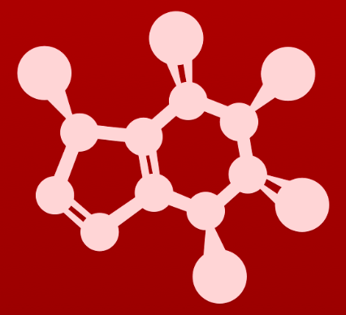
4. Acid-base reaction mechanism
Step-by-step animation of acid-base reactions

Slide 2
4. Acid-base reaction mechanism
1. Who’s the Lewis acid and who’s the Lewis base?
LA – look for either a + charge, a δ+ charge, or a H with a polar bond
LB – look for either a – charge, or a free electron pair :

Slide 3
4. Acid-base reaction mechanism
1. Who’s the Lewis acid and who’s the Lewis base?
LA
LB

Slide 4
4. Acid-base reaction mechanism
2. Who’s the electrophile (E+) and who’s the nucleophile (Nu:)?
LA
LB
E+ – again, either a + charge, a δ+ charge, or a H with a polar bond
Nu: – again, either a – charge, or a free electron pair :

Slide 5
4. Acid-base reaction mechanism
2. Who’s the electrophile (E+) and who’s the nucleophile (Nu:)?
LA/E+
LB/Nu:

Slide 6
4. Acid-base reaction mechanism
3. The : of the Nu: attacks the E+ to create a new dative bond.
LA/E+
LB/Nu:

Slide 7
4. Acid-base reaction mechanism
3. The : of the Nu: attacks the E+ to create a new dative bond.
LA/E+
LB/Nu:

Slide 8
4. Acid-base reaction mechanism
4. Since H can only have one bond, the : of its previous bond return to the E+
LA/E+
LB/Nu:

Slide 9
4. Acid-base reaction mechanism
4. Since H can only have one bond, the : of its previous bond return to the E+
LA/E+
LB/Nu:

Slide 10
4. Acid-base reaction mechanism
5. Two new products, the conjugate base and conjugate acid, are produced.
LA/E+
LB/Nu:
Conjugate base is the LA without a proton. The conjugate base will have a free : and may have a – charge.
Conjugate acid is the LB with an added proton. The conjugate acid can be neutral or may have a + charge.

Slide 11
4. Acid-base reaction mechanism
5. Two new products, the conjugate base and conjugate acid, are produced.
LA/E+
LB/Nu:
conjugate
base
conjugate
acid

Slide 12
4. Acid-base reaction mechanism
6. Are reactants or products favored in this equilibrium reaction?
LA/E+
LB/Nu:
conjugate
base
conjugate
acid
Find the pKa value of the acid on each side of the reaction.
The side with the higher pKa (the weaker acid) is favored...
… because the strong acid gets to be the acid and give its proton away.

Slide 13
4. Acid-base reaction mechanism
6. Are reactants or products favored in this equilibrium reaction?
LA/E+
LB/Nu:
conjugate
base
conjugate
acid
pKa 4.76
pKa 10.7

