Slide 1
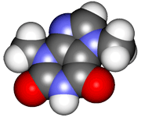
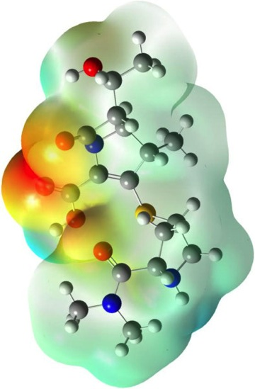
CHE2060 Topic 1: Atoms, orbitals & bonding
Atoms, Orbitals & Bonding Topics:
Very quick history of chemistry…
What is organic chemistry?
Atomic models: nuclear to quantum
All about orbitals
How orbitals fill: electron configuration
Basic bonding: valence electrons & molecular orbitals
Lewis dot structures of molecules
Electronegativity & bond polarity
Resonance: a critical concept
Orbital hybridization: key to carbon’s “flexibility”
sp3
sp2
sp
Free electron pairs & radicals
VSEPR: classifying molecular geometry & orbital hybridization
Daley & Daley, Chapter 1
Atoms, Orbitals & Bonds

Slide 2
CHE2060 Topic 1: Atoms, orbitals & bonding
Orbital hybridization:
the key to carbon’s “flexibility”

Slide 3
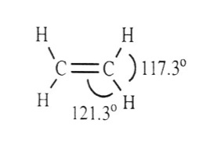
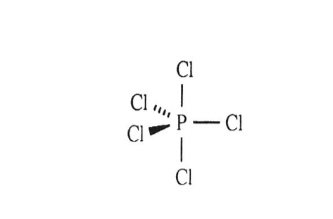
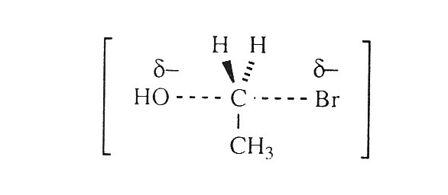
Preview of basic molecular geometries
Many single-bonded molecules have tetrahedral geometries, with bond angles close to 109° and a 3D shape.
Double-bonds have a trigonal planar geometry, with bond angles close to 120° and a flat (or planar) shape.
Atoms with five bonds (rather than 4) create trigonal bipyrimidal geometry:
3 atoms bond in the plane of the central atom with 120° bond angles; and
the other 2 atoms are perpendicular to this flat plane.
PCl5
An SN2 addition reaction intermediate
H&P p.11-13

Slide 4
Geometry suggests orbital hybridization
In the mid-1800s, chemists knew that C liked to form four bonds. They thought that the four bonding atoms would all lie in the same plane as C.
So what would the structure of CH2Cl2 be?
How many “versions” of CH2Cl2 could there be?
H
Cl
However, chemists only found one isomer (“version”) of this molecule. Hmmm……
Cl
C
Cl
Cl
C
H
H
H
The single version showed that the molecule’s shape was not planar. Therefore it must be 3-dimensional?!
In 1874, van’t Hoff & Bell proposed a 3D tetrahedral structure, like a pyramid.
All tetrahedral bond angles are 109.5°.
H
C
Cl
Cl
H

Slide 5
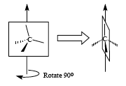
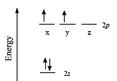
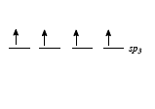
How can methane’s bonds be “equivalent”?
Methane is the smallest hydrocarbon, CH4.
By using a technique called electron diffraction, chemists found that each of its 4 C-H bonds is identical: same length & strength.
Does this sound possible? Sensible?
Think about the electron configuration of the atoms involved!
H = 1s¹
C = 1s²2s²2p² …. so C’s 4 e- don’t all have the same energy levels – how can they form 4 identical bonds to the Hs?
The answer is orbital hybridization: the valence (bonding) e- of carbon become identical in order to form the four identical bonds to H.
The hybrid orbital is called sp³ because it’s 1 s orbital mixed with 3 p orbitals:
s¹p³

Slide 6
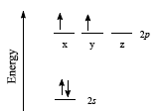
Exercise: think!
If one electron were “promoted” from carbon’s s orbital to it’s p orbital could this explain the structure of methane?
Why or why not?
The “promotion” would create 4 different orbitals:
3 identical p orbitals
1 s orbital
But we know that methane’s carbon needs 4 identical orbitals in order to form 4 identical bonds to 4 hydrogens.

Slide 7
Preview of carbon’s hybridizations
Carbon’s valence electrons can hybridize in three different ways.
This gives carbon the ability to act as the structural framework for a huge number of molecules.
hybridization | p obitals (# left) | bonds formed | geometry | bond angle (°)
sp3 | none | 4 σ | tetrahedral | 109.5°
sp2 | one | 3 σ, 1 π | trigonal planar | 120°
sp | two | 2 σ, 2 π | linear | 180°
Single bonds
Double bonds
Triple bonds

Slide 8
Predicting hybridization from bonding pattern
The orbital hybridization of carbon (and other atoms) can also be predicted from atomic bonding patterns in Lewis dot structures.
Each π bond requires an one unhybridized p orbital…
…and all other orbitals hybridize.
σ
σ
π
π
σ
C
σ
C
σ
σ
C
← σ
σ
π
σ
sppp
sppp
sppp
= sp³
= sp²
= sp
This method works for C, N, O, P & S because all have ve- in s and p orbitals.
C 1s²2s²sp²
N 1s²2s²sp³
O 1s²2s²sp⁴
P 1s²2s²sp⁶3s²3p³
S 1s²2s²sp⁶3s²3p⁴

Slide 9
CHE2060 Topic 1: Atoms, orbitals & bonding
Atoms, Orbitals & Bonding Topics:
Very quick history of chemistry…
What is organic chemistry?
Atomic models: nuclear to quantum
All about orbitals
How orbitals fill: electron configuration
Basic bonding: valence electrons & molecular orbitals
Lewis dot structures of molecules
Electronegativity & bond polarity
Resonance: a critical concept
Orbital hybridization: key to carbon’s “flexibility”
sp3
sp2
sp
Free electron pairs & radicals
VSEPR: classifying molecular geometry & orbital hybridization
Daley & Daley, Chapter 1
Atoms, Orbitals & Bonds

Slide 10
CHE2060 Topic 1: Atoms, orbitals & bonding
sp3 hybridization of carbon

Slide 11
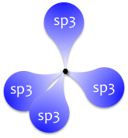
“Ground state” vs. hybridized sp3 carbon
2s
1s
2p_{x}
2p_{y}
nucleus
C
1s
2s
2p
C
1s
2sp3

Slide 12
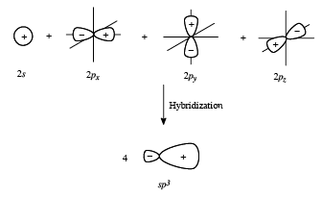
What do hybrid orbitals look like?
Linus Pauling realized that since orbitals were wave functions they could “add” or mix to form new intermediate shapes.
Hybrid orbitals blend shapes and energy levels.
So 75% of shape is like p, 25% like s.
Often, the vestigal lobe (-) is not shown.
D&D p.38-39

Slide 13
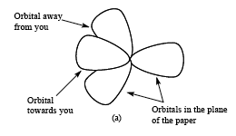
VSEPR “shapes” molecular geometry
Methane has four identical sp³ orbitals. How are they arranged in the molecule?
Hybrid orbital geometry is dictated by VSEPR (valence shell e- pair repulsion):
“Since e- pairs occupying orbitals are all negatively charged they repel each other & therefore occupy spaces as far from other pairs as possible.”
Tetrahedral geometry:
There are identical angles of 109.5° between each hybrid sp³ orbital.
• •
• •
• •
• •
D&D p.39

Slide 14
Orbitals overlap to form bonds
Methane’s four identical hybrid sp³ orbitals are arranged in a tetrahedron to minimize electrostatic repulsion.
Each hybrid has a single valence electron.
Each H atom also has a single valence electron.
Overlap creates four single covalent bonds, sigma bonds.
H
H
sp3
sp3
109.5°
H
H
sp3
sp3
H
sp3
sp3
H
sp3
sp3
H
109.5°
H
D&D p.39

Slide 15
Relating orbital bonding to molecular orbitals
For ammonia:
How many valence orbitals are there in the molecule?
How many are bonding
How many are non-bonding?
How many are anti-bonding?
How many orbitals are occupied?
..
N
H
sp3
H
sp3
sp3
H
Each H has a 1s valence shell & N has a 2s and three 2p orbitals in its valence shell. So the total number of valence shells in the molecule is seven. Formation of ammonia gives nitrogen its octet and this requires four of the seven orbitals. Three molecular orbitals form between N and the three Hs. On non-bonding orbital holds N’s unbounded pair of electrons. The other three orbitals are unfilled anti-boding orbitals; note that there is one anti-boding orbital for each bonding orbital.
D&D p.39

Slide 16
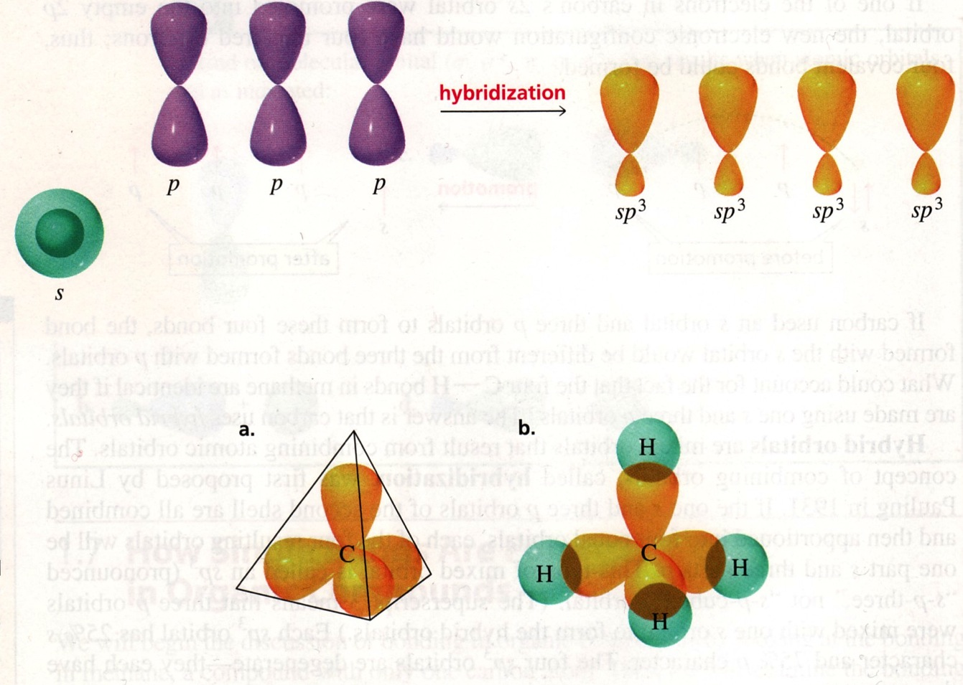
Review of sp³ & geometry
Bruice (2007)

Slide 17
Ethane, an sp3 example
Bruice (2007)

Slide 18
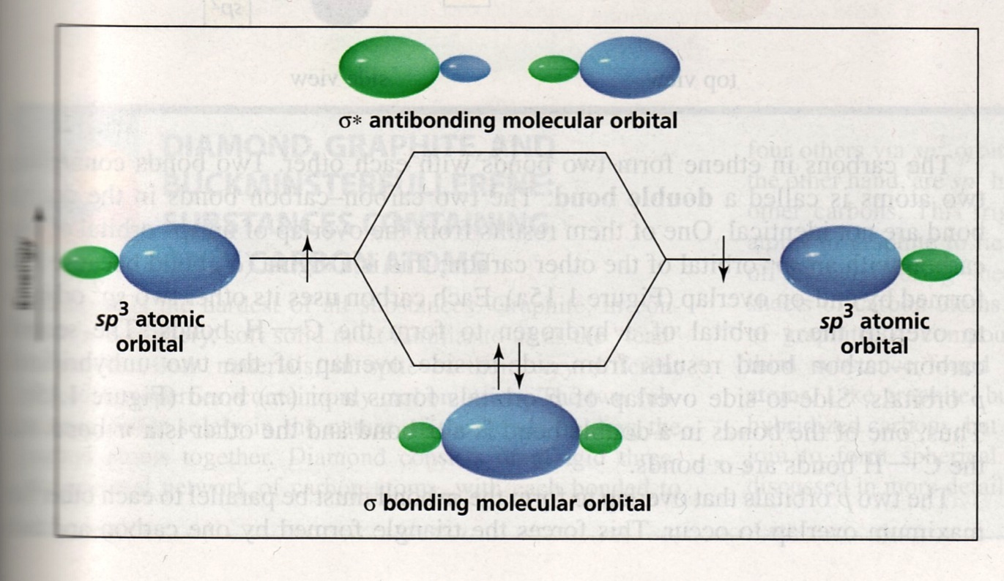
Bonding & anti-bonding with hybrid orbitals
Bruice (2007)

Slide 19
Free electron pairs can occupy orbitals
Hybridized orbitals can hold electron pairs, and play a exagerated role in molecular geometry.
Orbitals with “lone pairs” are more electronegative & push harder for their own space. Tetrahedrons are distorted to….
..
..
N
O
H
H
sp3
H
..
sp3
sp3
sp3
H
sp3
H
trigonal planar
104.5°
107.3°
“bent”
The N of ammonia and the O of water are both sp3 hybridized & therefore have roughly tetrahedral geometries.
Single bonding in simple organic molecules often involves sp3 hybridization.
D&D p.39

Slide 20
CHE2060 Topic 1: Atoms, orbitals & bonding
Atoms, Orbitals & Bonding Topics:
Very quick history of chemistry…
What is organic chemistry?
Atomic models: nuclear to quantum
All about orbitals
How orbitals fill: electron configuration
Basic bonding: valence electrons & molecular orbitals
Lewis dot structures of molecules
Electronegativity & bond polarity
Resonance: a critical concept
Orbital hybridization: key to carbon’s “flexibility”
sp3
sp2
sp
Free electron pairs & radicals
VSEPR: classifying molecular geometry & orbital hybridization
Daley & Daley, Chapter 1
Atoms, Orbitals & Bonds

Slide 21
CHE2060 Topic 1: Atoms, orbitals & bonding
sp2 hybridization of carbon

Slide 22
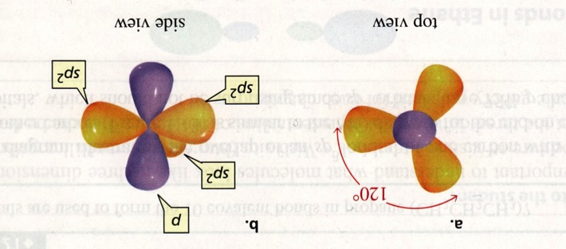
Hybrid sp2 orbitals & double bond geometry
Bruice (2007)

Slide 23
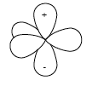
Hybrid sp2 orbitals
The molecule BF3 has a trigonal planar geometry with three equal bonds.
F
all angles = 120°
B
B is 1s²2s²2p¹
F
F
To create three equivalent bonds, hybridize three orbitals.
One p remains unchanged
2p
2p
2sp²
energy
2s
p
The hybridized atom has 3 sp2 orbitals in trigonal planar geometry, & an unhybridized p perpendicular to them
sp2
The sp2 orbital is more “s-like” than an sp3 orbital.
sp2
sp2
p
D&D p.41-42

Slide 24
Exercise: hybridizing orbitals
Write “slot-arrow” diagrams for the following hybridized atoms:
sp² carbon
sp² nitrogen
sp² oxygen
2p
2p
2sp²
energy
2s
2p
2p
2sp²
energy
2s
2p
2p
2sp²
energy
2s

Slide 25
Double bonding of sp2 carbons
Sp2 hybridized carbons form double bonds to make molecules like CH2CH2, ethylene.
H H
| |
H – C = C – H
| |
H H
p+
p+
sp2
sp2
sp2
sp2
sp2
sp2
p-
p-
Each carbon has 3 trigonal planar hybridized sp2 orbitals and an unhybridized p orbital that is perpendicular to their plane.
Two of the sp2 orbitals approach to overlap and bond.

Slide 26
Double bonding of sp2 carbons
Sp2 hybridized carbons form double bonds to make molecules like CH2CH2, ethylene.
p+
p+
sp2
sp2
sp2
sp2
sp2
sp2
p-
p-
sigma bond (σ)
The overlapping sp2 orbitals form a sigma (single) bond between the carbons.

Slide 27
Double bonding of sp2 carbons
Sp2 hybridized carbons form double bonds to make molecules like CH2CH2, ethylene.
p+
p+
sp2
sp2
sp2
sp2
sp2
sp2
p-
p-
sigma bond (σ)
The overlapping sp2 orbitals form a sigma (single) bond between the carbons.
The 2 unhybridized p orbitals bend in towards one another.

Slide 28
Double bonding of sp2 carbons
Sp2 hybridized carbons form double bonds to make molecules like CH2CH2, ethylene.
p+
sp2
sp2
sp2
sp2
sp2
sp2
p-
pi bond (π)
sigma bond (σ)
The parallel p orbitals “fuse” to form a π bond.
The π bond has both + and – lobe that sit further from the nucleus, above & below the sigma bond.
The π bond is the “second” bond of the double bond.
There is no rotational freedom around a π bond.

Slide 29
Exercise: show hybridization & geometry
Here are two molecules in which double bonds form between carbon & oxygen. For each draw a structure showing both bond angles & orbitals.
O
Acetaldehyde ||
CH3 – C – H
O
||
Methyl acetate CH3 – C – O – CH3
Acetaldehyde: methyl group is tetrahedral, sp3, 109.5 central C is sp2 (120) & empty p forms π with O
O is sp2 w/ e- pairs in 2 sp2 (120°), empty p forms π with C
Methyl acetate: methyl groups are tetrahedral, sp3, 109.5° central C is sp2 (120°) & empty p forms π with O
double O is sp2 w/ e- pairs in 2 sp2 (120°), empty p forms π
single-bonded O is tetrahedral, sp3, 109.5° w/ free pairs in 2 orb.

Slide 30
CHE2060 Topic 1: Atoms, orbitals & bonding
Atoms, Orbitals & Bonding Topics:
Very quick history of chemistry…
What is organic chemistry?
Atomic models: nuclear to quantum
All about orbitals
How orbitals fill: electron configuration
Basic bonding: valence electrons & molecular orbitals
Lewis dot structures of molecules
Electronegativity & bond polarity
Resonance: a critical concept
Orbital hybridization: key to carbon’s “flexibility”
sp3
sp2
sp
Free electron pairs & radicals
VSEPR: classifying molecular geometry & orbital hybridization
Daley & Daley, Chapter 1
Atoms, Orbitals & Bonds

Slide 31
CHE2060 Topic 1: Atoms, orbitals & bonding
sp hybridization of carbon

Slide 32
Triple bond geometry: linear
Bruice (2007)

Slide 33
Hybrid sp orbitals
The molecule BeH2 has a linear geometry with two equal bonds with identical bond angles.
Can this geometry cannot be explained by the electron configuration of the ground state Be atom?!
Both angles = 180°
H
Be
H
Nope! Be is 1s²2s², so it’s valence shell (2s) contains a pair of electrons & that pair is fairly stable and unlikely to participate in bonding. However, Be’s 2p orbital is empty. So:
“Promote” one electron from 2s to 2p. Now two unpaired e- are available for bonding.
Hybridize the s & p orbitals to form two equivalent hybridized sp orbitals that can form two linear bonds to H atoms to create BeH2.
2p
2p
2p
energy
2sp
2s
2s
2s
M&B p.11-12

Slide 34
Triple bonded carbons are sp hybridized
Acetylene gas is a high energy fuel and has the formula CHCH and the structure:
H – C C – H
The triple bond consists of: 1 σ bond + 2 π bonds
Each carbon has 2 hybridized sp orbitals an 2 unhybridized p orbitals
2p
2p
energy
2sp
2s

Slide 35
Geometry of sp hybridization & triple bond
p+
p+
p+
sp
sp
sp
sp
p+
sp
sp
p+
sp
sp
p+
p-
p-
p-
Two sp orbitals overlap to form a single or σ bond.
Two sets of parallel p orbitals bend toward one another & then “fuse” to form 2 perpendicular π bonds.
Each π bond has both + and – lobe that sit further from the nucleus, above & below the sigma bond.
The π bonds are the “second” & “third” bonds of the triple bond.
There is no rotational freedom around the bonded carbons.

Slide 36
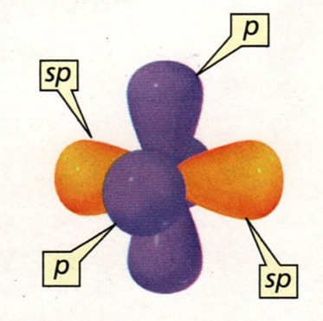
Hybrid sp & triple bonding
Bruice (2007)

Slide 37
Exercise: hybridization & geometry
For the molecule below, nitrile, draw a structure showing both bond angles & orbitals.
CH3 – C N:
Methyl group is sp3 hybridized & tetrahedral with 109.5° angles.
Central carbon is sp hybridized & linear with 180° angles; 2 unhybridized p orbitals
The nitrogen is sp hybridized & linear with 180° angles; 2 unhybridized p orbitals; free e- pair in the second unbonded sp orbital
H
sp3
109.5°
sp
sp3
sp
sp
sp
. .
H
sp3
H
sp3

Slide 38
Bottom line for orbital hybridization?
Explanations range from the simple to the complex; we’ll focus on the former.
Hybridization is a quantum mechanical approach that combines wave functions to give new wave functions. This definition is based on sound mathematics.
Hybrid orbitals are possible states of an e- in an atom, especially when that atom is bonded to other atoms in a molecule.
The concept of hybridization is a story made up to explain how bonding
explains the observed shapes (or geometries) and behaviors of molecules.

