Slide 1
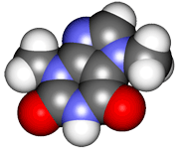
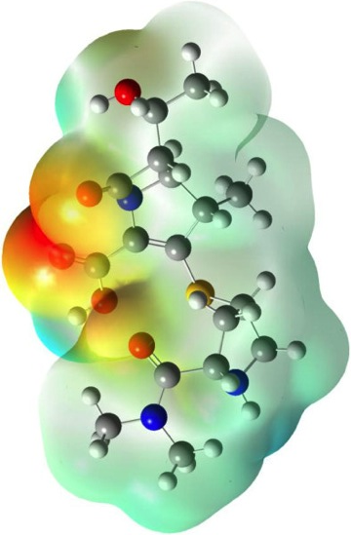
CHE2060 Topic 1: Atoms, orbitals & bonding
Atoms, Orbitals & Bonding Topics:
Very quick history of chemistry…
What is organic chemistry?
Atomic models: nuclear to quantum
All about orbitals
How orbitals fill: electron configuration
Basic bonding: valence electrons & molecular orbitals
Lewis dot structures of molecules
Electronegativity & bond polarity
Resonance: a critical concept
Orbital hybridization: key to carbon’s “flexibility”
sp3
sp2
sp
Free electron pairs & radicals
VSEPR: classifying molecular geometry & orbital hybridization
Daley & Daley, Chapter 1
Atoms, Orbitals & Bonds

Slide 2
CHE2060 Topic 1: Atoms, orbitals & bonding
What is organic chemistry?
Notes:
In the early 1800s chemists found the chemistry of living things to be amazing and a bit intimidating:
“ Organic chemistry nowadays drives me mad. To me it appears like a primeval tropical forest full of the most remarkable things, a dreadful endless jungle into which one does not dare enter for there seems to be no way out.” – Friedrich Wohler, 1835

Slide 3
What’s “chemistry”?
Chemistry:
The study of matter at the molecular and atomic level, focusing on the changes matter undergoes
Notes:
In the early 1800s chemists found the chemistry of living things to be amazing and a bit intimidating:
“ Organic chemistry nowadays drives me mad. To me it appears like a primeval tropical forest full of the most remarkable things, a dreadful endless jungle into which one does not dare enter for there seems to be no way out.” – Friedrich Wohler, 1835

Slide 4
What’s “organic chemistry”?
“The chemistry of living things; the chemistry of carbon-based molecules.”
By 1807, Jöns Jakob Berzelius had divided molecules into two camps:
There are at least 10 million different organic molecules!
Inorganic molecules
Organic molecules
It was generally believed that only God could create organic biomolecules, that were imbued with a mysterious and vital life force: vitalism
All this changed when….
…1828, a young German chemist, ___ Wölher, synthesized an simple organic molecule, urea:
H2N – C – NH2
||
:O:
Wöhler is thus the father of synthetic organic chemistry: “piecing together small organic molecules to create larger and more complex organic molecules.”
D&D p.4-9
Notes:
In the early 1800s chemists found the chemistry of living things to be amazing and a bit intimidating:
“ Organic chemistry nowadays drives me mad. To me it appears like a primeval tropical forest full of the most remarkable things, a dreadful endless jungle into which one does not dare enter for there seems to be no way out.” – Friedrich Wohler, 1835

Slide 5
Wöhler’s happy accident
Wöhler was actually trying to make ammonium cyanate for his research. NH4OCN, an inorganic H
|
:N C – O: H – N – H
|
H
-1
+1
Ironically, when dissolved in hot water, ammonium cyanate becomes urea!
..
..
Sadly, no matter how he tried to do this he always ended up with the same powder, and it was not ammonium cyanate. Instead, he’d made urea a very simple organic molecule found in excretions. So, he was the first to synthesize an organic molecule, debunking vitalism.
NH4+1 + (:N = C - O:)-1 → H2N - C - NH2
ammonium cyanogen ||
:O: urea
..
=
..
Many of the most famous discoveries have been made by accident.
“[The] research gave the unexpected result . . . that is the more noteworthy inasmuch as it furnishes an example of the artificial production of an organic, indeed a so-called animal substance from inorganic materials.” - Wohler, 1828
D&D p.4-9
Notes:
Note that ammonium cyanate and urea are constitutional (or structural) isomers.

Slide 6
Wöhler’s happy accident
Animation of Wöhler’s synthesis of urea:
http://chemwiki.ucdavis.edu/Organic_Chemistry/Case_Studies/What_is_Organic%3F
D&D p.4-9
Notes:
Note that ammonium cyanate and urea are constitutional (or structural) isomers.

Slide 7
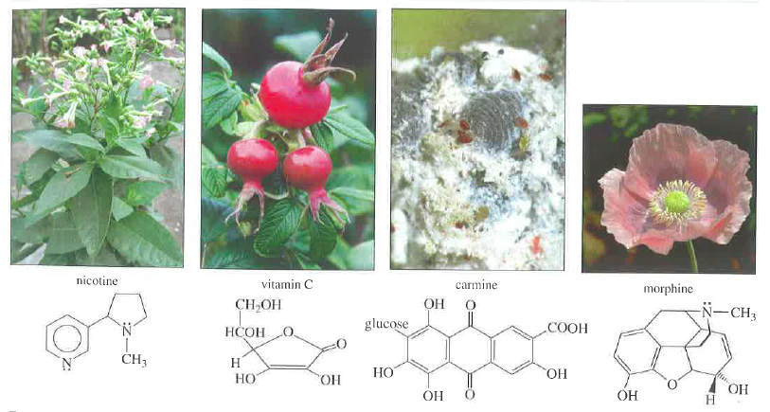
Examples of the diversity of organics
This small gallery of molecules shows the diversity of organic molecules.
Wade p.2
Notes:
In the early 1800s chemists found the chemistry of living things to be amazing and a bit intimidating:
“ Organic chemistry nowadays drives me mad. To me it appears like a primeval tropical forest full of the most remarkable things, a dreadful endless jungle into which one does not dare enter for there seems to be no way out.” – Friedrich Wohler, 1835

Slide 8
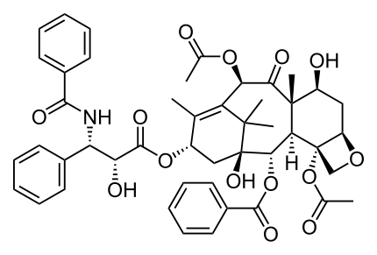
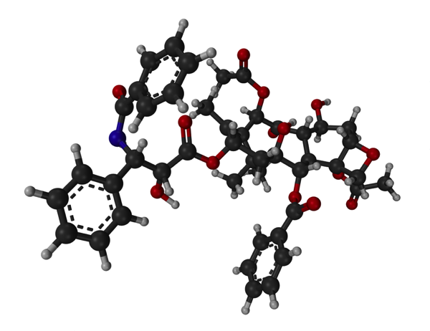
Why synthesize molecules?
1. Sometimes the synthetic version is faster, easier or cheaper to create than to isolate from natural sources.
Taxol (paclitaxel): inhibitor of mitosis used to treat breast, lung, ovarian, head & neck cancers & Karposi’s sarcoma
Discovered in 1966 in the bark of the Pacific yew during an NIH push for anticancer agents. Yews couldn’t supply enough.
Structure determined in 1971 – tough synthesis project & many researchers took up the challenge.
In 1993 the drug was synthesized using more than 40 steps.
It’s now obtained by extracting a related compound from yew leaves and then modifying it to produce taxol.
http://www.org-chem.org/yuuki/taxol/taxol_en.html
Notes:
In the early 1800s chemists found the chemistry of living things to be amazing and a bit intimidating:
“ Organic chemistry nowadays drives me mad. To me it appears like a primeval tropical forest full of the most remarkable things, a dreadful endless jungle into which one does not dare enter for there seems to be no way out.” – Friedrich Wohler, 1835

Slide 9
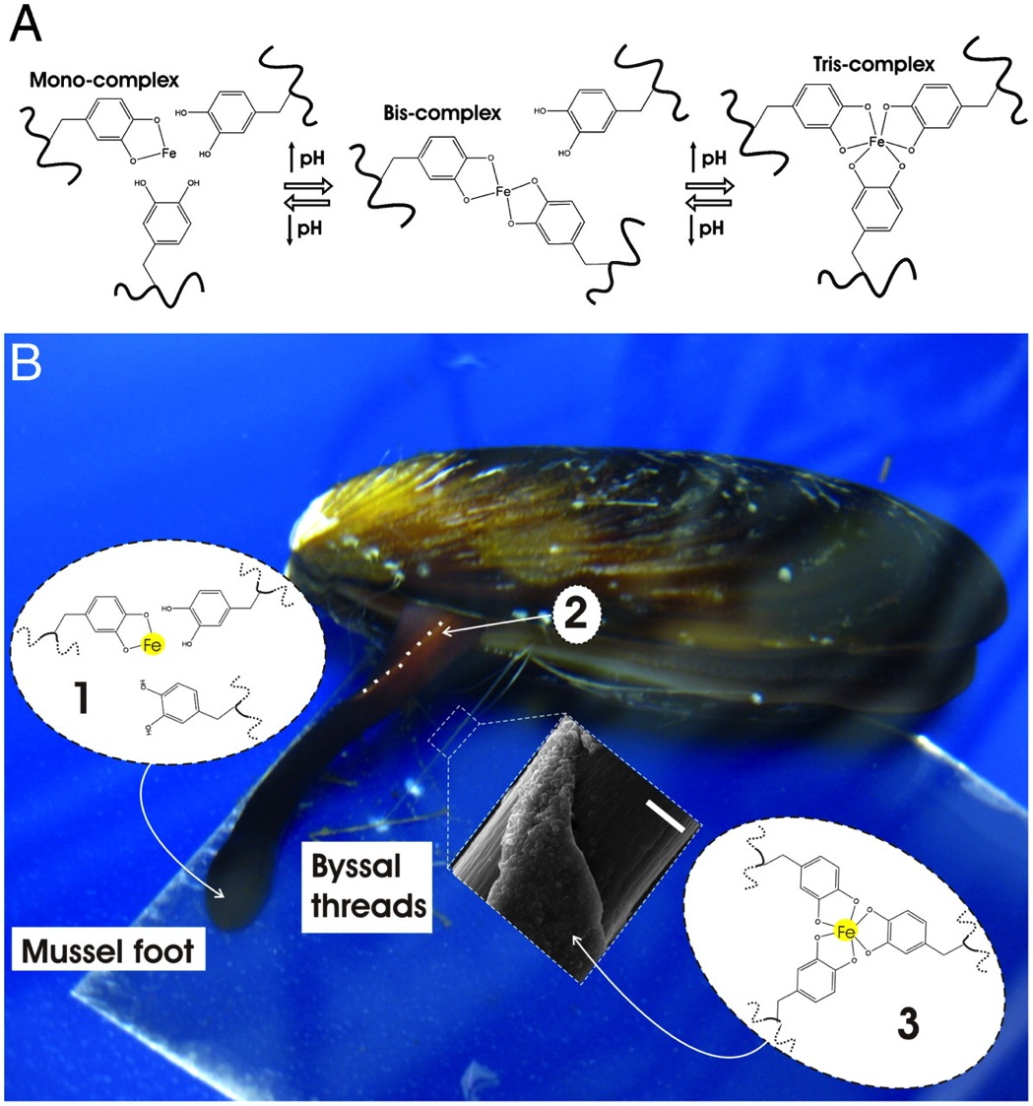
http://www.pnas.org/content/108/7/2651/F1.expansion.html
Notes:
In the early 1800s chemists found the chemistry of living things to be amazing and a bit intimidating:
“ Organic chemistry nowadays drives me mad. To me it appears like a primeval tropical forest full of the most remarkable things, a dreadful endless jungle into which one does not dare enter for there seems to be no way out.” – Friedrich Wohler, 1835

Slide 10
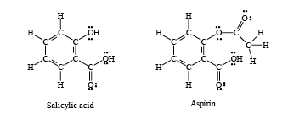
Why synthesize molecules?
2. Chemists can ‘tweak’ or modify natural organics to change or improve them.
For centuries willow bark (salix) was eaten or taken as a tea to relieve pain. The bark contains salicylic acid.
Side effect: stomach irritation!
aceto group
In 1899, Felix Hoffmann of the Bayer Chemical Company created a “new and improved” version called acetosalicylic acid or “aspirin”.
By adding a 2-carbon aceto group he created a stable compound that caused less stomach irritation.
D&D p.4-9

Slide 11
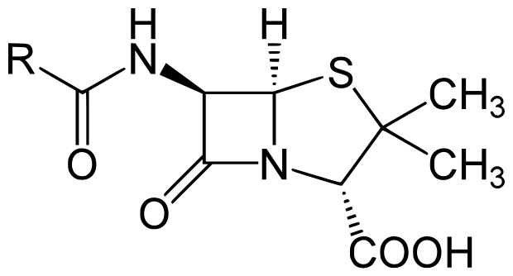
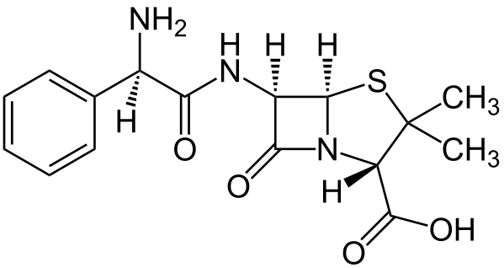
Why synthesize molecules?
2. Chemists can ‘tweak’ or modify natural organics to change or improve them.
Penicillin occurs in nature and is made by some species of mold. It was first isolated by Alexander Fleming in 1928.
Penicillin kill gram + bacteria.
Ampicillin was synthesized from penicillin in 1961. It kills a broader variety of bacteria than penicillin.
Ampicillin kills gram + bacteria and also some gram – bugs.
Notes:
In the early 1800s chemists found the chemistry of living things to be amazing and a bit intimidating:
“ Organic chemistry nowadays drives me mad. To me it appears like a primeval tropical forest full of the most remarkable things, a dreadful endless jungle into which one does not dare enter for there seems to be no way out.” – Friedrich Wohler, 1835

Slide 12
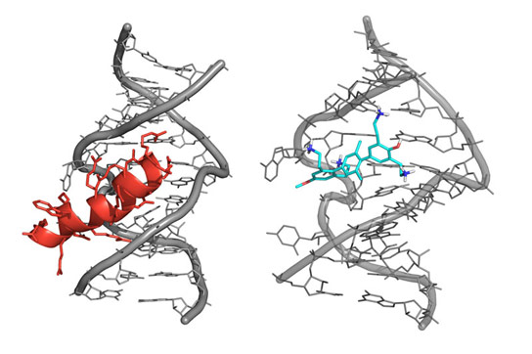
Why synthesize molecules?
3. Chemists can create new materials with novel properties.
HIV DNA
Medicines
Polymers
Superconductors
Etc.
Use the good ones!
Rev protein
synthetic
terphenyl
Scientists from Spain, led by Dr. José Gallego have designed small synthetic molecules capable of binding to the genetic material of the virus AIDS and blocking its replication.
http://scitechdaily.com/synthetic-molecules-capable-blocking-aids-replication/
Notes:
In the early 1800s chemists found the chemistry of living things to be amazing and a bit intimidating:
“ Organic chemistry nowadays drives me mad. To me it appears like a primeval tropical forest full of the most remarkable things, a dreadful endless jungle into which one does not dare enter for there seems to be no way out.” – Friedrich Wohler, 1835

Slide 13
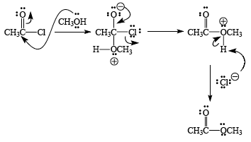
Goals (superconcepts) for CHE2060
Understand that the function and behavior of organic molecules is determined by their form or structure
H2N
H2N
NH2
N
NH2
triethylamine (gas/liquid)
fermented shark
rotten fish
putrecine (solid)
bad breath
death & decay
cadaverine (liquid)
bad breath
death & decay
2. Understand some basic type of reactions that organics undergo .
Bruice p.90
Atkins p.144
D&D p.276

