Slide 1
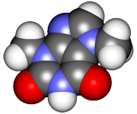
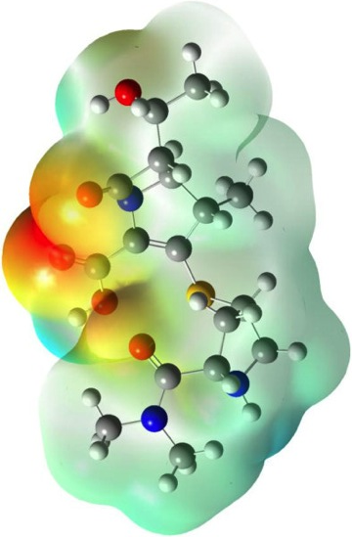
CHE2060 Topic 1: Atoms, orbitals & bonding
Atoms, Orbitals & Bonding Topics:
Very quick history of chemistry…
What is organic chemistry?
Atomic models: nuclear to quantum
All about orbitals
How orbitals fill: electron configuration
Basic bonding: valence electrons & molecular orbitals
Lewis dot structures of molecules
Electronegativity & bond polarity
Resonance: a critical concept
Orbital hybridization: key to carbon’s “flexibility”
sp3
sp2
sp
Free electron pairs & radicals
VSEPR: classifying molecular geometry & orbital hybridization
Daley & Daley, Chapter 1
Atoms, Orbitals & Bonds

Slide 2
CHE2060 Topic 1: Atoms, orbitals & bonding
How electrons fill orbitals:
electron configuration

Slide 3
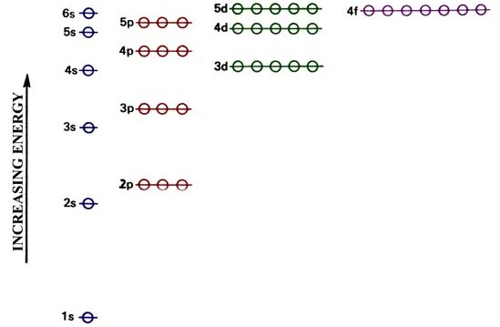
Aufbau: e- fill “up” atomic energy levels
Aufbau, to “fill up”
Notice that the energy levels, and thus the order in which shells fill, is not as expected.
The 4s orbital (beginning of the 4th shell) has a lower energy level & fills before the d orbital of the 3rd shell, because that 3d orbital has a higher energy level than the 4s orbital.
This pattern of mixed levels starts at the 3rd level & continues up through the seventh level.
Note that all transition metals have this type of “mixed” orbital structure that allows valence e- to move between energy levels.
D&D p.27-28

Slide 4
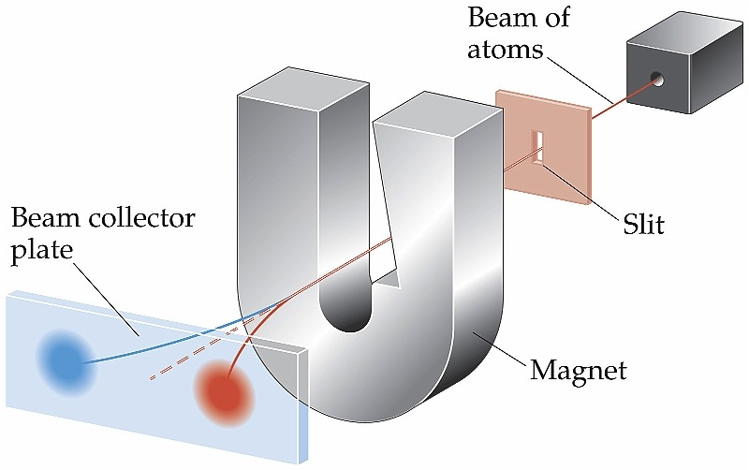
Electrons have spin
Pauli’s exclusion principle states that each orbital can contain no
more than two electrons. And if two electrons occupy a single orbital they must have opposite spin.
Stern- Gerlach exp’t
Spin: the electro- magnetic field angular momentum
of an e-
This gives rise to the intrinsic spin of some molecules – particularly those with a single valence electron. This allows NMR & MRI. And it causes us to use “up” & “down” arrows when describing configuration.

Slide 5
Pauli & Hund
These rules govern the way that electrons fill orbitals.
Pauli’s Exclusion Principle: if two e- occupy the same orbital they must be different; they must have opposite “spin”
X
X
Hund’s Rule: if an energy level has a number of orbitals with equivalent energies then each gets one e- before any get two. Equal treatment for equal orbitals!
Think about wanting as much ‘personal space’ as you can get.
D&D p.27-28

Slide 6
Full shells are happy shells….
…and happy shells are stable. Atoms do whatever they have to do to become & remain stable.
Atoms will bond to fill their valence shells & become more stable.
Na
Cl
ground state
You can temporarily excite e-, but they will fall back & release energy.
Ar
Na
+1
Cl
-1
Ions
Ionization also fills valence shells -> stability.
Ar
zero
D&D p.28-29
Notes:
Exercise: electron configurations & location in periodic table of:
C & Si; O & S; F & Br; Mg & Ca

