Slide 1
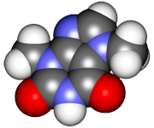
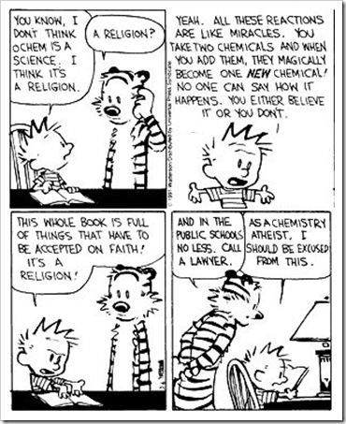
CHE2060: Principles of Organic Chemistry
This course is designed to introduce students to the study of organic chemistry, and serves as a comprehensive introduction to the subject. Material includes a general overview of the basic organic compounds, from alkanes to heterocyclic compounds, their bonding, structures and reactions these compounds commonly undergo. Important areas of organic chemistry will be included.
4 Credits: 3 hours of lecture, 3 hours of lab
Required text:
Daley and Daley’s ‘Organic Chemistry for the 21st Century’
http://www.ochem4free.info/node/1
Molymod’s organic chemistry ultimate kit
Available at the Bookstore or at Amazon
Other texts are available in Hartness Library or linked at the course web site:
richmond-hall.weebly.com/CHE-2060.html

Slide 2
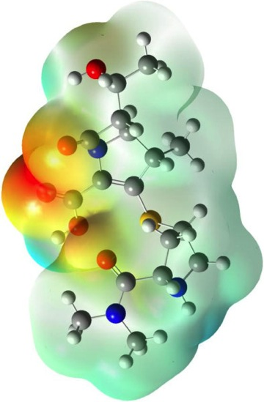
CHE2060 Topic 1: Atoms, orbitals & bonding
Atoms, Orbitals & Bonding Topics:
1.1: Very quick history of chemistry…
1.2: What is organic chemistry?
1.3: All about orbitals
1.4: How orbitals fill: electron configuration
1.5: Basic bonding: valence electrons & molecular orbitals
1.6: Lewis dot structures of molecules
1.7: Electronegativity & bond polarity
1.8: Resonance: a critical concept
1.9: Orbital hybridization: key to carbon’s “flexibility”
sp3
sp2
sp
1.10: Free electron pairs & radicals
1.11: VSEPR: classifying molecular geometry & orbital hybridization
Daley & Daley, Chapter 1
Atoms, Orbitals & Bonds

Slide 3
CHE2060 Topic 1: Atoms, orbitals & bonding
1.1: Very quick history of chemistry
Is it real? Is it rational?
Notes:
In the early 1800s chemists found the chemistry of living things to be amazing and a bit intimidating:
“ Organic chemistry nowadays drives me mad. To me it appears like a primeval tropical forest full of the most remarkable things, a dreadful endless jungle into which one does not dare enter for there seems to be no way out.” – Friedrich Wohler, 1835

Slide 4
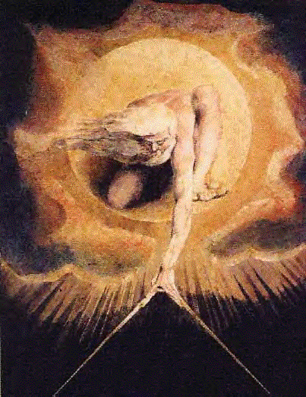
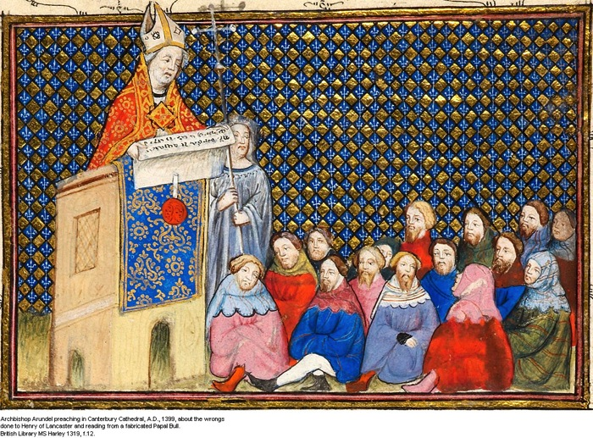
Tackling the invisible
All chemistry describes material changes at the molecular & atomic level. But organic chemistry is the chemistry of biomolecules; the chemistry of life.
Prior to the 1600s, most people believed that life, it’s forms, molecules & processes were governed by divine authority.
Canterbury 1399
Wm. Blake
For many, that authority was held by those men who interpreted divine authority, creating an institutional authority.
http://webpage.pace.edu/bkirschstein/papers/Image5.gif
http://www.luminarium.org/medlit/harleyms1319f12.jpg

Slide 5
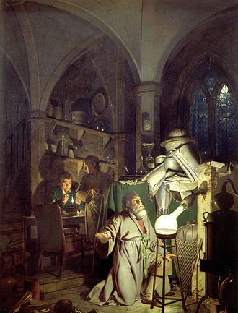
Alchemy vs. chemistry
Through the middle ages, the renaissance and the early 1700s, most explanations of chemical phenomena were alchemy rather than chemistry.
‘a philosophical and protoscientific tradition practiced throughout Egypt and Eurasia which aimed to purify, mature, and perfect certain objects.’
Wright’s ‘The Alchemist…’
Turn lead to gold
Stop disease & death
Perfect the human soul
https://en.wikipedia.org/wiki/Alchemy#/media/File:Joseph_Wright_of_Derby_The_Alchemist.jpg
‘Alchemy’ derives from the Egyptian khimi for ‘black earth’, the Greek chemia for ‘black magic’, worked into the Arabic ‘al-kimiya’ for philosopher’s stone.
An 8th-century arab alchemist, Jābir ibn Hayyān, added lab experimentation to alchemy and may be the father of modern chemistry.
See ‘Harry Potter and the Philosopher’s Stone’

Slide 6
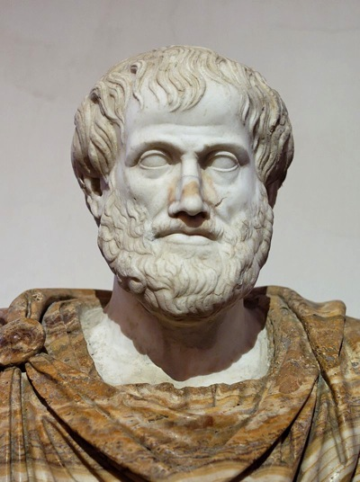
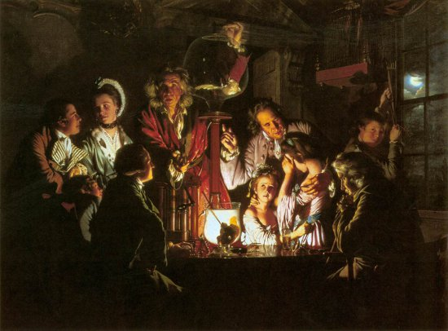
The Enlightenment
During the Enlightenment (1600s to 1800) the Western world rediscovered the works of philosophers of the ancient world (Greek, Arabic, Asian) who had developed logic and experimentation.
Aristotle
Scientists like Bacon, Newton, Hooke, Boyle, Faraday, Wright, Lavoisier and others married logic with experimentation to ask and answer questions about the ‘invisible’ forces of the natural world.
1700’s gas pump experiment
https://en.wikipedia.org/wiki/Logic#/media/File:Aristotle_Altemps_Inv8575.jpg
http://ideonexus.com/wp-content/uploads/2011/07/joseph-wright-experiment-with-the-air-pump.jpg

Slide 7
Can you?
Explain what is meant by the terms ‘divine authority’ and ‘institutional authority’ as they relate the the evolution of science & chemistry?
Define the term ‘alchemy’.
Remember who brought experimentation to chemistry?
List two critical elements that the Enlightenment returned to science?
Aristotle
1700’s gas pump experiment

