Slide 1
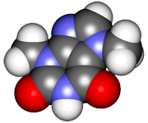
CHE2060 Topic 1: Atoms, orbitals & bonding
1.9: Orbital hybridization:
the key to carbon’s “flexibility”

Slide 2
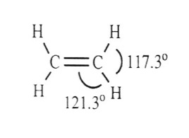
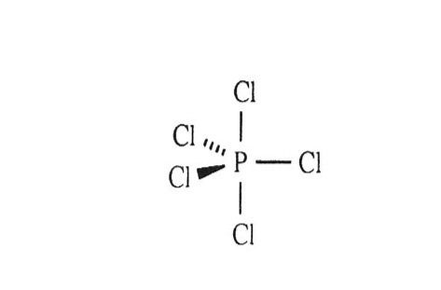
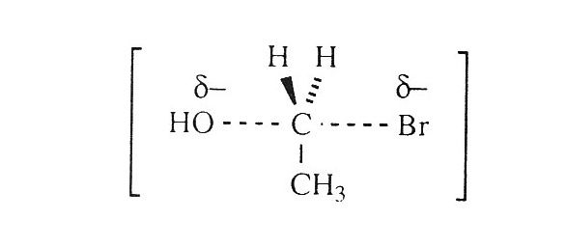
Preview of basic molecular geometries
Many single-bonded molecules have tetrahedral geometries, with bond angles close to 109° and a 3D shape.
Double-bonds have a trigonal planar geometry, with bond angles close to 120° and a flat (or planar) shape.
Atoms with five bonds (rather than 4) create trigonal bipyrimidal geometry:
3 atoms bond in the plane of the central atom with 120° bond angles; and
the other 2 atoms are perpendicular to this flat plane.
PCl5
An SN2 addition reaction intermediate
H&P p.11-13

Slide 3
Geometry suggests orbital hybridization
In the mid-1800s, chemists knew that C liked to form four bonds. They thought that the four bonding atoms would all lie in the same plane as C.
So what would the structure of CH2Cl2 be?
How many “versions” of CH2Cl2 could there be?
H
Cl
However, chemists only found one isomer (“version”) of this molecule. Hmmm……
Cl
C
Cl
Cl
C
H
H
H
The single version showed that the molecule’s shape was not planar. Therefore it must be 3-dimensional?!
In 1874, van’t Hoff & Bell proposed a 3D tetrahedral structure, like a pyramid.
All tetrahedral bond angles are 109.5°.
H
C
Cl
Cl
H

Slide 4
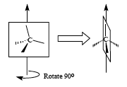
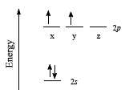
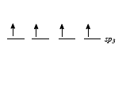
How can methane’s bonds be “equivalent”?
Methane is the smallest hydrocarbon, CH4.
By using a technique called electron diffraction, chemists found that each of its 4 C-H bonds is identical: same length & strength.
Does this sound possible? Sensible?
Think about the electron configuration of the atoms involved!
H = 1s¹
C = 1s²2s²2p² …. so C’s 4 e- don’t all have the same energy levels – how can they form 4 identical bonds to the Hs?
The answer is orbital hybridization: the valence (bonding) e- of carbon become identical in order to form the four identical bonds to H.
The hybrid orbital is called sp³ because it’s 1 s orbital mixed with 3 p orbitals:
s¹p³

Slide 5
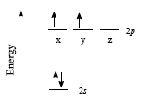
Exercise: think!
If one electron were “promoted” from carbon’s s orbital to it’s p orbital could this explain the structure of methane?
Why or why not?
The “promotion” would create 4 different orbitals:
3 identical p orbitals
1 s orbital
But we know that methane’s carbon needs 4 identical orbitals in order to form 4 identical bonds to 4 hydrogens.

Slide 6
Preview of carbon’s hybridizations
Carbon’s valence electrons can hybridize in three different ways.
This gives carbon the ability to act as the structural framework for a huge number of molecules.
hybridization | p obitals (# left) | bonds formed | geometry | bond angle (°)
sp3 | none | 4 σ | tetrahedral | 109.5°
sp2 | one | 3 σ, 1 π | trigonal planar | 120°
sp | two | 2 σ, 2 π | linear | 180°
Single bonds
Double bonds
Triple bonds

Slide 7
Predicting hybridization from bonding pattern
The orbital hybridization of carbon (and other atoms) can also be predicted from atomic bonding patterns in Lewis dot structures.
Each π bond requires an one unhybridized p orbital…
…and all other orbitals hybridize.
σ
σ
π
π
σ
C
σ
C
σ
σ
C
← σ
σ
π
σ
sppp
sppp
sppp
= sp³
= sp²
= sp
This method works for C, N, O, P & S because all have ve- in s and p orbitals.
C 1s²2s²sp²
N 1s²2s²sp³
O 1s²2s²sp⁴
P 1s²2s²sp⁶3s²3p³
S 1s²2s²sp⁶3s²3p⁴

Slide 8
Can you?
Explain how the varied molecular geometries and bonding patterns of carbon suggested that orbital hybridization might occur?
Draw an orbital hybridization diagram for methane’s carbon and use it to explain why hybridization is necessary to describe this molecule?
Describe the geometry, types of bonds and number of unhybridized p orbitals in sp3 vs. sp2 vs. sp hybridized carbon?
Predict the bonding pattern of carbons if you know their hybridization?
1700’s gas pump experiment

