Slide 1
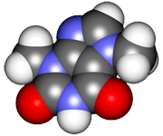
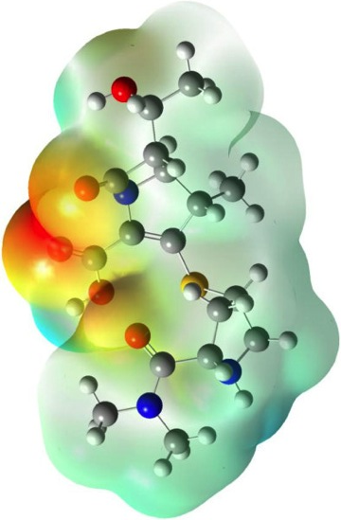
CHE2060 2: Simple structures, functional groups
Topics
Drawing molecular structures
Arrow formalism & molecular framework
Introduction to alkanes
Isomers
IUPAC naming of alkanes
Alkyl halides & cycloalkanes
Functional groups: where the action is
Alkenes: hydrocarbons with > one double bond
Alkynes: hydrocarbons with > one triple bond
Alkene isomers: who’s across that double bond?
Arenes
Organohalogens
Using molecular formulas
Daley & Daley, Chapter 2
Organic Nomenclature & Functional Groups

Slide 2
Variations on the alkane theme:
Alkyl halides
Cycloalkanes

Slide 3
Alkyl halides
Halides are the atoms found in column 7 of the periodic table and are often substituents of alkanes.
F fluro-
Cl chloro-
I iodo-
Br bromo-
Br
Cl
F
2-chlorobutane
n-fluorobutane
2-bromo-2-methylpropane
(NOT 1-bromo-1,1-dimethylethane)
I
I
1,2-diiodobutane
D&D p.112-14

Slide 4
Cycloalkanes
Root name is based on the number of carbons in the ring.
cyclo_________ane
most common
cyclopropane
cyclobutane
cyclopentane
Remember, there is no free rotation around ring single bonds.
bp -32.7°C
bp 12°C
bp 49.3°C
most common
cyclohexane
cycloheptane
cyclooctane
bp 80.7°C
bp 118.5°C
bp 149°C
What’s the molecular formula for cycloalkanes? CnH2n
D&D p.87-90

Slide 5
Naming cycloalkanes with substituents
Begin numbering ring carbons where the first (or alphabetically first) substituent appears.
Clockwise or counterclockwise? Towards the next substituent
1-methycyclopropane
1,1-dimethylcyclobutane
1,3-dimethylcyclopentane
1,1,2-trimethylcyclohexane
1-ethyl-4-methylcycloheptane
D&D p.87-90

Slide 6
Naming substituents: alkyl groups
Alkyl substituents are named for the number of carbons in their chains:
Number C Alkyl name
1
2
3
4
5
methyl
ethyl
propyl
butyl
pentyl
There are also some common names you should know:
iso- sec- tert-
2 methyls on the far end of the chain
1 methyl branches at the attachment
2 methyls branch at the attachment
D&D p.87-90

Slide 7
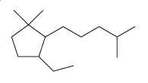
Example: alkyl group substitutents
Create line-bond drawings of these alkanes:
Isobutylcycloexane
1-tert-butyl-2-methylcyclopentane
1-ethyl-3,3-dimethyl-2-isohexylcyclopentane
D&D p.87-90

