Slide 1
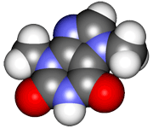
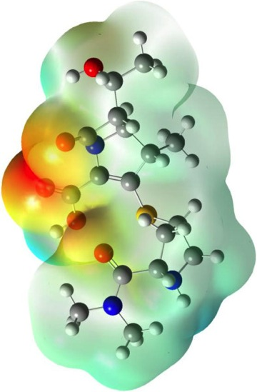
CHE2060 4: Physical properties & interactions
4.1 Physical properties of organic molecules
Solids, liquids & gases
Melting point
Boiling point
4.2 Types of intermolecular interactions
van der Waals interactions
Dipolar interactions
Hydrogen bonding
4.3 Solubility
4.4 Surfactants
Micelles & emulsions
Labs
Melting point determination
Viscosity of organic compounds
Distillation of wine
Daley & Daley
Chapter 4:
Physical Properties

Slide 2
Physical properties of simple organic molecules
Physical states
Boiling points & melting points

Slide 3
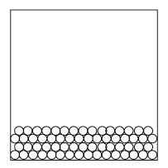
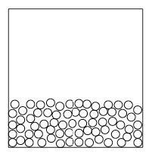
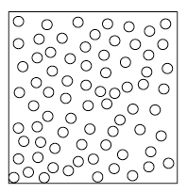
Remember physical properties?
A substance’s (or a molecule’s) physical properties include:
State
Color & odor
Refractive index
Density
Solubility
Melting & boiling points
Fusion or
mp
vaporization or
bp
solid
liquid
gas
Heat
Heat
Crystalline matrix is held together by inter- molecular forces.
D&D p.175-6

Slide 4
Liquid crystals
Liquid crystals are sometimes called a mesophase because they have more order than a liquid, but less than a crystal. Molecules involved are often rod-like and have disc-like arenes.
The more ordered smectic state is due to stronger intermolecular forces.
smectic
nematic
D&D p.178-9

Slide 5
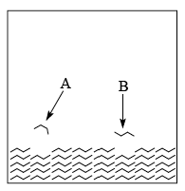
Melting point
The temperature at which a solid becomes a liquid. Characteristic of molecule can be used to determine identity & purity.
Four factors influence (and increase) melting point:
Molecular symmetry
Molecular polarity
H-bonding
Molecular weight
Both conformation & orientation also matter
Pentane
mp = - 130°C
2,2-dimethylpropane
mp = -17°C
Benzoic acid = 2 H-bonds
Benzoic alcohol = 1 H-bond
D&D p.179-83

Slide 6
Even vs. odd chain length
The ability of molecules to pack together tightly influences intermolecular interactions & melting point.
Tighter packing increases melting point
Pure substances also have higher mps. Why?
It’s easier for identical molecules to pack together evenly & tightly.
A mixture of molecules of different shapes & lengths does not pack efficiently, so fewer interactions.
Bruice p98

Slide 7
Melting point & shape
So even chains pack tighter than odd. And molecules with spherical shapes have unusually high melting points.
Molecule | Shape | Boiling point °C | Melting point °C
pentane | linear | 36 | -130
hexane | linear | 69 | -95
heptane | linear | 98 | -91
octane | linear | 126 | -57
nonane | linear | 151 | -54
decane | linear | 174 | -30
tetramethylbutane (8C) | spherical | 106 | +100
Notice that even-numbered chains have higher mp than odd.
Spherical molecules pack more efficiently than elongated (linear) molecules. The shape of spherical molecules is stable. But the rotation of all bonds in long alkanes gives them shifting shapes that are less likely to settle in a solid (packed & crystalline) form.
www.cem.msu.edu

Slide 8
Examples: melting point
Which has the higher melting point and why?
Hexane or cyclohexane?
Cyclopentanethiol or cyclopentanol?
Cyclohexane, because it has higher symmetry
mp 6.47 C
mp -95 C
SH
OH
The alcohol because it is able to form
H-bonds.
bp 130 C
bp 140 C
D&D p.179-83

Slide 9
Similar principles for boiling points
Notice the effects of size, polarity, & ability to H-bond!
I’ve circled acetate, propionate, butyrate & pentanoate…. VFAs!
D&D p.183-5

