Slide 1
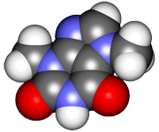
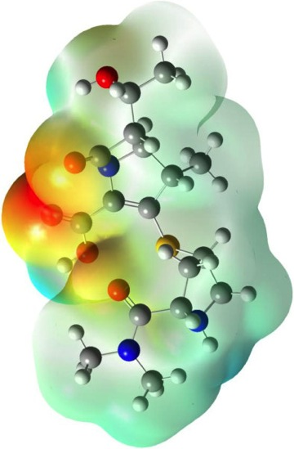
CHE2060 4: Physical properties & interactions
4.1 Physical properties of organic molecules
Solids, liquids & gases
Melting point
Boiling point
4.2 Types of intermolecular interactions
van der Waals interactions
Dipolar interactions
Hydrogen bonding
4.3 Solubility
4.4 Surfactants
Micelles & emulsions
Labs
Melting point determination
Viscosity of organic compounds
Distillation of wine
Daley & Daley
Chapter 4:
Physical Properties

Slide 2
Lecture 4 key concepts (1):
Matter has four physical states: solid, liquid, gas & plasma.
Do states of matter have definite shape & volume?
Gases – neither
Liquids – definite volume but no fixed shape
Solid – yes to both
Molecular structure determines a molecules physical properties.
Intermolecular forces have major effects on the physical properties of a molecule.
van der Waals
dipolar
hydrogen bonding
Temporary dipolar attractions between neighboring molecules cause vdW.
Melting point is the temperature at which solid & liquid states are in equilibrium.
Boiling point “ “ “ liquid & gas states “
Solubility is favored when the solute interacts more strongly with the solvent than with other molecules of solute.

Slide 3
Lecture 4 key concepts (2):
A carbon bonded to some atom of different electronegativity results in a polar bond. Polar bonds cause dipolar interactions.
The interaction between a hydrogen that is attached to an electronegative atom and the nonbonding electrons of an atom in another molecule results in hydrogen bonding.
If the intermolecular forces between solute and solvent are as strong or stronger as the attractions between molecules of the solute or the solvent itself, then the solute will be soluble in the solvent.
The atomic weights of the atoms of a molecule contribute to the density of that molecule. When a molecule has a relatively large number of heavy atoms, its density is high.
Another factor that determines the density of a compound is the strength of its intermolecular attractions. The stronger the intermolecular attractions, the higher the density.
The larger the molecule, the less important are any functional groups in determining that molecule’s physical properties.

