Slide 1
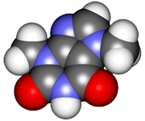
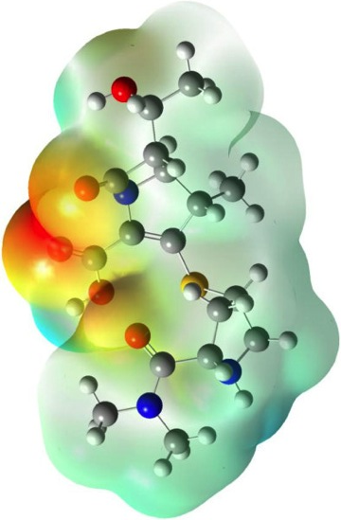
CHE2060 Lecture 6: Chirality
6.1: Symmetry & asymmetry
6.2: Nomenclature of stereocenters
6.3: Properties of asymmetric molecules
6.4: Optical isomerism
6.5: Fisher projections
6.6: Molecules with two stereocenters
6.7: Resolution of enantiomers
6.8: Stereocenters other than carbon
Daley & Daley, Chapter 11
Chirality

Slide 2
More than one stereocenter

Slide 3
Multiple chiral carbons & diastereomers
Not all pairs of stereoisomers are enantiomers or mirror images. These are both 3-chloro-2-butanol, and they are diastereomers.
Diastereomers: stereoisomers that are not enationmers.
S
S
R
S
Conformation @ C3
has been switched.
Each of these diastereomers has a mirror image enantiomer. Draw them!
How many stereoisomers can a molecule have? Well, if it has n chiral carbons, there can be 2^{n} stereoisomers.
D&D, p.556 -
Notes:
M

Slide 4
Meso isomers
Meso compounds: another form of stereoisomer defined by an internal plane of symmetry (internal reflection).
Meso compounds have no optical activity.
In meso compounds the groups at C2 & C3 are the same…
…but the conformations at C2 & C3 are opposite.
D&D, p.557 -
Notes:
M

Slide 5
Meso examples
For each compound shown here:
Mark chiral carbons
Determine whether they are R or S
Are any meso?
Which are optically active?
R
*
*
R
meso
S
S
*
*
S
*
R
*
*
S
*
S
*
S
*
S
All but the cyclohexane are optically active.
D&D, p.557 -
Notes:
M

