Slide 1
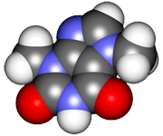
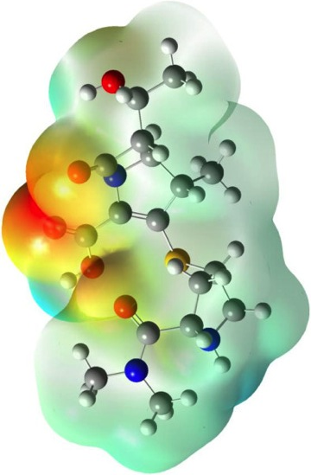
CHE2060 Lecture 6: Chirality
6.1: Symmetry & asymmetry
6.2: Nomenclature of stereocenters
6.3: Properties of asymmetric molecules
6.4: Optical isomerism
6.5: Fisher projections
6.6: Molecules with two stereocenters
6.7: Resolution of enantiomers
6.8: Stereocenters other than carbon
Daley & Daley, Chapter 11
Chirality

Slide 2
Key ideas about chirality (1)
All three-dimensional objects are either symmetric or asymmetric. You can superimpose a symmetric object onto its mirror image, but you cannot superimpose an asymmetric object onto its mirror image.
Stereoisomers are molecules that have the same sequence of bonds, but have a different arrangement of the atoms in space.
There are two types of stereoisomers.
1. Enantiomers: Compounds that have a mirror image relationship.
2. Diastereomers: Stereoisomers that are not enantiomers.
A carbon atom bonded to four different groups is stereogenic center. A molecule with a single stereogenic center is asymmetric. Molecules with more than one stereocenter may be chiral molecules or they may be meso molecules.
Meso molecules are symmetrical molecules with even numbers of stereogenic center. Meso isomers occur with molecules that have an internal plane of symmetry.
D&D, p.566 -
Notes:
M

Slide 3
Key ideas about chirality (2)
The pure components of an enantiomeric pair have the same melting points, boiling points, and other physical properties, but they rotate the plane of polarized light in equal but opposite directions.
Diastereomers, in general, differ in their physical properties. That is, they have different melting points, boiling points, etc.
A chemical reaction capable of producing an asymmetric product from a symmetric substrate produces both enantiomers equally with symmetric reagents. Asymmetric reagents usually prefer one enantiomer rather than the other.
Atoms other than carbon (e.g. nitrogen, phosphorus, and sulfur) can also be stereocenters. The four different groups can include a non-bonding pair of electrons as one of the groups.
D&D, p.566 -
Notes:
M

