Slide 1
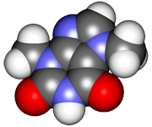
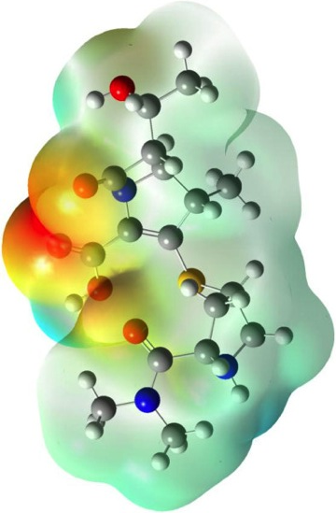
CHE2060 Lecture 7: Brief Overview of Reactions
7.1 Reaction energies & transition states
7.2 Review of acid-base reaction mechanisms
7.3 Writing reactions as transformations
7.4 Substitution reactions
7.5 Addition reactions
7.6 Elimination reactions
7.7 Competition between substitution, addition & elimination reactions
7.8 Diagnostic chart to identify reactions
Daley & Daley, Chapter 6
Reaction Mechanisms: an
Overview of Organic Chemistry

Slide 2
Review of acid-base reaction mechanisms
Nucleophiles & electrophiles
Equilibrium constants
Most likely reactions
Notes:
In the early 1800s chemists found the chemistry of living things to be amazing and a bit intimidating:
“ Organic chemistry nowadays drives me mad. To me it appears like a primeval tropical forest full of the most remarkable things, a dreadful endless jungle into which one does not dare enter for there seems to be no way out.” – Friedrich Wohler, 1835

Slide 3
Review of acid base reactions
Most of the reactions we will study this semester are acid-base reactions. So it’s critical that you learn to identify acids and bases in reactions.
Writing complete Lewis dot structures of each reactant helps to determine who’s the Nu: & who’s the E+.
δ+
E+/Lewis acid
δ-
Nu:/Lewis base
So what happens next?
What products form?
D&D, p.258 - 9
Notes:
M

Slide 4
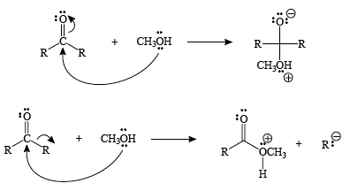
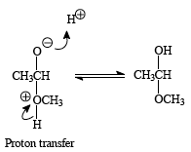
Which products are formed?
Here we see two possible sets of products. Which is correct? How do you evaluate & make a decision?
Both products have a positive charge on an oxygen atom.
The negative charge’s location differs. Generally (-) belongs on the more en atom.
So, the first set of products are much more likely.
A last proton transfer step produces the final product, hemiacetal (on way to sugar).
D&D, p.258 - 9
Notes:
M

Slide 5
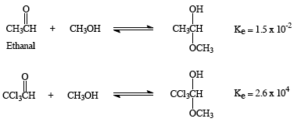
How good will the yield be?
Here we see two possible sets of products. Which is correct? How do you evaluate & make a decision?
The K (equilibrium constant) value shows that the ketone with the Cl favors products more.
Why?
The Cls have a higher en than H & C and pulls e-.
So the central carbonyl C is more dipolar + in the second reaction than the first.
So the second reaction is more likely to favor products.
D&D, p.258 - 9
Notes:
M

Slide 6
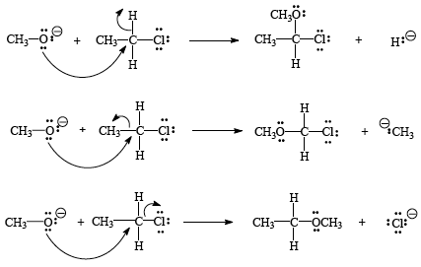
Another example
Who’s the Nu: and E+ here? What are the product(s)?
chloroethane
methoxide
Which of these 3 reactions is most likely? And why?
Neg O = Nu:-
Central C = E+
3rd reaction occurs:
C can’t have 5 bonds
The most en atom takes the : & is the leaving group.
D&D, p.258 - 9
Notes:
M

Slide 7
What’s a leaving group?
Leaving group: an atom (or group) that leaves a molecule & takes the electron pair bonding it to the molecule with it
LGs may or may not be negatively charged;
Weak bases make the best LGs since the LG must takes its : with it
Strong bases want to donate their :
So, good LGs have:
High EN values (motivation to take :)
Large atomic radii (space for :)
Resonance (stabilizes negative charge)
Rank these LGs:
..
..
worst
- :CH3 - :NH2 -:OH - :F:
best
..
..
best
I Br Cl F
worst
Notes:
M

